Slide 1
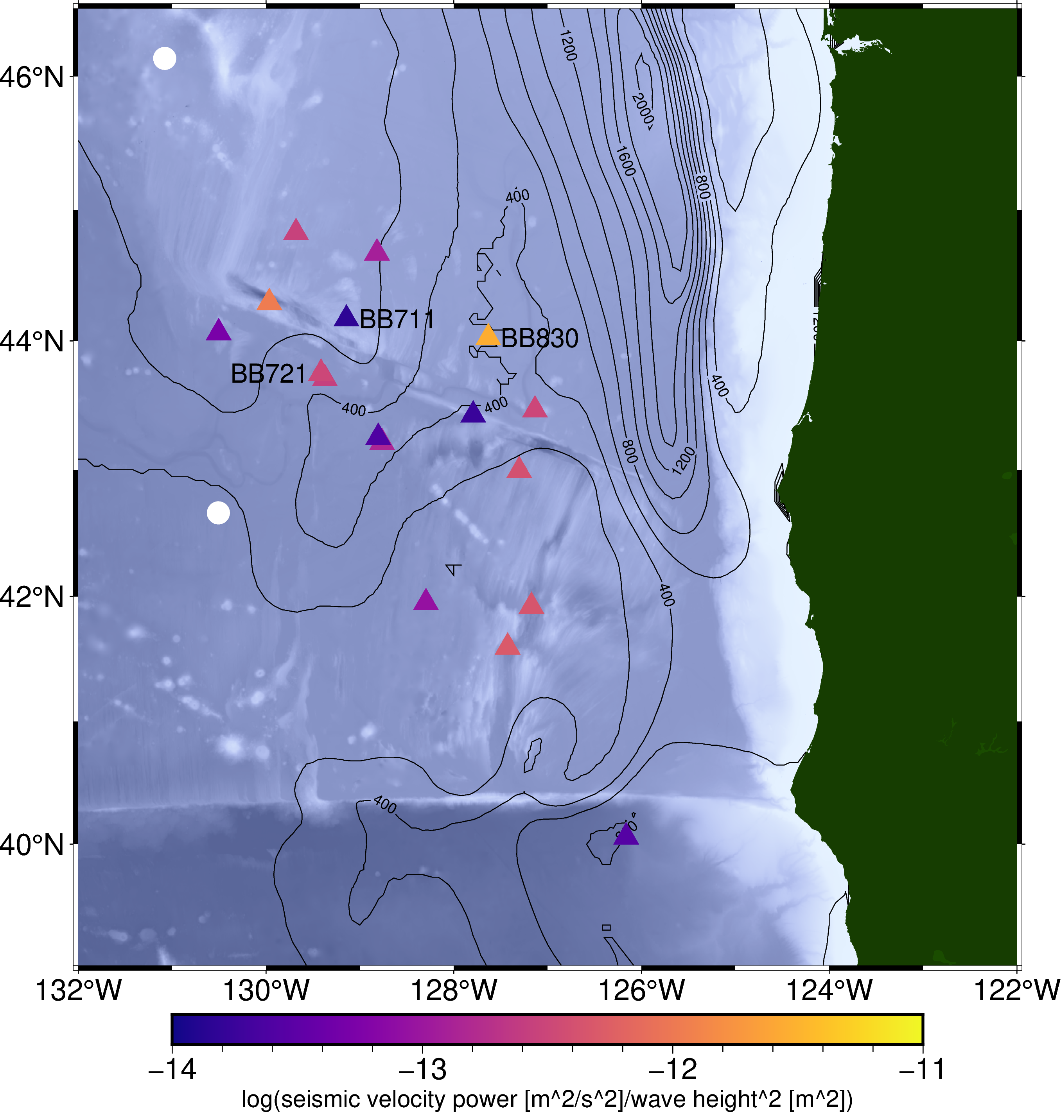
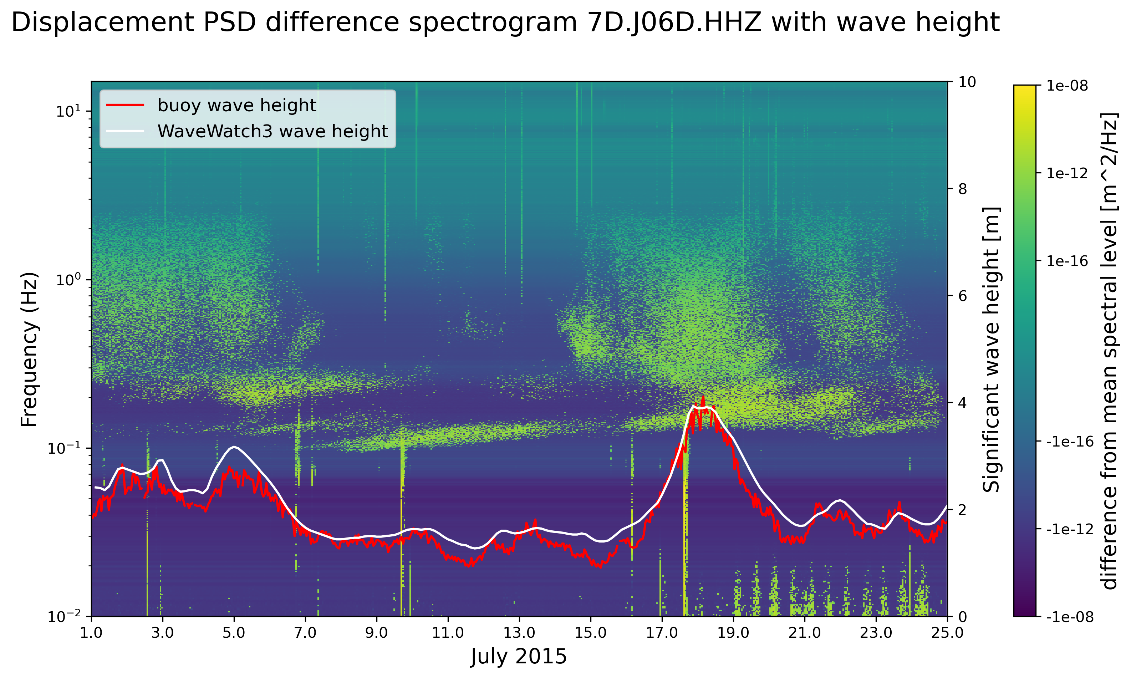
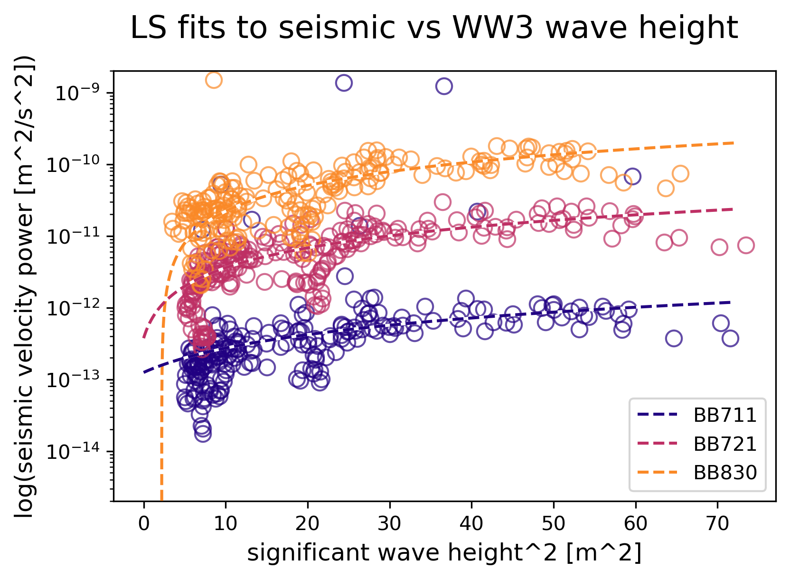
Comparison of ambient noise between ocean-bottom seismic networks
Siobhan Niklasson^{1,2}, Charlotte Rowe¹ & Susan Bilek²
¹Los Alamos National Laboratory, ²New Mexico Tech
P1.3-516
High ambient noise levels in the ocean are a major challenge in using seafloor seismic data to complement land-based networks for monitoring and tomography.
We establish how seismic noise near 1 Hz increases with increasing local sea surface wave height.
Geologic and other site factors must be considered to detail how seismic noise responds to wave height.
Site-specific vertical seismic response to increasing wave height
Z-component seismic noise increases with increasing wave height. Response varies between stations.
Seismic noise in this band, where teleseismic body wave energy is greatest, correlates with local sea surface wave height.
Oregon
wave
height
California
NDBC buoy
OBS station
LA-UR-23-25195

