Slide 1

High-Precision Characterization of Seismicity from the 2022 Hunga Tonga-Hunga Ha'apai Volcanic Eruption
Jonas A. Kintner
Los Alamos National Laboratory
Los Alamos, New Mexico, USA
We compute improved locations, magnitudes, and regional moment tensors of seismicity from the 2022 Hunga Tonga-Hunga Ha'apai (HTHH) Volcanic Eruption.
We use regional to teleseismic surface-wave cross correlation and waveform modeling
The relocated events fall within a small area around the HTHH volcano and migrate to the southeast.
Improved magnitudes and moments tensors suggest the events are positive CLVD and increase in size and frequency days after the eruption before becoming more periodic.
1. Seismic activity shortly after eruption sequence may point toward magma resupply.
2. Seismicity weeks after the eruption is consistent with internal faulting or
additional collapse mechanisms near the volcano.
Please do not use this space, a QR code will be automatically overlayed
P1.4-487

Slide 2
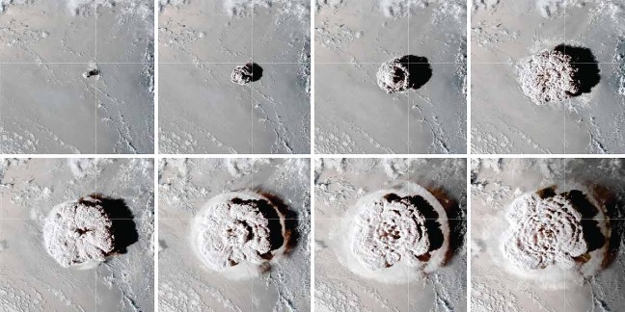
Introduction
The 2022 eruption of the Hunga Tonga-Hunga Ha'apai (HTHH) volcano was among the largest volcanic eruptions recorded in the past hundred years. The paroxysmal explosions on 15 January was one of the largest volcanic eruptions to be recorded using modern global ground- and space-based geophysical instrumentation.
In this study, we compute improved epicentroid locations, magnitudes, and regional moment tensors of eruption-related seismicity using regional to teleseismic surface-wave cross correlation and waveform modeling.
Please do not use this space, a QR code will be automatically overlayed
P1.4-487

Slide 3
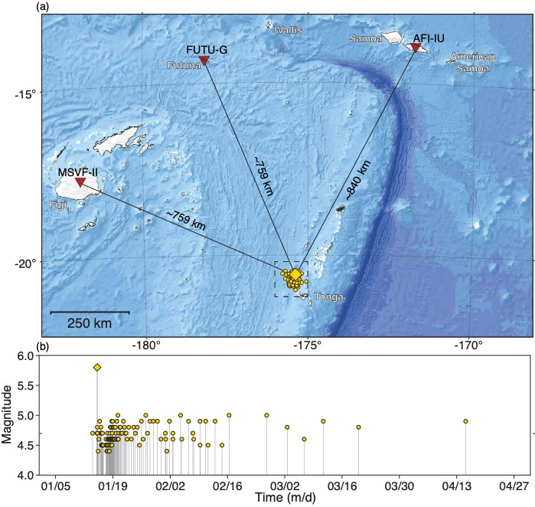
Objectives: Data and Observations (1/2)
We seek to improve existing earthquake catalogs and better understand the HTHH eruption. Despite many global observations, this presents a challenge due to sparse local monitoring required to detect and characterize eruption seismicity with high precision.
Initial Event information
We select all shallow seismic events (<35 km) between Dec. 1, 2021 and May 1, 2022 from the published USGS earthquake catalog. The 112 initial hypocenters are distributed over an area of ~1500 km² and consist of magnitudes that range between body-wave magnitude (mb) 4.25 and 5.0.
Please do not use this space, a QR code will be automatically overlayed
P1.4-487

Slide 4
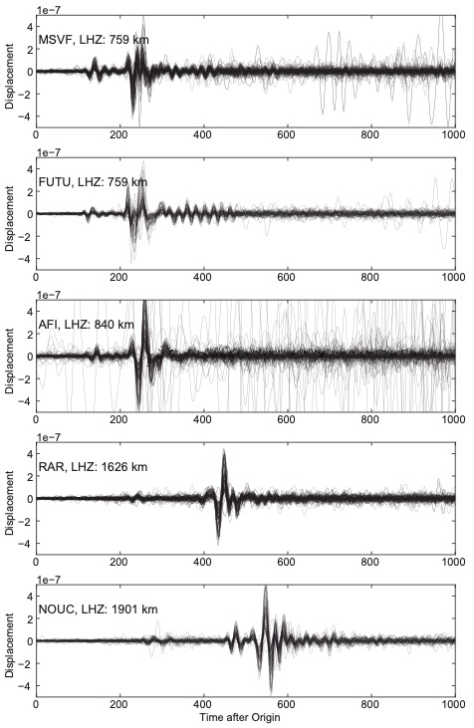
Objectives: Data and Observations (2/2)
Waveform Observations
We observe high similarity between waveforms at nearby common stations, indicating that many of the events in this sequence may have a similar mechanism, location, and size.
Signal Cross Correlation
Cross correlation is the basis for many of our methods, we observe high consistency when plotting phase lag as a function of station azimuth.
The amplitude of the pattern represents the distance between two events, the phase represents the relative
azimuth between events, and an absolute shift represents a difference in origin/centroid time.
Please do not use this space, a QR code will be automatically overlayed
P1.4-487

Slide 5
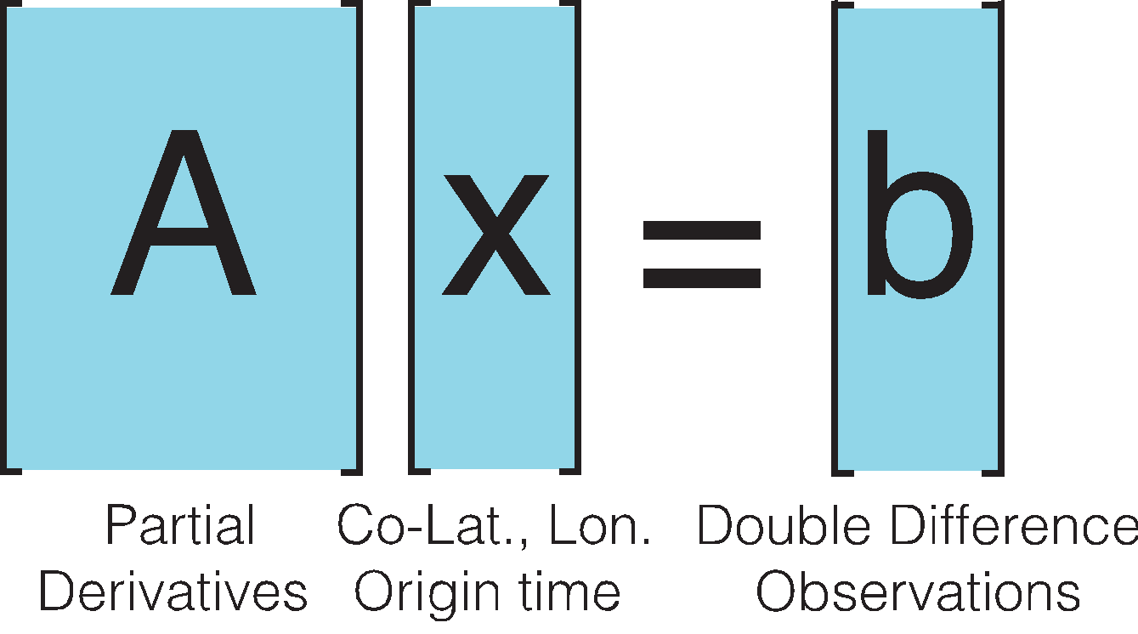
Methods (1/2)
Surface Wave-Based Seismic Event Relocation
We invert linear equations that relate the difference between observed and predicted differential travel times to partial derivates with respect to the seismic event locations and origin times.
The technique has been implemented in a variety of tectonic settings, event sizes, distance scales, etc.
Relative Magnitude Estimation
We invert for precise relative moment magnitudes by relating the difference in seismic moments between two events to a scale factor (s1=αs2) (Eq 1).
(1)
Where α is given by scaling the max common-station surface wave cross-correlation (CC) amplitude by the squared length of the reference signal. (Eq 2).
Please do not use this space, a QR code will be automatically overlayed
(2)
Modification of
Cleveland & Ammon (2013, 2015)
P1.4-487

Slide 6
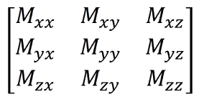
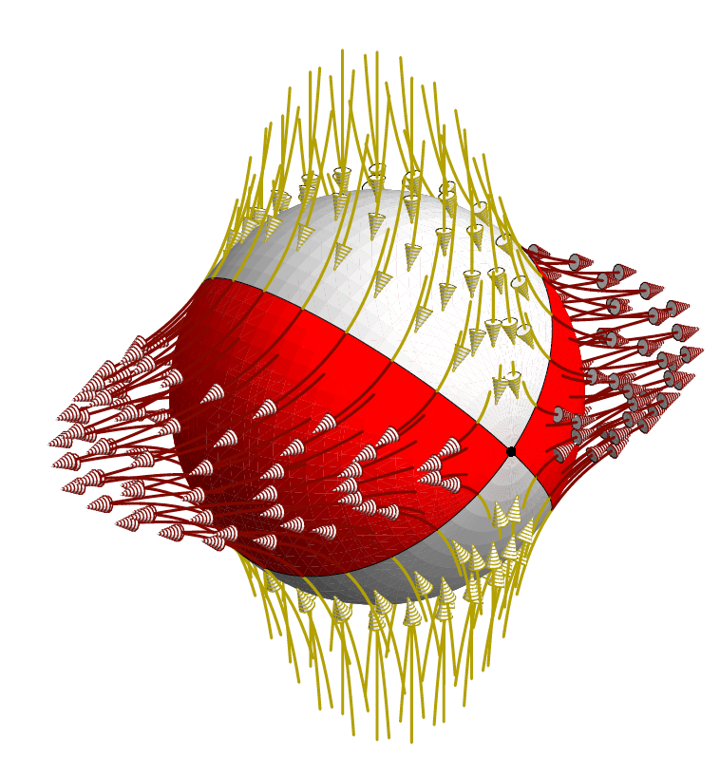
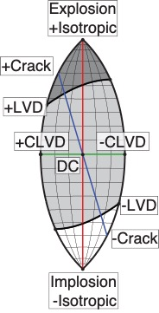
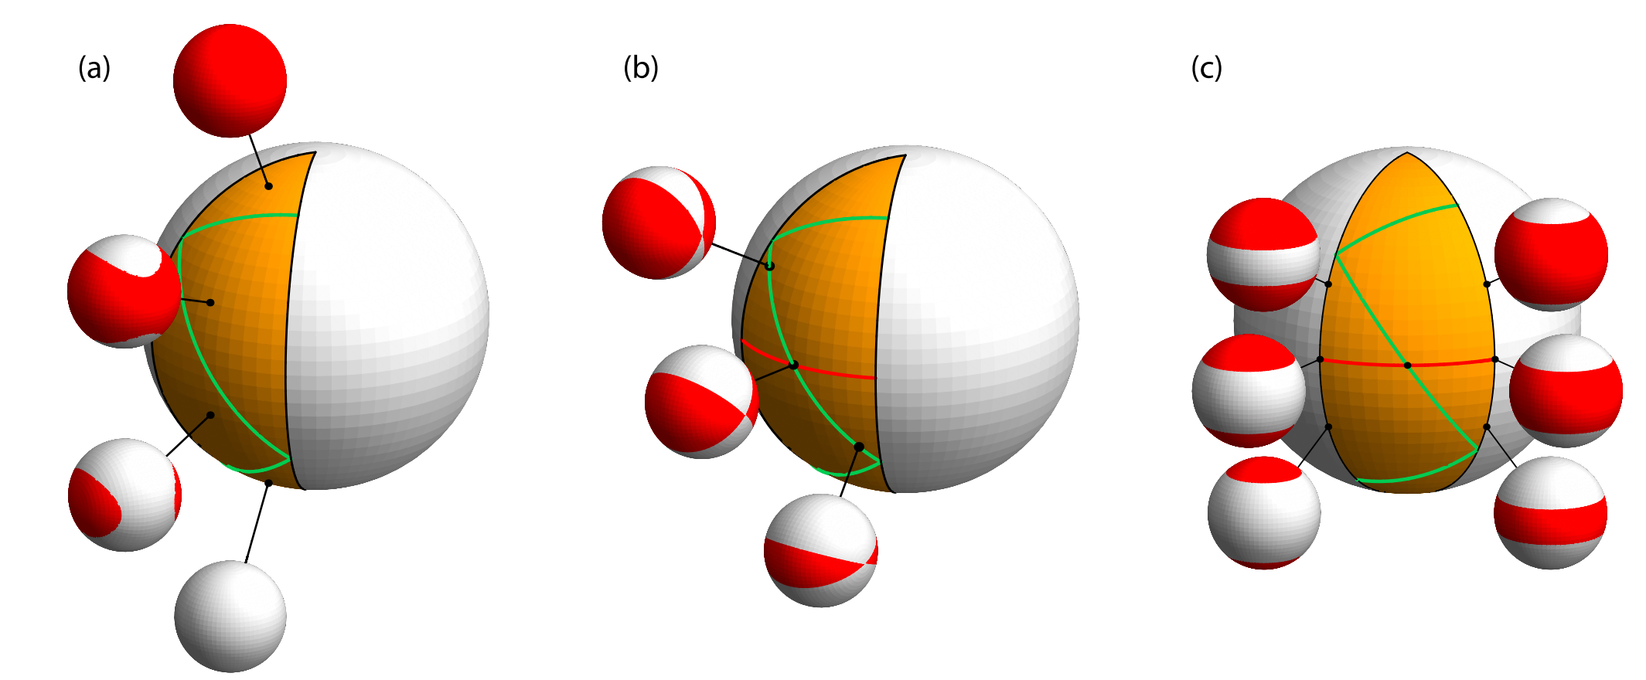
Methods (2/2)
Moment Tensor Uncertainty Quantification (MTUQ)
We employ the MTUQ software (Modrak & Tape, 2022).
MTUQ uses the 'cut-and-paste' technique and an L2-misfit function that measures the difference between observed and predicted seismograms.
We invert observed and predicted Surface-waveforms.
We select seven nearby stations and analyze the 20-60 second bandwidth.
Results are assessed through MTUQ visualization tools.
Moment Tensors are defined by a series of force couples
They can be visualized through the eigenvalue lune projection
Please do not use this space, a QR code will be automatically overlayed
Tape & Tape (2019)
P1.4-487

Slide 7
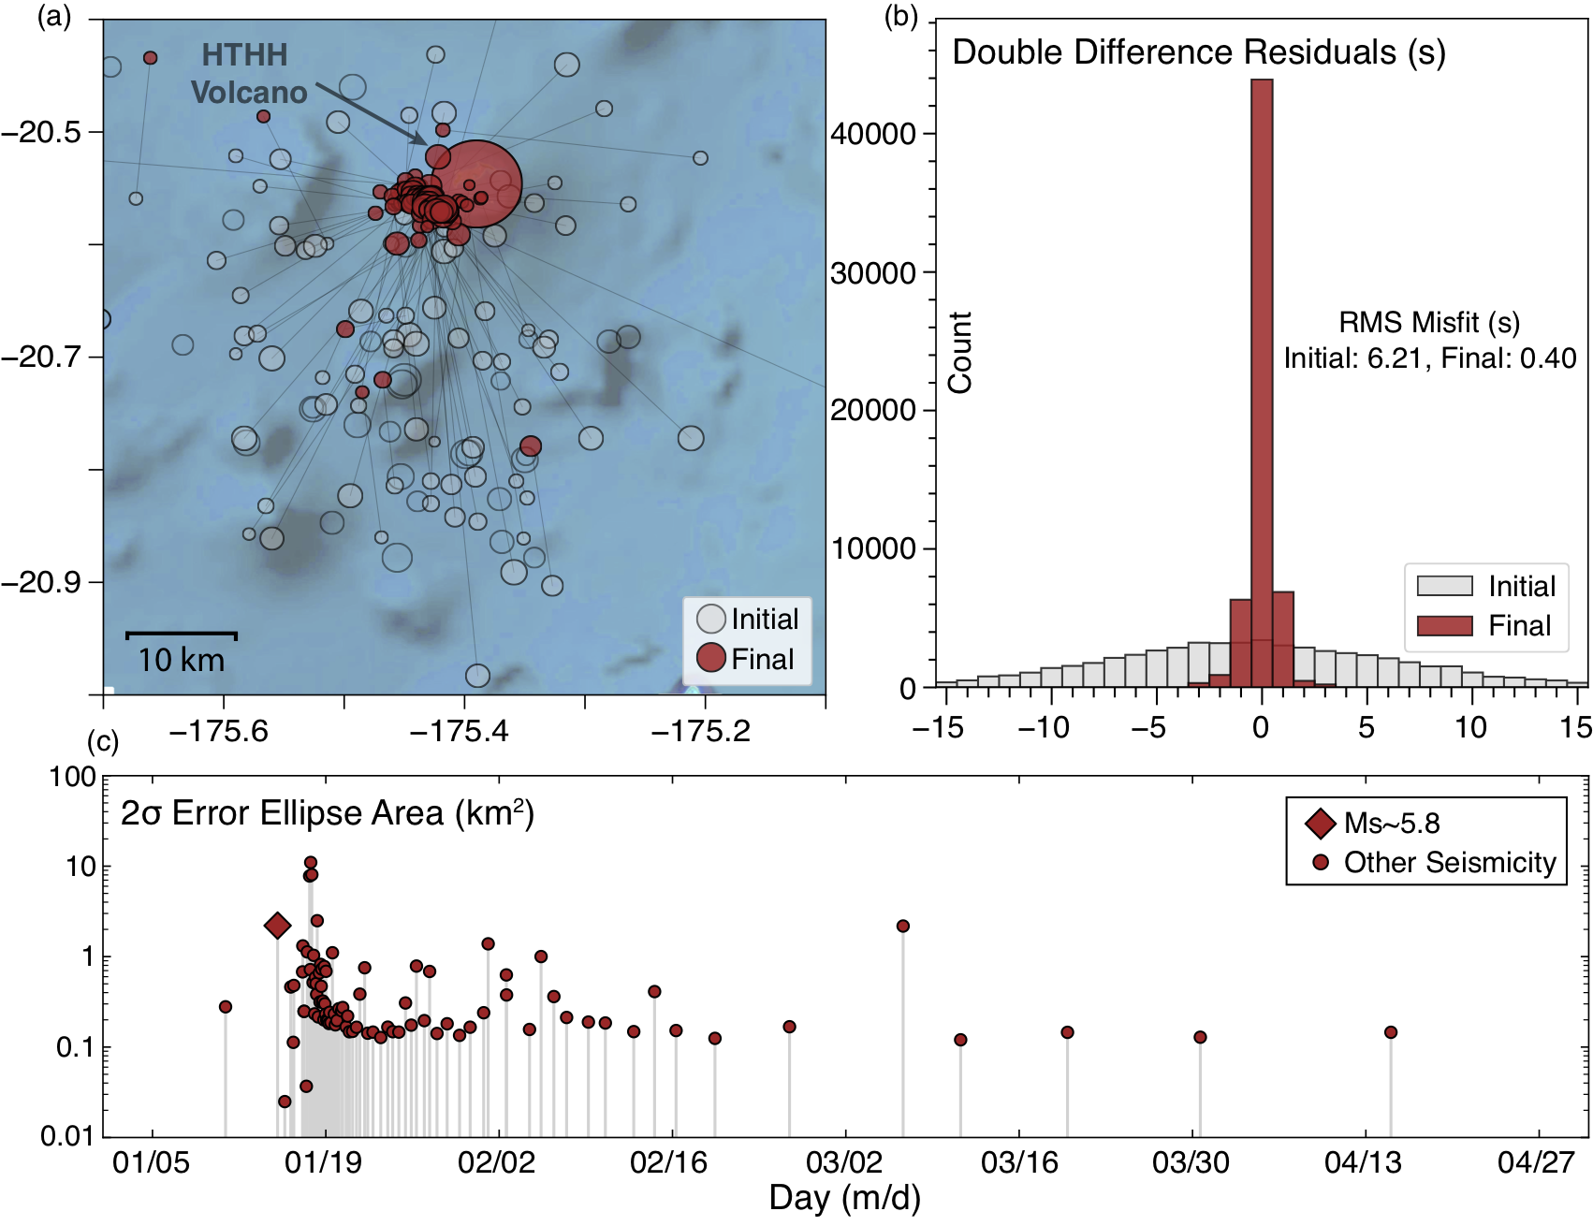
Results (1/2)
Relative Relocation Results
The technique computes common-station cross correlation measurements, and iteratively inverts or differences in event latitude, longitude and origin time.
The final locations collapse from an area of 1500 km² to ∼25 km², roughly the size of the caldera area.
The high-precision locations determined using this approach resulted in an overall variance
reduction of 99.46% compared with the initial locations.
Please do not use this space, a QR code will be automatically overlayed
P1.4-487

Slide 8
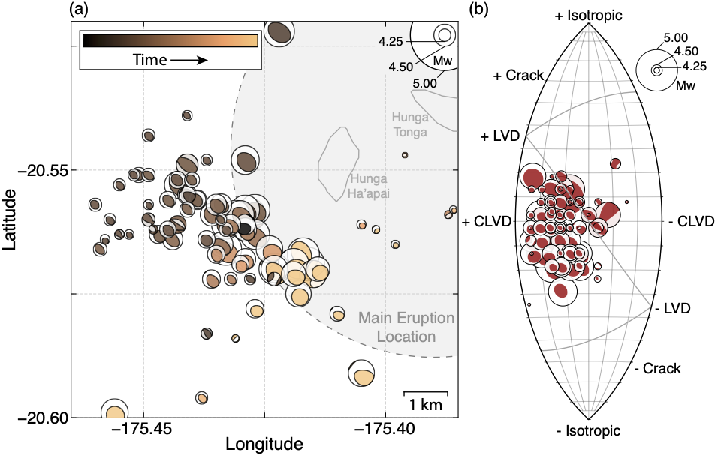
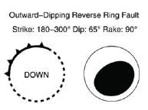
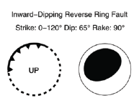
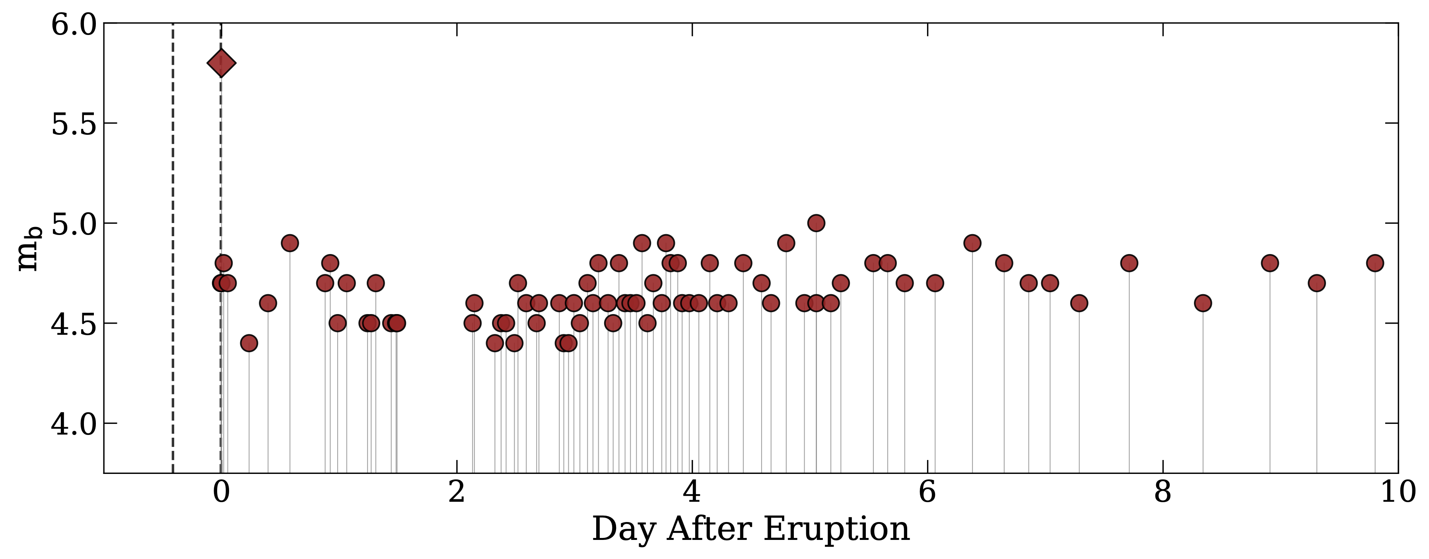
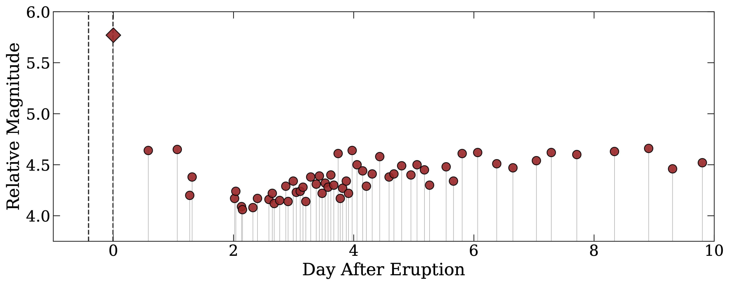

Results (2/2)
Relative Magnitude and Moment Tensor Results
Relocated events migrate to the southeast during the days after the eruption.
Regional moment tensor solutions indicate that many of these events
are shallow and show a strong positive compensated linear vector dipole (CLVD) component.
Relative magnitudes increase days after the eruption and show greater precision than initial catalog magnitudes.
Initial
Catalog Magnitudes
Final
Relative Magnitudes
Please do not use this space, a QR code will be automatically overlayed
P1.4-487

Slide 9
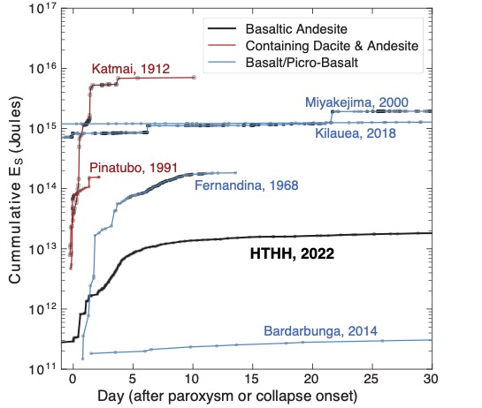
Conclusions
Key Observations -
The relocations fall within a small area around the HTHH volcano.
Time-dependent migration to the southeast.
The relative magnitudes increase in size days after the eruption before leveling off and becoming more periodic.
Moment tensors suggest the events are positive CLVD.
To agree with other observations -
Seismic activity early in the post-eruption sequence may point toward the rapid resupply of magma after depressurization of the shallow crustal magma chamber.
Seismicity that occurs in the weeks after the paroxysm are relatively consistent and periodic with no spatial migration. This behavior has been observed mainly for instances of internal faulting or additional collapse mechanisms near volcanoes.
Please do not use this space, a QR code will be automatically overlayed
P1.4-487

Slide 10
References
This Work
Jonas A. Kintner, William L. Yeck, Paul S. Earle, Stephanie Prejean, Jeremy D. Pesicek; High‐Precision Characterization of Seismicity from the 2022 Hunga Tonga‐Hunga Ha'apai Volcanic Eruption. Seismological Research Letters 2022; 94 (2A): 589–602. doi: https://doi.org/10.1785/0220220250
Cited in Presentation
Cleveland, K. M., & Ammon, C. J. (2013). Precise relative earthquake location using surface waves. Journal of Geophysical Research: Solid Earth, 118(6), 2893–2904. https://doi.org/10.1002/jgrb.50146
Cleveland, K. M., & Ammon, C. J. (2015). Precise relative earthquake magnitudes from cross correlation. Bulletin of the Seismological Society of America, 105(3), 1792–1796. https://doi.org/10.1785/0120140329
Tape, W., Tape, C. (2019) The eigenvalue lune as a window on moment tensors, Geophysical Journal International, Volume 216, 1, 19–33, https://doi.org/10.1093/gji/ggy373
Please do not use this space, a QR code will be automatically overlayed
P1.4-487

