Slide 1
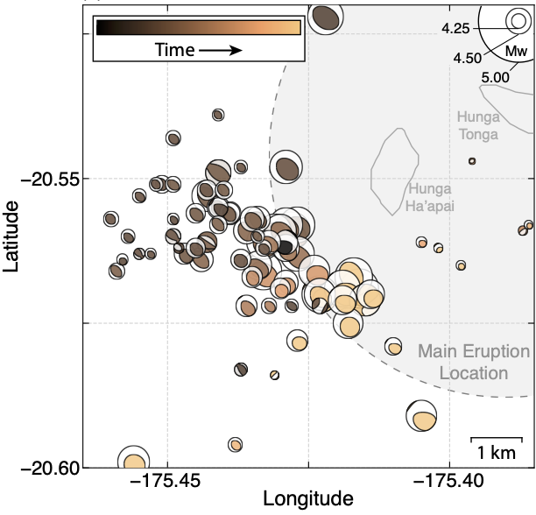
High-Precision Characterization of Seismicity from the 2022 Hunga Tonga-Hunga Ha'apai Volcanic Eruption
Jonas A. Kintner
Los Alamos National Laboratory, Los Alamos, New Mexico, USA
P1.4-487
Objective
Calibrated relocated events with their best-fitting moment tensor solutions, colored by time.
Improve existing earthquake catalogs and better understand the 2022 HTHH eruption.
Methods
We compute improved epicentroid locations, magnitudes, and regional moment tensors of eruption-related seismicity using regional to teleseismic surface-wave cross correlation and waveform modeling.
Results
(a) The relocations fall into an area of ~25 km², (b) migrate to the southeast, (c) increase in size days after the eruption before leveling off and becoming more periodic, and (d) exhibit a positive CLVD source type.
Conclusions
Seismic activity early on may point toward the rapid resupply of the magma chamber, later seismicity may be consistent with internal faulting or additional collapse mechanisms near the volcano.

