Slide 1
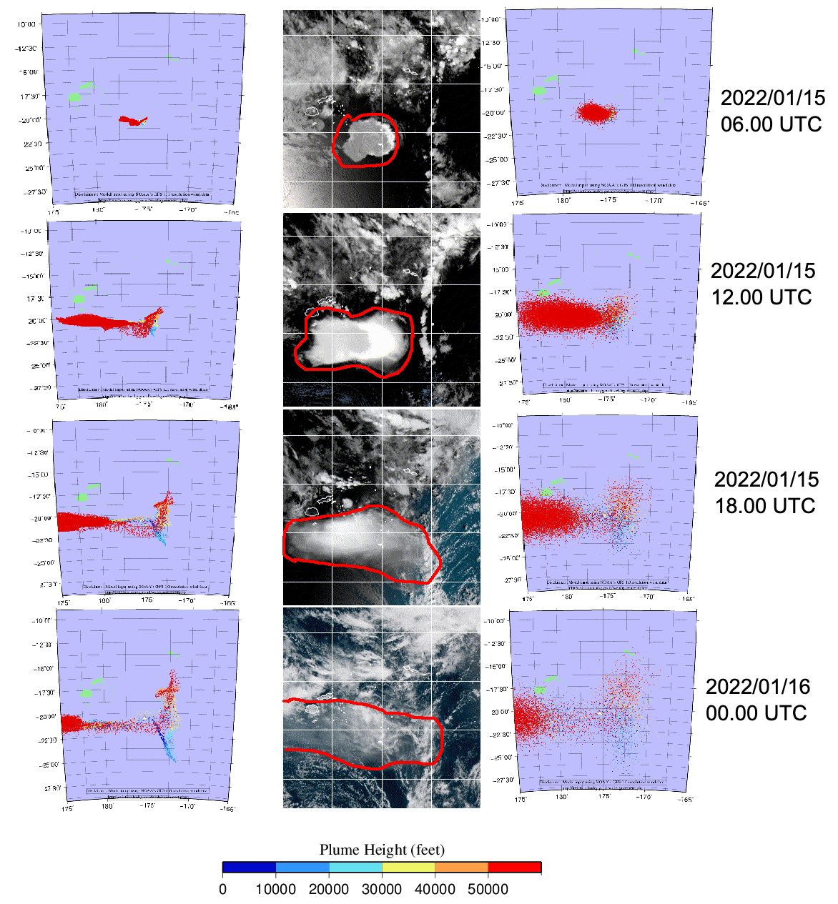
The Volcanic Ash Dispersion Simulation of Huge Volcanic Eruption with the PUFF Lagrangian Method : A case Study of Tonga Eruption 15 January 2022
I Kadek Nova Arta Kusuma
BMKG Indonesia
Px.x-xxx
Although PUFF Model performs well when using default parameters for volcano eruptions in Indonesia (which are usually has VEI<3), it did not provide satisfactory results for the Tonga eruption case on January 15th, 2022 (VEI=5), specifically regarding the ash coverage.
This poster has 2 main objectives:
Identify the performance of the model for simulating of large scale eruption which throughout this operational time are used for small scale eruption.
Demonstrate simulation of Tonga Case on January 15, 2022 with PUFF Model, with changing diffusion coefficient parameter and compared with observation data to figure out the best value for large scale eruption.
According to the figure, majority of the upper ash moves to west and accordance to the observation. Lower ash gradually moves to east but less significant as the upper ash. Tonga Eruption on January, 15th 2022 considered as large scale eruption with VEI 5 to 6.
Model with default value has smaller area compared to the observation. Increasing the horizontal diffusion coefficient from 150 m²/s to 150,000 m²/s broadens the coverage and appears to resemble the observations more closely.
Eventhough default value works well on the small scale eruption, but PUFF model need to be adjusted in case to simulate large scale eruption to get a better prediction area of coverage.

