Slide 1
The Volcanic Ash Dispersion Simulation of Huge Volcanic Eruption with the PUFF Lagrangian Method : A case Study of Tonga Eruption 15 January 2022
I Kadek Nova Arta Kusuma
BMKG, Indonesia
The PUFF Model uses the Lagrangian method, taking into account wind, diffusion, and gravity parameters. Although it performs well when using default parameters for volcano eruptions in Indonesia(which are usually has VEI<3), it did not provide satisfactory results for the Tonga eruption case on January 15th, 2022 (VEI=5), specifically regarding the ash coverage.
In order to verify the dispersion of Tonga's ash, it is necessary to compare it with the observation of GOES West Geocolor Satellite images. To increase the spatial area coverage of the model's ash results, changes were made to the horizontal diffusion coefficient.
Increasing the horizontal diffusion coefficient from 150 m²/s to 150,000 m²/s broadens the coverage and appears to resemble the observations more closely.
Despite default parameters working well for relatively small volcanic eruptions (VEI<3), the diffusion coefficient is not suitable for large-scale eruptions. Adjusting the value is necessary for better prediction results concerning ash coverage.
Leave empty – QR code will be overlayed on touchscreen
P2.4-123

Slide 2
Introduction: the CTBTO and the SnT2023 conference
The PUFF Model (originally was developed by Tanaka 1991) is a volcanic ash dispersion model used in Indonesia to aid in predicting the distribution of volcanic ash for aviation safety purposes. This model utilizes the Lagrangian method, taking into account parameters such as wind, random walk, and gravity. The eruption of Mount Tonga on January 15, 2022, with a Volcanic Explosivity Index (VEI) of 5, exceeded that of Galunggung in 1982 and Kelud in 2014. It presents an intriguing phenomenon to study using the PUFF model due to the relatively extensive distribution of ash eruptions. Volcanic eruptions with a VEI >= 3 exhibit distinct characteristics compared to VEI <3 eruptions, which are more common in Indonesia.
PUFF Model performance is largely depends on wind prediction for the ash movement in the atmosphere. Gravity parameter has a role for ash fall to the ground and depends on the terminal velocity of each particles of ash. The simulation of Mount Tonga eruption on January 15, 2022 with PUFF Model, produce good result on ash movement but not in ash coverage. Random walk which has diffusion coefficient in its formula responsible for the ash coverage.
where r_{i}(t) is a position vector of an i-th particle at time t, V is the local wind velocity
Z is a vector containing three Gaussian
Random numbers, and G is the gravitational
fallout speed by the Stokes Law.
P2.4-123
Leave empty – QR code will be overlayed on touchscreen

Slide 3
Objectives of the Conference
This poster has 2 main objectives:
Identify the performance of the model for simulating of large scale eruption which throughout this operational time are used for small scale eruption.
Demonstrate simulation of Tonga Case on January 15, 2022 with PUFF Model, with changing diffusion coefficient parameter and compared with observation data to figure out the best value for large scale eruption.
P2.4-123
Leave empty – QR code will be overlayed on touchscreen

Slide 4
Methods and Data used for the Conference
Simulation is runned using wind model data Global Forecast System (GFS) 1.0 degree.
The simulation is carried out by changing the value of the diffusion parameter in the model and comparing it with satellite imagery to find a suitable value for a large type of eruption.
In order to get the coverage performance of the model, comparison is made every 6 hours with sateliite images (GOES-West GEOCOLOR). Both for model images and satellite images are limited to 175 E - 165 W and 7.5 S - 27.5 S.
P2.4-123
Leave empty – QR code will be overlayed on touchscreen

Slide 5
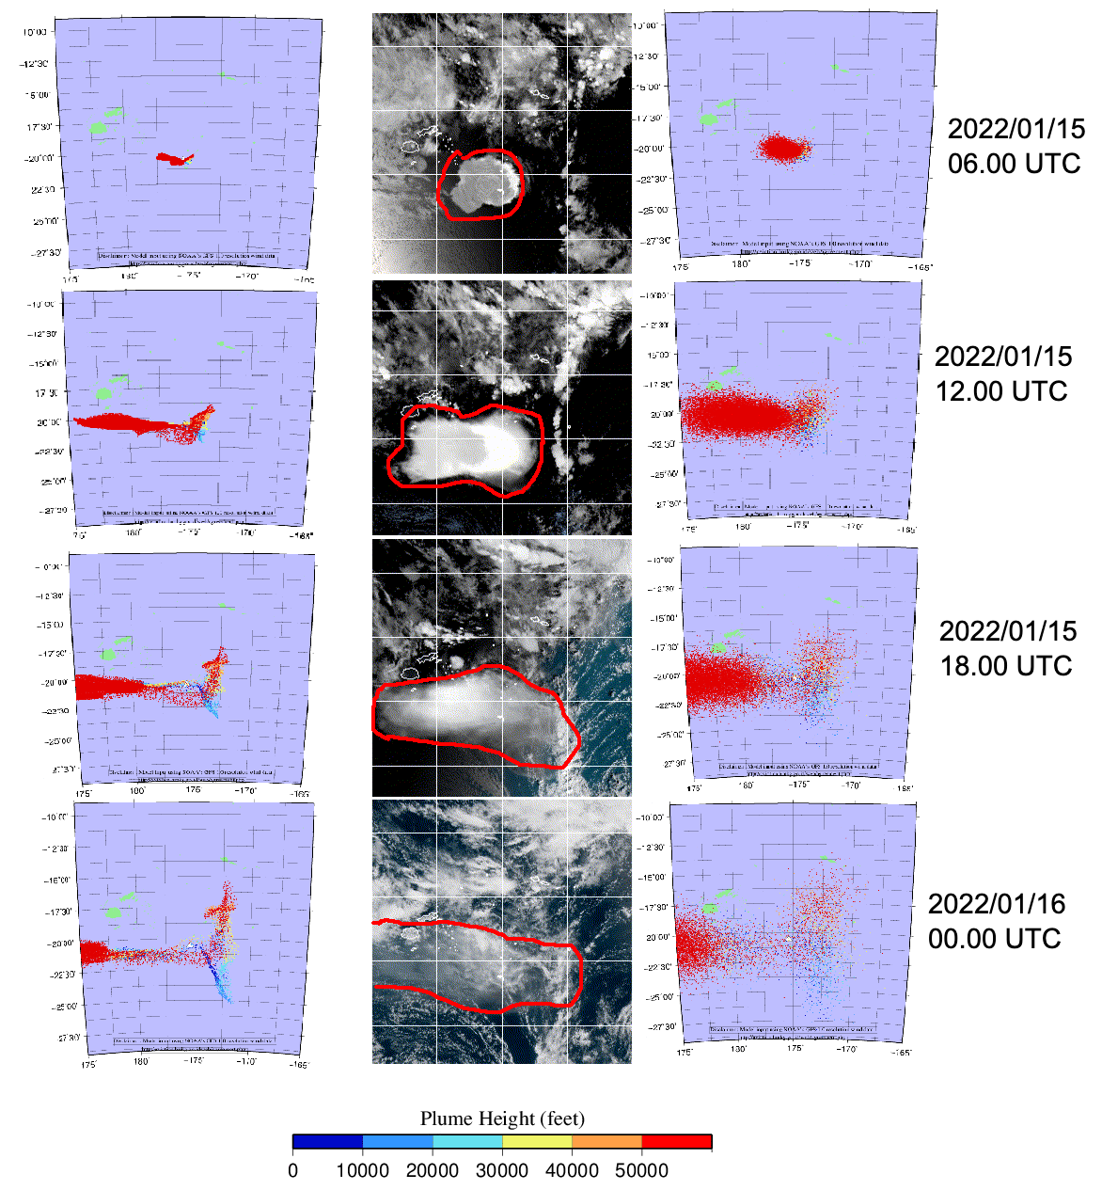
Results presented at the Conference
According to the figure 1, majority of the upper ash moves to west and accordance to the observation. Lower ash gradually moves to east but less significant as the upper ash. Tonga Eruption on January, 15th 2022 considered as large scale eruption with VEI 5 to 6.
Model with default value has smaller area compared to the observation. Increasing the horizontal diffusion coefficient from 150 m²/s to 150,000 m²/s broadens the coverage and appears to resemble the observations more closely.
Eventhough default value works well on the small scale eruption, but PUFF model need to be adjusted in case to simulate large scale eruption to get a better prediction area of coverage.
P2.4-123
Leave empty – QR code will be overlayed on touchscreen
Figure 1. Comparisson between model prediction with defaut value (left), satellite observation images with ash coverage - red polygon (middle), and model with adjusting diffusion coefficient (right). Model colours indicate plume height in feet.

Slide 6
Conclusion
Despite default parameters working well for relatively small volcanic eruptions (VEI<3), the diffusion coefficient is not suitable for large-scale eruptions. Adjusting the value is necessary for better prediction results concerning ash coverage.
P2.4-123
Leave empty – QR code will be overlayed on touchscreen

Slide 7
References
Tanaka, H.L. Development of a prediction scheme for the volcanic ash fall from Redoubt volcano. In Proceedings of the First International Symposium on Volcanic Ash and Aviation Safety; U.S. Geological Survey: Reston, VA, USA, 1991; Volume 1065, p. 58.
David A. Yuen; Melissa A. Scruggs; Frank J. Spera; Yingcai Zheng; Hao Hu; Stephen R. McNutt; Glenn Thompson; Kyle Mandli; Barry R. Keller; Songqiao Shawn Wei; Zhigang Peng; Zili Zhou; Francesco Mulargia; Yuichiro Tanioka (July 2022). "Under the Surface: Pressure-Induced Planetary-Scale Waves, Volcanic Lightning, and Gaseous Clouds Caused by the Submarine Eruption of Hunga Tonga-Hunga Ha'apai Volcano Provide an Excellent Research Opportunity". Earthquake Research Advances. 2 (3). doi:10.1016/j.eqrea.2022.100134. S2CID 247550313.
Blake, D.M. & Wilson, G. & Stewart, Christiana & Craig, H.M. & Hayes, Josh & Jenkins, Susanna & Wilson, Tom & Horwell, C.J. & Andreastuti, Supriyati & Daniswara, R. & Ferdiwijaya, Djoni & Leonard, G.S. & Hendrasto, M. & Cronin, Shane. (2015). The 2014 eruption of Kelud volcano, Indonesia : impacts on infrastructure, utilities, agriculture and health.
Px.x-xxx
Please do not use this space, a QR code will be automatically overlayed

