Slide 1
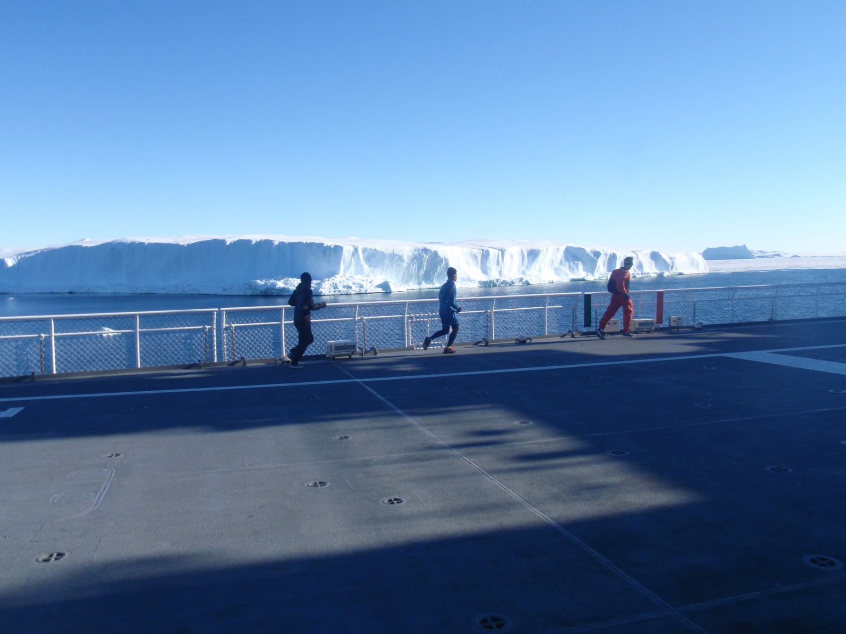
Detection of Infrasound Sources using Array Data from 2019 to 2021
Deployed at the Lützow-Holm Bay Region, Antarctica
Masaki Kanao
National Institute of Polar Research, Tokyo, Japan
P1.4-053
Time-space variations of infrasound sources for three years in 2019-2021 were investigated by using local arrays deployed at two outcrops in LHB, Antarctica.
A large number of infrasound sources were detected and many of them located between northward and north-westward directions from the arrays. These source events are generated within the Southern Indian Ocean to the northern part of the LHB with frequency content of few seconds; that is the microbaroms originated from oceanic swells and relating sea-ice dynamics.
Several sporadic infrasound events during wintering seasons had predominant frequency content of few Hz, which are clearly higher than microbaroms. Based on a comparison with sea-ice and glacier distribution form MODIS satellite images, these high-frequency sources were considered to be cryo-seismic signals associated with cryosphere dynamics, near the Shirase glacier in the southern part of LHB.

