Slide 1
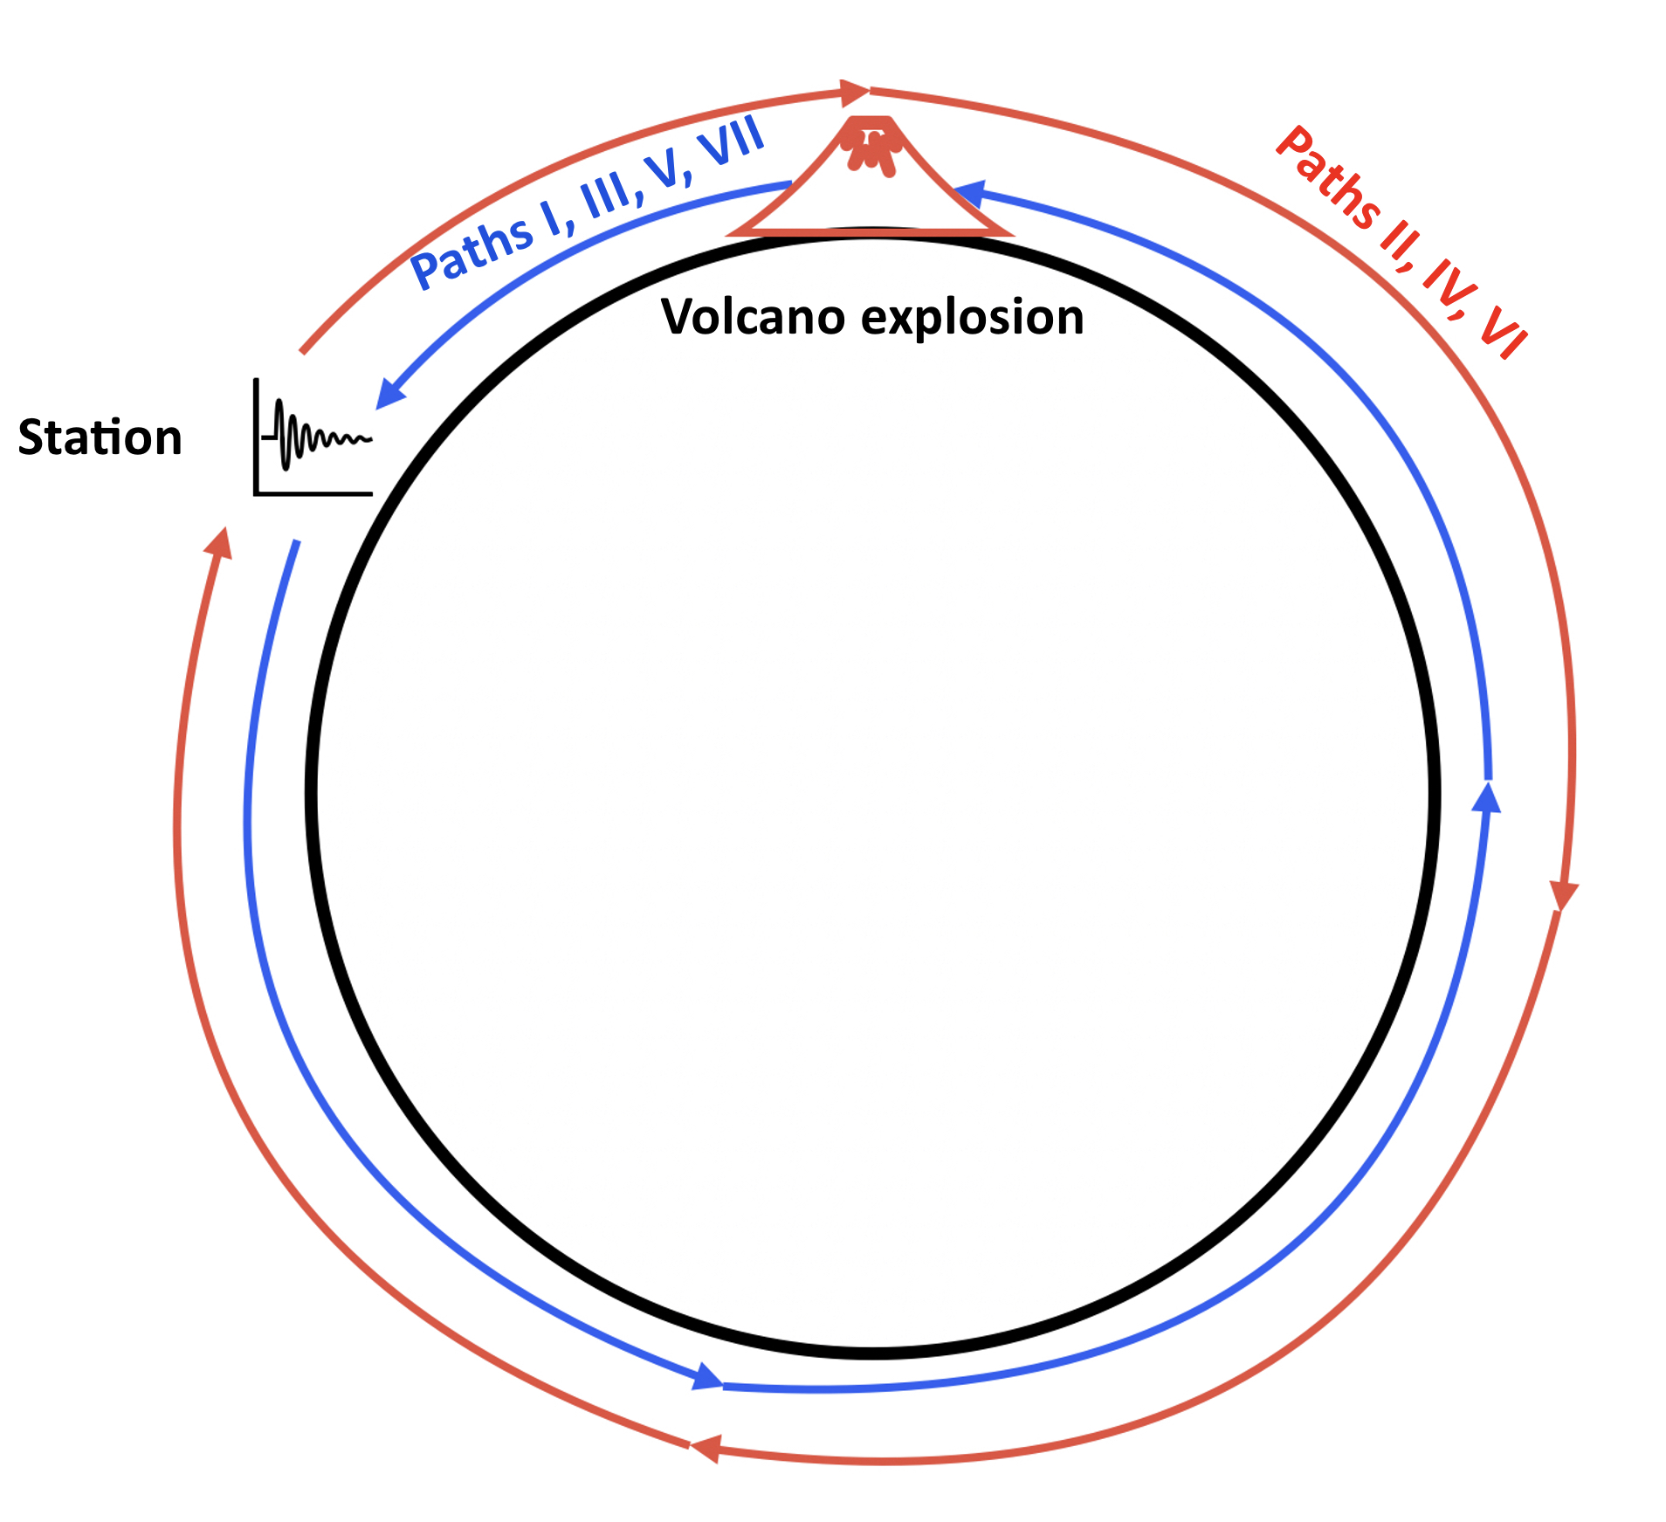
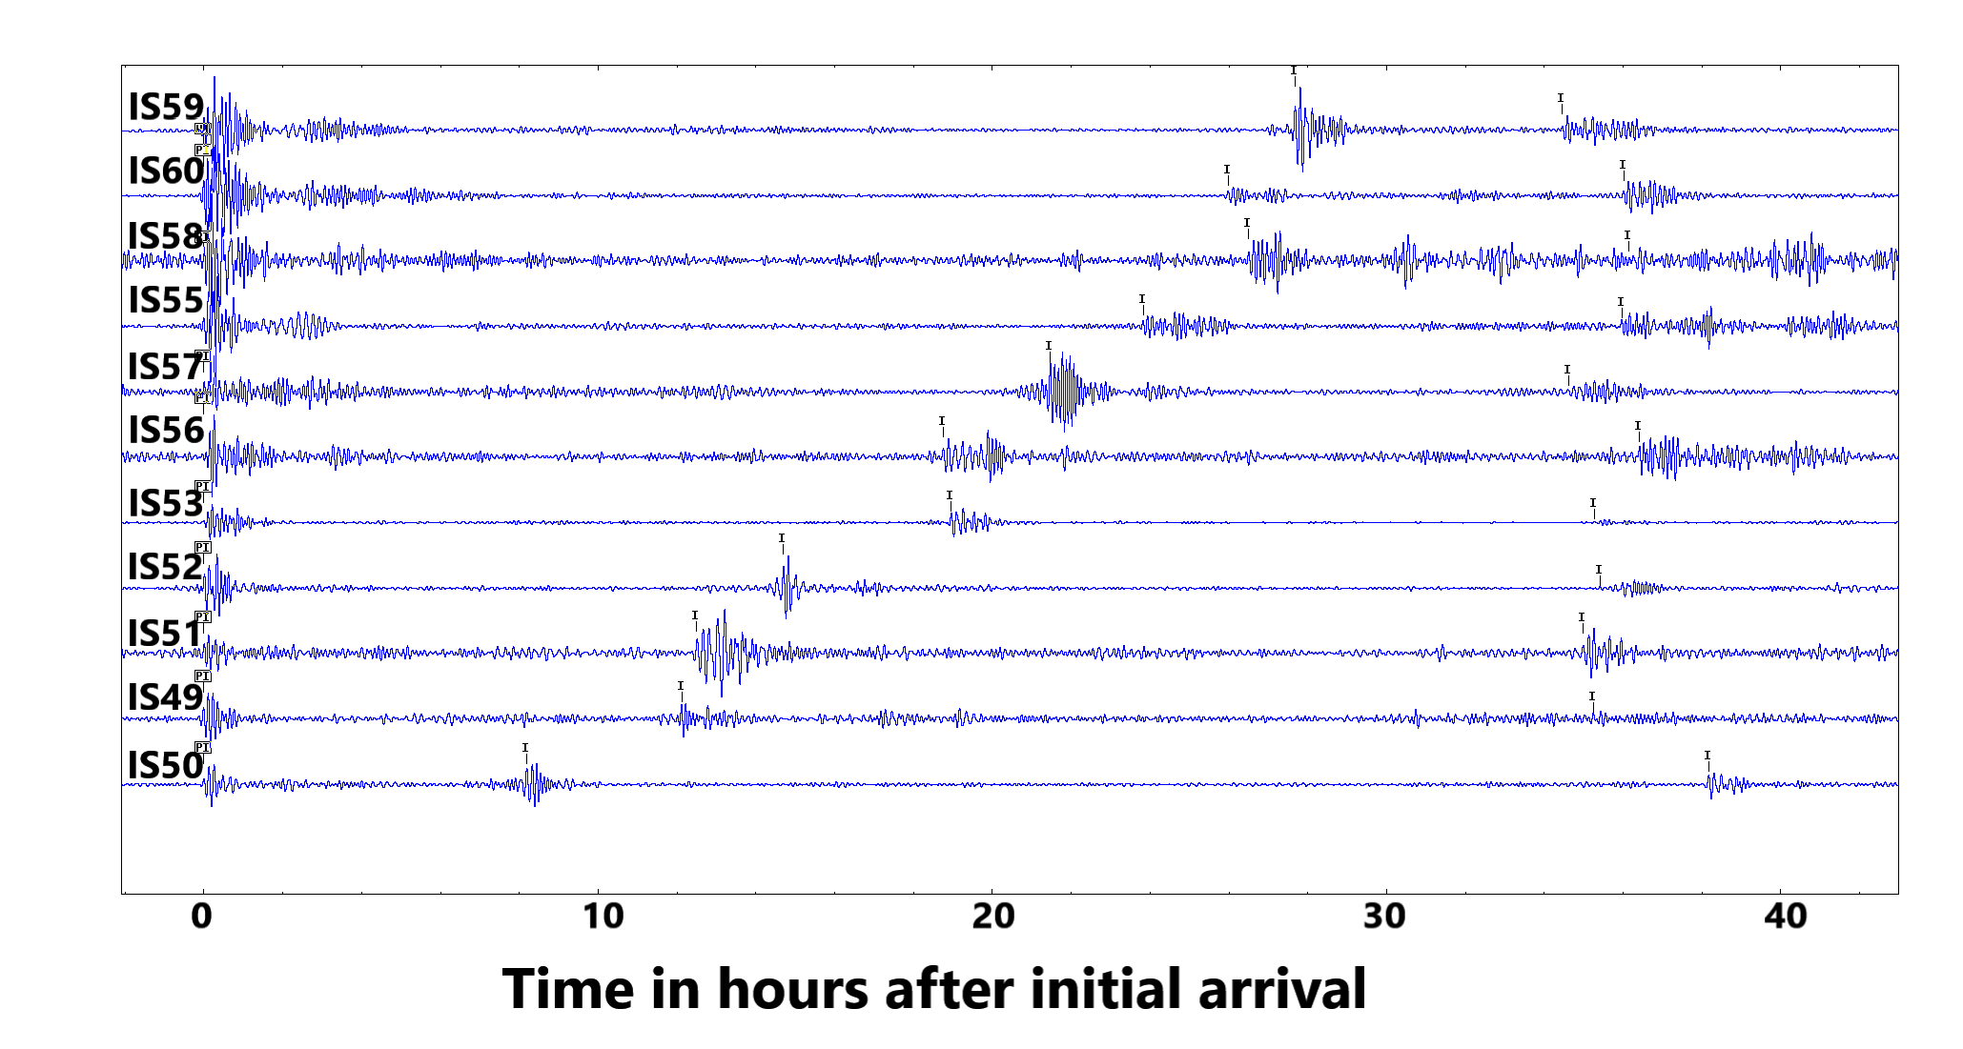
Timing statistics of the multiple passages of the pressure wave generated by the 2022 Hunga Tonga- Hunga -Ha’apai and comparison with the 1883 Krakatoa pressure wave
LE BRAS, Ronan, BITTNER, Paulina, RAMBOLAMANANA, Gérard
Comprehensive Nuclear-Test-Ban Treaty Organisation
[
P1.4-472
Attempt to explain observations for Krakatoa and HTHH (travel times difference).
Compare the pressure wave travel times observations at 138.5 years interval. Very long Earth circumference paths allow for precise measurements.
Please come to see our poster!

