Slide 1
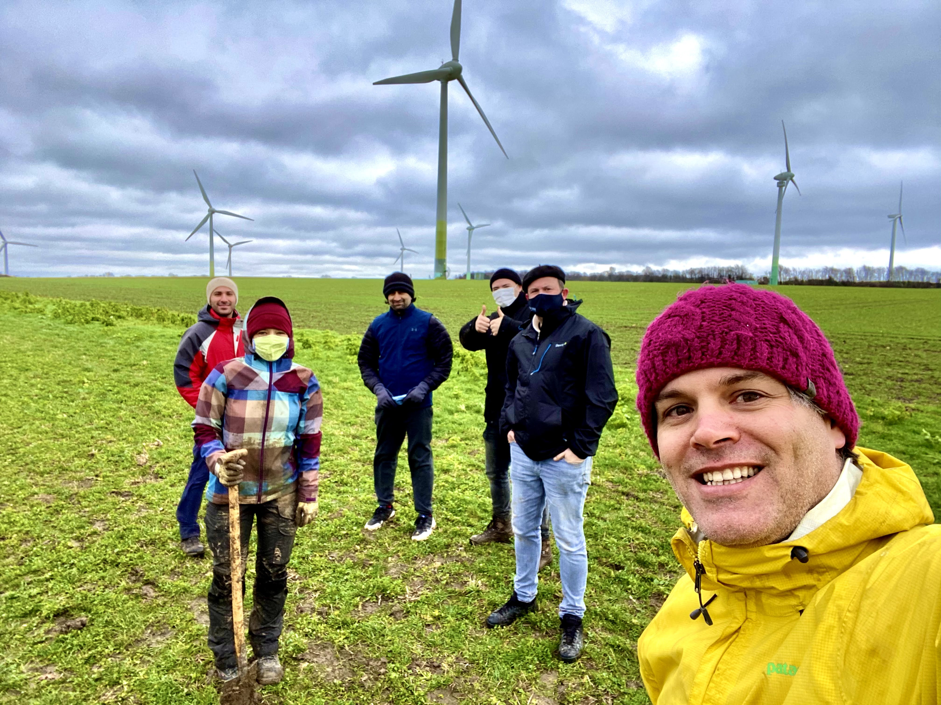
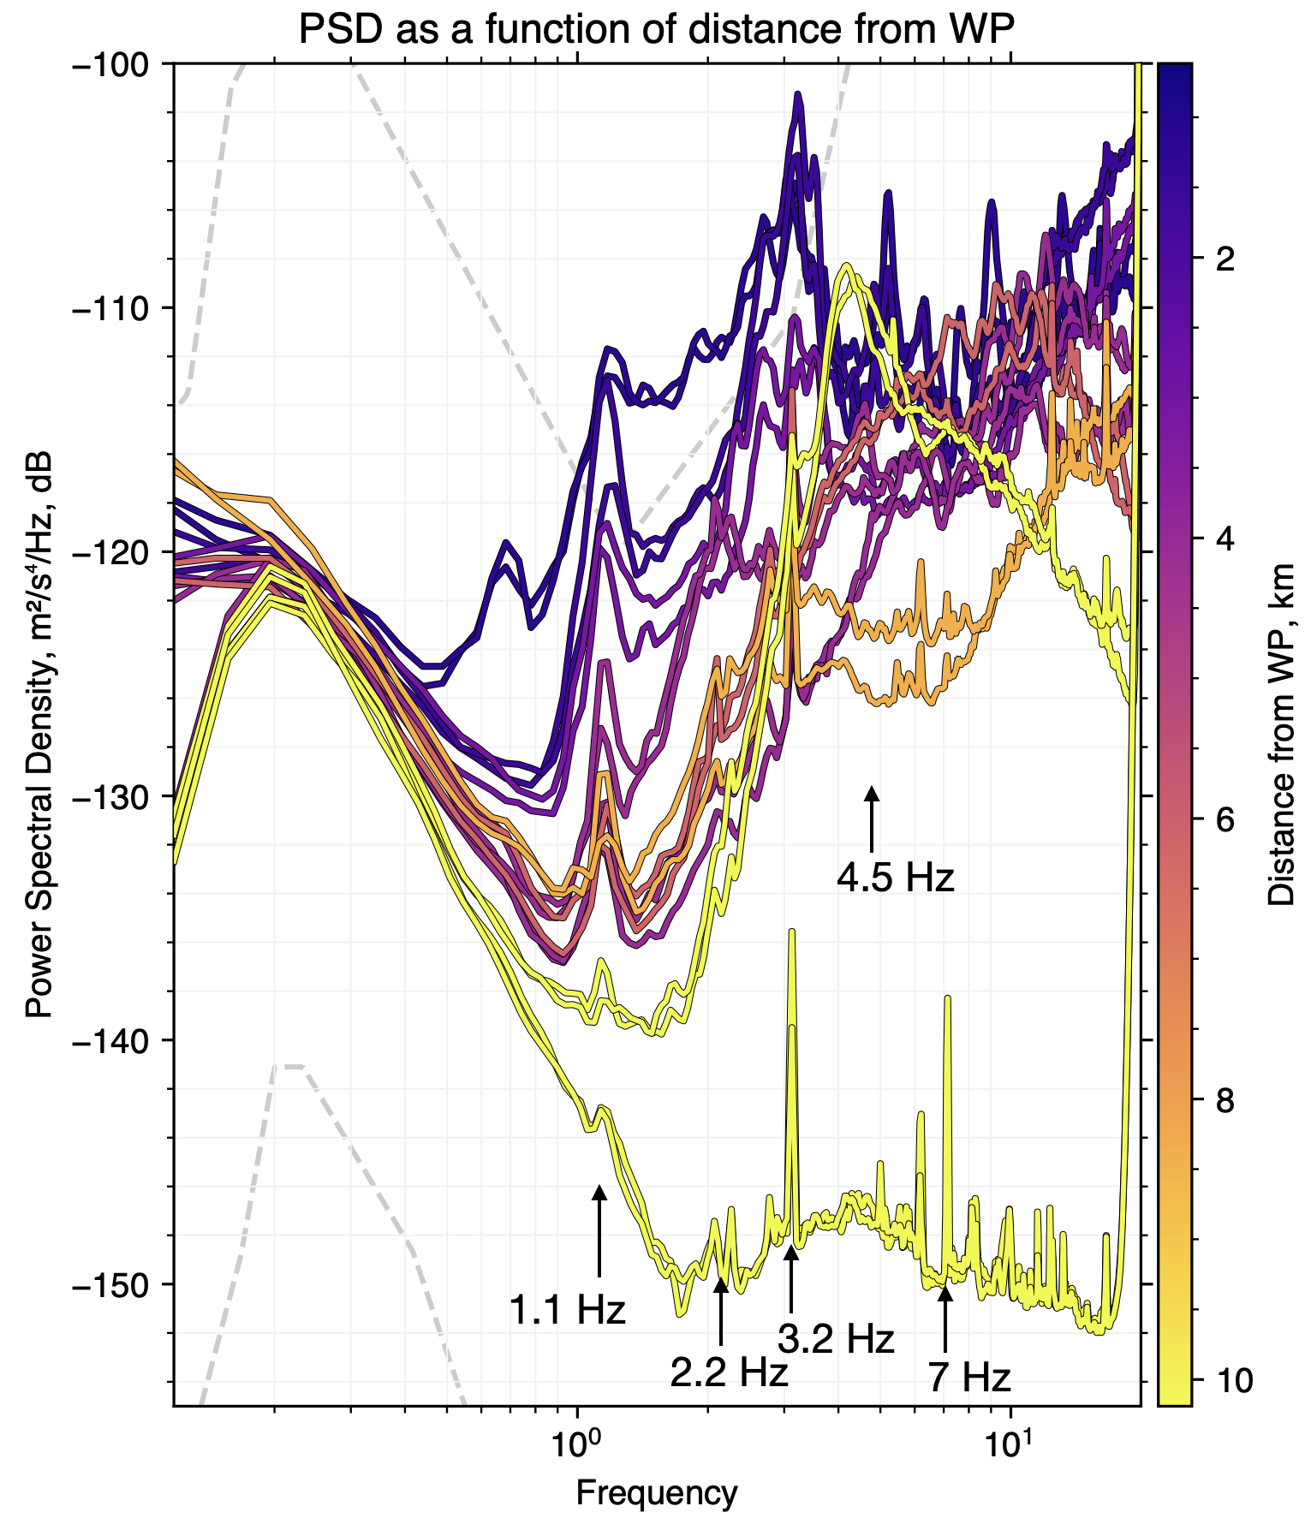
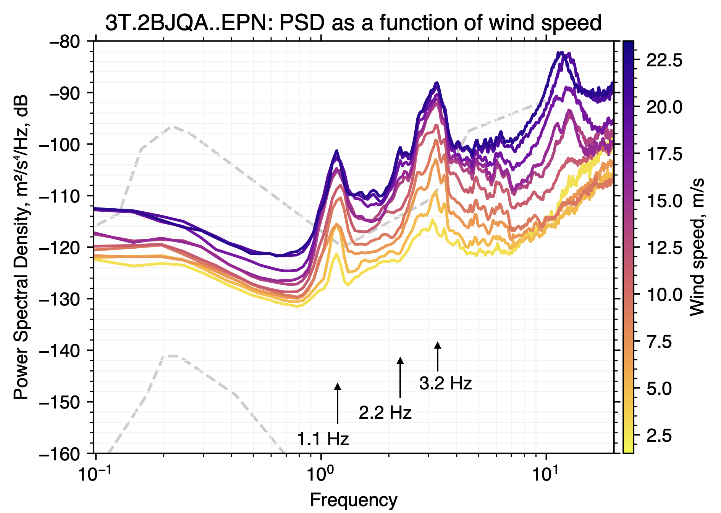
Seismoacoustic Monitoring of Wind Turbines
Around a Proposed Einstein Telescope Site
Shahar Shani-Kadmiel¹, Bjorn Vink², Jelle Assink¹, Läslo Evers¹, Frank Linde³
P1.4-587
Spectral peaks of ~1.1, ~2.2, and ~3.2 Hz have been clearly identified to be related to wind turbines. These change as a function of wind and as a function of distance from the wind park.

