Slide 1
Integrated analysis based on all-sky cameras and infrasonic array for the characterisation of small fireballs events
Giacomo Belli
Dipartimento di Scienze della Terra, Università degli Studi di Firenze
This study presents the integrated analysis of ~15 small fireball events recorded both by multiple all-sky cameras of the PRISMA meteor surveillance network and by an infrasonic array.
The events are physically characterized based on optical data. Infrasonic signals are analysed with array processing and ray-tracing techniques to locate the source. Optical and infrasonic data are compared.
Good agreement between the optical trajectories and the infrasound-based ones.
Unclear relations between the recorded infrasonic signal features and the physical parameters of the fireballs.
This study highlights the potential of the cooperation between infrasonic and optical networks to detect fireballs. Lots of work still to be done to define accurate laws linking measured infrasound to event parameters for smaller fireballs.
Please do not use this space, a QR code will be automatically overlayed
P1.4-482

Slide 2
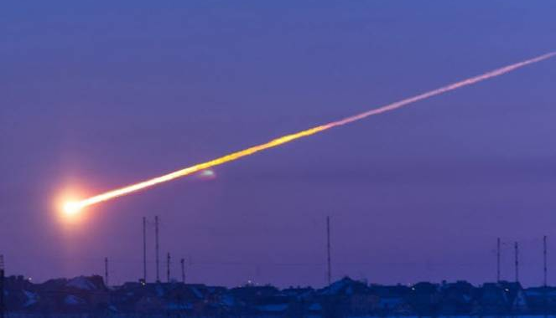
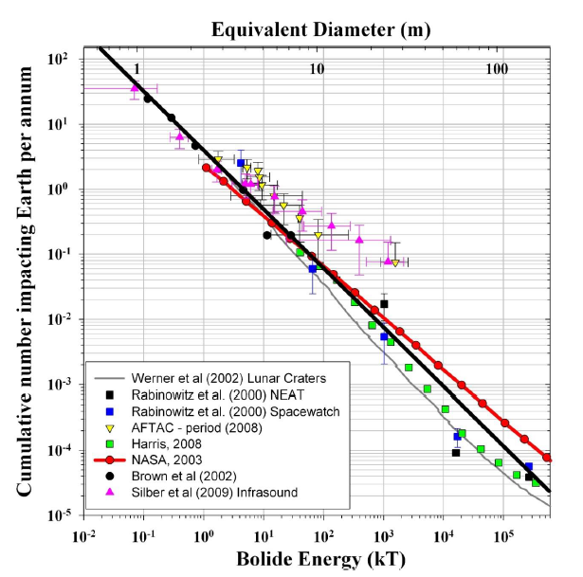
Introduction
Meteoroids of various size continuously enter the Earth’s atmosphere with velocities of a few tens of km/s and with a rate which reversely scales with their size.
Their supersonic flow through the air produces cylindrical shock waves. In the final phase of their fall, meteoroids can fragment, due to the dynamic pressure: each fragmentation episode generates spherical blast waves. Both the wave types are inverted into infrasound with the propagation.
Cylindrical shock waves
Spherical blast waves
Chelyabinsk
1 kt= 4,184 TJ
Please do not use this space, a QR code will be automatically overlayed
P1.4-482
[Silber et al., 2009]

Slide 3
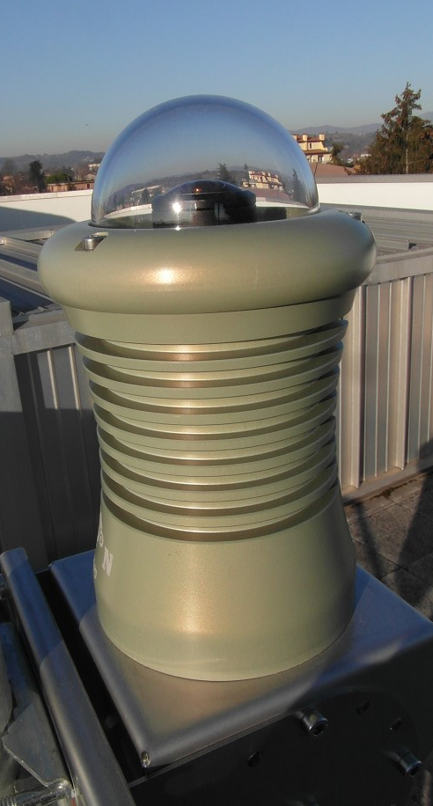
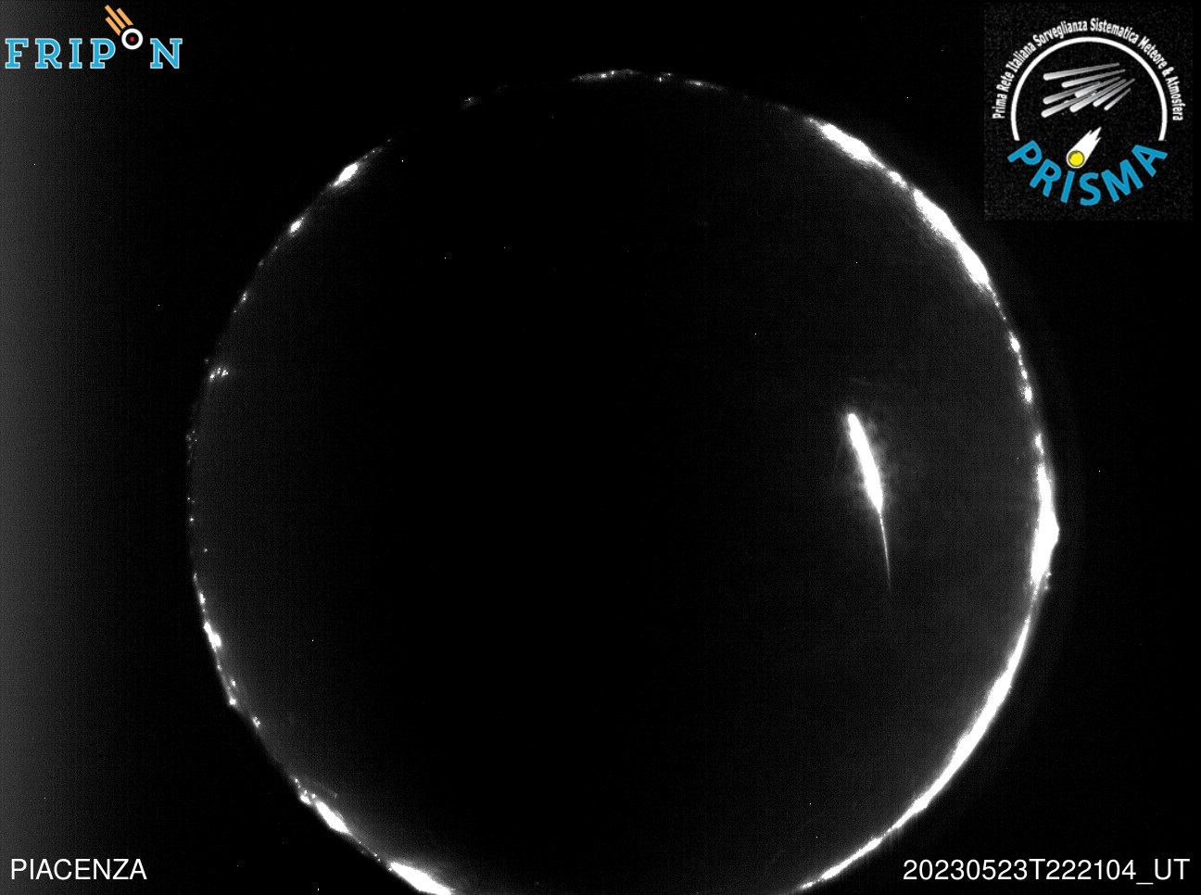
Objectives
Meteoroid observation is traditionally performed with all-sky cameras. This observation is possible only by night and with clear sky.
The use of infrasonic can provide a more complete fireball dataset, providing more details on optically-detected events or also identifying events when the traditional optical observation is prevented.
Several studies has already been carried out on the infrasonic analysis of large fireball events. Less energetic but more frequent events are instead less studied.
This study aims to investigate the potential of a synergetic use of networks of both all-sky cameras and infrasonic arrays to detect and characterize small fireball events.
Please do not use this space, a QR code will be automatically overlayed
P1.4-482

Slide 4
Methods/Data
We identified 14 fireball events recorded both with multiple all-sky cameras of the PRISMA meteor surveillance network and with an infrasonic array of the University of Florence. The events are optically characterized in terms of 3D-trajectory, initial velocity, size and mass and kinetic energy. Rather small fireballs: initial mass < 4.3 kg and initial
diameter < 13.5 cm (for comparison, Čeljabinsk: mass $\sim$10,000 t and diameter $\sim$15 m). Infrasonic signals are analysed with array processing techniques. The infrasonic wave parameters obtained with a single array are used to locate the source with a 2D ray-tracing, using the exact time of the event provided by all-sky cameras (Belli et al., 2021).
PRISMA all-sky cameras:
Please do not use this space, a QR code will be automatically overlayed
already working
deployment phase
purchasing phase
under repair
Infrasonic array (UNIFI)
P1.4-482

Slide 5
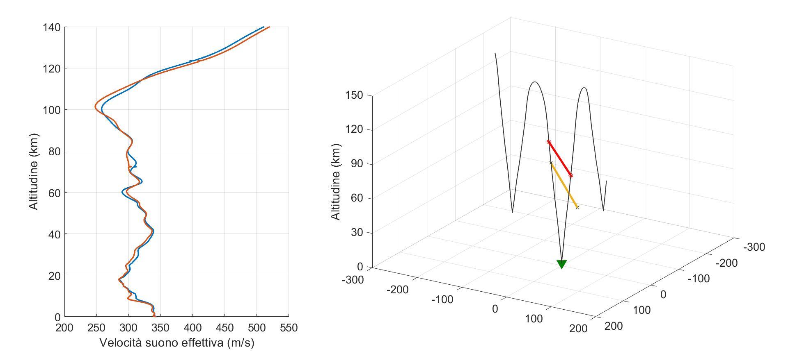
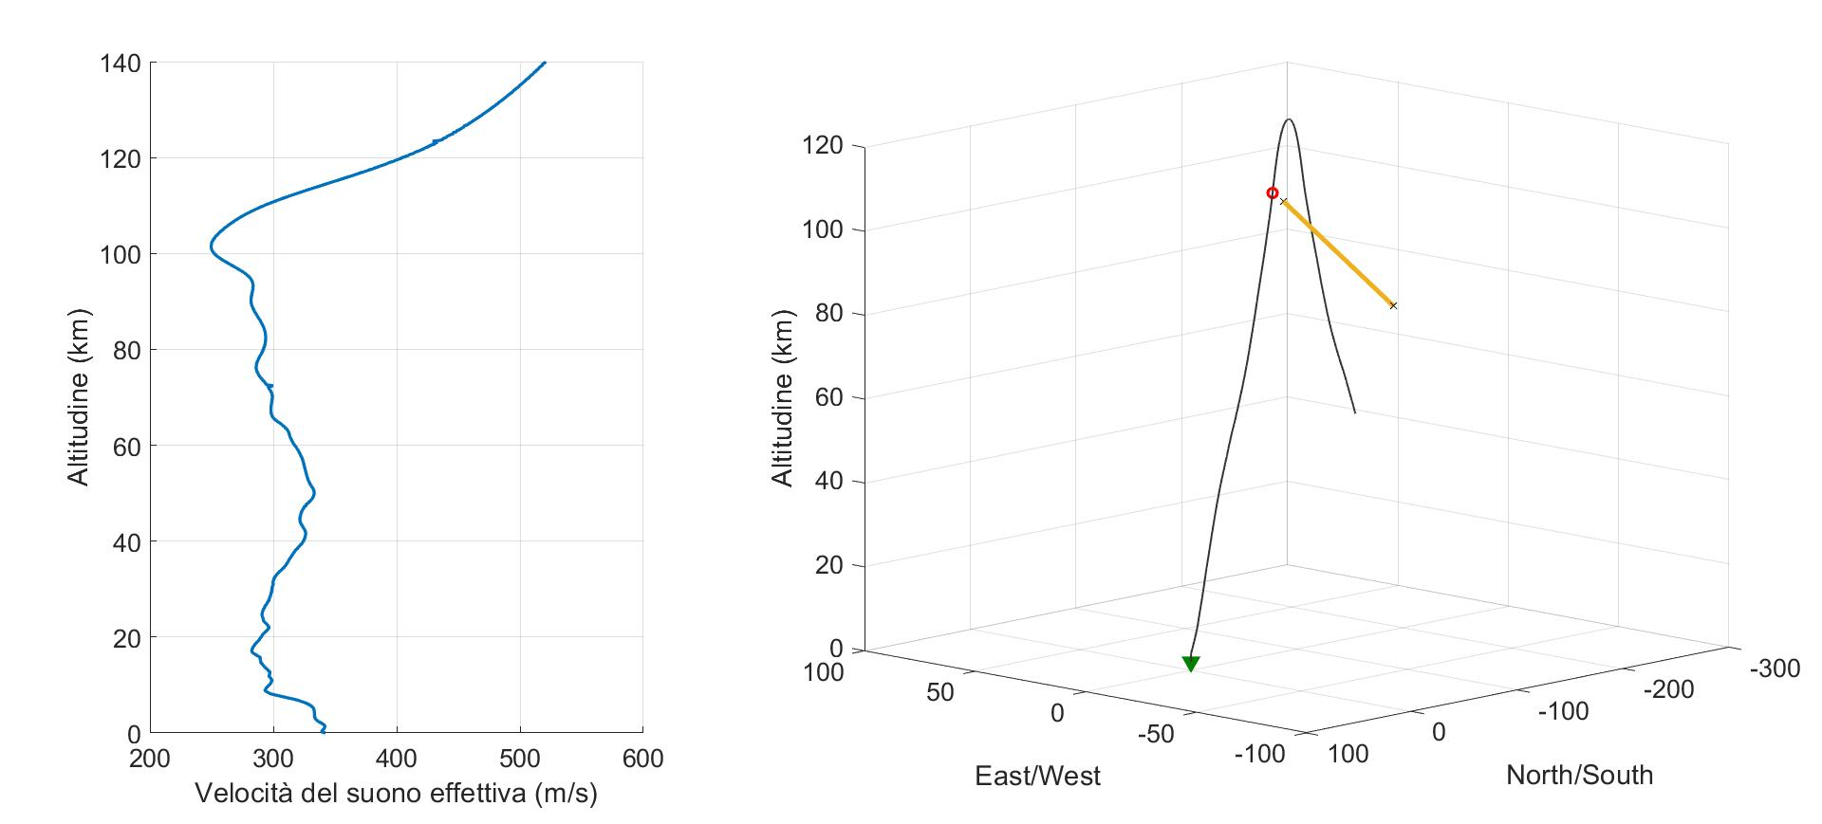
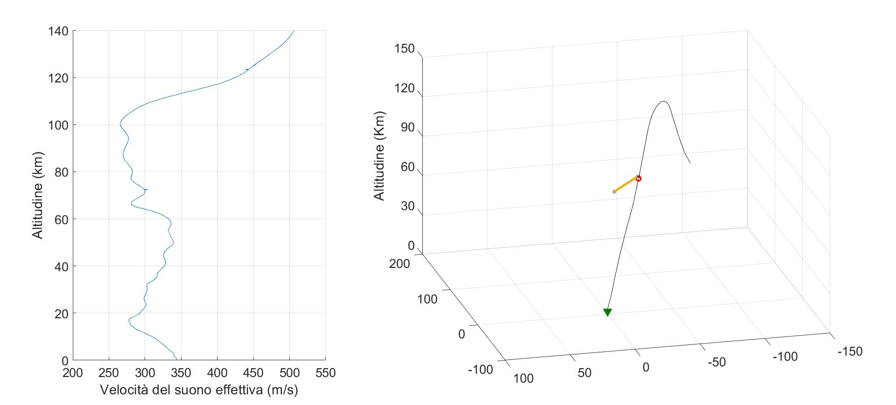
Results
Fireball event on 15 April 2018
Fireball event on 22 April 2018
Fireball event on 11 September 2018
Altitude (km)
Altitude (km)
Altitude (km)
Distance EW (km)
Distance EW (km)
Distance NS (km)
Distance EW (km)
Distance NS (km)
Distance NS (km)
Results show a good agreement between the optically determined fireball trajectories (orange) and the infrasound-based source localisations (red).
All recorded signals are direct arrivals.
Lot of uncertainties remain when the infrasonic pressure recalculated at the source (corrected just for geometrical spreading) is compared with the fireball kinetic energy determined with the analysis of all-sky camera images.
?
Please do not use this space, a QR code will be automatically overlayed
P1.4-482

Slide 6
Conclusion
The analysis highlights the high potential of an integrated network of both all-sky cameras and infrasonic array for the meteoroid surveillance and detection.
Infrasonic records allow to locate a bolide using data from a single array, the atmospheric specifications at the time of the event and the event timing provided by an all-sky camera. This allows to locate an event recorded only with a single all-sky camera and one infrasonic array.
Fireball event on 22 August 2018
Altitude (km)
Distance NS (km)
Distance EW (km)
Open questions remain in estimating the energy of smaller fireball events based on infrasound records.
Not enough events in our database.
The simple correction for the geometrical spreading may not be sufficient.
Probable importance of other parameters: altitude of the meteoroid fragmentation (different air pressure), size of the meteoroid and its velocity.
Lots of work still to do!
Please do not use this space, a QR code will be automatically overlayed
P1.4-482

