Slide 1
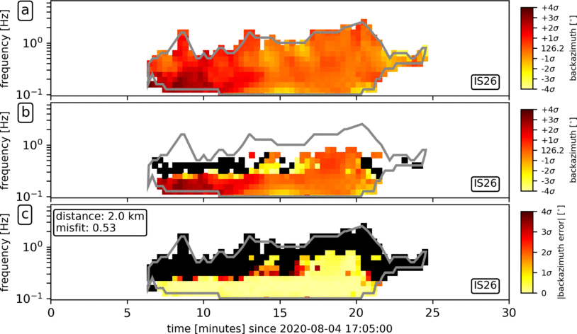
On the infrasound emission generated by wind turbines
Isolating Beirut explosion‘s signals at IS26 and IS48 by subtracting bg noise
Studying influence on detction capability using PMCC by considering the reference signal (coherent infra- sound) and WT-signals (incoherent infdrasound) recorded at a large wind farm (48 MW) at distances up to 4.5 km
reference signal + bg noise (top)
reference signal + bg noise + WT-signal (middle)
reduced coherency (bottom) – black areas = no coherency
here: intermediate wind speed and p50
Lars Ceranna, Peter Gaebler, Gernot Hartmann, Patrick Hupe,
Christop Pilger & Andreas Steinberg
Federal Institute for Geosciences and Natural Resources (BGR)
P1.4-112

