Slide 1
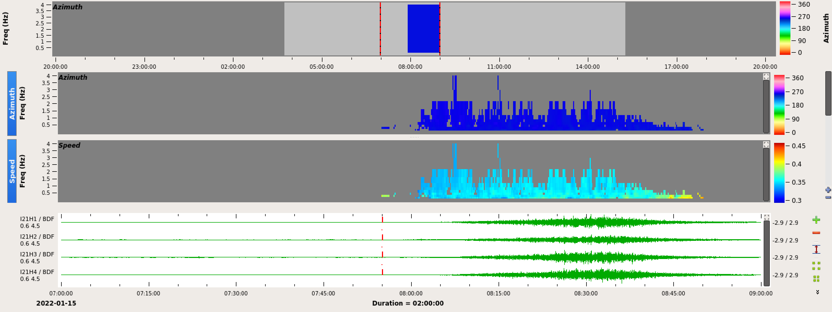
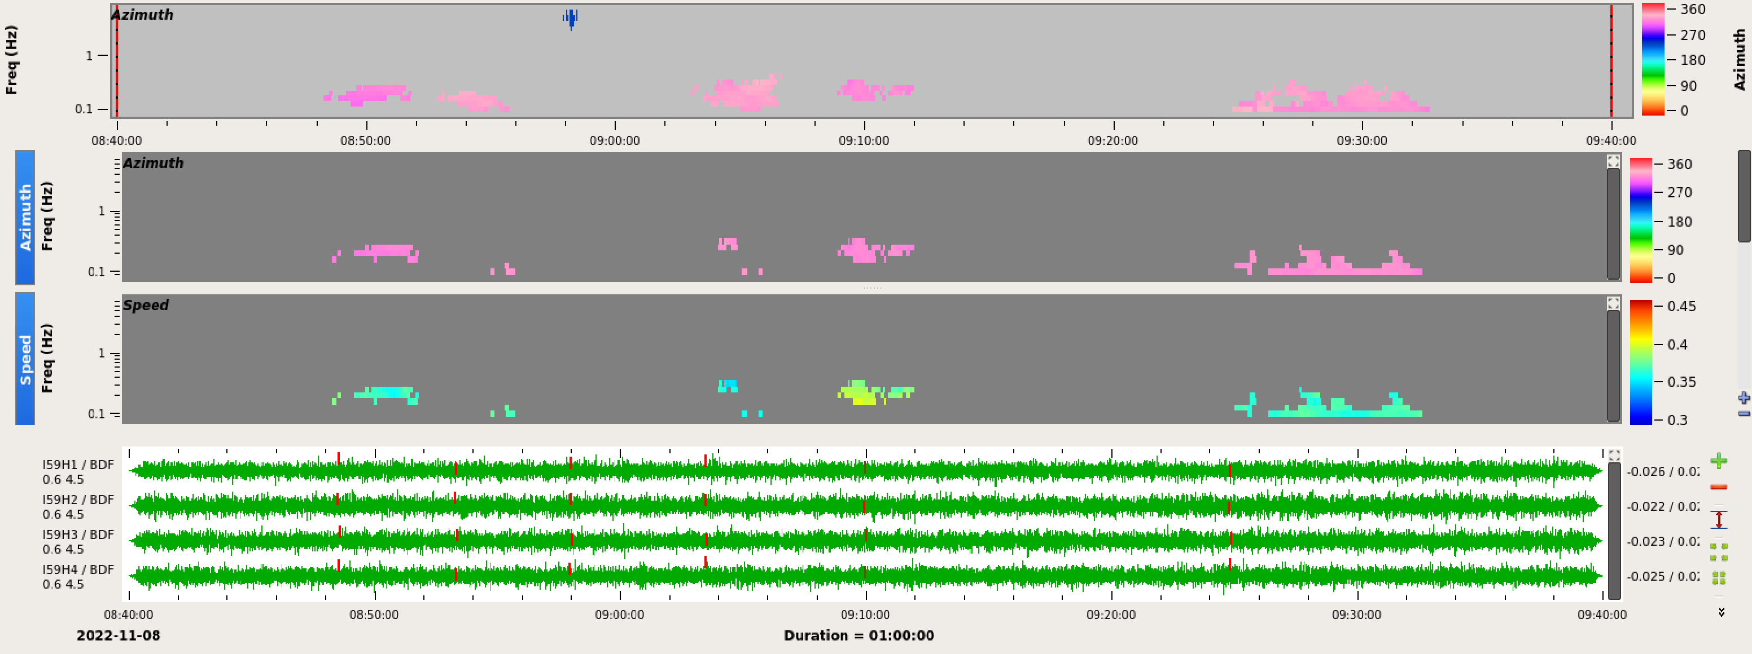
Data Analysis of the Hunga-Tonga-Hunga-Ha’apai Eruption and Mauna Loa Eruption with Three International Monitoring System Technologies
Yasameen Hameed Shamkhi
Iraqi National Monitoring Authority (INMA)
P1.4_792
The potential of a joint work CTBTO-NDCs is enormous and use the IMS data and International Data Centre (IDC) products for scientific and civil application vast.
The three IMS technology was able to detect the Eruption of the Hunga-Tonga volcano and Mauna Loa eruption .We used IDC products to characterize it.
Eruption of the Hunga-Tonga volcano on 15-01- 2022
Mauna Loa eruption on 28-11- 2022
It would be my pleasure to invite you to attend my e-poster presentation during sessions P1.4 on this date
P3.5-529

