Slide 1
Data Analysis of the Hunga-Tonga-Hunga-Ha’apai Eruption and Mauna Loa Eruption with Three International Monitoring System Technologies
Yasameen Hameed Shamkhi
Iraqi National Monitoring Authority (INMA)
This work is about the eruption of the Hunga-Tonga-Hunga-Ha’apai volcano on 15 January 2022 and Mauna Loa eruption 28 November 2022 at 08:56 UTC with data 3 IMS technologies of CTBTO.
We use the REB-LEB bulletins from IDC analysis, and we use data from Infrasound, Hydroacoustic and seismic IMS stations around of the events locations and we use the tools from NDC-in-a-box for NDCs.
Different IMS monitoring techniques were identified, detected and correlated to be analyzed in this investigation and to have a location of the events with NDC-in-a-box tolos.
With the analysis of the events, the importance of the use of IMS monitoring technologies for the NDCs is demonstrated .
The detection capability of the infrasound IMS stations is very good.
Please do not use this space, a QR code will be automatically overlayed
P1.4-792

Slide 2
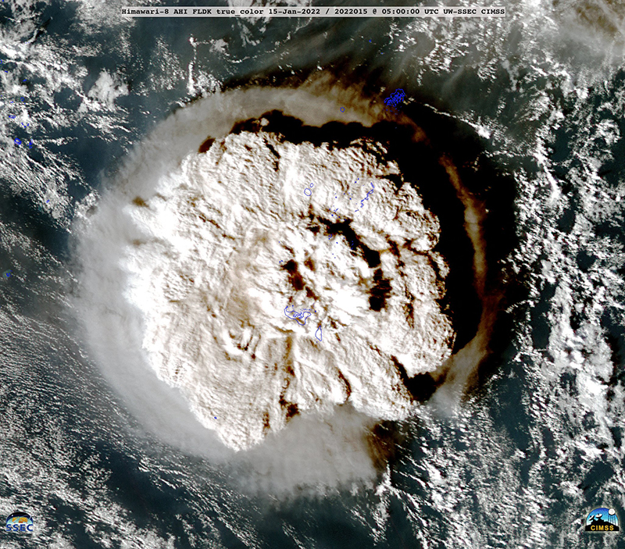
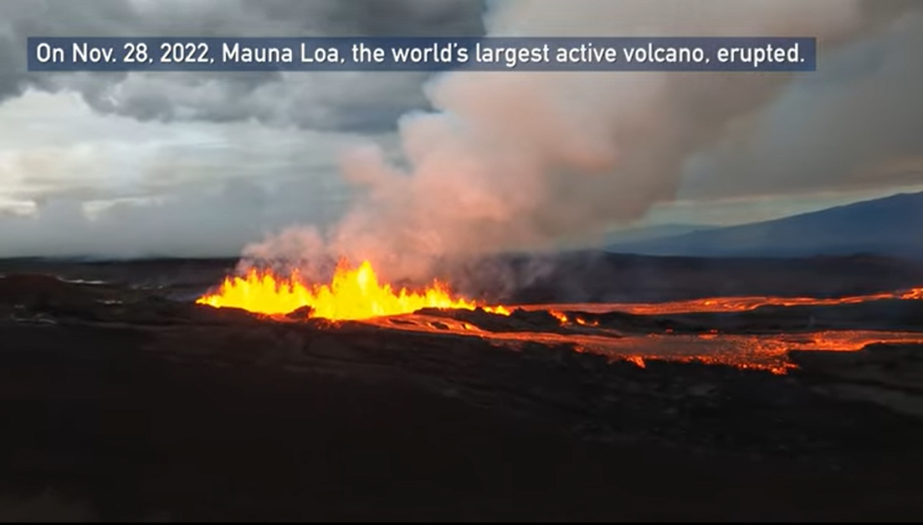
Introduction
The eruption of the Hunga-Tonga-Hunga-Ha’apai volcano on 15 January 2022 was the largest recorded since the eruption of Krakatoa in 1883. The eruption triggered tsunami waves of up to 15m which struck the west coast of Tongatapu, ‘Eua and Ha’apai.
In this work we analyze data of this event with magnitude mb 4.2 at 04:14:59 UTC, was detected by the 3 IMS (International Monitoring System) technologies, which is carried out in this work is the inclusion of the data analysis with the HA11 and HA03 hydro-acoustic stations with the integration of the location of the event with the seismic and infrasound data of the stations close to the event. In addition, we analysis of signals related to Mauna Loa eruption from infrasound, seismic and hydroacoustic IMS stations detected an event located in Hawaii, USA, 28 November 2022 at 08:56 UTC.
Please do not use this space, a QR code will be automatically overlayed
P1.4-792
Eruption Hunga-Tonga. Source: CIMSS
Eruption Mauna Loa. Source: https://www.nesdis.noaa.gov

Slide 3
Objectives
Understand the origin of the events and type of data to use.
Use seismic, infrasound and hydroacoustic data from IMS and access to NDCs.
Carry out data analysis with the tools provided in the NDC-in-a-BOX accessible to all member states and their users.
Have results closer to the IDC reports as referenced by the REB-LEB bulletin .
Make use of the 3 monitoring technologies with the different waveforms and differentiate between the different types of events.
Please do not use this space, a QR code will be automatically overlayed
P1.4-792

Slide 4
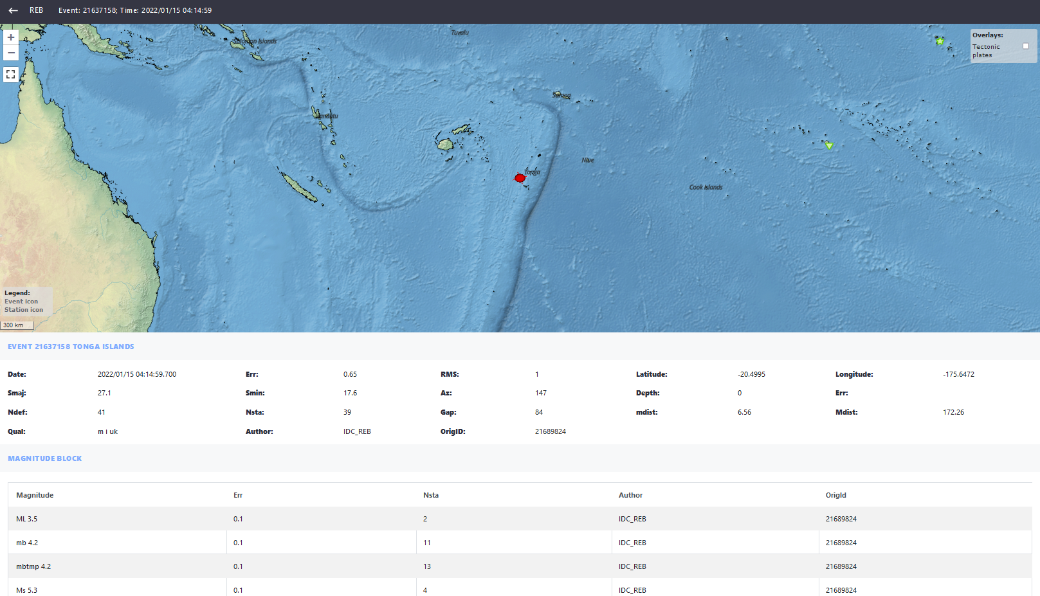
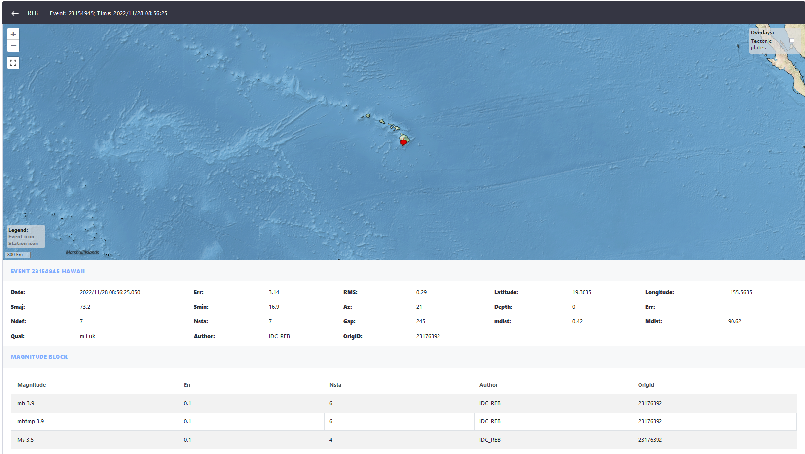
Methods
We use for this data analysis the tools for NDCs such as Geotool and DTK-GPMCC and in addition to listing the REB and LEB Bulletins with the analyzed data. For this work, data from the 3 IMS monitoring technologies were used.
Please do not use this space, a QR code will be automatically overlayed
Eruption of the Hunga-Tonga volcano on 15-01- 2022 (mb 4.2 at 04:14:59 UTC)
REB Bulletin
Mauna Loa eruption on 28-11- 2022 (mb 3.9 at 08:56 UTC)
REB Bulletin
P1.4-792

Slide 5
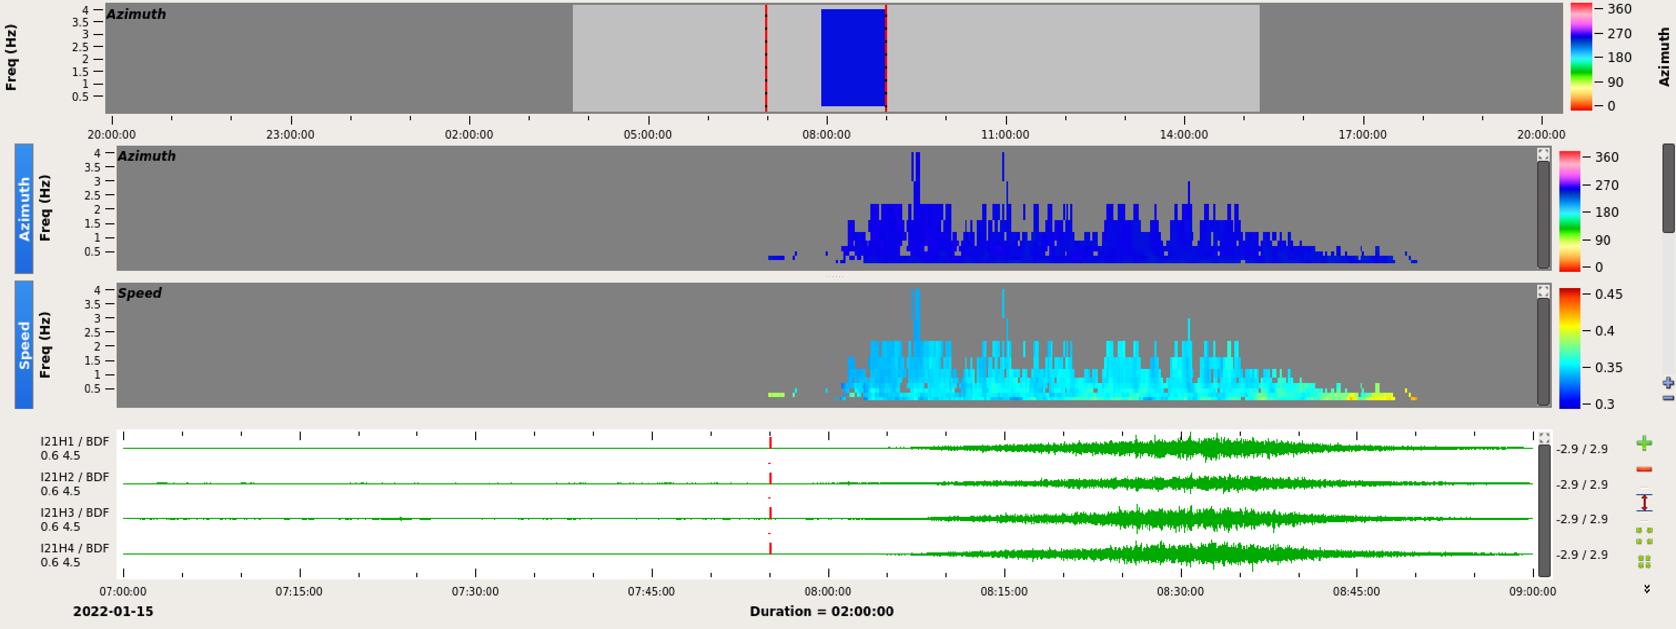
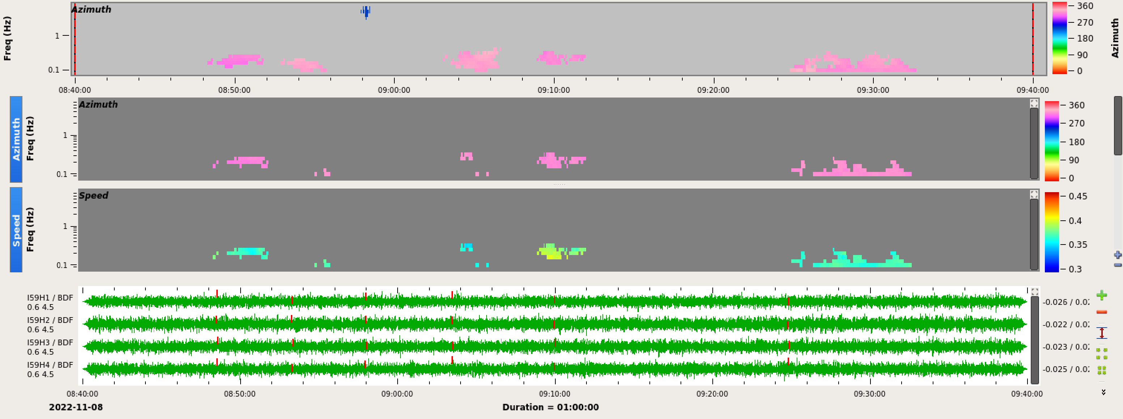
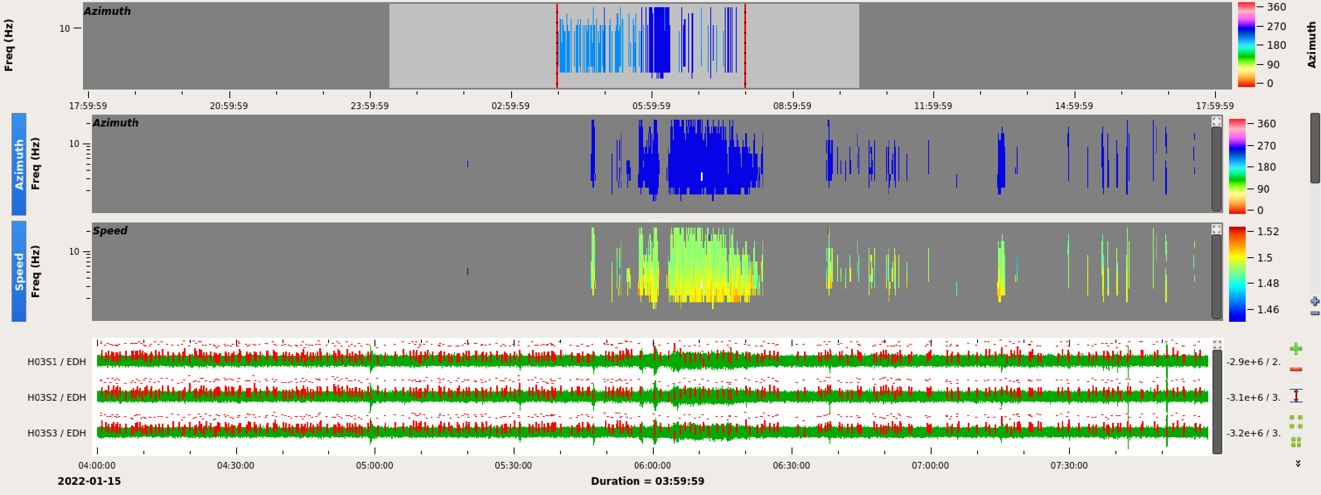
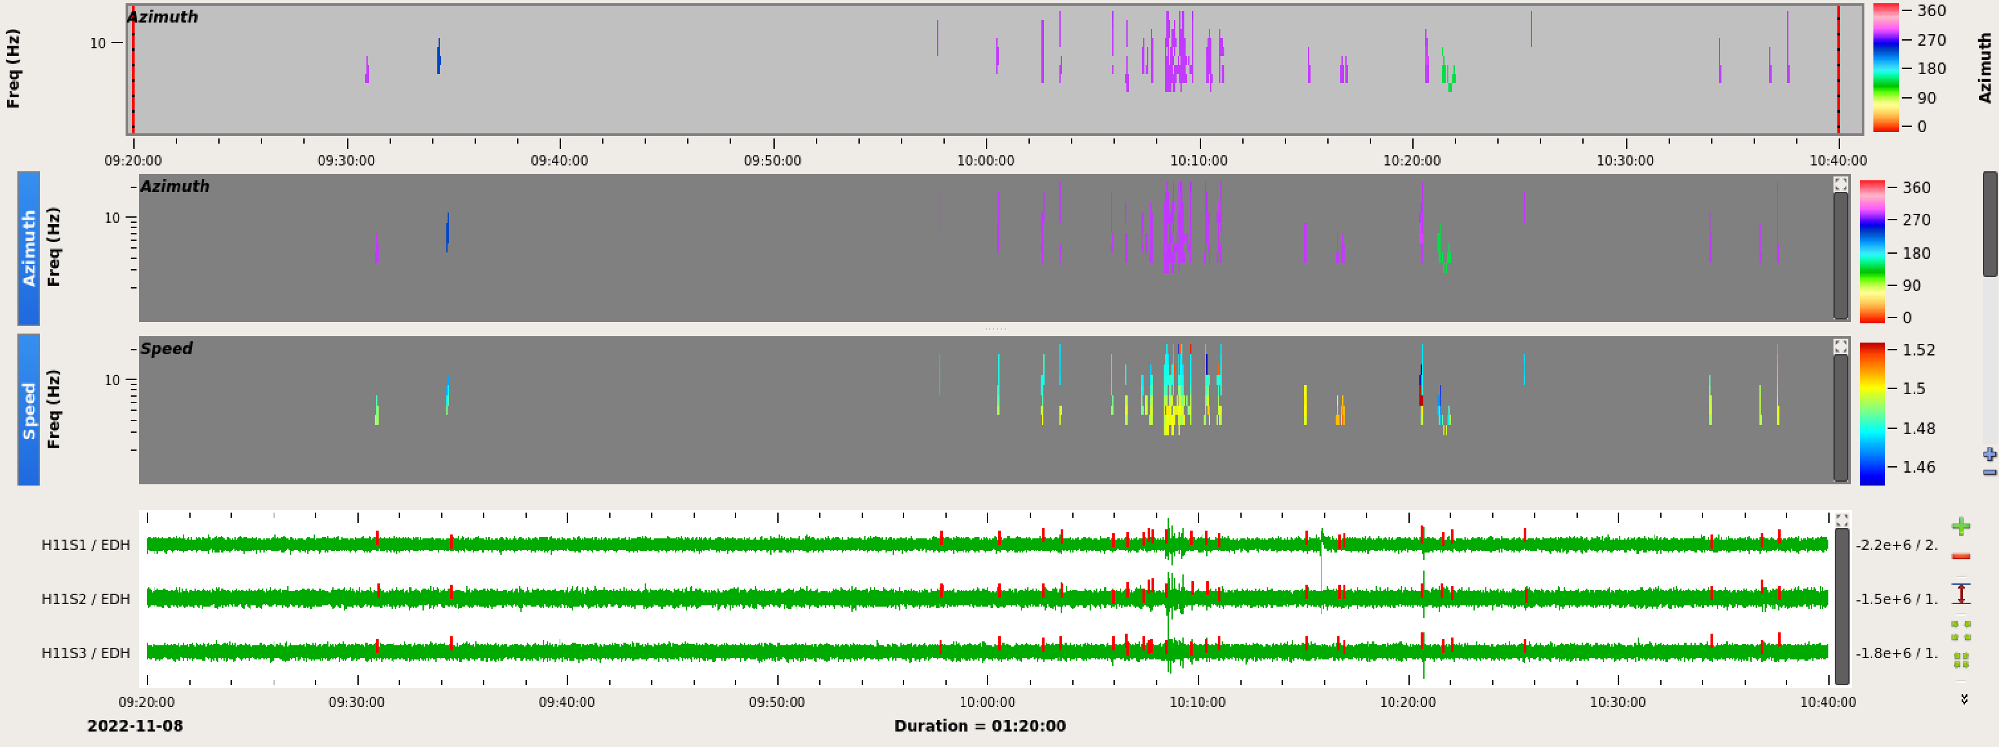
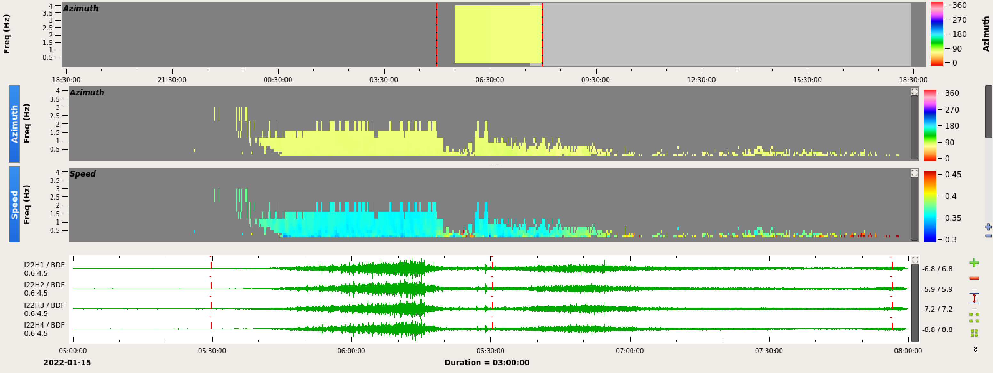
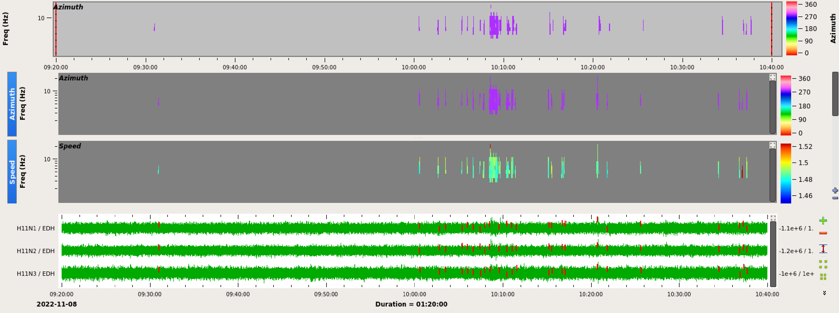
DATA (SHI stations)
Eruption of the Hunga-Tonga volcano on 15-01- 2022
Mauna Loa eruption on 28-11- 2022
I21FR
I59US
H03S
H11S
Please do not use this space, a QR code will be automatically overlayed
I22FR
P1.4-792
H11N

Slide 6
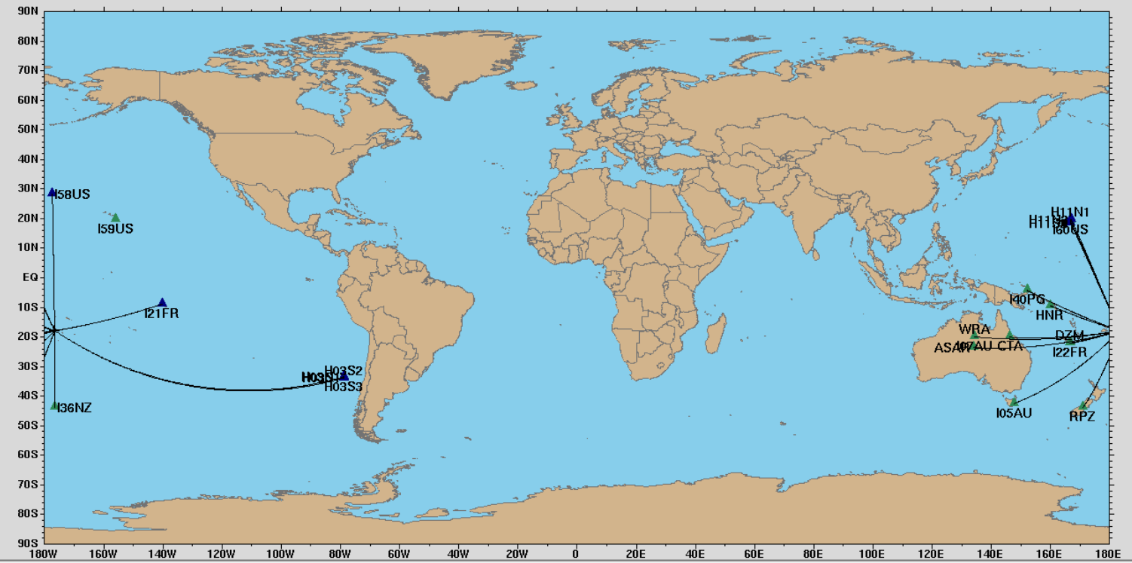
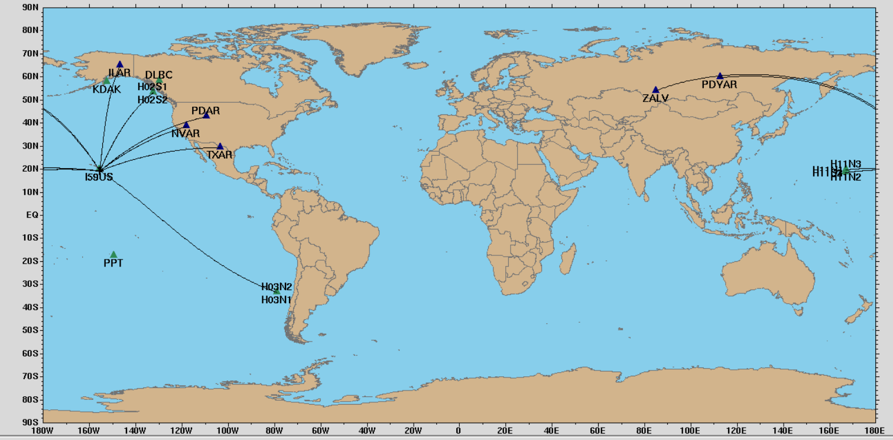
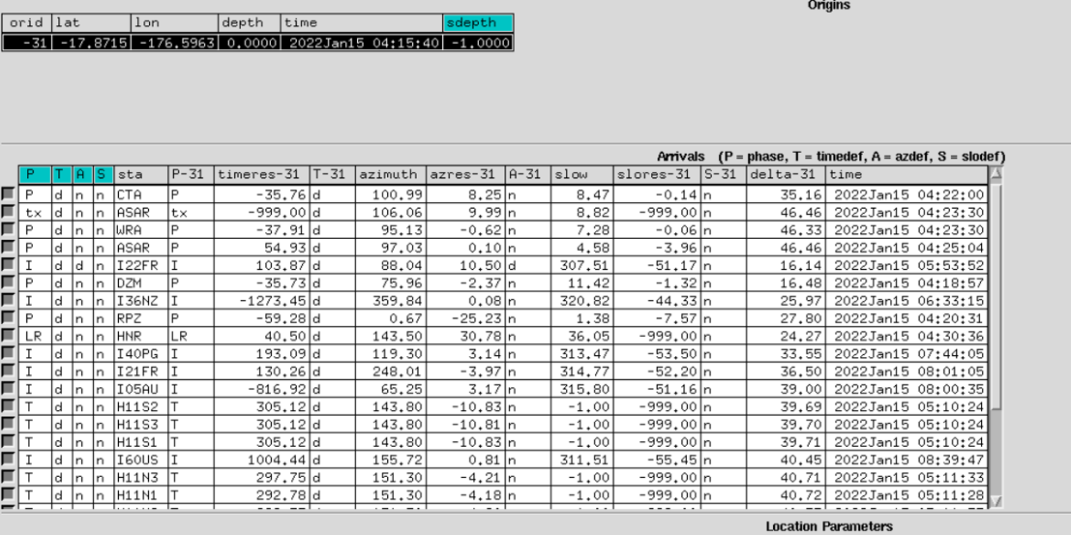
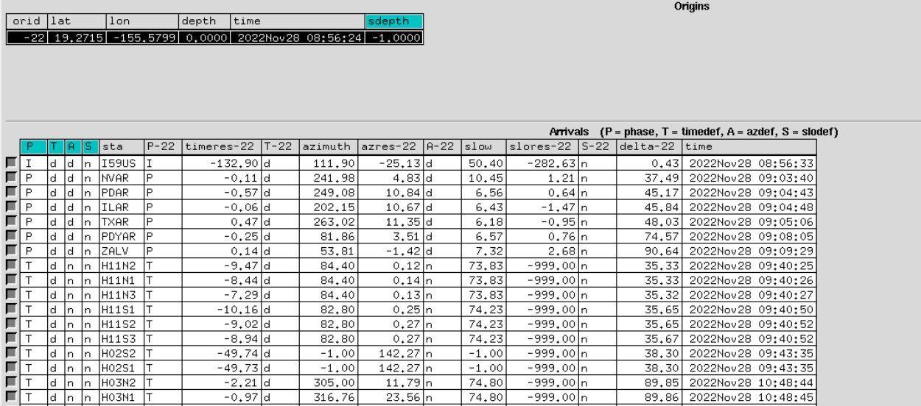
Results
Eruption of the Hunga-Tonga volcano on 15-01- 2022
Mauna Loa eruption on 28-11- 2022
Please do not use this space, a QR code will be automatically overlayed
P1.4-792

Slide 7
Conclusions
It is possible to verify the use of data by NDC Iraq for events that involve detection through the 3 IMS-IDC monitoring technologies.
It was possible to correlate the REB-LEB bulletins with the analysis of the waveforms of the 3 monitoring technologies.
The detection capability of the infrasound IMS stations is very good.
Analyzing infrasound waves from such events provides a location and in some cases estimate of the origin time of the source.
The IMS hydroacoustic network is unique in a global scale in terms of spatial and temporal coverage of the oceans .
Please do not use this space, a QR code will be automatically overlayed
P1.4-792

