Slide 1
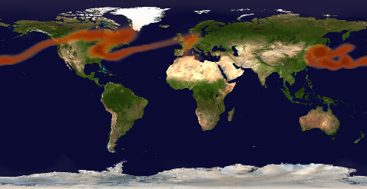
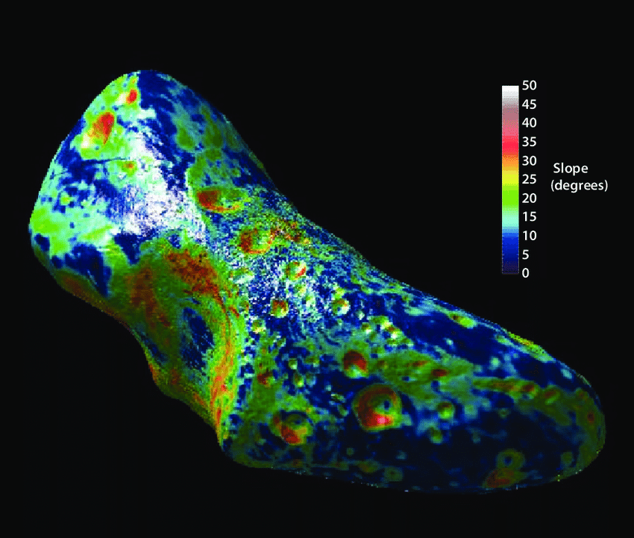
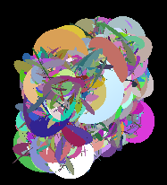
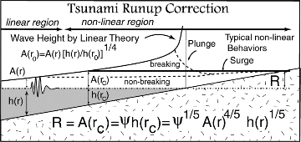
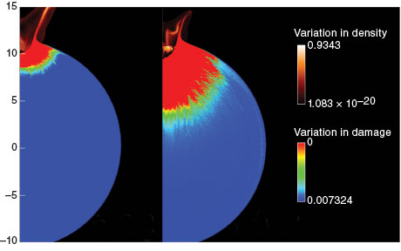
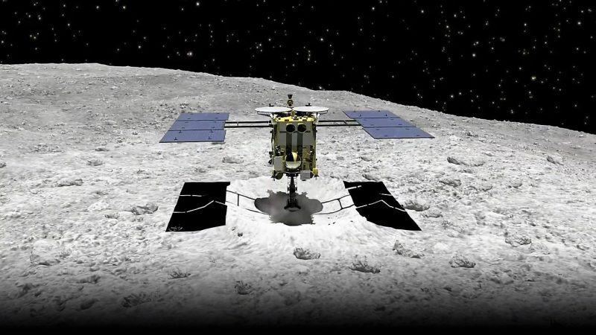
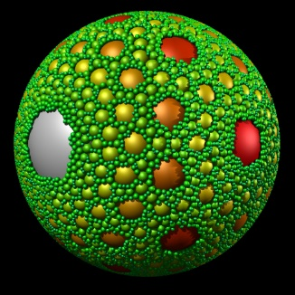
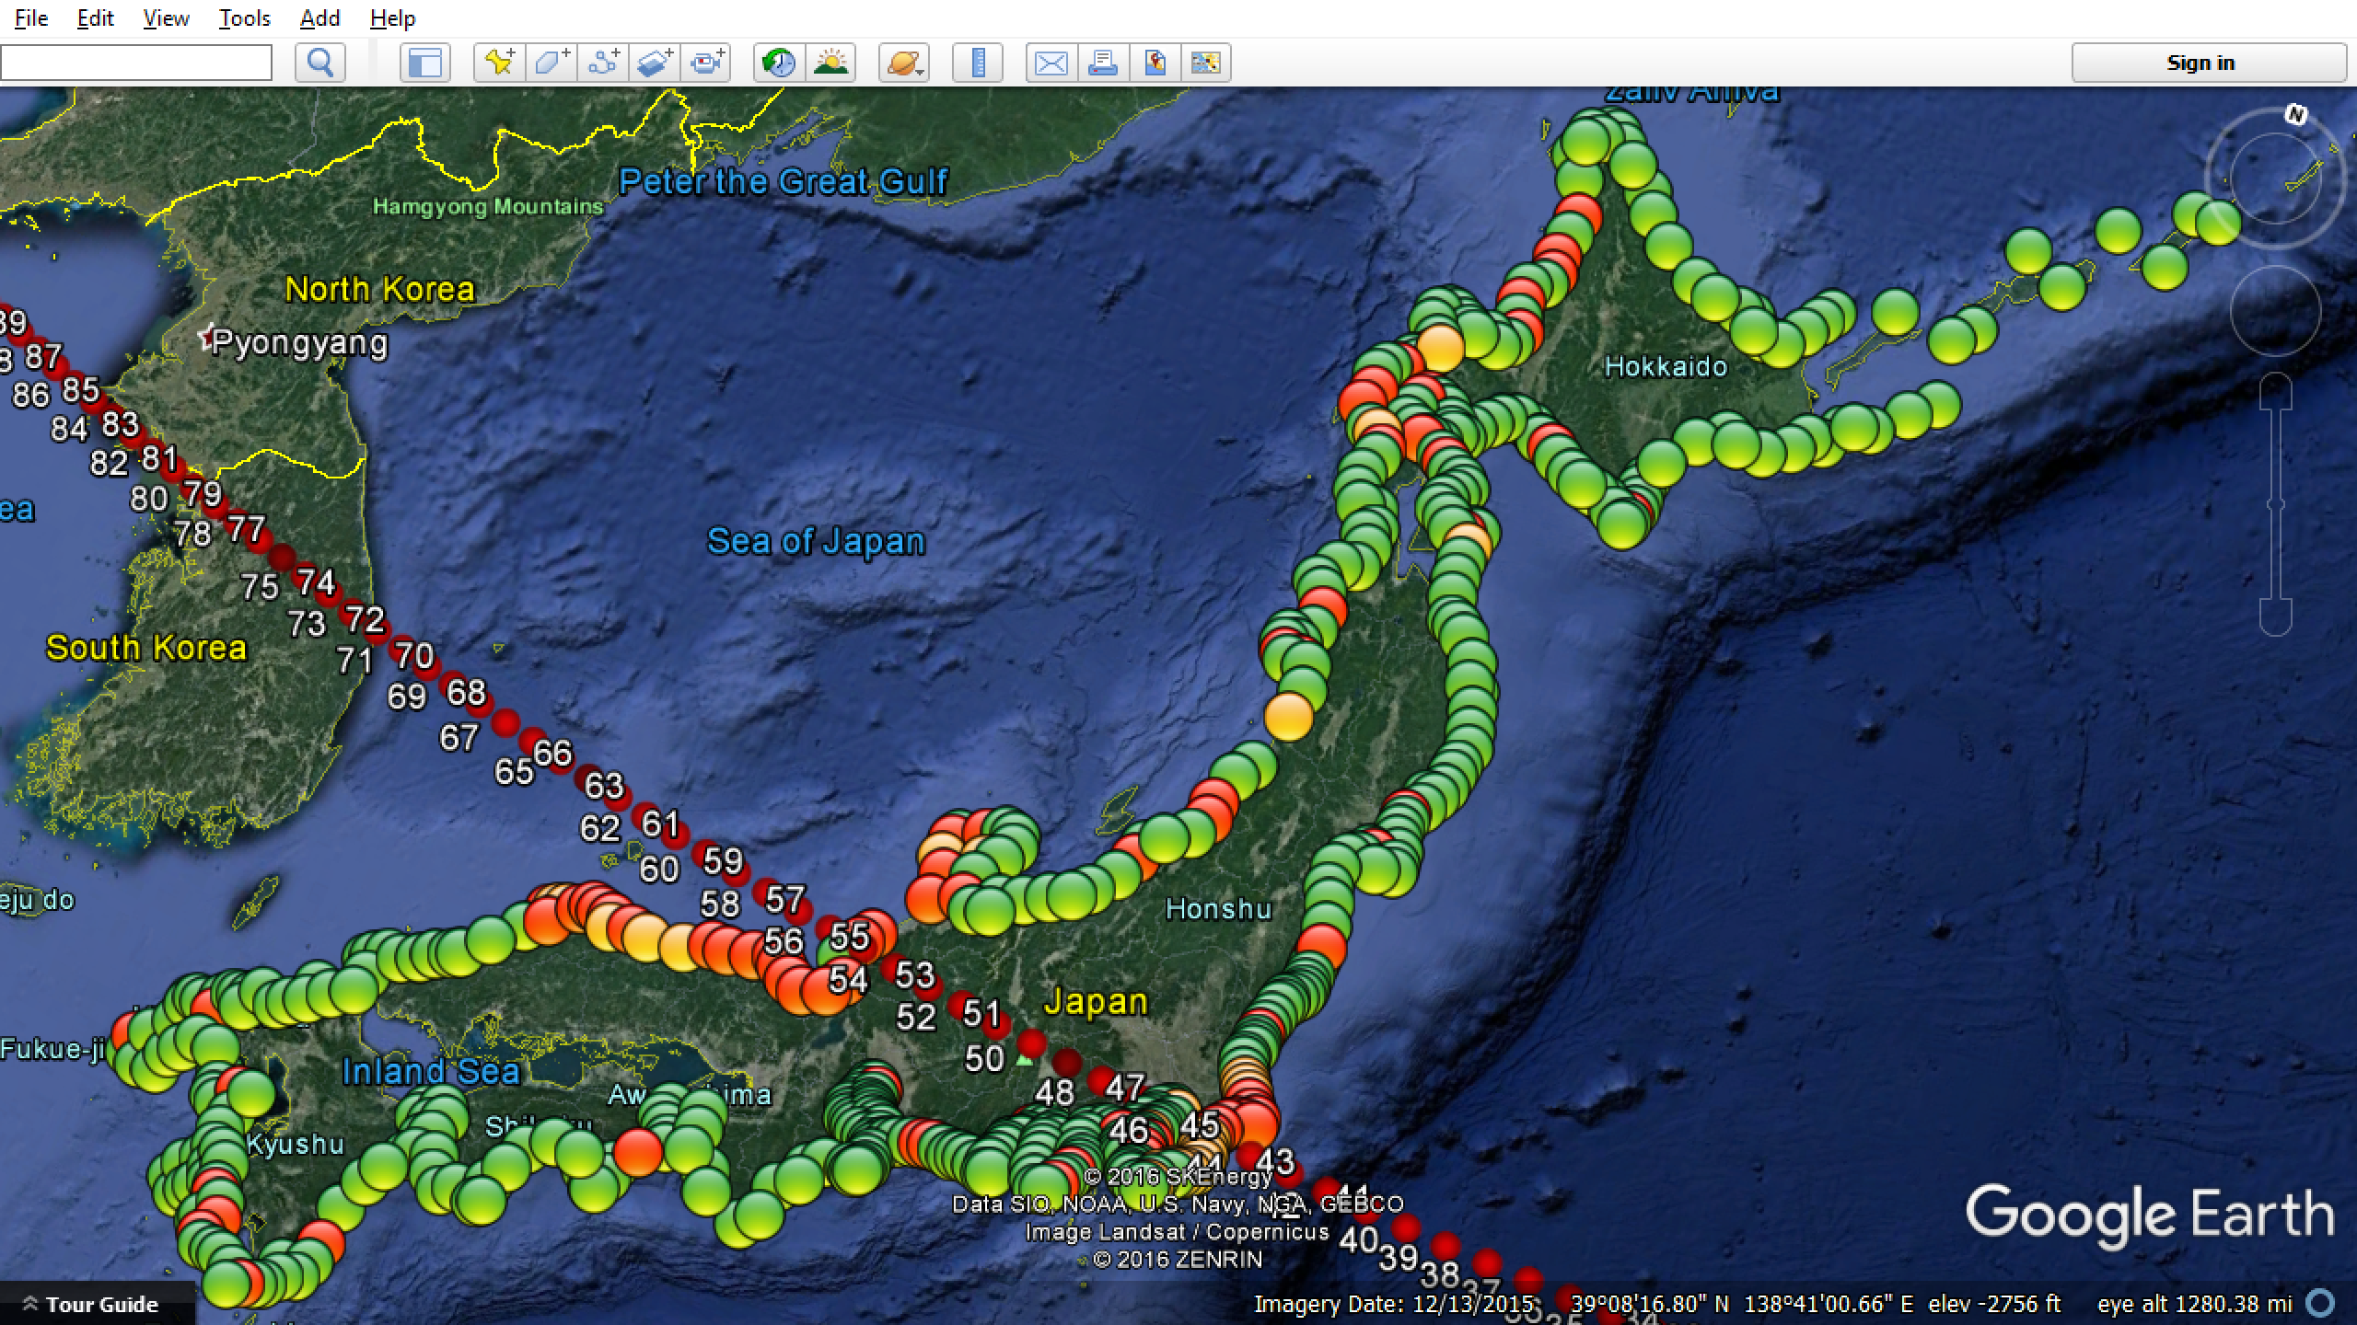
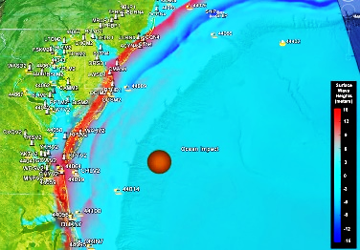
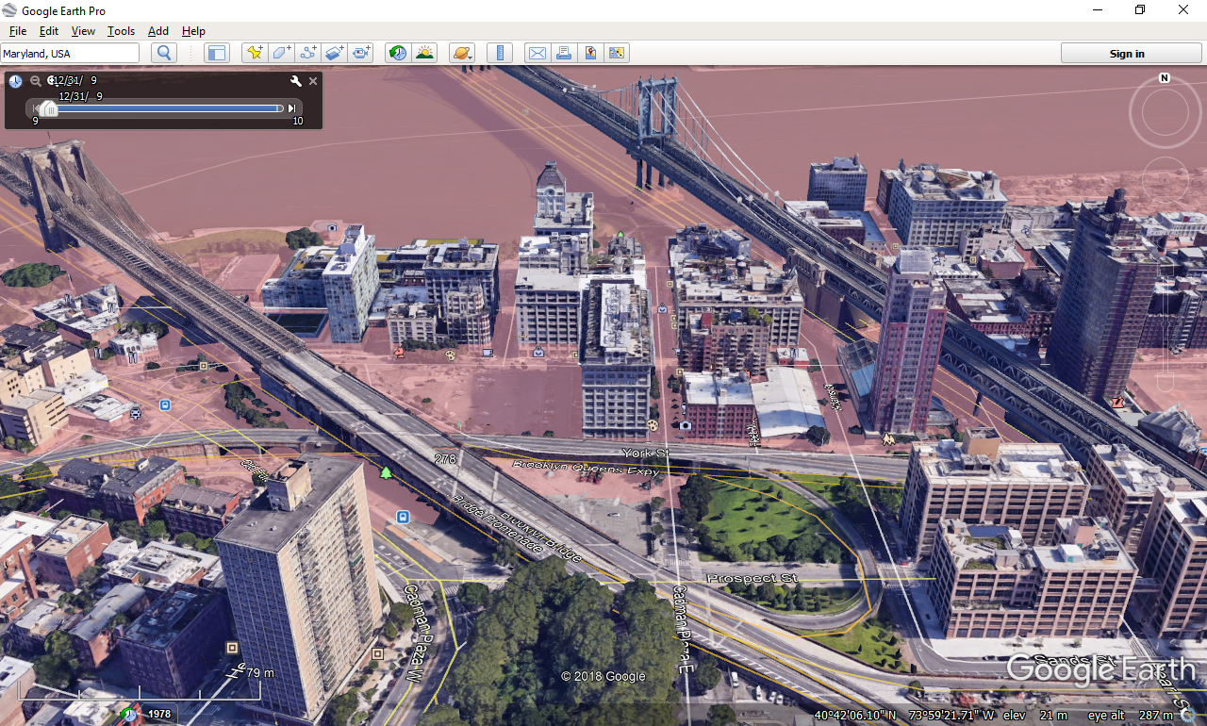
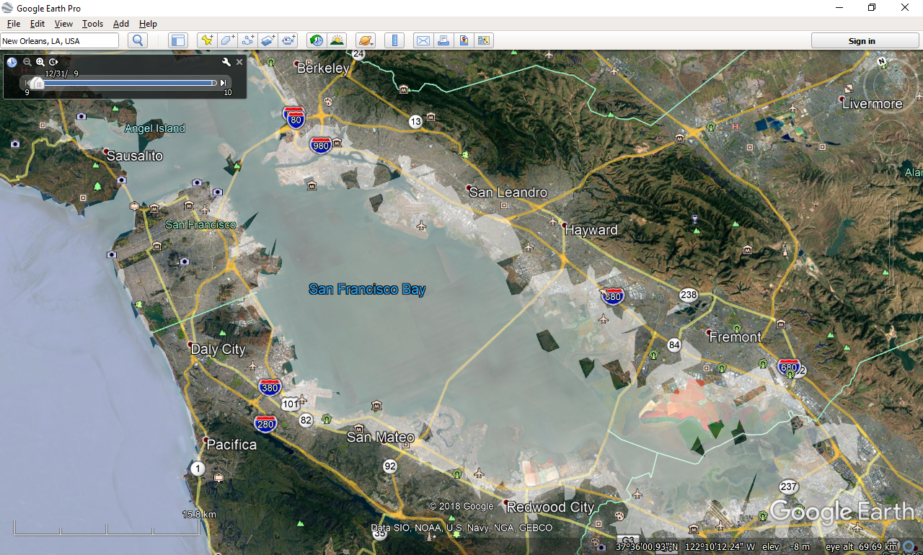
End-to-end numerical simulation of a bolide’s reentry, impact, cratering,
fireball and cloud generation
S. Ezzedine, M. Syal, D. Dearborn, P. Miller
Lawrence Livermore National Laboratory
P1.4-272
We report on advances in end-to-end numerical simulation of bolides impact on either solid earth or ocean surfaces and their consequences on local and global scales. The first-ever framework has been developed on LLNL’s HPC clusters and has been applied to support FEMA.
Our goal is to extend and apply the simulation framework to the CTBTO missions.
Global climate effects
(Collaboration with
L. Oman/GSFC/NASA)
Structural and material
characterization
Numerical
simulations
GEOSCCM
Analytical
Geodyn
Global Climate Effects
Rim breakup
Vapor
Air
Salt water vapor
dissociates into chlorine
which reacts with oxygen
and bromine and
Destroys the
stratospheric
ozone
Water rims
StoTran
Only 15 to 25% of the energy
is “impact” energy the rest is mainly
used to a) vaporize the asteroid and ocean
and b) create wind and shear wave.
Stochastic Fractures
ALE3D
Chemical Speciation
Ocean depression
Ocean
Remote Sensing
Characterization
Hydrodynamics
Water Waves
W2Bi.py
Landing Missions
Stochastic Packings
Coastlines Impacts
Ground
impact &
effects
Asteroid
Atmosphere
Ocean
Coastline & infrastructure consequences
Ocean floor
This work was done by Lawrence Livermore National Laboratory (LLNL) under award number DE-AC52-06NA25946.

