Slide 1
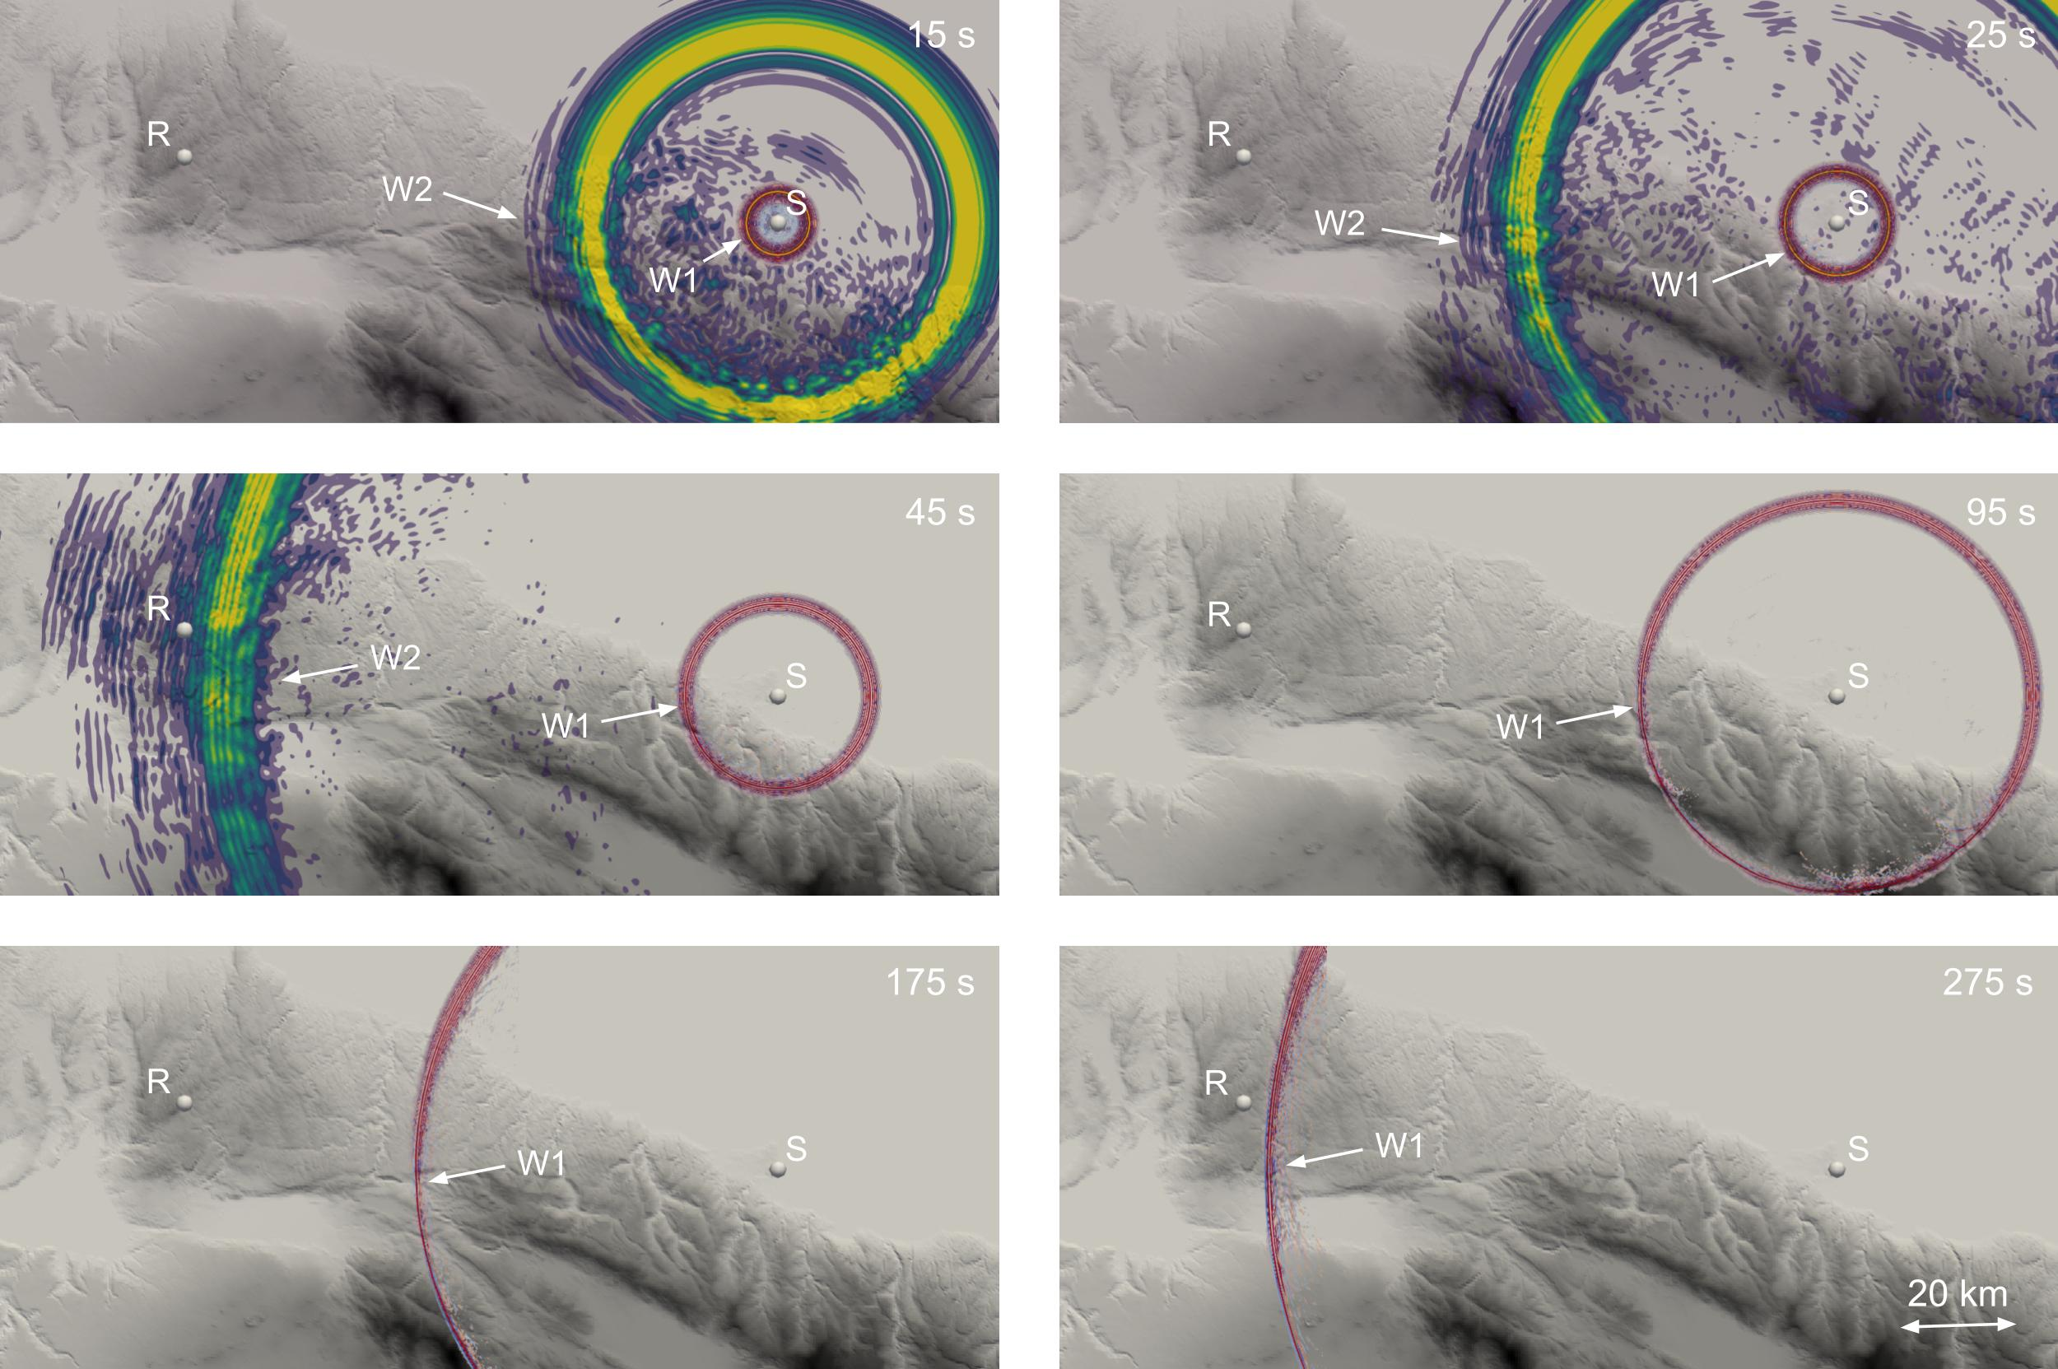
Seismoacoustics wavefield generated by the Beirut explosion: an application of the Unfitted HDG method to yield estimation
G. Burgos, L. Guillot, O. Gainville, J. Vergoz, R. Mottier
CEA/DAM/DIF, France
P1.4-795
Empirical-based studies on Beirut explosion bring estimations of the yield between 0.1 and 2kT (eq. TNT);
Our goal is to show that simulating the seismoacoustic wavefield using a propagation-based method and 3D a priori information (weather model, topographical features and 3D seismic model) we get a sharper estimation for yield;
Here the direct solver is a classical one (3D-spectral-element), not an hybrid, unfitted HDG method as claimed in the abstract.. But it does the job very well!
Although our yield estimates depend on blast models, we get quite coherent values of 0.3 kT using acoustic data, and 1 kT using seismic ones. Results strongly depend on the existence of a tropospheric waveguide, and as sush, on the weather model.

