Slide 1
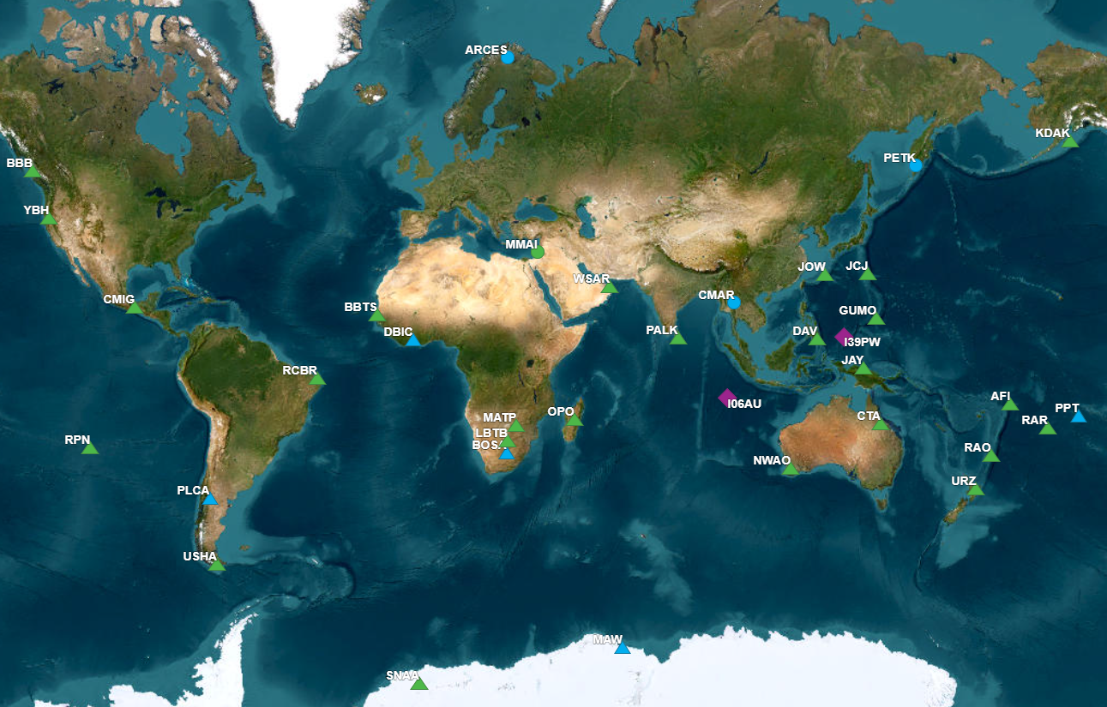
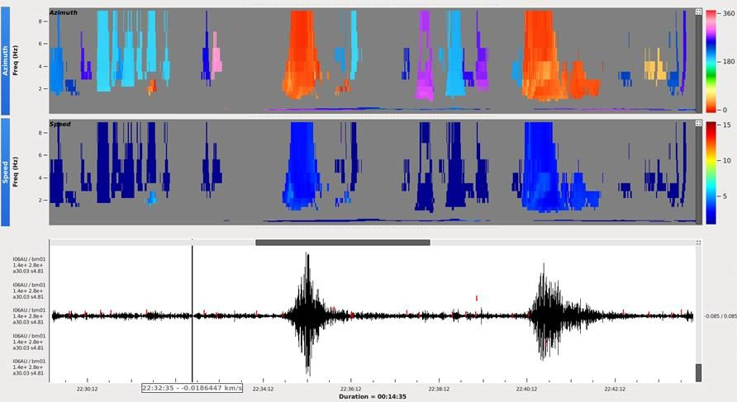
Hydroacoustic Signals Converted at Coastal International Monitoring System Stations
Paulina Bittner, Ali Kasmi, Sherif Ali, Marcela Villarroel, Ivana Jukic
CTBTO Preparatory Commission
[Author name goes here / Font: Arial Size: 18]
Affiliation / Organization / Company / Institute [if any / Font: Arial Size: 14]
P1.4-584
23 years of Late Event Bulletin (LEB) events were searched for T phase associations on other than hydroacoustic network
Stations which detected T phases
Example of T phases detected by I06AU
Please come to see our poster

