Slide 1
ACOUSTIC DATA ANALYSIS OF THE TONGA SUBMARINE VOLCANIC ERUPTIONS IN JANUARY 2022
U.O. Madu¹; A. Bisallah¹ and C.C. Anyaegbu¹
¹Nigeria Atomic Energy Commission, Abuja, Nigeria
A series of volcanic eruptions triggering tsunamis occurred in HTHH occurred on January 15, 2022. The violent eruption had a Volcanic Explosivity Index (VEI 5 intensity) and recorded as a 6.2 magnitude earthquake. The eruption destroyed 31 houses and caused substantial damage to another 172 houses in the Kingdom of Tonga. The death toll reported was 6, with 19 persons injured.
The IMS data analysed were obtained from IDC. Data processing was performed using GMPCC software provided by the CTBTO. The parameters studied were velocity, frequency, magnitude, azimuth
The acoustic waves associated with the event when filtered with the extended time-frequency configuration produce waves with undistorted shapes and easy to estimate amplitudes. The filtered waves were observed to have decayed over distance and had the characteristics of a surface waves propagating through the atmosphere with N shape, an indication that they are Lamb wave
The data from IMS acoustic stations (foreshock, event and aftershock) indicated that the eruptions are modest-size earthquakes of surt-seyan type. The eruption of 15 January, 2022 could also be classified as caldera in nature as a result of observed interaction of fresh magma highly charged with gas and water
Please do not use this space, a QR code will be automatically overlayed
P1.4-796

Slide 2
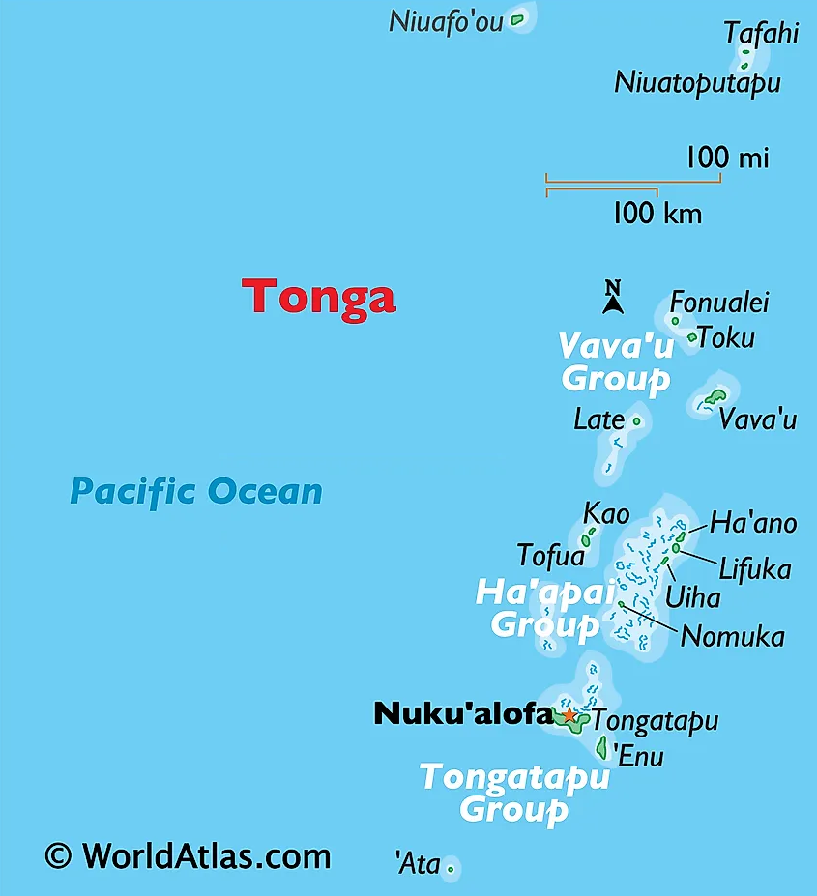
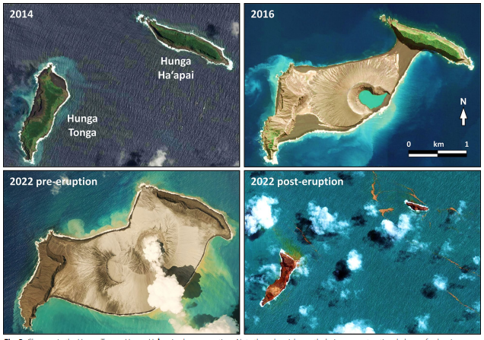
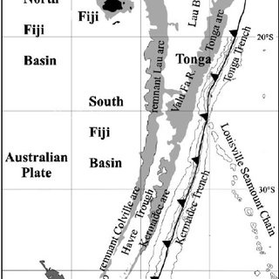
INTRODUCTION
The HTHH volcano is an active one. An eruption occurred in 2009 from 17th to 21st March generating new land to the northwest and south of Hunga Haʻapai. The volcanic activity from December 2014 to January 2015 joined Hunga Tonga and Hunga Haʻapai islets into a single island. The last eruption is from 28 December 2021 to 15 January 2022 (Fig 3).
Fig 3: Eruption history of HTHH;
Source: Terry et al., (2022)
Fig 1: Map of the Kingdom of Tonga
A series of volcanic eruptions triggering tsunamis occurred in HTHH from January 14 to January 16. The ash clouds ejected into the stratosphere by the eruption were about 40 km high (Fig 3). The most violent eruption with a Volcanic Explosivity Index (VEI 5 intensity) occurred on January 15 with a recording as a 6.2 magnitude earthquake (Terry et al. 2022). The eruption destroyed 31 houses and caused substantial damage to another 172 houses in the Kingdom of Tonga. The death toll reported was 6, with 19 persons injured.
The Kingdom of Tonga consisting of three groups of Islands – Vava’u, Ha’apai and Tongatapu (Fig 1) is located in the South Pacific. The Kingdom has a rich history of volcanic eruptions dating from AD 1040. The Hunga Tonga-Hunga Ha'apai (HTHH) Island is part of a highly active Tonga – Kermadec arc–back-arc system (Fig 2). The arc is an intra-oceanic volcanic arc which sits along the boundary where the Pacific Plate subdued underneath the Indo-Australian plate (Taylor et al. 2016).
Please do not use this space, a QR code will be automatically overlayed
Fig 2: Tonga–Kermadec arc–back-arc system
(Source: Smith and Price, 2006)
Px.x-xxx

Slide 3
OBJECTIVES
The objectives of the study are:
Examine the usefulness of acoustic stations in CTBT and its verification regime
Identify the importance of the acoustic (infrasound and hydroacoustic) data application
Please do not use this space, a QR code will be automatically overlayed
P1.4-796

Slide 4
METHODS/DATA
The event was reported in REB (Fig. 4). Hydroacoustic and infrasound stations at local, regional and teleseismic distances from the epicentre recorded the event. The IMS data analysed were obtained from IDC using AutoDRM. Data processing was performed using DTK-GMPCC part of NDC in-a-Box software provided by the CTBTO. Data from BDF and EDH channels of the infrasound and hydroacoustic stations were analysed respectively. GPMCC was used for the analysis because of its ability to detect low-amplitude acoustic waves hidden in incoherent noise. GPMCC was used to:
study the wave front property by extending the time-frequency band configuration from 0.01 – 4.0Hz to 0.0001 – 0.1Hz.
determine the wave parameters of:
backazimuth,
frequency,
amplitude, and
velocity
Please do not use this space, a QR code will be automatically overlayed
Fig 4: REB Event 21637158
P1.4-796

Slide 5
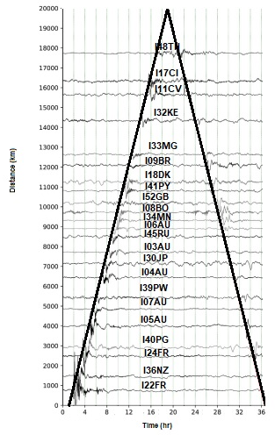
RESULTS AND DISCUSSIONS
The Tonga eruption is a natural occurring inter-geosphere interaction. It started from the earth through the ocean into the atmosphere with frequency ranges and energy transfer pattern varying from one medium to another.
The acoustic waves associated with the event when filtered with the extended time-frequency configuration produce waves with undistorted shapes and easy to estimate amplitudes. The filtered waves were observed to have decayed over distance and had the characteristics of a surface waves propagating through the atmosphere with N shape, an indication that they are Lamb wave (Fig 6).
Fig 5B: GMPCC analysis of H11S
Fig 6: Lamb wave from filtered waveforms
Result obtained from reduced pressure calculation estimated the signal strength at the source as about 22kPa. Results also indicated a far-field speed of about 313​m/s. The back-azimuth showed a drift from the antipode (Vergoz et al., 2022).
The eruption of 15 January, 2022 could also be classified as caldera in nature (Cronin, 2022; Terry et al. (2022) ). Brenna et al. (2022) reported that geochemical analysis of magma which erupted indicated they were phenocrystic basaltic andesites and andesites.
Fig 5A: Spectral analysis of I22FR
Fig 5C: GMPCC analysis of I22FR
The study of acoustic signals (Fig 5 A, B and C) for the foreshock showed that the first arrival was recorded by infrasound station I22FR that is 16.61º at 05.30.14 and for aftershock the last arrival was the hydroacoustic station H11N that is 42.42º at 21.14.02.
Please do not use this space, a QR code will be automatically overlayed
P1.4-796

Slide 6
CONCLUSION
The analysis using GPMCC generated information on azimuth, frequency, average speed and correlation between element traces for the acoustic stations. Azimuthal rays of each station pointed to the source of infrasound waves. The data from IMS acoustic stations (foreshock, event and aftershock) indicated that the eruptions are modest-size earthquakes of surt-seyan type. The eruption of 15 January, 2022 could also be classified as caldera in nature as a result of observed interaction of fresh magma highly charged with gas and water
Please do not use this space, a QR code will be automatically overlayed
P1.4-796

Slide 7
REFERENCES
Brenna, M., Cronin, S.J., Smith, I.E.M., Pontesilli, A., Tost, M., Barker, S., Tonga’onevai, S., Kula, T., and Rennie, V., (2022) Post-caldera volcanism reveals shallow priming of an intra-ocean arc andesitic caldera Lithos, 412–413, Article 106614 10.1016/j.lithos.2022.106614
Cronin, S., (2022). Why the volcanic eruption in Tonga was so violent, and what to expect next. The conversation https://theconversation.com/why-thevolcanic-eruption-in-tonga-was-so-violent-and-what-to-expect-next175035
Smith, I.E.M. and Price, R.C., (2006). The Tonga–Kermadec arc and Havre–Lau back-arc system: Their role in the development of tectonic and magmatic models for the western Pacific. Journal of Volcanology and Geothermal Research 156 pp 315–331
Taylor, P.W., Mafi, K.S., and ‘Aho, P., (2016). Volcanic hazards and their management in the Kingdom of Tonga P.W. Taylor (Ed.), SPC Technical Bulletin SPC00017: Volcanic Hazards and Emergency Management in the Southwest Pacific, pp. 75-86
Terry, J.P., Gof, J., Winspear, N., Bongolan, V.P., and Fisher, S. (2022) Tonga volcanic eruption and tsunami, January 2022: globally the most signifcant opportunity to observe an explosive and tsunamigenic submarine eruption since AD 1883 Krakatau. Geoscience Letters 9:24, pp. 1-11
Vergoz, J., Hupe, P., Listowski, C., Le Pichon, A., Garcés, M.A., Marchetti, E., Labazuy, P., Ceranna, L., Pilger, C., Gaebler, P., Näsholm, S.P., Brissaud, Q., Poli, P.., Shapiro, N., De Negri, R., Mialle, P., (2020). IMS observations of infrasound and acoustic-gravity waves produced by the January 2022 volcanic eruption of Hunga, Tonga: A global analysis. Earth and Planetary Science Letters 591, pp 1-13
Please do not use this space, a QR code will be automatically overlayed
P1.4-796

