Slide 1
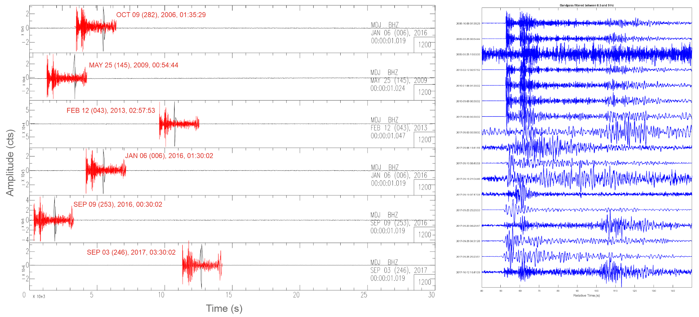
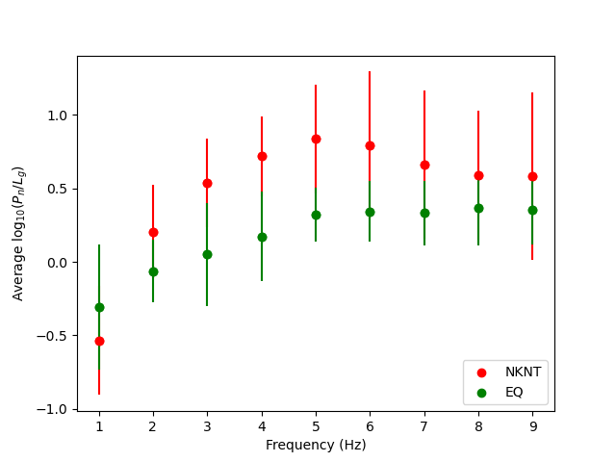
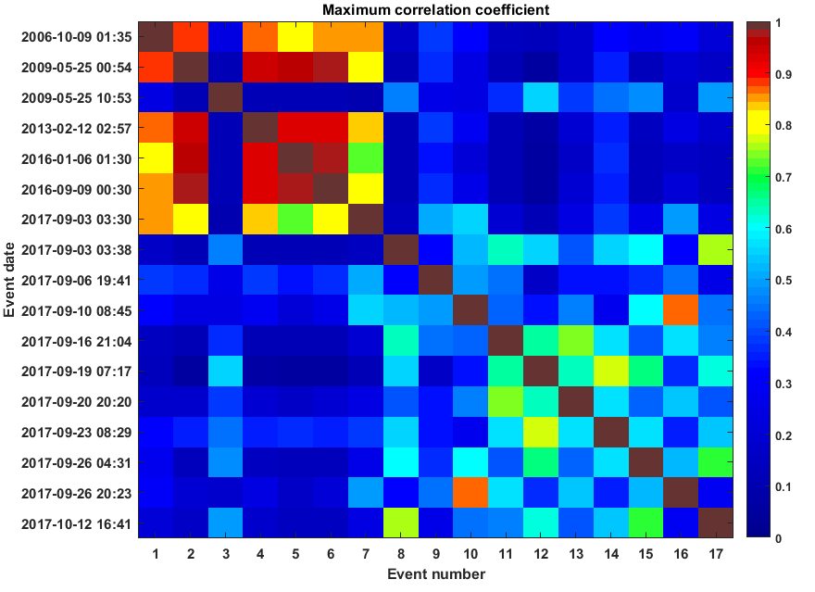
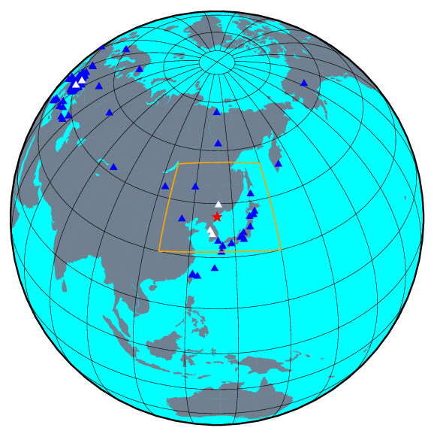
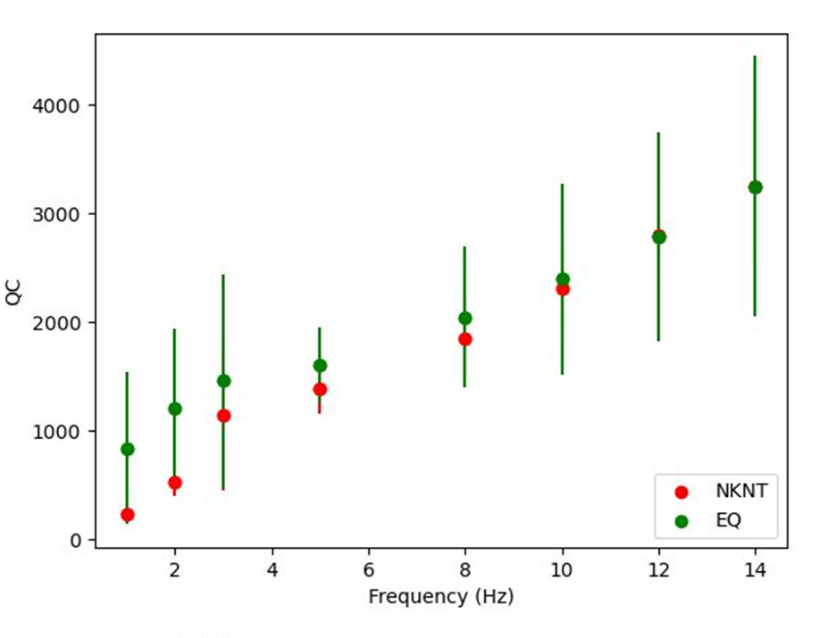
Seismic Data Analysis for the Discrimination, Detection, and Location of Seismic Events of the People’s Democratic Republic of Korea
Iulia Armeanu^{1,2}, Felix Borleanu¹, Daniela Ghica¹, Cristian Neagoe¹, Lavinia Varzaru¹
1 - National Institute for Earth Physics, Romania; 2 – University of Bucharest, Faculty of Physics, Romania
P2.1-806
The study aims to perform high-accuracy locations of DPRK nuclear tests and identify any potential seismic event that could occur near the test site. In addition, multiple discrimination algorithms to distinguish between the known nuclear events and surrounding natural seismic activity were applied.
Seismic signals recorded by seismic stations at various distances were examined using DPRK’s nuclear tests and seismic activity between 2006 and 2022, in order to acquire fresh insights into the spatial distribution of seismic events and to develop accurate discrimination approaches.
The results showed that there is an average bias of up to 5 km between the locations shown by our analysis and those provided by IDC. In addition, Pn/Lg, Pg/Lg spectral ratio measurements can successfully distinguish NKNT from nearby earthquakes at frequencies over 2 Hz.
Despite the fact that there aren't many measurements of the quality factors of the coda waves at regional stations, the Qc values for earthquakes tend to be higher than those for nuclear tests.

