Slide 1
Seismic Data Analysis for the Discrimination, Detection, and Location of Seismic Events of the People’s Democratic Republic of Korea
Iulia Armeanu^{1,2}, Felix Borleanu¹, Daniela Ghica¹, Cristian Neagoe¹, Lavinia Varzaru¹
1 - National Institute for Earth Physics, Romania
2 – University of Bucharest, Faculty of Physics, Romania
The study aims to perform high-accuracy locations of DPRK nuclear tests and identify any potential seismic event that could occur near the test site. In addition, we apply multiple discrimination algorithms to distinguish between the known nuclear events and surrounding natural seismic activity.
To examine the seismic activity from 2006 to 2022, we applied relative and absolute location techniques, as well as a waveform cross-correlation detector, to scan the continuous recordings. The discrimination algorithms, based on multiple signal processing, were evaluated using recordings from regional and distant stations.
The relocation of nuclear tests showed average differences of up to 5 km compared to previous studies. Moreover, the detection technique identified 8 new potential tectonic events. The selected discrimination algorithms successfully separated the seismic events, but their accuracy is influenced by distance, SNR and geology.
High accurate locations are obtained using stations with a good azimuthal coverage. Relative locations techniques are more accurate than those revealed by routine methods. Selected algorithms reveal distinct characteristics for the two types of events that could be further used as labels in convolutional neural network approaches.
Please do not use this space, a QR code will be automatically overlayed
P2.1-806

Slide 2
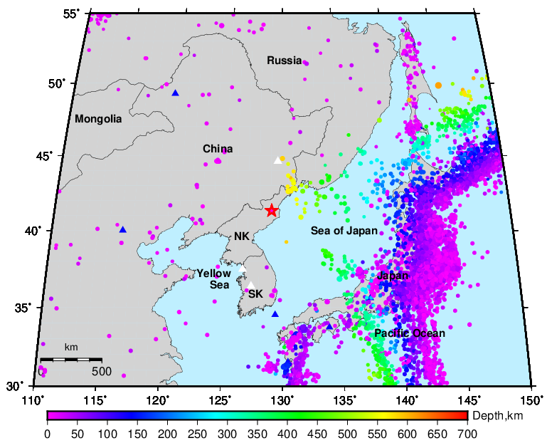
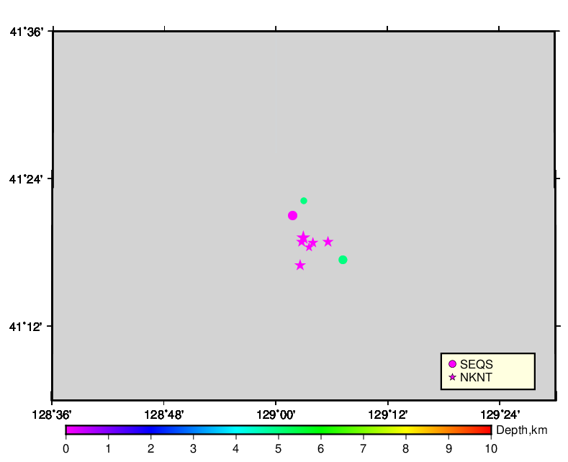
Introduction and Objectives
In the last years, North Korea conducted a series of nuclear tests (He et al., 2017) and has managed to establish itself as a major player in the global nuclear landscape.
To conclusively verify the occurrence of a future artificial nuclear test prior nuclear tests must be thoroughly examined applying interdisciplinary analytic techniques, to establish as many patterns as possible.
Because natural earthquakes were also reported in the area where the nuclear tests were conducted (He et al., 2017, Hong et al., 2019), it is essential that the two types of events be distinguished as precisely as possible.
In the following, we examine seismic signals recorded by seismic stations at various distances in order to acquire fresh insights into the spatial distribution of seismic events and to develop accurate discrimination approaches.
Through a comprehensive analysis of seismic data, we can contribute to efforts aimed at promoting non-proliferation and peaceful resolutions to nuclear challenges.
Seismic activity between 2006 and 2017 according to EMSC-CSEM
Please do not use this space, a QR code will be automatically overlayed
P2.1-806

Slide 3
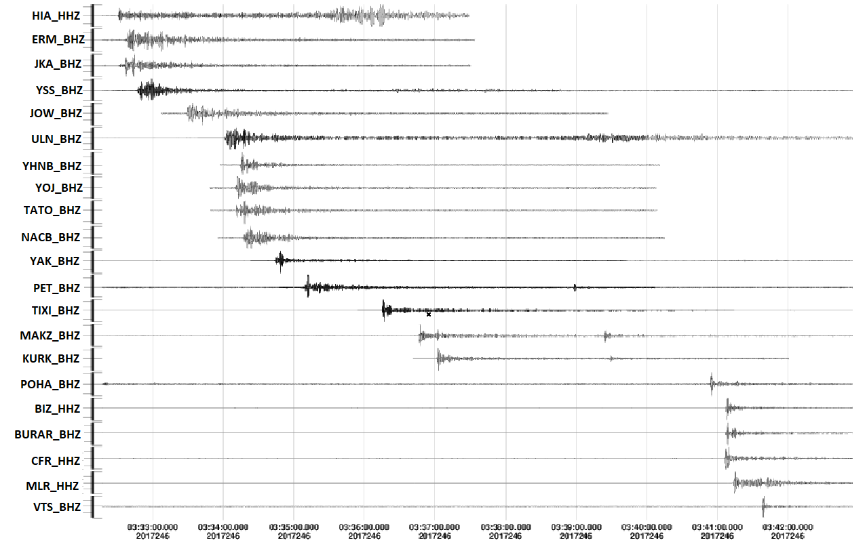
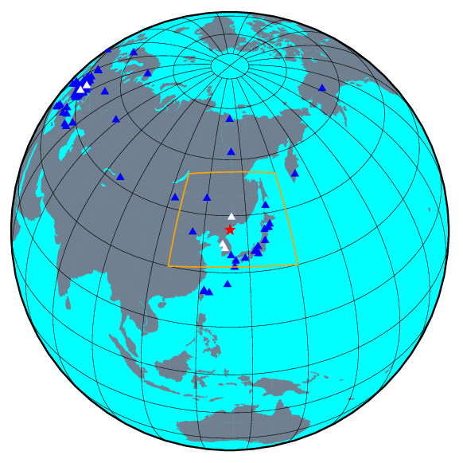
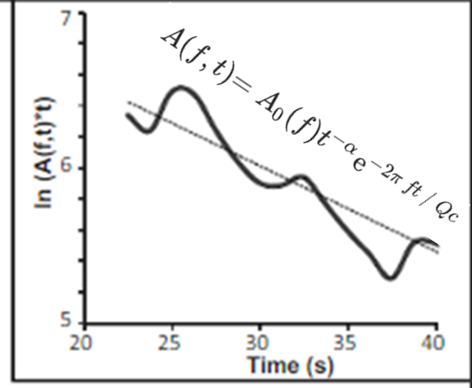
Data and Methods
Please do not use this space, a QR code will be automatically overlayed
P2.1-806

Slide 4
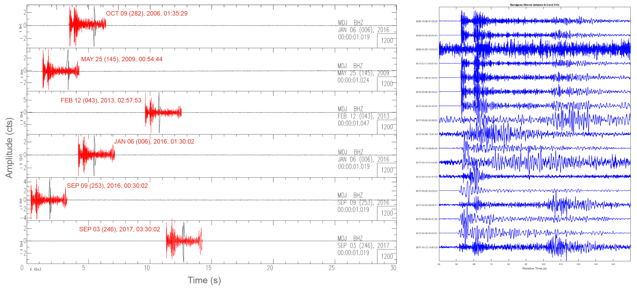
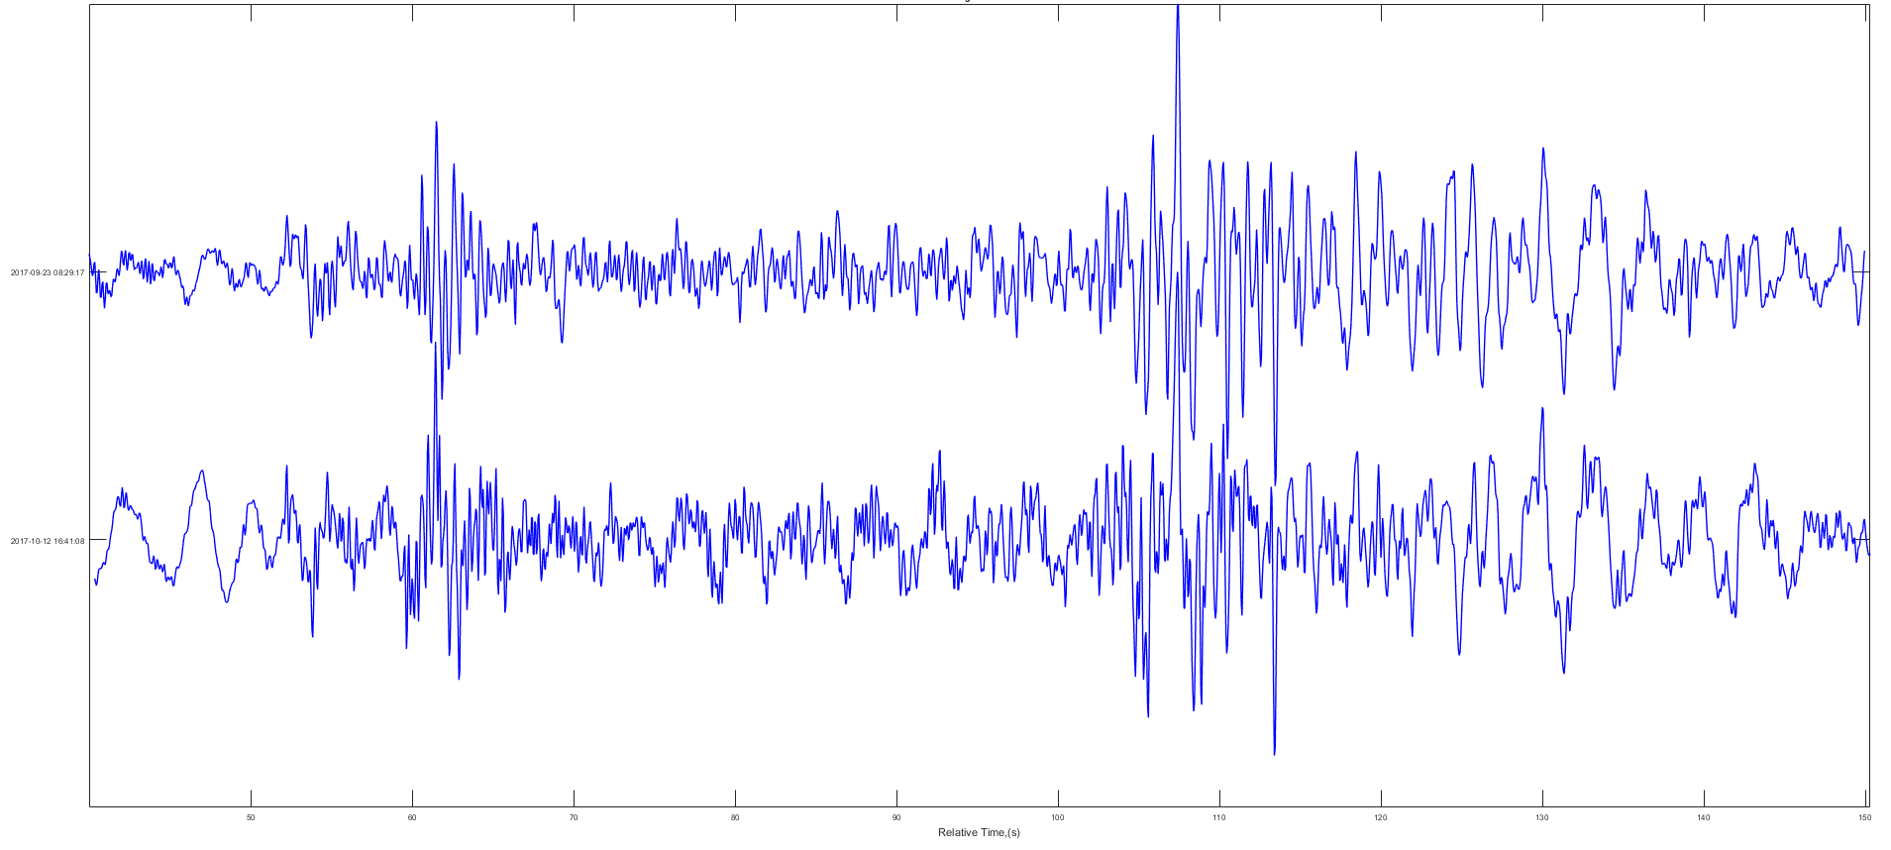
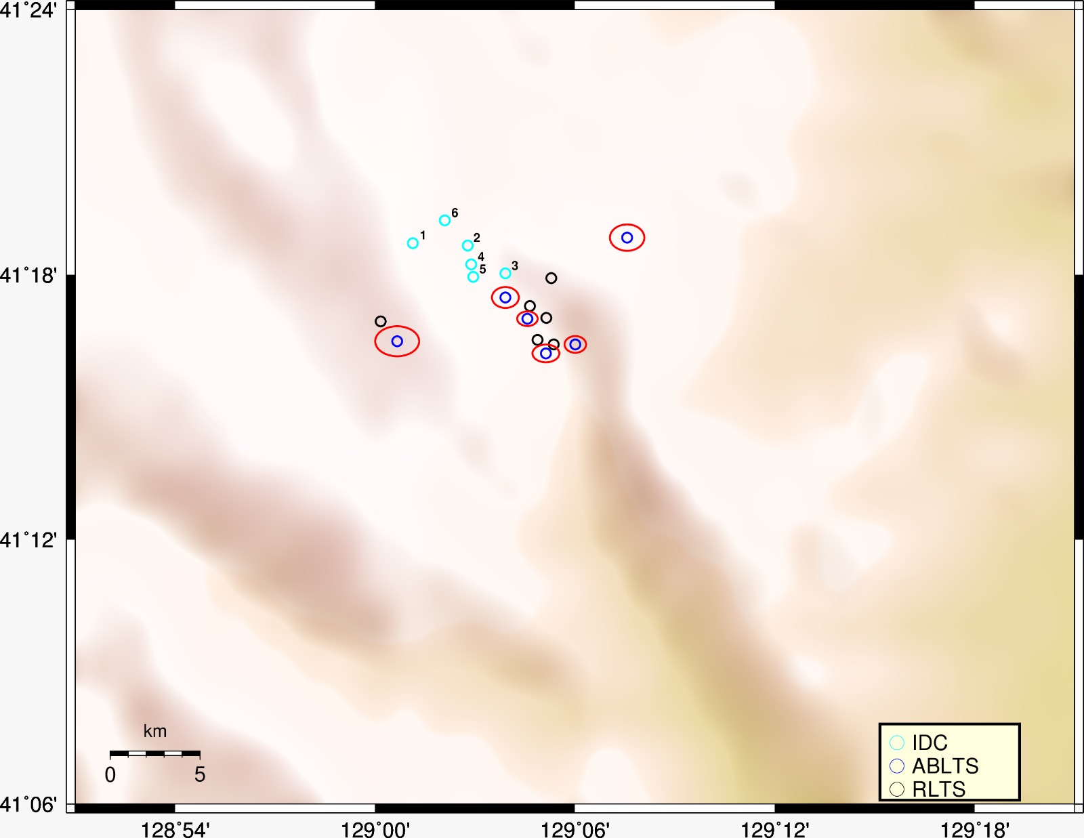
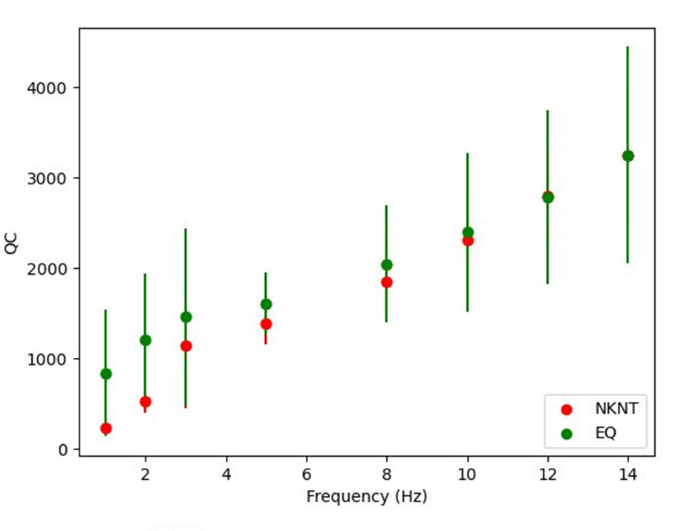
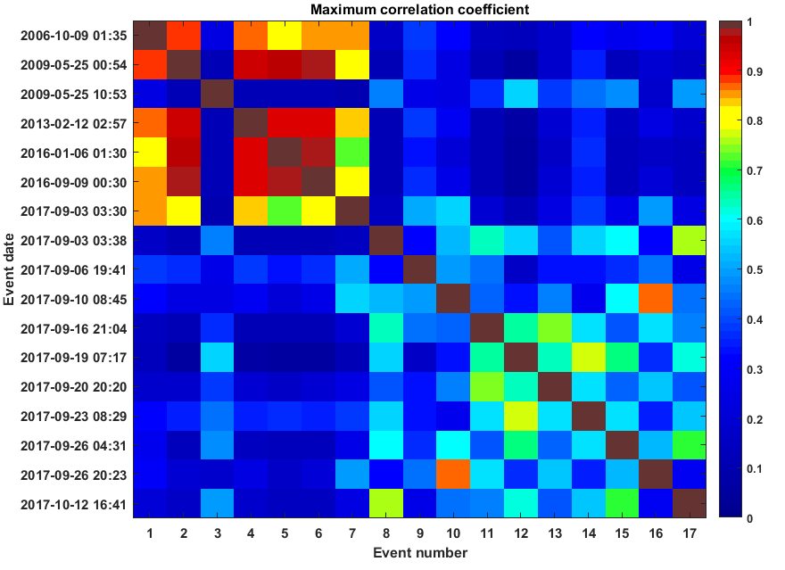
Results
Waveform correlation detector
High-Precision Location of NKNT
Seismic events identified by the waveform cross-correlation detector after the occurrence of nuclear tests.
Coda waves analysis
Waveform cross-correlation
MDJ
NKT1 - 2006/10/09; 01:35:27
NKT2 - 2009/05/25; 00:54:42
NKT3 - 2013/02/12; 02:57:50
NKT4 - 2016/01/06; 01:30:00
NKT5 - 2016/09/09; 00:30:00
NKT6 - 2017/09/03; 03:30:01
EQ1 - 2017/09/03; 03:38:32
EQ2 - 2017/09/23; 08:29:16
EQ3 - 2017/10/12; 16:41:05
The location of nuclear tests with absolute and relative algorithms using regional and distant station recordings and the IASP91 (Kennett and Engdahl, 1991) velocity model matches well the IDC solutions.
Please do not use this space, a QR code will be automatically overlayed
Qc tends to be higher for earthquakes than for nuclear tests, especially in the lower frequency ranges.
The nuclear tests exhibit a stronger correlation, as observed in the upper left corner.
P2.1-806

Slide 5
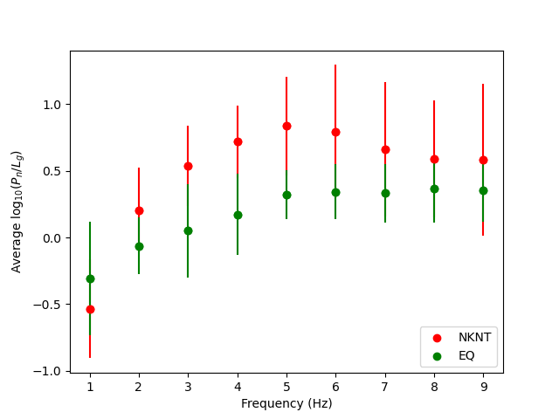
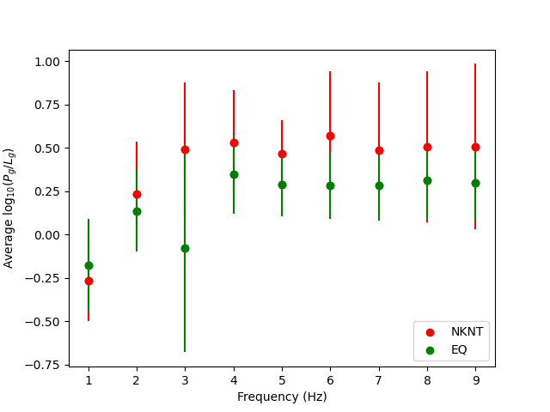
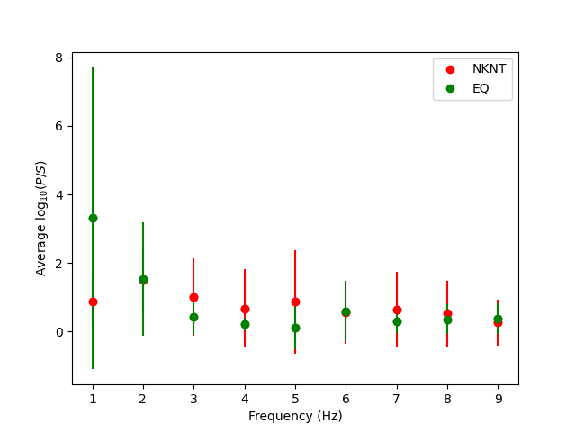
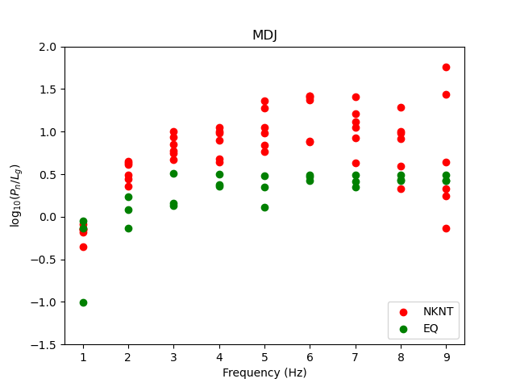
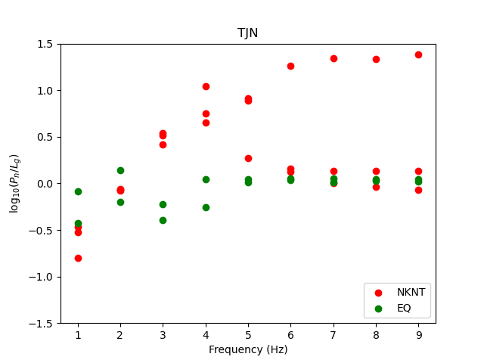
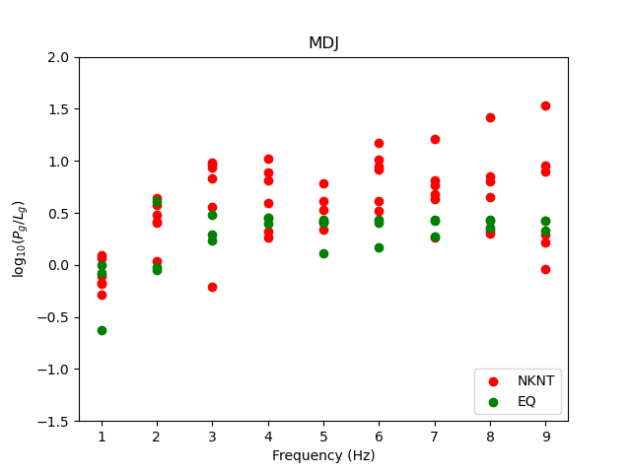
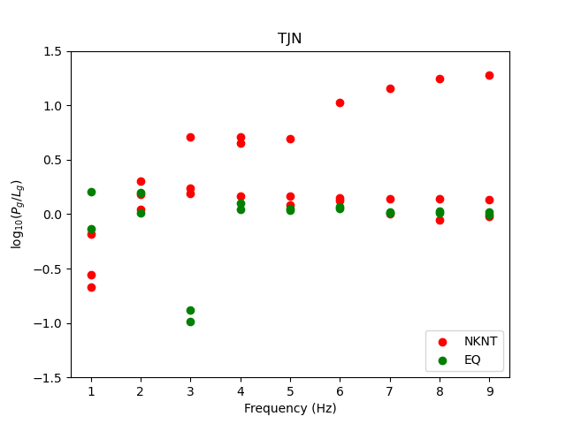
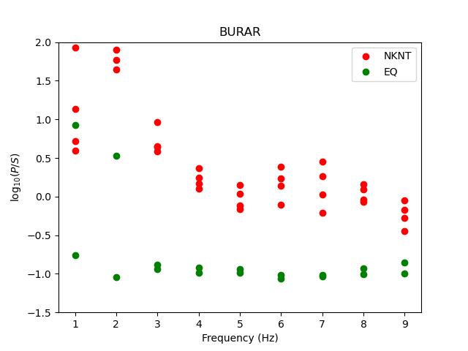
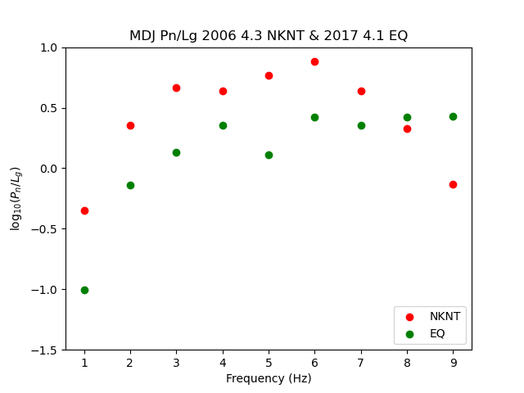
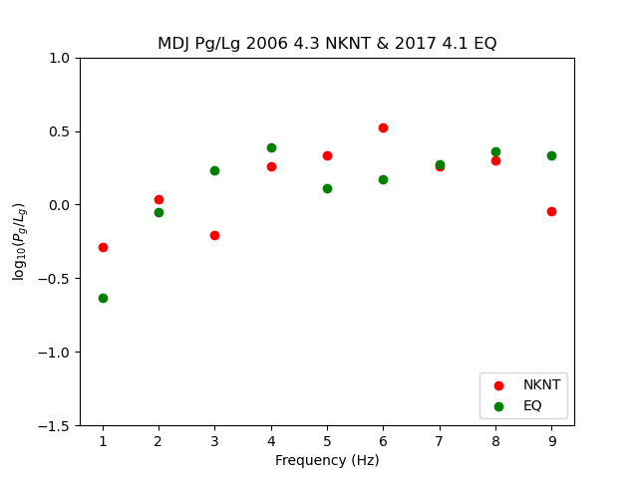
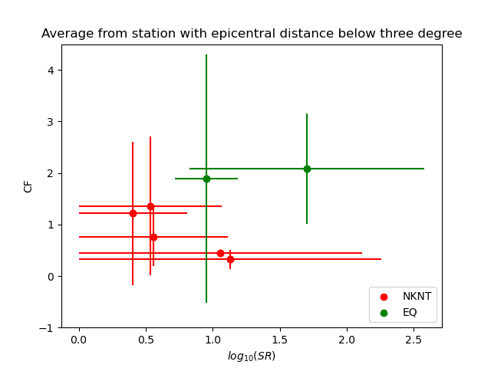
Results
Pn/Lg network average
Pg/Lg network average
P/S network average
Pn/Lg, Pg/Lg, and P/S spectral ratios provide an excellent discriminant in the high-frequency range.
Pn/Lg spectral ratios determined for a pair of events with similar magnitudes. Notice of the separation tendency between the two types of events.
For regional stations, CF vs SR shows a clear distinction between the two type of events.
Please do not use this space, a QR code will be automatically overlayed
P2.1-806

Slide 6
Conclusions
Using regional and teleseismic data recordings, we analyzed the locations of North Korean nuclear tests (NKNT) and used a large variety of discrimination algorithms to properly discern between nuclear and natural tectonic events. With the 6 NKNT selected as templates, we simultaneously ran a waveform cross-correlation detector on regional recordings to look for microseismic events that could have occurred near the test site area.
The NKNT test locations are strongly dependent on the accuracy of NKT6's defined location. Because of the different datasets used, there is still an average bias of up to 5 km between the locations shown by our analysis and those provided by IDC.
Despite significant scattering in the Pn/Lg, Pg/Lg, and P/S spectral ratio measurements, we found that by using the network average, the Pg/Lg and Pn/Lg spectral ratios, in particular, can successfully distinguish NKNT from nearby earthquakes at frequencies over 2 Hz.
Discrimination based on CF and SR is also successful, especially when average values are used. However, the frequency ranges may differ from one station to another, having a major influence on the final results.
Despite the fact that there aren't many measurements of the quality factors of the coda waves at regional stations, the Qc values for earthquakes tend to be higher than those for nuclear tests.
Please do not use this space, a QR code will be automatically overlayed
P2.1-806

Slide 7
References and Acknowledgements
Arai N, Yosida Y (2004) Discrimination by short-period seismograms. International institute of seismology and earthquake engineering, Building Research Institute (IISEE), Lecture Note, Global Course, Tsukuba
Hong, TK., Lee, J., Park, S. et al. Seismic detection of strong ground motions by MW5.6 North Korean nuclear explosion. Sci Rep 9, 5124 (2019). https://doi.org/10.1038/s41598-019-41627-x
Gitterman Y, Shapira A (1993) Spectral discrimination of underwater explosions, J Earth Sci 42:37–44
Hongchun Wang, Henglei Xu, Xiong Xu, Haofeng Zhu, Shiban Ding, Weiping Wang, Peizhong Wang; Explosion or Tectonic Earthquake? Evidence That an ML 3.7 Seismic Event Occurred near North Korea’s Nuclear Test Site on 11 February 2022. Seismological Research Letters 2023; 94 (3): 1334–1341. doi: https://doi.org/10.1785/0220220207
Xi He, Lian‐Feng Zhao, Xiao‐Bi Xie, Zhen‐Xing Yao; High‐Precision Relocation and Event Discrimination for the 3 September 2017 Underground Nuclear Explosion and Subsequent Seismic Events at the North Korean Test Site. Seismological Research Letters 2018; 89 (6): 2042–2048. doi: https://doi.org/10.1785/0220180164
Waldhauser F. and W.L. Ellsworth, A double-difference earthquake location algorithm: Method and application to the northern Hayward fault, Bull. Seism. Soc. Am., 90, 1353-1368, 2000.
The present study was partially funded by the EENSANE (East European Ambient Seismic Noise, Project PN-III-P4-ID-PCE-2020-2972); AFROS (Analysis and Forecasting of Romanian Seismicity, Project PN-III-P4-IDPCE, 2020-1361); DISSA (Data-intensive study of intermediate-depth and shallow seismic activity in Romania: from regular earthquakes to tectonic tremor, Project PN-III-P1-1.1-TE2019-1797), all supported by UEFISCDI (Executive Agency for Higher Education, Research, Development and Innovation Funding), Romania; the Nucleu Program SOL4RISC, projects no PN23360101, PN23360201, supported by the Romania Ministry of Research, Innovation and Digitalization; Integrated thematic services in the field of Earth observation: a national platform for innovation (SETTING) co-funded from the European Regional Development Fund (FEDR) through the Operational Competitivity Programme 2014-2020 (contract no. 336/390012). The authors also acknowledge the CTBTO Mobility Grant, which allowed the first author to present the results at the SnT2023 conference. Most figures were made using GMT (Wessel and Smith, 1998) and GISMO (Thompson and Reyes, 2018) packages.
Please do not use this space, a QR code will be automatically overlayed
P2.1-806

