Slide 1
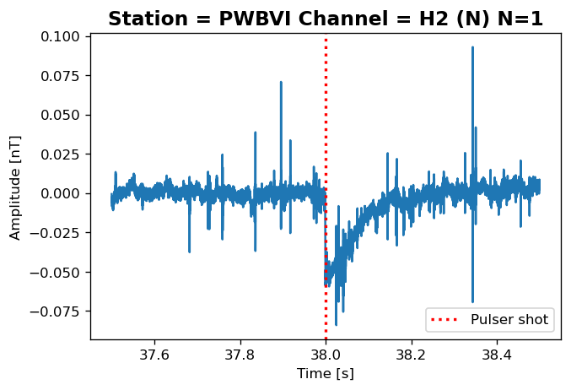
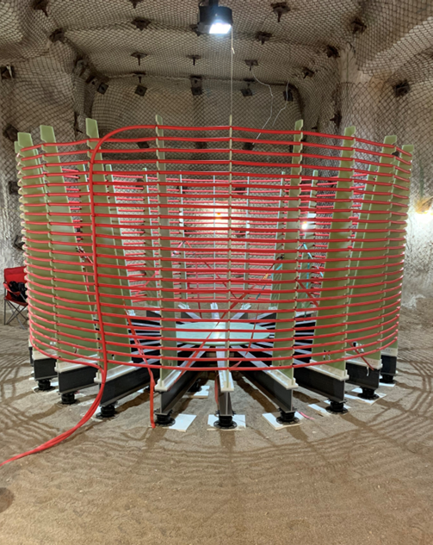
Lightning Talk: Using low-frequency electromagnetic signals to explore historic nuclear test observations
William Junor, Gordon Macleod (LANL), Xianjin Yang (LLNL)
P2.5-494
LA-UR-23-26193
Our synthetic magnetic dipole source (right) emulates the electromagnetic (EM) signature of the “magnetic bubble” created by a hot UGT. Measurements through 500m of tuff overburden (above) suggest that historic EM measurements did detect the VLF magnetic bubble signature.
This Low Yield Nuclear Monitoring (LYNM) research was funded by the National Nuclear Security Administration, Defense Nuclear Nonproliferation Research and Development (NNSA DNN R&D). The authors acknowledge important interdisciplinary collaboration with scientists and engineers from LANL, LLNL, NNSS, PNNL, and SNL.

