Slide 1
Using low-frequency electromagnetic signals to explore
historic nuclear test observations
William Junor, Gordon Macleod (LANL), Xianjin Yang (LLNL)
LA-UR-23-26192
Electromagnetic measurements from historic UGTs offer tantalizing evidence for the propagation of signals through the overburden to distances of several kilometres from the test site. These signals have confusing polarities and temporal profiles
A magnetic pulse generator has been built to emulate the UGT magnetic bubble signature. This source is located in a tunnel ≈250 metres deep. The low frequency electromagnetic signals from this source are sensed at several measurement stations nearby the synthetic source.
The historic data have been compromised by poor timing, limited bandwidth, and other instrumental effects. Nevertheless, they are consistent with low frequency signals created by the magnetic bubble mechanism
The decease of VLF signal strength with radial distance is consistent with
the magnetic bubble mechanism. Instrumental effects have corrupted the temporal profiles of the historic data.
Please do not use this space, a QR code will be automatically overlayed
P2.5-494

Slide 2
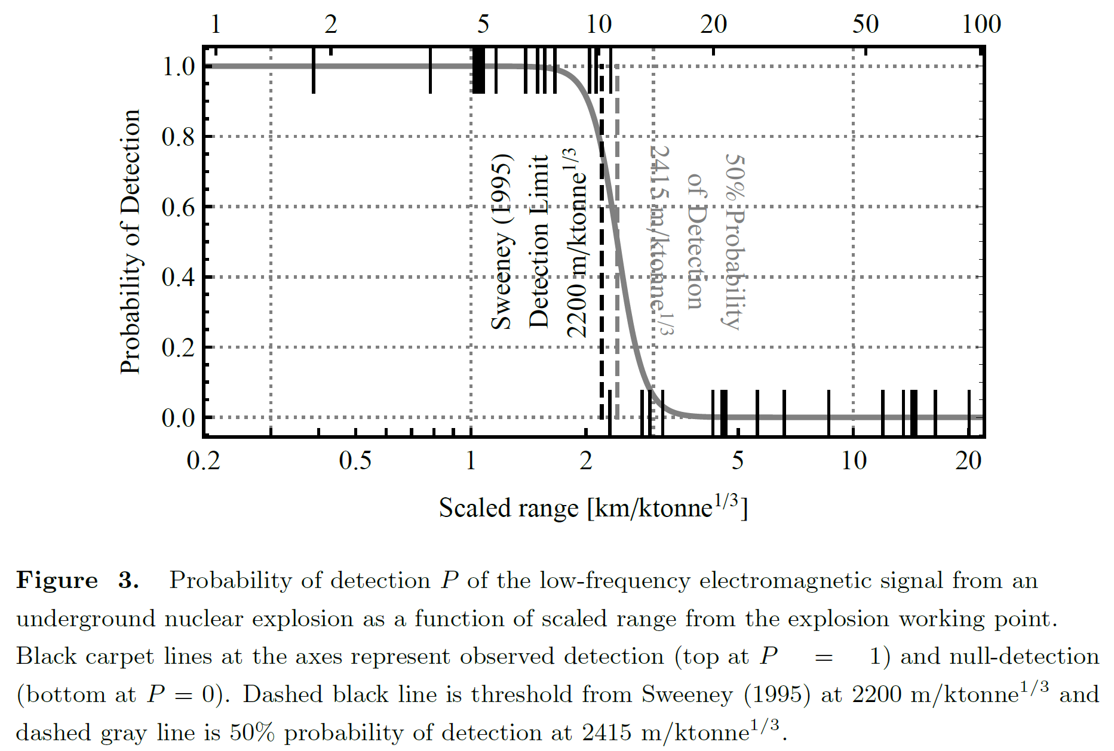
Using low-frequency electromagnetic signals to explore
historic nuclear test observations: Introduction
Impulsive, low-frequency, electromagnetic signals were observed during historic United States underground nuclear tests. The source of these signals is uncertain though a prime candidate is the so-called “magnetic bubble”. This mechanism creates a magnetic signature when the hot plasma shell from the explosion expands in the Earth’s magnetic field. At low frequencies, this signal can diffuse to the surface where it can be detected. We have conducted experiments with an underground synthetic source at the Nevada National Security Site to emulate possible magnetic bubble signals and to investigate propagation through the intervening overburden.
Ford & Sweeney (2020) LLNL-TR-815199, Lawrence Livermore National Laboratory
Analyzed historic US UNT data for detect/non-detect using low frequency electromagnetic signals
Ignore polarization, pulse shape, etc. - just use detection of LF EM signal
Assumed vertical magnetic noise level 10pT – close to ambient noise floor
Strong evidence that sensed signals are magnetic bubble signatures
Please do not use this space, a QR code will be automatically overlayed
P2.5-494

Slide 3
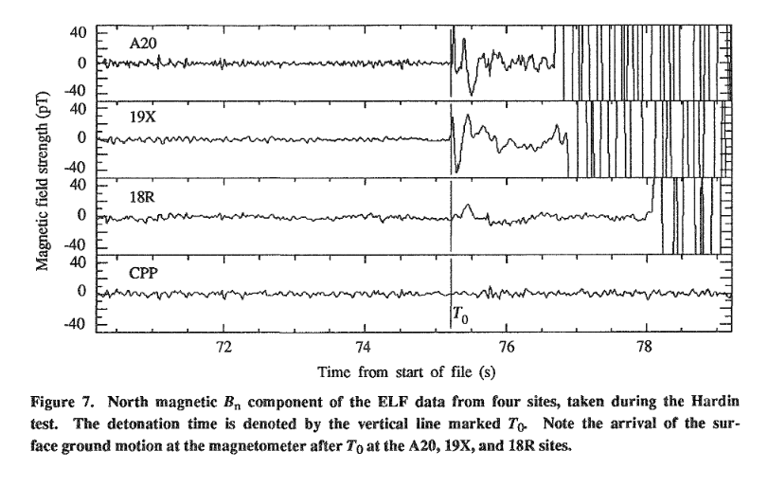
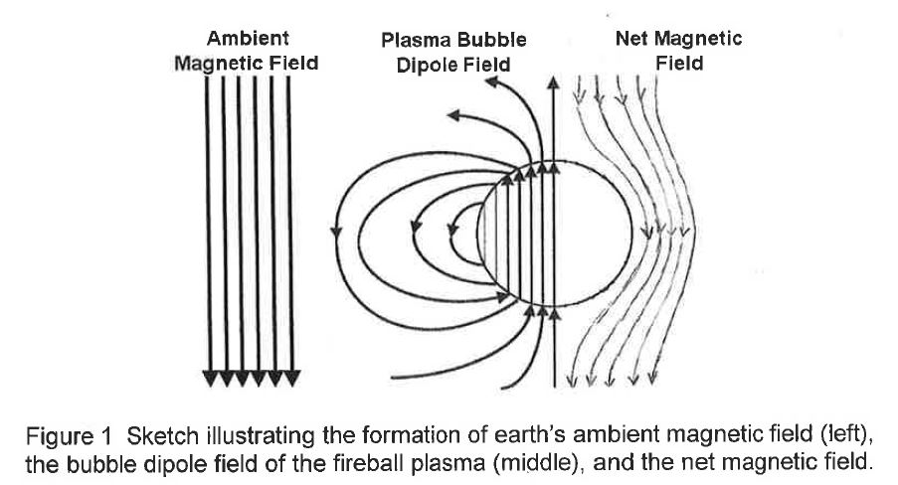
Using low-frequency electromagnetic signals to explore
historic nuclear test observations: Objectives
Hardin Test (20-150kT) DOE/NV-209, Rev. 16: Sweeney (1989) UCRL-53899, Lawrence Livermore National Laboratory
Many questions remain about the nature of the electromagnetic signals seen during US tests:
Are they causally connected to the test?
Is the mechanism the magnetic bubble?
How do we interpret the historic signals?
Much of the historic electromagnetic data collected during US UGTs used poor timing (no GPS) and limited bandwidth (<40Hz effective, 8-bit digitizers)
Please do not use this space, a QR code will be automatically overlayed
P2.5-494

Slide 4
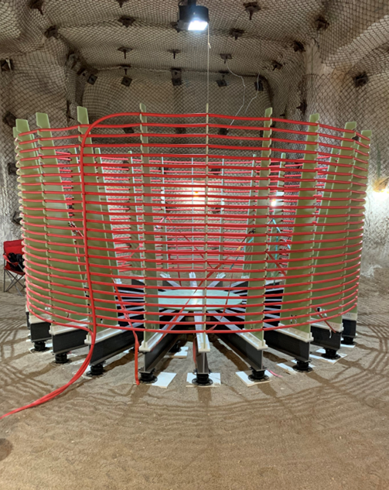
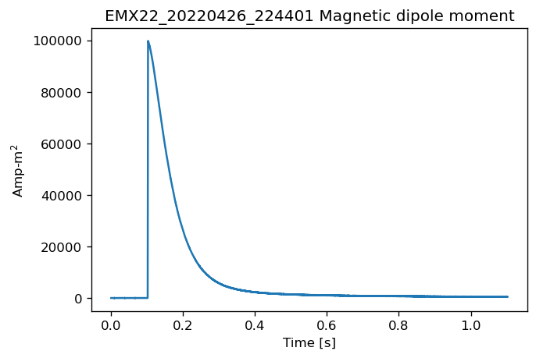
Using low-frequency electromagnetic signals to explore
historic nuclear test observations: Methods
Use synthetic source (right) to create “magnetic bubble”-like electromagnetic pulses; use timed discharge of ≈320A from capacitor bank into 4m diameter coil
Reproducible pulses, GPS-slaved timing of transmitter and electromagnetic detectors
Use network of low frequency (<10 kHz) magnetic and electric field sensors in tunnel and on top of ≈300m of rock overburden
Collect orthogonal components of E and B fields at each sensor station location
Use testbed in tuff at Nevada Nuclear Security Site
Peak magnetic dipole moment = 100 kA-m² (predicted for ≈1kt UGT in 10m radius cavity – Karlykhanov et al. 2004)
Attenuation in rock is small in VLF range (<3 kHz)
Can synthetic pulses be seen at distance through overburden?
What are the ambient noise sources?
How much dispersion will occur?
Can we scale these tests to historic UGT collects?
Do our results explain historic EM collects against US UGTs?
Rise time (10/90) = 0.68 ms
Please do not use this space, a QR code will be automatically overlayed
P2.5-494

Slide 5
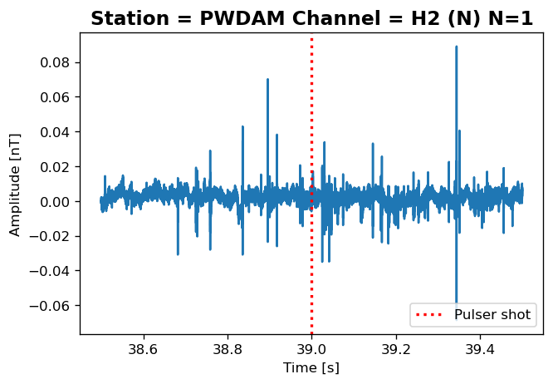
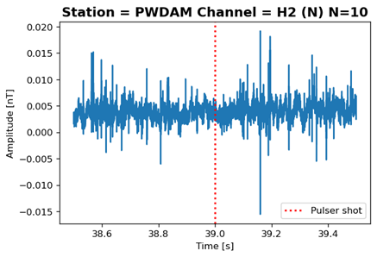
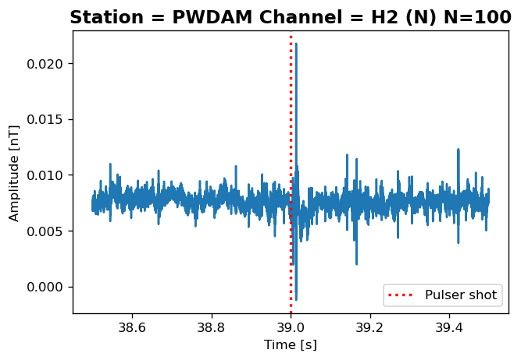
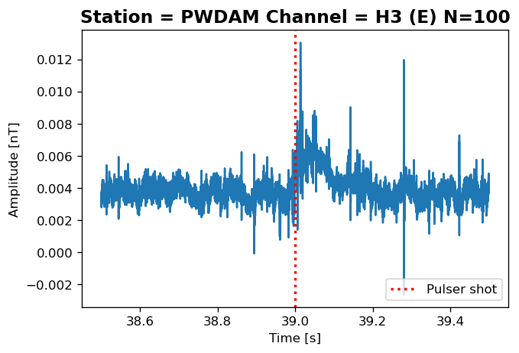
Using low-frequency electromagnetic signals to explore
historic nuclear test observations: Results
Our mesa sensor suite used Phoenix Geophysics MTC-150 induction magnetometers and associated RXU-8a data recorders, and Quasar Federal Systems capacitive electric field sensors.
The noise background is significant. Most of the impulsive events are due to lightning discharges, many at geographically-distant locations but propagated efficiently in the Earth—ionospheric duct.
Some anthropogenic (60Hz and harmonics) noise is also seen in the data records. These signals can be removed effectively with signal processing.
Our electromagnetic stations in the tunnel close to the synthetic Source (within 150 m)) can see a single pulse easily
Station “19X” for the Hardin collects was at 5.1 km from the UGT. The electromagnetic signals are in the near-field i.e. propagation losses scale as 1/R³. Therefore we expect a propagation loss of ≈125 bigger than for our experiments.
The scaling of a nominal 1 kt event to the size of the Hardin event is not straightforward – many factors are involved e.g. rock electrical properties, and the geometry of device emplacement.
At 1 km there is limited dispersion of the synthetic pulse.
The attenuation in the tunnel infrastructure rock bolts, ground control mesh, rails) is small (<2 dB) at the frequencies of interest <1 kHz)
Collects at 1 km from synthetic Source; (top left) no evidence of Source pulse in single N-S magnetic field collect; (top right) coherent stacking of 10 N-S channel collects – no pulse detected; (bottom left) coherent stacking of 100 N-S collects – marginal detection; (bottom right) coherent stacking of 100 pulses for E-W sensor – robust detection of synthetic pulse
Please do not use this space, a QR code will be automatically overlayed
P2.5-494

Slide 6
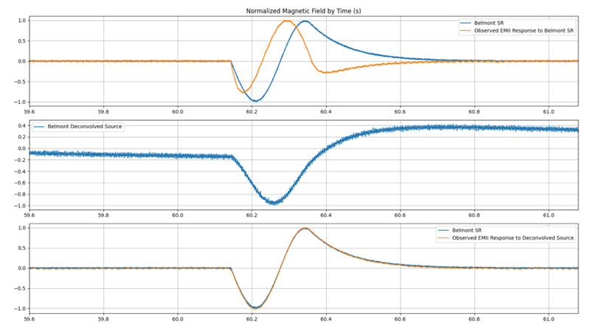
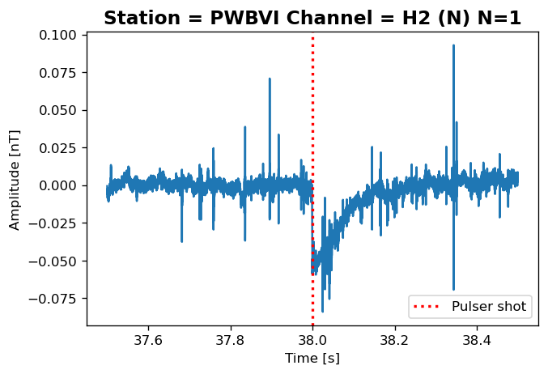
Using low-frequency electromagnetic signals to explore
historic nuclear test observations: Results
The time series collected from historic UGTs show profiles that are difficult to understand. We calibrated some of the original collection equipment in the lab and found that there was significant distortion of the signal (right panel).
The Belmont magnetic field signal (north orientation) shown in the right panel was collected at 9.5km from the shot and had a peak of 44 pT with good signal-to-noise. [Sweeney (1989) UCRL-53899, Lawrence Livermore National Laboratory]
Propagation loss would be nearly 10³ larger than for our experiment.
The polarizations of the historic data are often contrary to expectations
Dispersion in tuff is very small over small distances e.g. to PWBVI station at ≈500m (left) – pulse broadening < 1ms. The inferred value of the Group Velocity Dispersion (GVD) is 10⁻¹² s²/m
The Belmont pulse (right) is smeared by ≈60ms over 9.5 km in alluvium for a plausible value of the GVD of 10⁻⁹ s²/m
(top) The output of the EMII sensor (orange) driven with the simplified representation of the Belmont 20-150 kt shot (DOE/NV-209, Rev. 16) data (blue) clearly shows that the transfer function of the EMII sensor and recording system used heavily distorts the actual magnetic field signal.
(middle) The source was found by deconvolving, in the frequency domain, the EMII response to the simplified representation of the Belmont data. The time profile is much closer to a Gaussian than reported.
(bottom) Driving the EMII sensor with the deconvolved source produces a trace that is consistent with the measured Belmont data.
Please do not use this space, a QR code will be automatically overlayed
P2.5-494

Slide 7
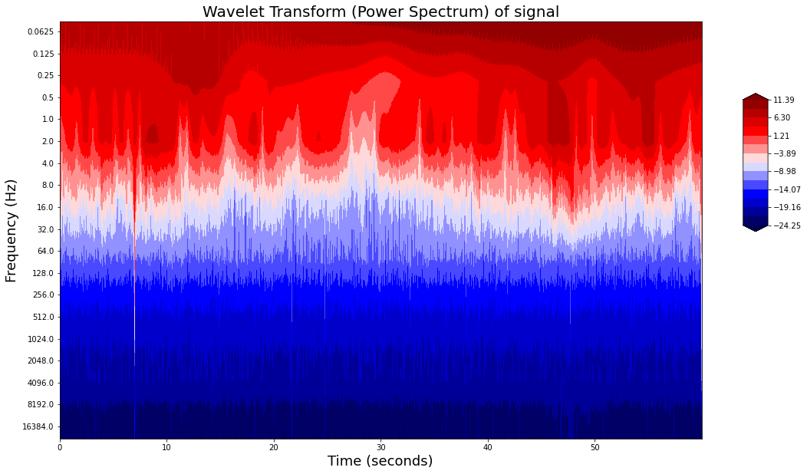
Using low-frequency electromagnetic signals to explore
historic nuclear test observations: Conclusion
VLF (<few kHz) electromagnetic signals can be detected after propagating through significant amounts of rock overburden
Dispersion and attenuation are modest over ≈1 km distances
Biggest challenges to detection are natural noise (mostly lightning) and anthropogenic noise (US utility 60 Hz and harmonics)
The synthetic pulse shape can be discriminated from the natural, impulsive noise
Tunnel ferrous infrastructure has a limited impact on signal strength at these frequencies
The data collected during US nuclear tests have been compromised by limited bandwidth, analogue filter responses and poor (non-GPS) timing – as shown by the Belmont example
The Belmont signal pulse has been broadened in time by the Group Velocity Dispersion
Numerical simulations will be used to scale the results seen in these experiments to historic US UGTs
Signal from impulsive Source
PWAOF Bz channel
Measurements of VLF propagation from our synthetic source and a re-assessment of historic VLF measurements against US UGTs provide strong evidence for magnetic bubble mechanism
Please do not use this space, a QR code will be automatically overlayed
This Low Yield Nuclear Monitoring (LYNM) research was funded by the National Nuclear Security Administration, Defense Nuclear Nonproliferation Research and Development (NNSA DNN R&D). The authors acknowledge important interdisciplinary collaboration with scientists and engineers from LANL, LLNL, NNSS, PNNL, and SNL.
P2.5-494

