Slide 1
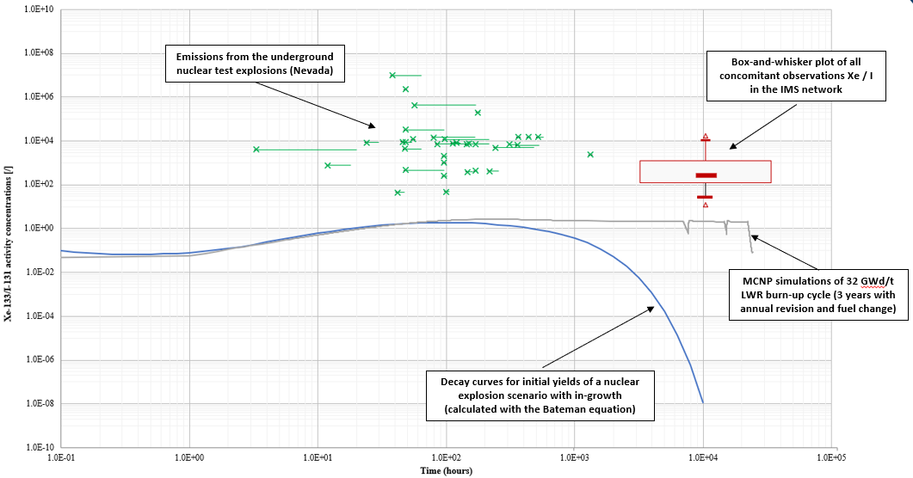
Exploring the use of radioxenon to radioiodine isotopic ratios as additional screening method regarding possible CTBT-relevant events
Martin Kalinowski, Jonathan Bare
International Data Centre (IDC), Comprehensive Nuclear-Test-Ban Treaty Organization (CTBTO), Vienna, Austria
P2.1-324
The purpose of this e-poster is to draw conclusions on the usefulness of radioxenon to radioiodine ratios for event screening in CTBT monitoring.
We use all concomitant detections of ¹³¹I and ¹³³Xe at IMS stations in the period Jan. 2010 – Dec. 2022.
We compare ¹³³Xe / ¹³¹I ratios in IMS observations with simulations of NPPs and nuclear explosions plus emissions in Nevada.
We investigate whether nuclear tests signals might appear as anomalies at IMS stations.
See our e-poster and discuss with us the conclusions that we draw.

