Slide 1
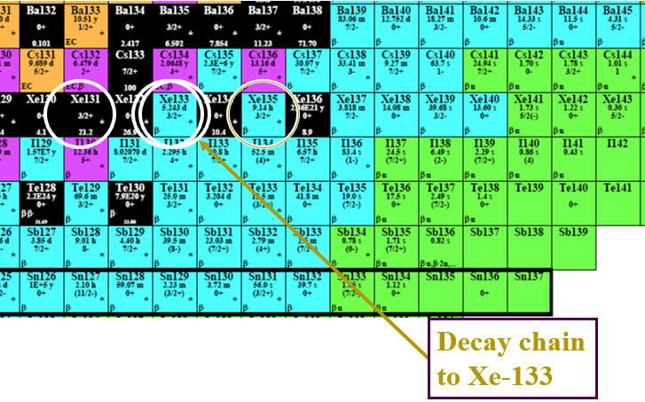
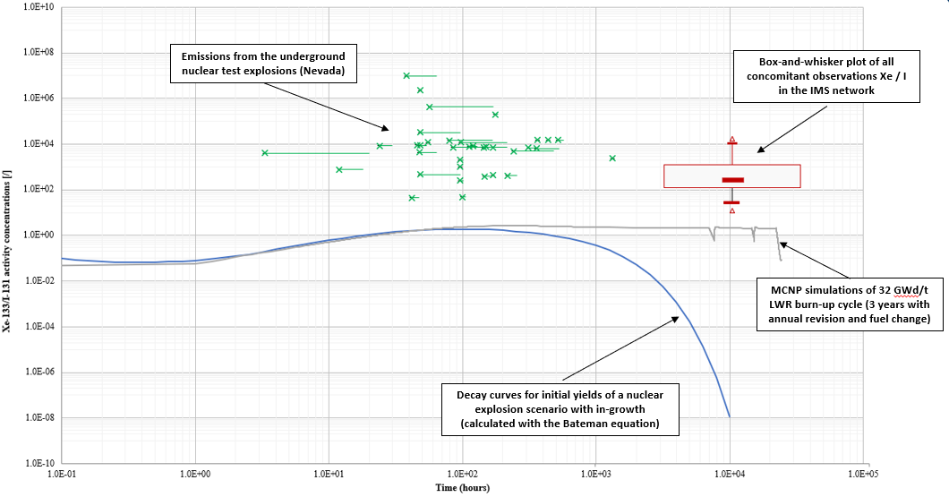
Exploring the use of radioxenon to radioiodine isotopic ratios as additional screening method regarding possible CTBT-relevant events
Martin Kalinowski, Jonathan Bare
International Data Centre (IDC), Comprehensive Nuclear-Test-Ban Treaty Organization (CTBTO), Vienna, Austria
Radioiodine is occasionally observed at IMS stations at the same time as radioxenon. The purpose of this e-poster is to draw conclusions on the usefulness of radioxenon to radioiodine ratios for event screening in CTBT monitoring.
All IMS observations for the period Jan. 2010 – Dec. 2022 are used here.
¹³³Xe / ¹³¹I ratios in IMS observations are compared with simulations of NPPs and nuclear explosions plus emissions in Nevada.
Based on this comparison, the main conclusions on event screening in CTBT monitoring are that nuclear explosion ratios are unlikely to appear as an anomaly and the atmospheric background of radioxenon and radioiodine needs to be better understood.
Please do not use this space, a QR code will be automatically overlayed
P2.1-324

Slide 2
Introduction
Xenon and iodine isotopes are, among other CTBT-relevant radionuclides, major indicators for nuclear explosions. They are therefore globally monitored by the International Monitoring System to verify compliance with the CTBT, using different technologies.
Xenon isotopes are intermediate decay products of radioiodine. If originating from the same source, the radioxenon to radioiodine ratio of isotopes from the same mass chain may be suitable for additional screening of events.
This study investigates the radioxenon to radioiodine isotopic activity concentration ratios, as they occur in samples of co-located noble gas and particulate systems that significantly overlap in sampling time. These IMS observations are compared to ratios of the same isotopes for different sources that may be observed. These are simulations of nuclear explosions and nuclear facilities (NPPs and MIPFs), as well as empirical data from published reports for both historic nuclear tests and for releases from nuclear facilities.
Based on this comparison, conclusions can be drawn on the usefulness of radioxenon to radioiodine ratios for event screening in CTBT monitoring.
P2.1-324
Please do not use this space, a QR code will be automatically overlayed

Slide 3
Objectives
Investigate the usefulness of radioxenon to radioiodine ratios for event screening in CTBT monitoring.
The focus of this e-poster is on the normal observations in the IMS network to find out whether a relevant signal would constitute an outstanding anomaly or whether it would appear similar to normal background.
P2.1-324
Please do not use this space, a QR code will be automatically overlayed
Decay chain to Xe-133

Slide 4
Methods
Several data sets are considered for the isotopic activity ratios in this study:
Real emission values from an underground nuclear test explosions at Nevada (Kalinowski, 2011)
MCNP simulations of 32 GWd/t LWR burn-up cycle (Kalinowski et al., 2014)
Decay curves for initial yields of a nuclear explosion scenario, calculated with the Bateman equation (Kalinowski/Pistner, 2006)
Observations from stations of the IMS network
Observations from the IMS network based on:
Quality-controlled reviewed spectra data (status R) retrieved from the operational database (OPS) of the CTBTO, for the period Jan. 2010 – Dec. 2022
Spectral data from samples of co-located noble gas and particulate systems that significantly (i.e. more than 50% of the collection time) overlap in sampling time
Concomitant detections of ¹³¹I and ¹³³Xe, ¹³¹I and ^{131m}Xe, ¹³³I and ¹³³Xe (i.e. minimum level 3 / level B for particulate / noble gas, respectively)
Focus is given on the ratio ¹³³Xe / ¹³¹I, because these two isotopes are the most frequently occurring.
Further investigation is needed for other ratios, specifically those of the same mass chain.
P2.1-324
Please do not use this space, a QR code will be automatically overlayed

Slide 5
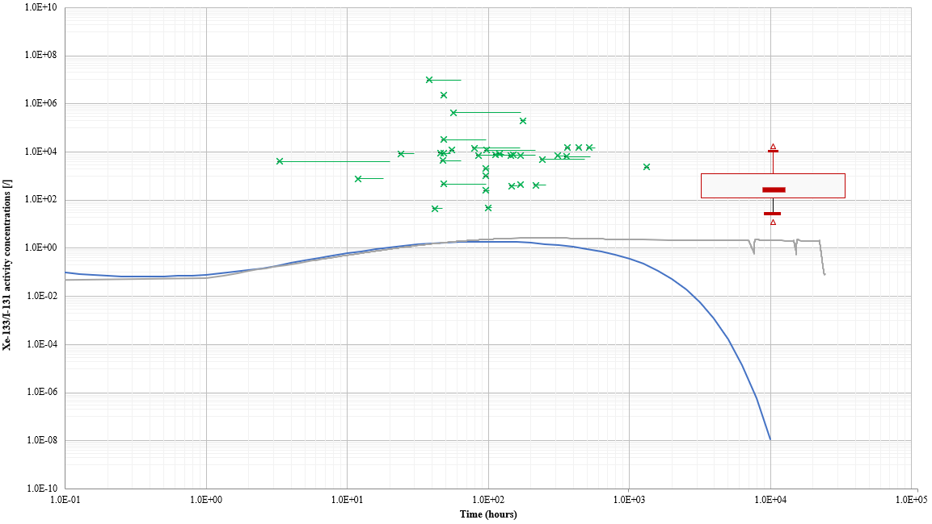
Results
Emissions from the underground nuclear test explosions (Nevada)
Box-and-whisker plot of all concomitant observations Xe / I in the IMS network
MCNP simulations of 32 GWd/t LWR burn-up cycle (3 years with annual revision and fuel change)
P2.1-324
Decay curves for initial yields of a nuclear explosion scenario with in-growth (calculated with the Bateman equation)
Please do not use this space, a QR code will be automatically overlayed

Slide 6
Conclusions
Conclusions on the ratio of concomitant detections of ¹³¹I and ¹³³Xe at IMS stations:
¹³³Xe / ¹³¹I ratios are found in a relatively small band of less than two orders of magnitude.
Note of caution: The observed distribution is not reflecting atmospheric background because the MDCs of both isotopes are limiting the range of ratios observed.
Comparison with ratios at known sources doesn’t provide a hint at a typical single source type (see companion e-poster P2.1-323).
It remains to be investigated whether concomitant detections are by chance or from the same source.
Conclusion on IMS observations vs nuclear explosion signals:
The range of ¹³³Xe / ¹³¹I ratios in IMS observations happens to have large overlap with releases of underground nuclear tests. The overlap is even stronger when decay correction along the atmospheric transport is taken into consideration.
Based on this comparison, the main conclusions on event screening in CTBT monitoring are:
In general, ¹³³Xe / ¹³¹I ratios from an underground nuclear test would appear like normal background.
The upper part of the ¹³³Xe / ¹³¹I ratio distribution at Nevada is higher than ever observed at IMS stations. Whether this can be observed as anomaly at an IMS station depends on the source strength vs MDC limits.
Atmospheric nuclear test would cause an anomaly of very low ratios, if iodine wash-out remains limited.
Better understanding the atmospheric background of ¹³¹I and ¹³³Xe is vital for event characterization.
P2.1-324
Please do not use this space, a QR code will be automatically overlayed

Slide 7
References
Martin B. Kalinowski and Christoph Pistner (2006): Isotopic signature of atmospheric xenon released from light water reactors”, Journal of Environmental Radioactivity, Volume 88, issue 3 (2006), 215-235. http://dx.doi.org/10.1016/j.jenvrad.2006.02.003
Martin B. Kalinowski (2011): Characterisation of prompt and delayed atmospheric radioactivity releases from underground nuclear tests at Nevada as a function of release time. Journal of Environmental Radioactivity 102 (2011), 824-836. https://doi.org/10.1016/j.jenvrad.2011.05.006
Martin B. Kalinowski, Yen-Yo Liao and Christoph Pistner (2014): Discrimination of Nuclear Explosions against Civilian Sources Based on Atmospheric Radioiodine Isotopic Activity Ratios. Pure and Applied Geophysics: Volume 171, Issue 3 (2014), Page 669-676. https://doi.org/10.1007/s00024-012-0564-7
P2.1-324
Please do not use this space, a QR code will be automatically overlayed

