Slide 1
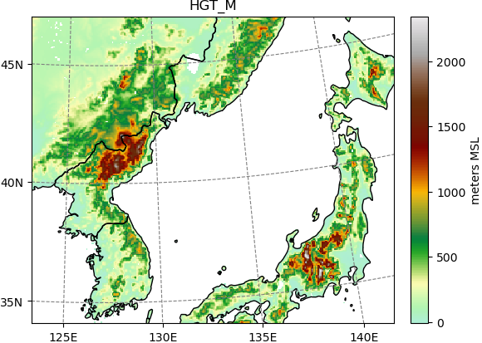
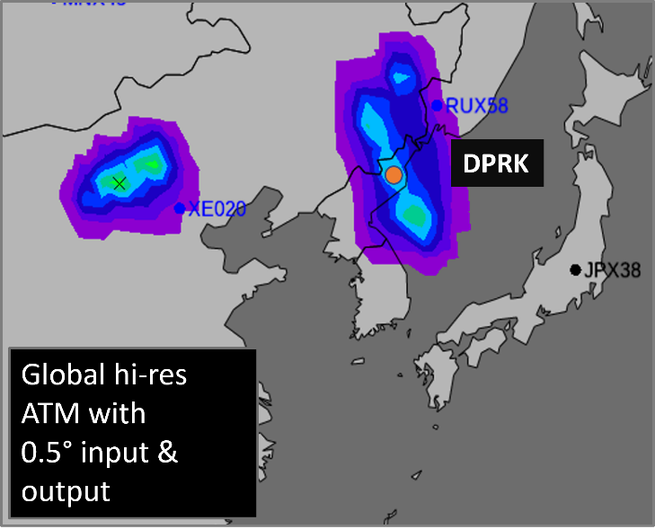
A Case Study on Using High Resolution Atmospheric Transport Modelling on Historical Democratic People’s Republic of Korea Announced Tests
Anne Tipka, Robin Schoemaker, Jolanta Kusmierczyk-Michulec, Martin Kalinowski
CTBTO Preparatory Commission / International Data Centre
P2.1-507
Problem:
The DPRK Test Site resides in a complex, mountainous area.
Come see me during e-poster session 2.1 on Thursday 21st to learn more.
Or access it online on the SnT2023 Conference platform!
Approach:
Small scale meteorological features become important in complex terrain
can be resolved by using higher-resolution meteorological input data
RN58
Left Panel:
Operational coarser possible source region, calculated with 3 Level C samples measured from station RN38.
RN38
DPRK
How does it look like with higher resolution?

