Slide 1
A Case Study on Using High Resolution Atmospheric Transport Modelling on Historical
Democratic People’s Republic of Korea Announced Tests
Anne Tipka, Robin Schoemaker, Jolanta Kusmierczyk-Michulec,
Martin Kalinowski
CTBTO Preparatory Commission / International Data Centre
The Democratic People’s Republic of Korea (DPRK) repeatedly executed (announced) nuclear tests at the Punggye-ri Nuclear Test Site. These tests are of high importance to the CTBTO in case of evaluating the ability of localization, especially in the complex terrain of the Test Site.
Comparing the use of a variation of meteorological input data (different spatial resolution and met models) and atmospheric transport models to demonstrate the influence of small-scale meteorological features in the DPRK domain.
Using three associated level C samples measured at the JPX38 IMS station after the 2013 announced DPRK nuclear test to locate the DPRK Test Site as the source with high-resolution ATM brings the most likely possible source region closer to the Test Site.
Increasing the resolution of meteorological input data has a favorable effect on the transport pathways and hence the localization of the source area.
Please do not use this space, a QR code will be automatically overlayed
P2.1-507

Slide 2
Introduction
The Democratic People’s Republic of Korea (DPRK) repeatedly executed (announced) nuclear tests at the Punggye-ri Nuclear Test Site.
These tests are of high importance to the CTBTO to evaluate its ability to backtrack relevant radioactive substances measured from samples taken at CTBTO’s International Monitoring Stations (IMS) to its source region.
Atmospheric transport modelling (ATM) is used to track the movement of radioactive substances in the atmosphere and serves as the essential tool to link sources and receptors.
This study demonstrates potential benefits of high-resolution ATM on transport pathways development by using different meteorological inputs with varying scales and physical parameterizations.
P2.1-507
Please do not use this space, a QR code will be automatically overlayed

Slide 3
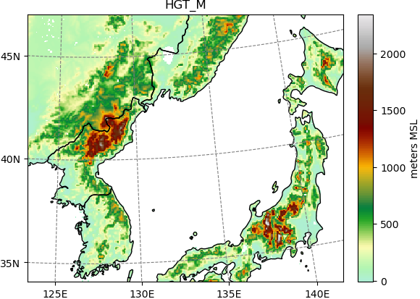
Objectives
Since the DPRK test site resides in a complex, mountainous area (right figure), accounting for local atmospheric dynamics in the lower planetary boundary layer can have a reasonable effect on the results.
Meteorological smaller scale features can be resolved by using higher-resolution meteorological input data
For example, to consider effects of convective vertical transport, turbulent phenomena and special effects due to elevations, coastlines, textures as forests and cities, etc., and the fact that e.g. mountains are smoothed on coarser grids causing pathways to be distorted.
Terrain around DPRK test site
and close by IMS stations
RN58
DPRK
RN38
P2.1-507
Please do not use this space, a QR code will be automatically overlayed

Slide 4
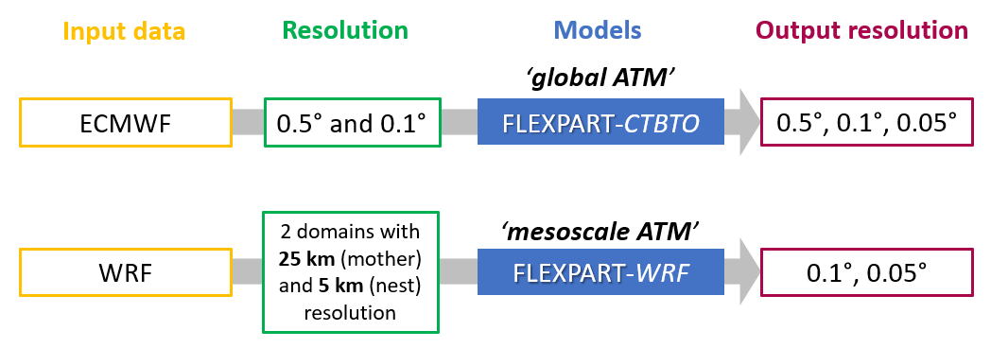
Methods
Investigate different weather models (ECMWF, WRF) as meteorological input for the atmospheric transport model FLEXPART.
Conduct case studies on combinations of input and output spatial resolutions for FLEXPART.
Compare results from different versions of the ATM Flexpart model, e.g., FLEXPART and FLEXPART-WRF.
P2.1-507
Please do not use this space, a QR code will be automatically overlayed

Slide 5
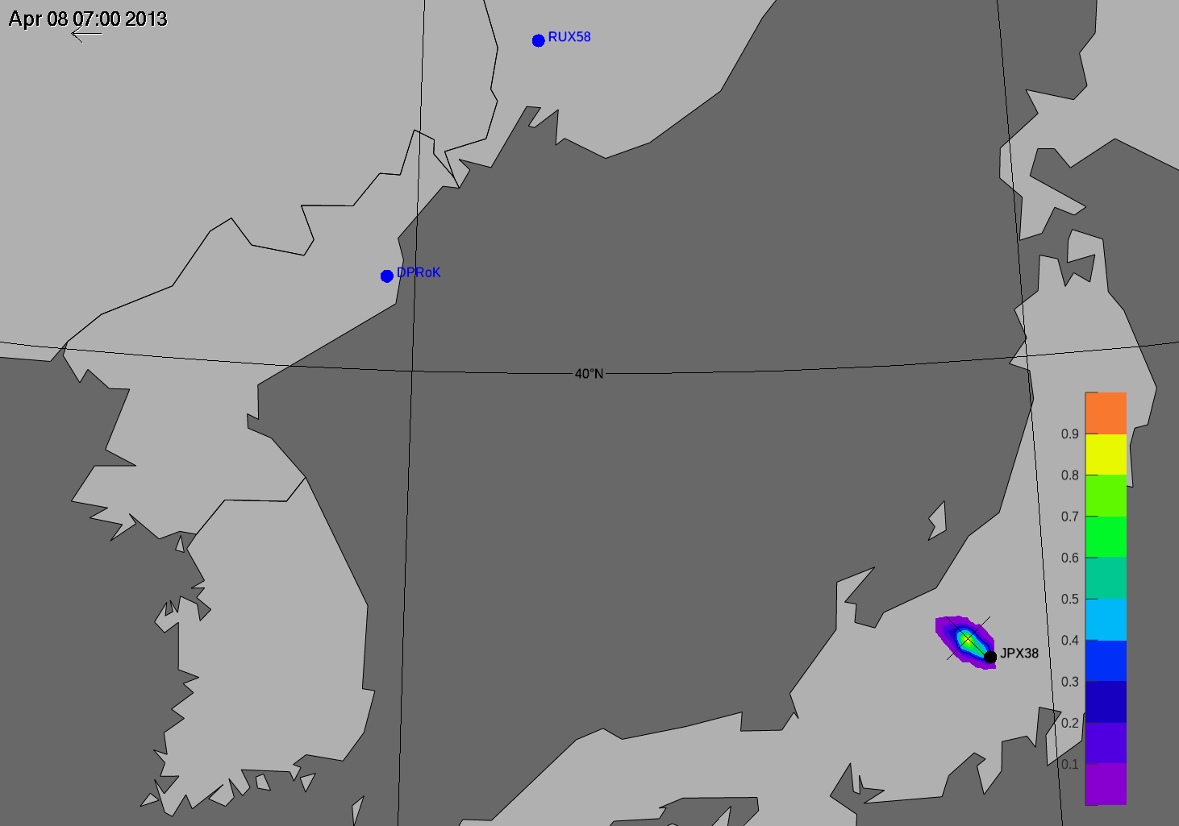
Results 1/3
The IMS network includes the station ‘JPX38’ located in Japan, which measured radioactive substances after the 2013 announced nuclear test (see Ringbom et al., 2014).
Using three Level C radioxenon observations at JPX38, considered to have originated from this event, the so-called Possible Source Region is calculated.
This study makes use of the sample association method to associate the Level C samples described in e-Poster P3.6-414 by Yuichi Kijima et al. and e-Poster P2.4-334 by Robin Schoemaker et al.
(8 April to 6 April 2013)
P2.1-507
Please do not use this space, a QR code will be automatically overlayed
collection stop times of samples
08/04/2013 07 UTC
08/04/2013 19 UTC
09/04/2013 07 UTC
See A. Ringbom, et al., “Radioxenon detections in the CTBT international monitoring system likely related to the announced nuclear test in North Korea on February 12, 2013”, Journal of Environmental Radioactivity, 128, pp. 47-63 (2014).

Slide 6
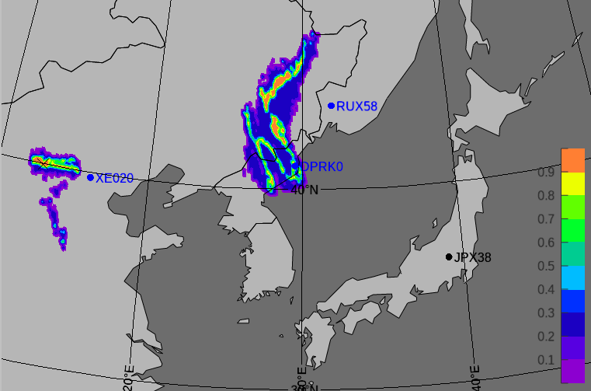
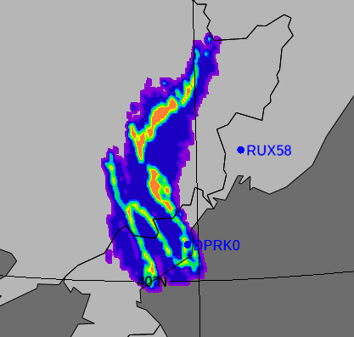
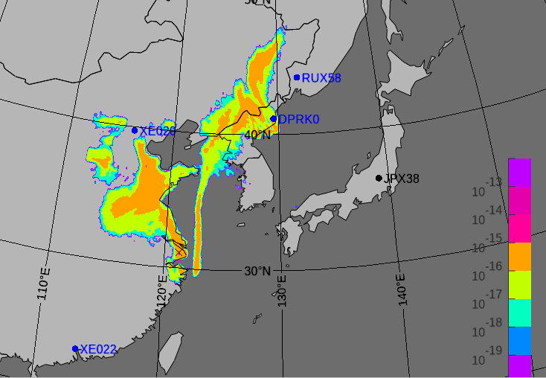
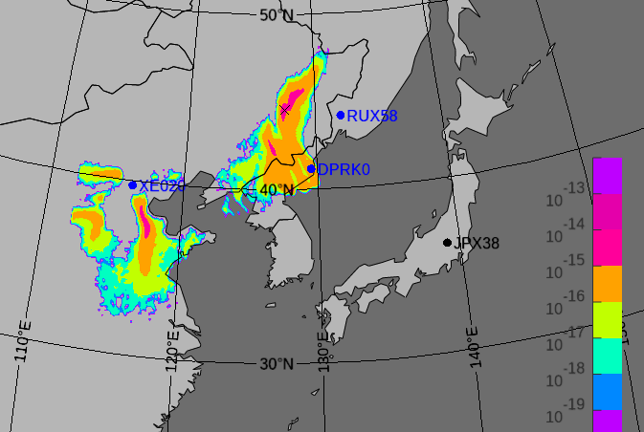
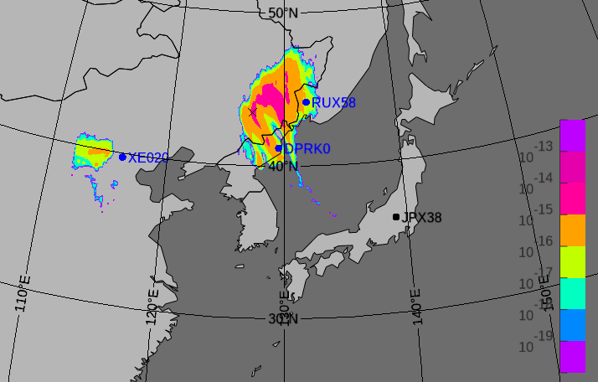
Results 2/3
Example of PSR calculation from 3 mesoscale ATM SRS files
from 7 April at 07:00 hrs. UTC
Spearman’s Rank algorithm with Correlation / SRS > 0
PSR for 7 April at 07:00 hrs.
The field of regard (FOR) represents a pre-defined SRS (Source Receptor Sensitivity) field linked to one sample. Here for 7 April at 07:00 hrs. UTC
The plotted field is the correlation coefficient [0,1]
PSR from 3 SRS files (Corr. / SRS > 0 Sp. Rank)
The plots show the FOR fields with values for dilution factor.
P2.1-507
Please do not use this space, a QR code will be automatically overlayed
Mesoscale ATM: FOR from SRS (9 April, 07:00)
Mesoscale ATM: FOR from SRS (8 April, 19:00)
Mesoscale ATM: FOR from SRS (8 April, 07:00)

Slide 7
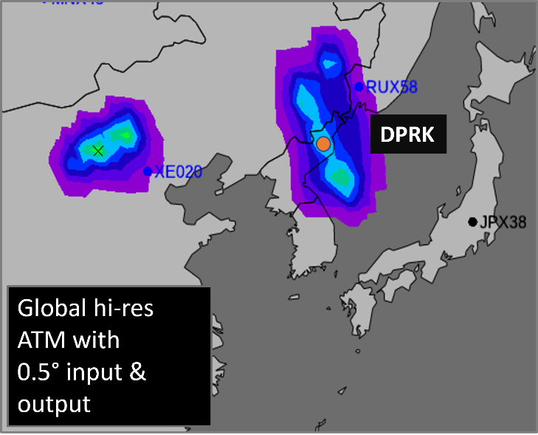
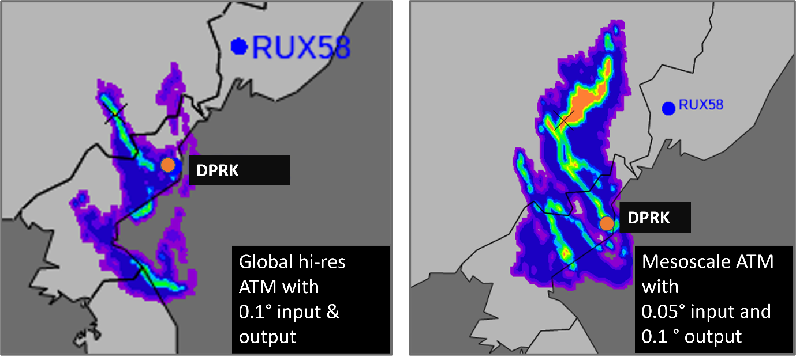
Results 3/3
Working with higher resolution meteorological input as well as adapting the output grid has a favorable effect to bring the maximum point closer to the source.
The plotted field is the correlation coefficient [0,1]
P2.1-507
Please do not use this space, a QR code will be automatically overlayed
Visualization of PSR for two different FLEXPART models and three different meteorological input data
collection stop times of samples
08/04/2013 07 UTC
08/04/2013 19 UTC
09/04/2013 07 UTC

Slide 8
Conclusion
The DPRK case study provides first promising results when comparing different higher resolution models (global and mesoscale for complex terrains); sample association benefits as well.
Using a meteorological domain of interest for the FLEXPART-CTBTO simulations only, the computational time can be reduced significantly.
Currently, the resolution of ECMWF data is limited to 0.1 degrees. Considering mesoscale modelling, using WRF and FLEXPART-WRF for higher spatial resolution (0.05 deg), seems to have a favorable impact on a more accurate estimation of the source location.
Further investigations will cover:
Exploring the sensitivities due to physical parameterizations in WRF setups.
Increasing the spatial resolution in mesoscale ATM to 1 km.
Including associated Level B samples.
P2.1-507
Please do not use this space, a QR code will be automatically overlayed

Slide 9
References
Ringbom, A., et al., “Radioxenon detections in the CTBT international monitoring system likely related to the announced nuclear test in North Korea on February 12, 2013”, Journal of Environmental Radioactivity, 128, pp. 47-63 (2014).
Related: SnT2023 e-Poster P3.6-414 by Yuichi Kijima et al.
Related: SnT2023 e-Poster P1.1-506 by Anne Tipka et al.
Related: SnT2023 e-Poster P2.4-334 by Robin Schoemaker et al.
P2.1-507
Please do not use this space, a QR code will be automatically overlayed

