Slide 1
Joint regional waveform, first motion polarity, and surface displacement inversion using a layered elastic model with topography for North Korean Nuclear explosions
Rodrigo Chi-Durán, Douglas Dreger and Arthur Rodgers
Earth and Planetary Science Department, University of California, Berkeley
Regional waveform and first-motion polarity moment tensor inversion can discriminate DPRK events as explosions. However, not all moment tensor solutions fit the observed static surface deformation field
We have developed a joint inversion of regional waveforms, first-motion polarity, and surface deformation to study DPRK4 and DPRK6. This includes the topography and geological structure of the test site
We are able to fit the waveforms, first-motion, and surface deformation, thereby narrowing down the space of possible MT solutions for DPRK4 and DPRK6
The combination of various data types reduces uncertainty in moment tensor solutions and enhances our understanding of DPRK events
Please do not use this space, a QR code will be automatically overlayed
P2.1-743

Slide 2
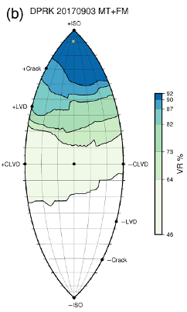
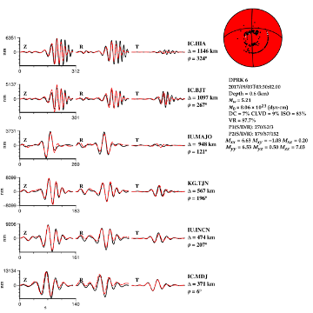
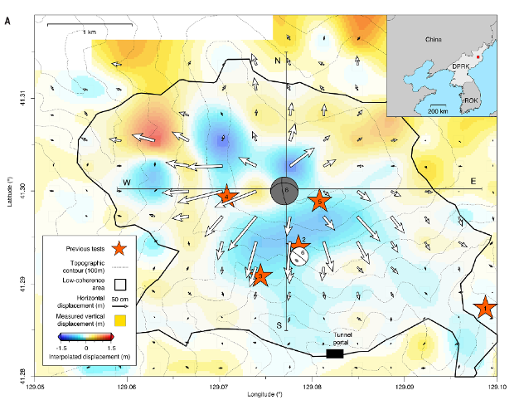
Introduction and Motivation
Regional waveform and first-motion polarity moment tensor inversion can discriminate DPRK events as explosions.
DPRK4 and especially DPRK6 generated significant surface deformation, inferred from satellite observations. However, the regional/first-motion moment tensor solutions do not align with the observed static surface deformation field.
In Chi-Durán et al. (2021), we developed a joint inversion of regional waveforms, first-motion polarity, and surface deformation to determine the seismic moment tensor. This method reduces uncertainties by employing a homogeneous model.
P2.1-743
Please do not use this space, a QR code will be automatically overlayed
Chiang et al., (2018)
Wang et al., (2018)

Slide 3
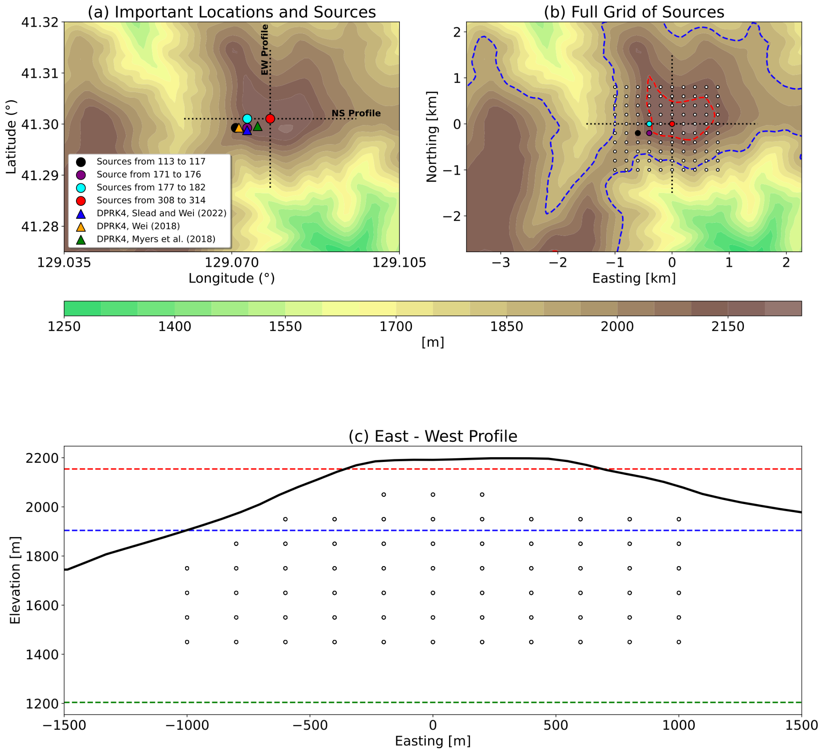
Objectives
Could the elevation of the source be better constrained? In Chi-Durán et al. (2021) we underestimated explosion burial depth.
Can we use a layered velocity model in order to model better the data? Satellite imagery helped Pabian and Coblentz (2015, 2018) to describe the geological composition of Mt. Mantap.
Can we extend the analysis to other events? There is waveform, first-motion data and line-of-sight deformation data available for DPRK4 (2016).
P2.1-743
Please do not use this space, a QR code will be automatically overlayed

Slide 4
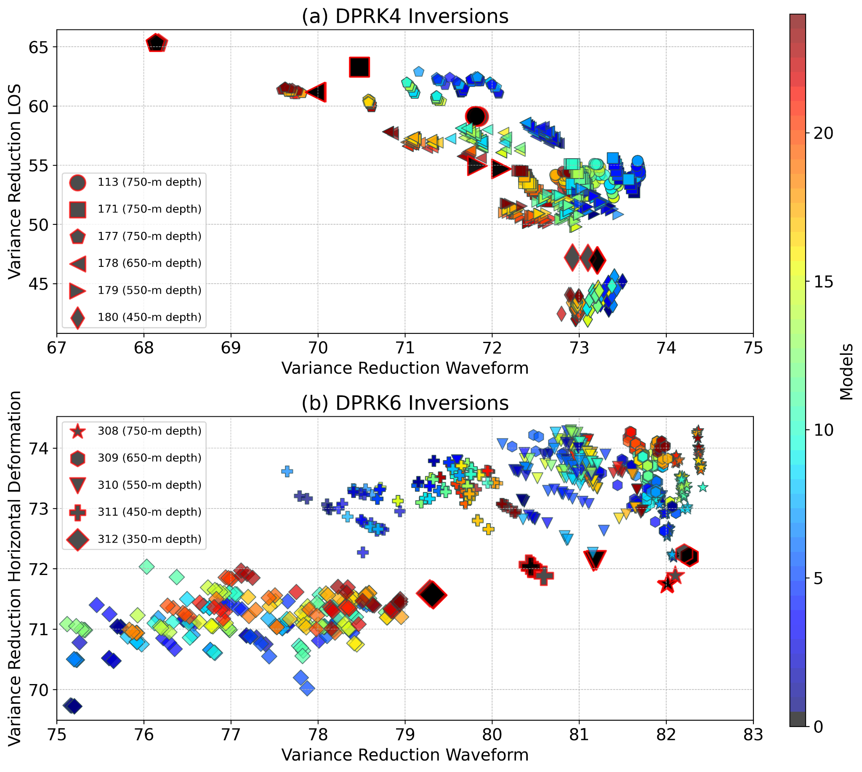
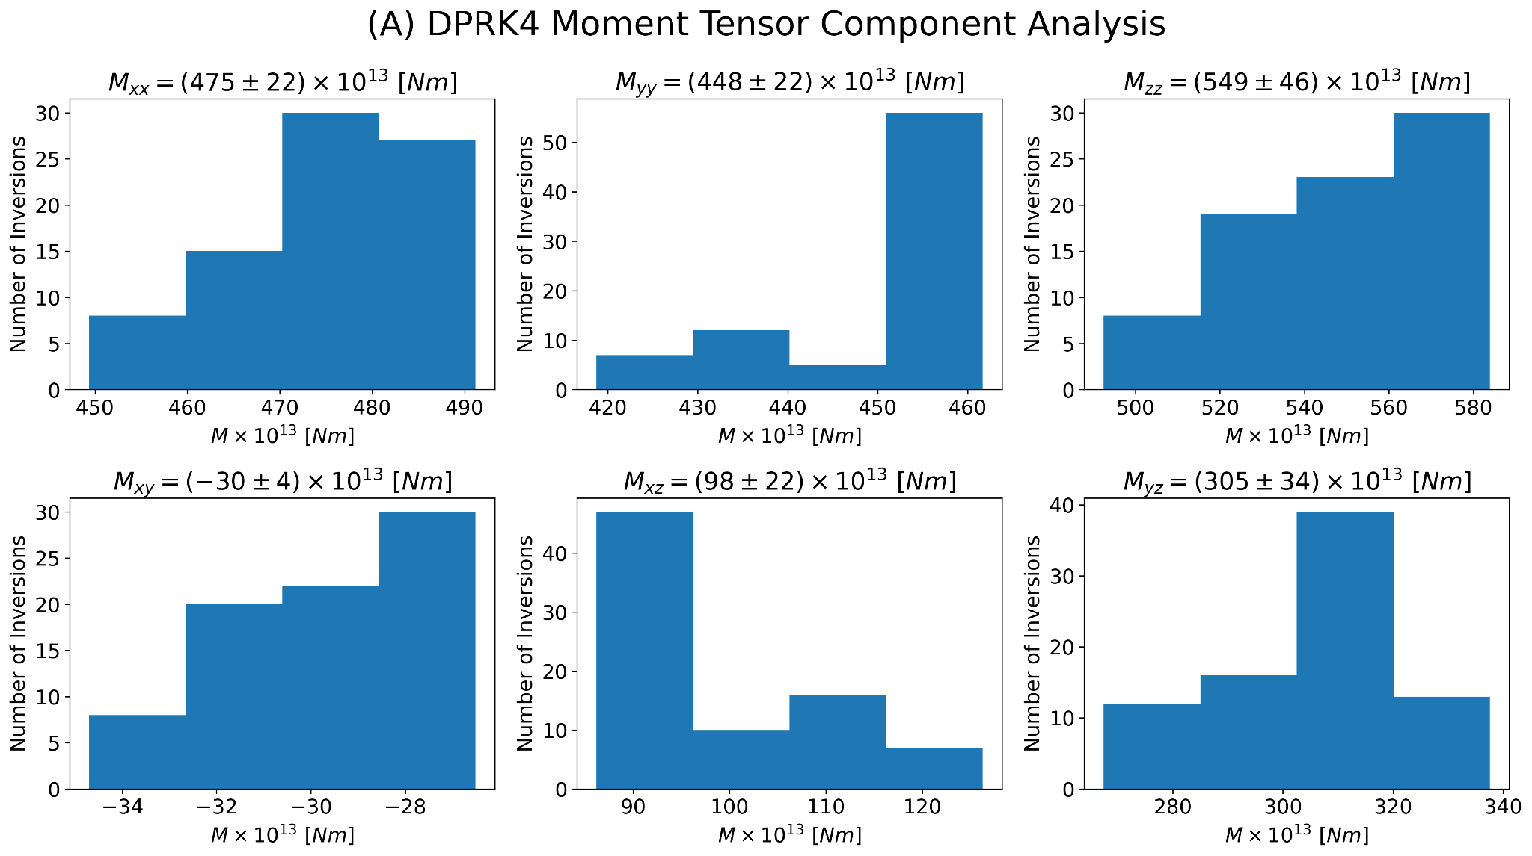
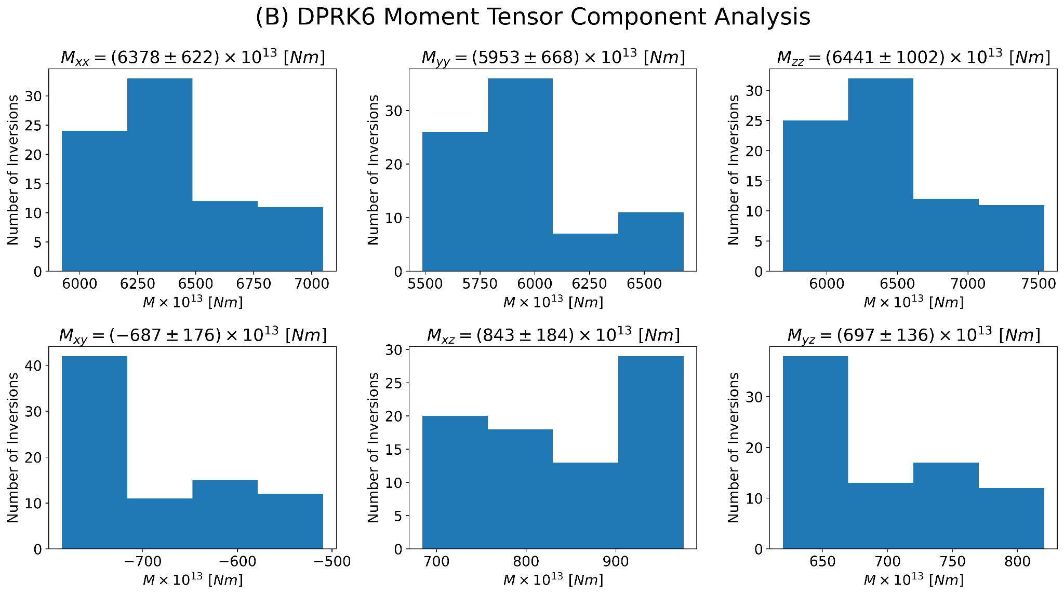
Methods/Data
We developed a joint inversion using regional waveform, first-motion polarities and ground deformation to study DPRK4 (LOS deformation) and DPRK6 (2D deformation).
We run 48 different layered models using typical seismic velocities for each layer.
P2.1-743
Please do not use this space, a QR code will be automatically overlayed

Slide 5
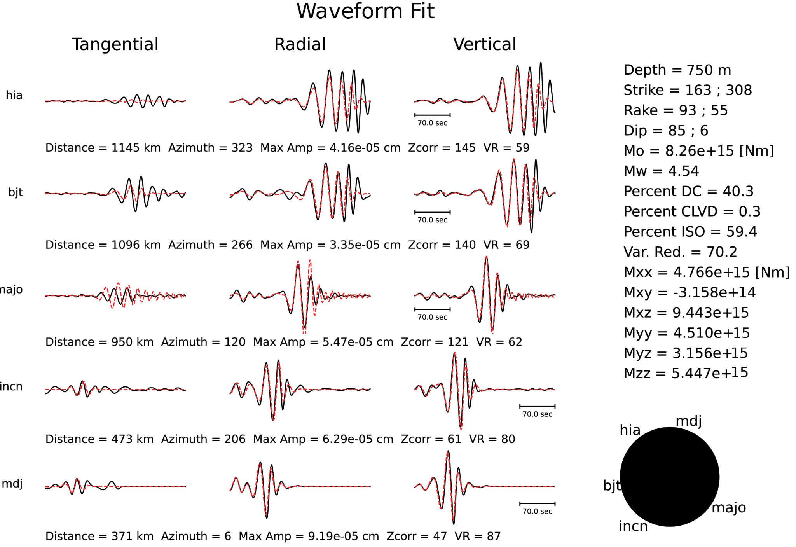
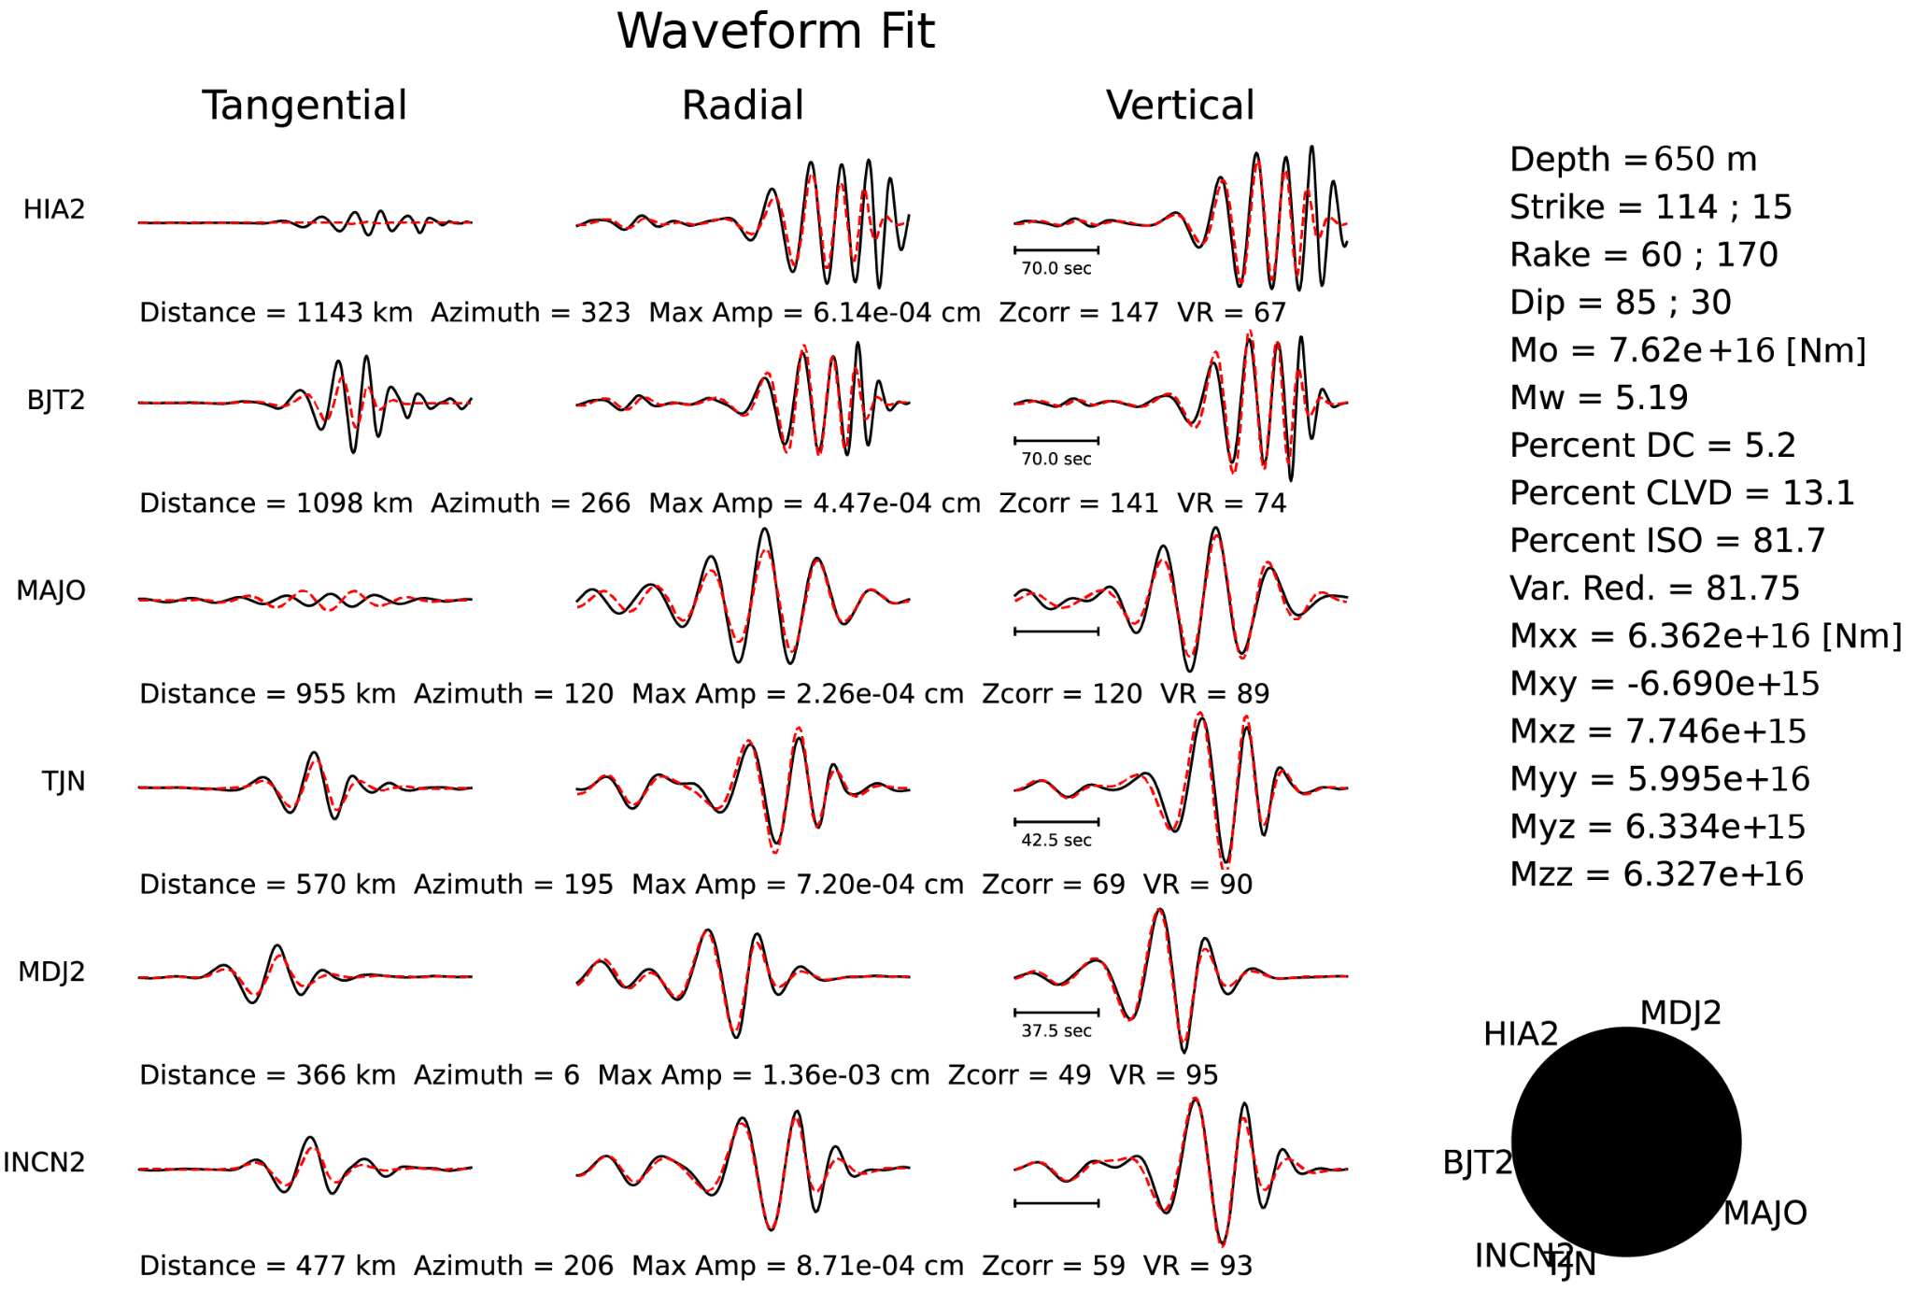
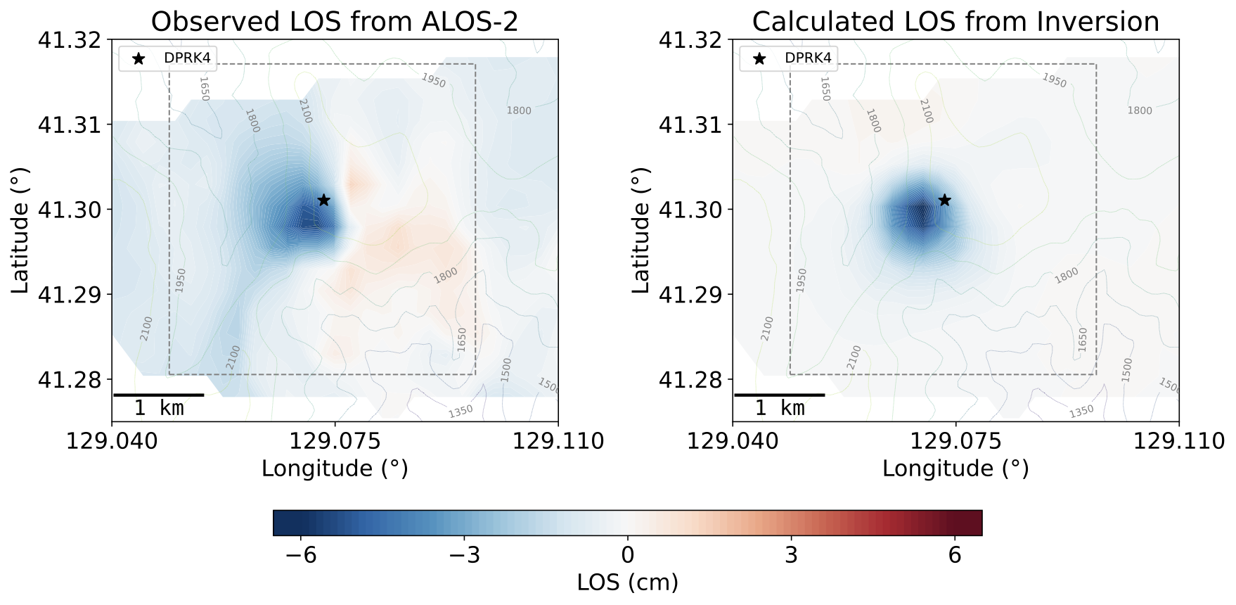
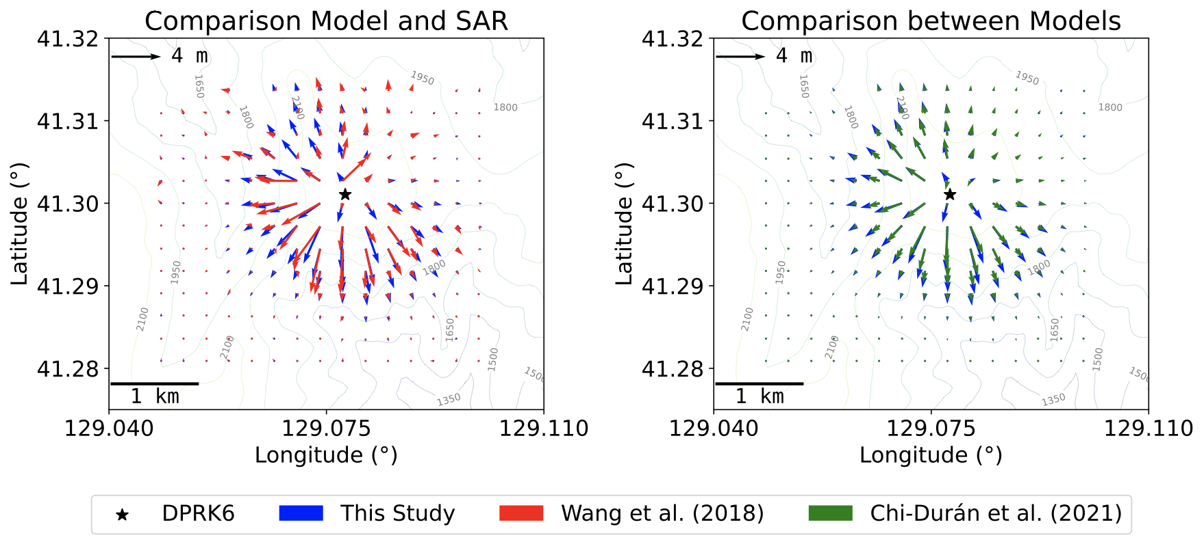
Results
DPRK4
DPRK6
P2.1-743
Please do not use this space, a QR code will be automatically overlayed

Slide 6
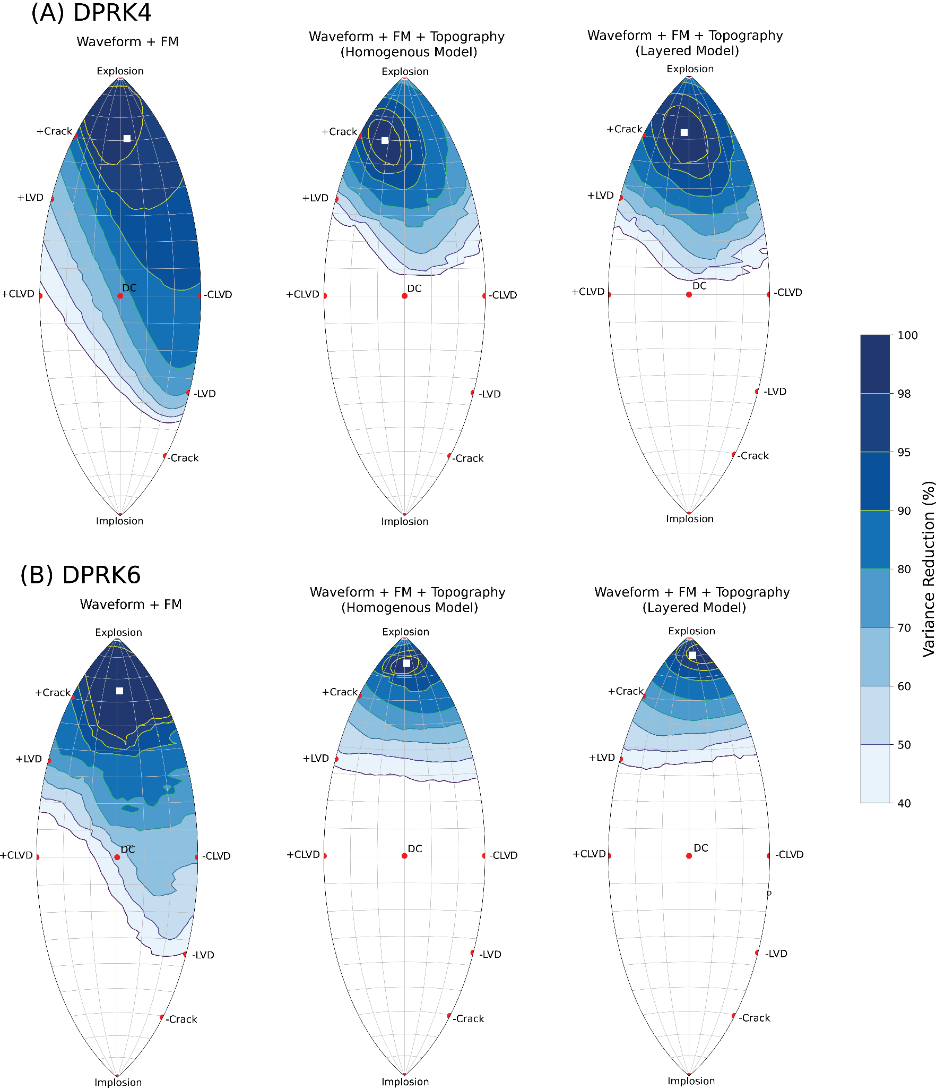
Conclusions
Using a combination of regional/teleseismic first motion polarity, regional distance long-period waveforms, and satellite radar measurements can effectively narrow down the source-type space of moment tensor solutions, increasing discrimination and reducing uncertainty.
We enhanced waveform and geodetic fits, refined moment tensor solutions and uncertainties, and importantly, improved the determination of source depth, incorporating the geological structure of Mt. Mantap.
The demonstrated method is adaptable to other events, and could be beneficial in characterizing underground mining events, collapses, and volcanic seismicity, especially when satellite-based measurements of ground deformation are available.
P2.1-743
Please do not use this space, a QR code will be automatically overlayed

