Slide 1
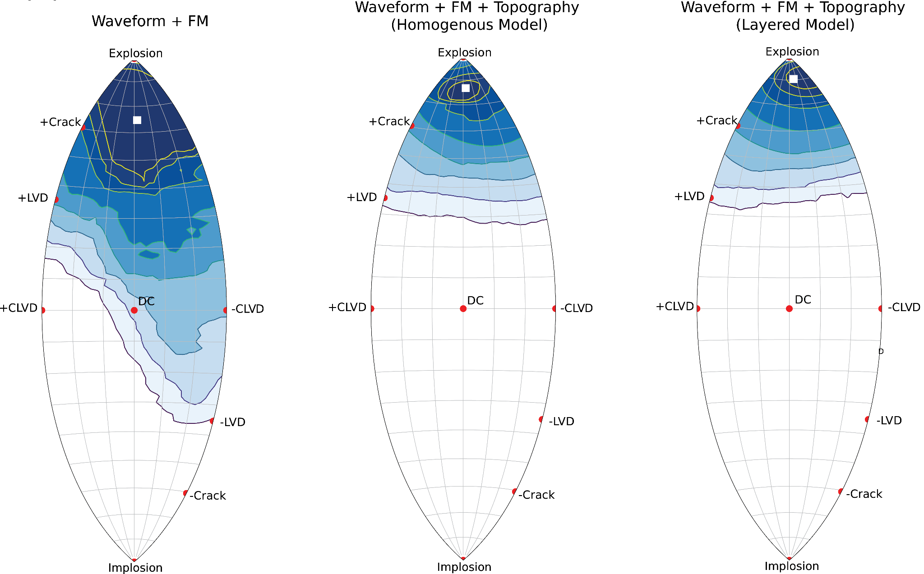
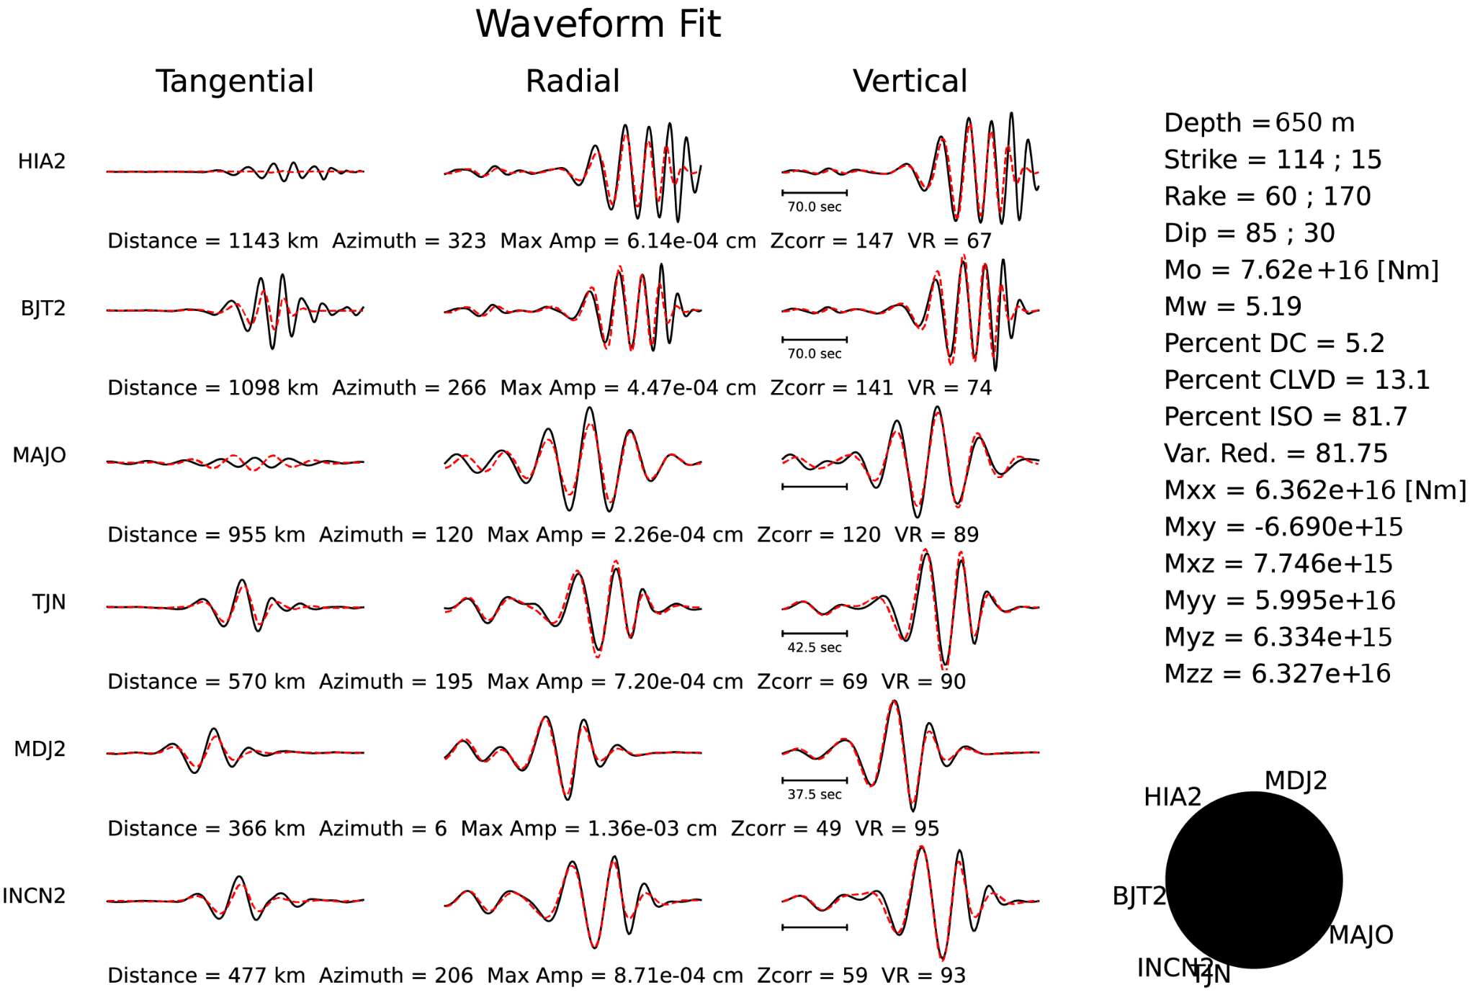
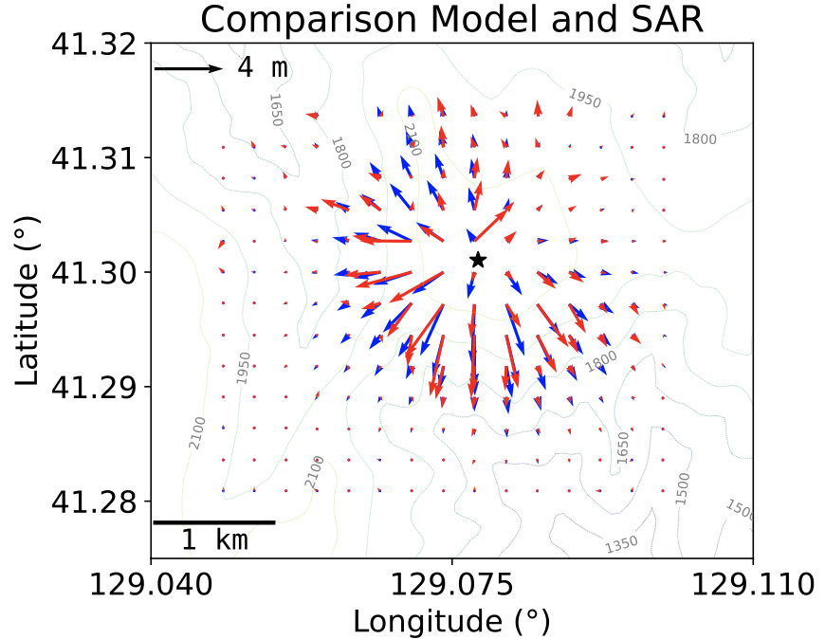
Joint regional waveform, first motion polarity, and surface displacement inversion using a layered elastic model with topography for North Korean Nuclear explosions
Rodrigo Chi-Durán, Douglas S. Dreger and Arthur Rodgers
Earth and Planetary Science Department, University of California, Berkeley
P2.1-743
Regional waveform and first-motion polarity moment tensor inversion can discriminate DPRK events as explosions.
North Korean nuclear explosions produced large amplitude surface deformation, as inferred from satellite observations (e.g., Wang et al. 2017; Myres et al. 2017). However, the regional/first-motion moment tensor solutions do not align with the observed static surface deformation field.
We have developed a joint inversion of regional waveforms, first-motion polarity and surface deformation to determine moment tensor solutions DPRK 4 and DPRK6.
We find:
The waveforms/fm are now consistent with an inversion only the surface data.
A geological model better explains the on-site deformation and helps to constrain the MT solutions.
The joint inversion improves overall discrimination capability and reduces uncertainty for both nuclear tests.

