Slide 1
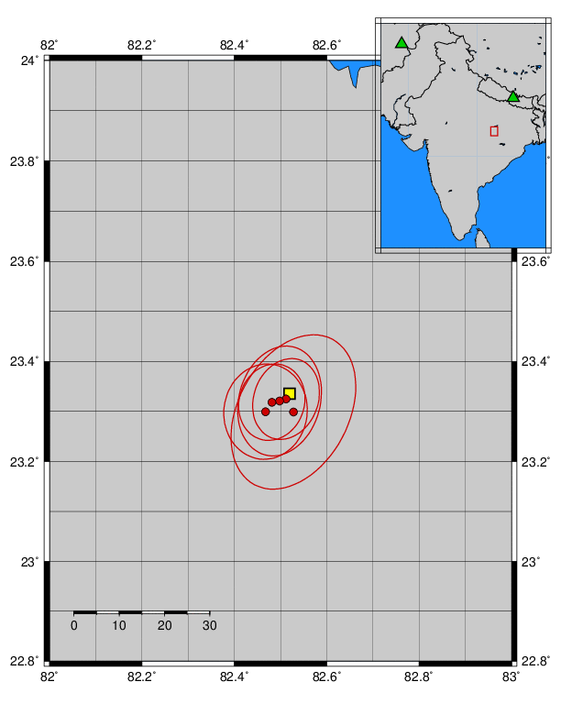
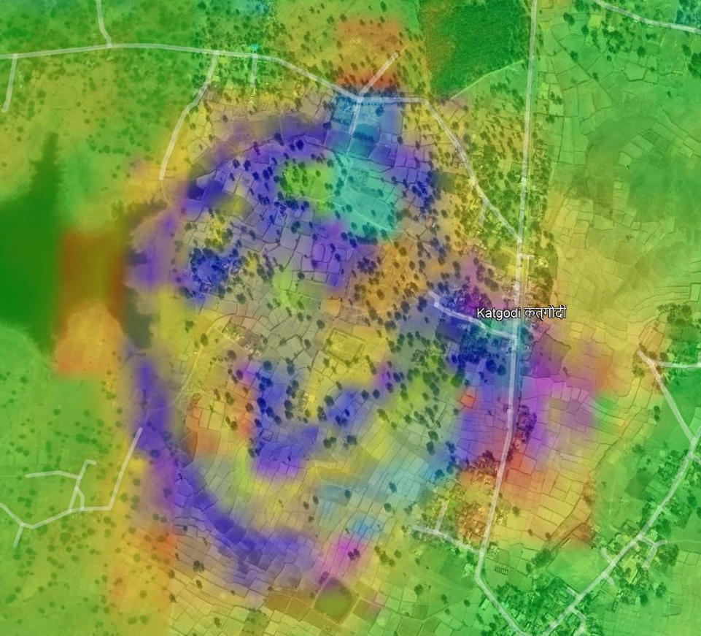
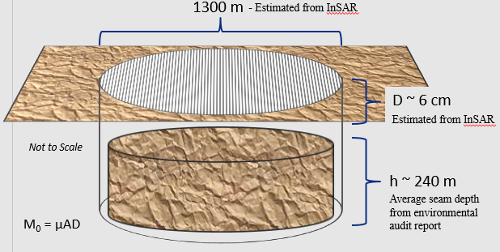
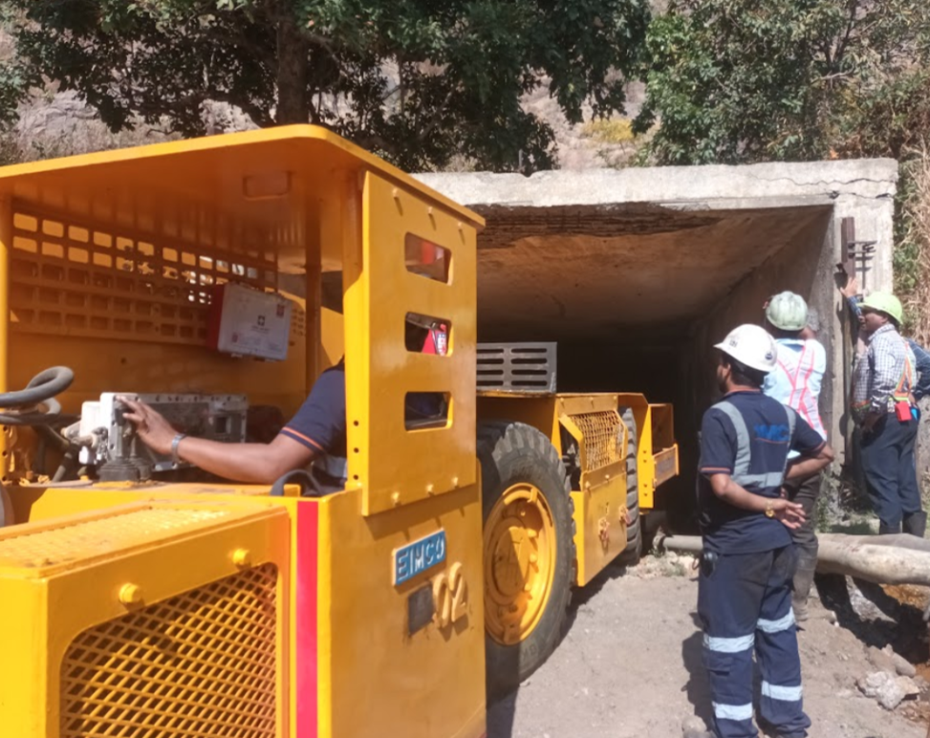
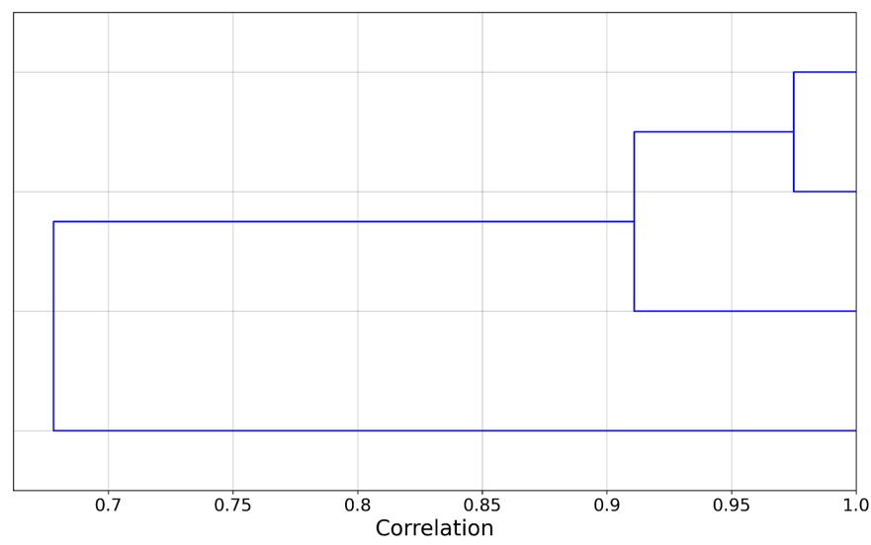
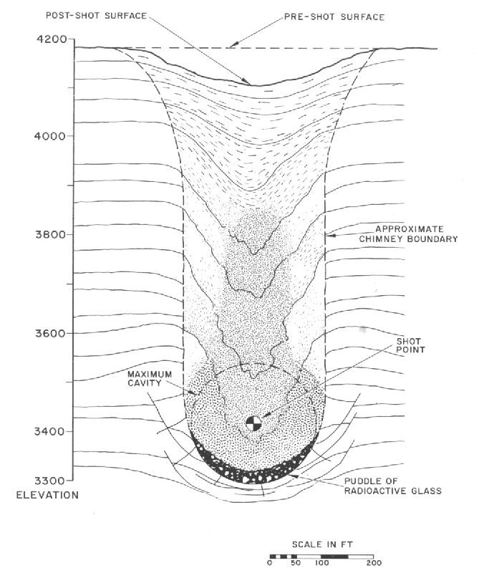
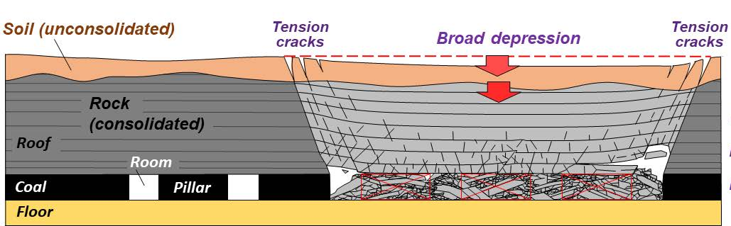
Anlaysis of Anomalous Seismic Events in India
T. VanDeMark, J. Roman-Nieves, R. Zhou, M. Woods, and G. Johnson
Air Force Technical Applications Center (US NDC), Patrick SFB, Florida, USA
P2.1-357
1300 m
KKN, full-waveform, 0.5 – 1.5 Hz, 200 sec, complete link clustering

