Slide 1
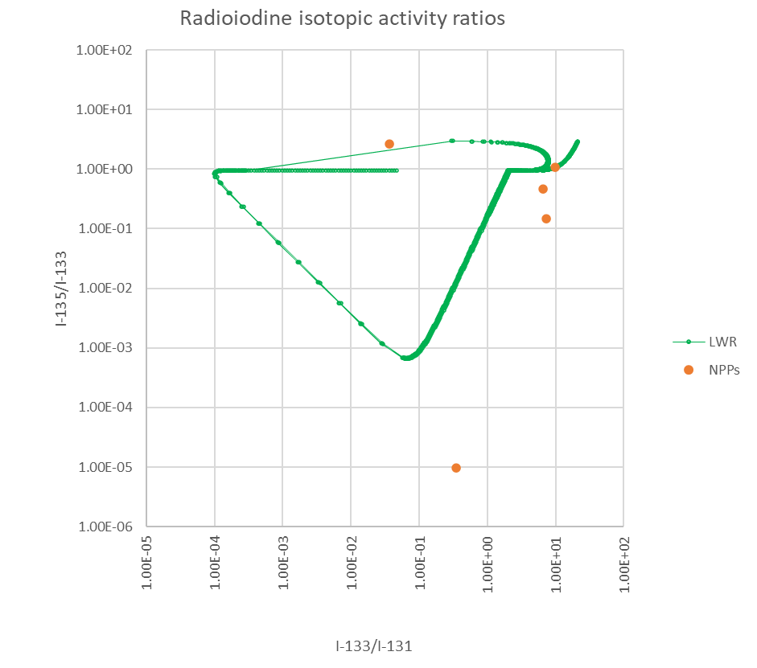
Radioxenon to radioiodine ratios in emissions from nuclear power plants
Martin Kalinowski, Halit Tatlisu
International Data Centre (IDC), Comprehensive Nuclear-Test-Ban Treaty Organization (CTBTO), Vienna, Austria
P2.1-323
The purpose of this e-poster is to establish knowledge about the radioxenon to radioiodine ratios that are released from nuclear power plants (NPPs).
We use annual release data from NPPs for three radioiodine isotopes and investigate the radioxenon to radioiodine ratios of ¹³³Xe / ¹³¹I.
We compare ratios of radioiodine and radioxenon in NPP releases with simulations of nuclear explosions and emissions in Nevada.
We investigate the 3-isotope plot for radioiodine isotopes.
We explore the ¹³³Xe / ¹³¹I ratio to see whether nuclear tests signals might be distinguishable from NPP releases.
See our e-poster and discuss with us the conclusions that we draw.

