Slide 1
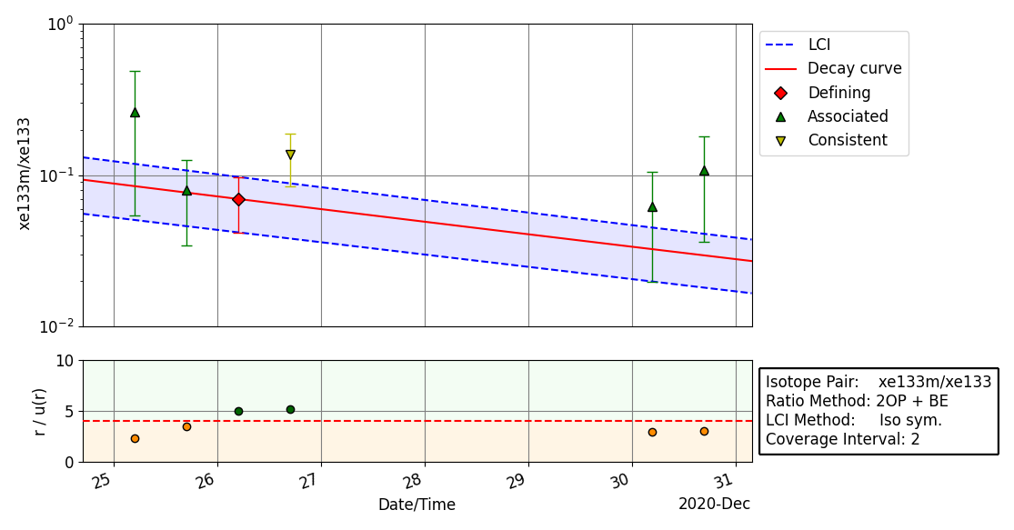
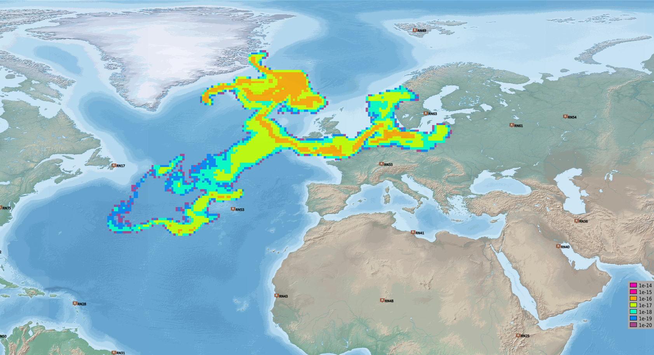
Development of Automatic Procedures for Selecting Samples Associated with a Release Event Based on the Evolution Consistency of Isotopic Ratios
Joshua Kunkle, Boxue Liu, Yuichi Kijima, Robin Schoemaker, Jolanta Kuśmierczyk-Michulec, Martin Kalinowski, CTBTO
P2.1-521
Automatic Sample association using isotopic ratios starts by selecting seed samples from sample measurements
Unique sample sequences are formed
Sequences at different times and from different stations are joined if they may have measured similar air masses, based on ATM simulation
Sample sequences are qualified by checking compatibility
Results are saved for further review
ATM backward simulation from RN63 at T – 115h
Selected samples at station RN63
RN63

