Slide 1
Development of Automatic Procedures for Selecting Samples Associated with a Release Event Based on the Evolution Consistency of Isotopic Ratios
Joshua Kunkle, Boxue Liu, Yuichi Kijima, Robin Schoemaker, Jolanta Kuśmierczyk-Michulec, Martin Kalinowski
CTBTO
Isotopic Ratios are used to associate samples to common origins
Samples having anomalous concentrations are selected, filtered, and matched using Atmospheric Transport Modeling
Sample sequences are created for further analysis and creation of Possible Source Regions
Future work will expand the procedure to include event discrimination and timing
Please do not use this space, a QR code will be automatically overlayed
P2.1-521

Slide 2
Expert Technical Analysis using Isotope Ratios
Isotope ratios are utilized instead of activity concentrations to eliminate the variability due to atmospheric transport
If the source location and type is known, the predicted isotope ratios at IMS stations vary only as a function of time due to differing half-lives
Measured activity concentration ratios between
Xe-133 and Xe-131m for the release from the suspected 2013 DPRK nuclear test
This poster presents an automatic processing pipeline that associates samples based on the evolution of activity ratios
P2.1-521
Please do not use this space, a QR code will be automatically overlayed
Algorithms And Associated Hypothesis Testing Applied to Noble Gas Spectrum Analysis Results and Event Characterization Regarding CTBT-Relevant Nuclear Events, Liu et.al.

Slide 3
Enable Expert Technical Analysis through automatic sample selection and association
Example analysis period from station RN63 in December 2022
Focus on radioxenon isotopes : Xe-131m, Xe-133, Xe-133m, Xe-135
Identify seeds samples where at least 2 Xenon isotopes are detected with anomalous concentrations
Form sequences based on time-interval requirements
Level A – no detection
Level B – detection
Level C – anomalous detection
P2.1-521
Please do not use this space, a QR code will be automatically overlayed
RN63 observes frequent anomalous detections due to nearby civil facilities

Slide 4
Seed selection and Sequence generation
Level A – no detection
Trim non-interesting samples
Combine sequences having overlapping seeds
Level B – detection
Level C – anomalous detection
Px.x-xxx
Sample sequences are further qualified by checking consistency among all measurements
Please do not use this space, a QR code will be automatically overlayed

Slide 5
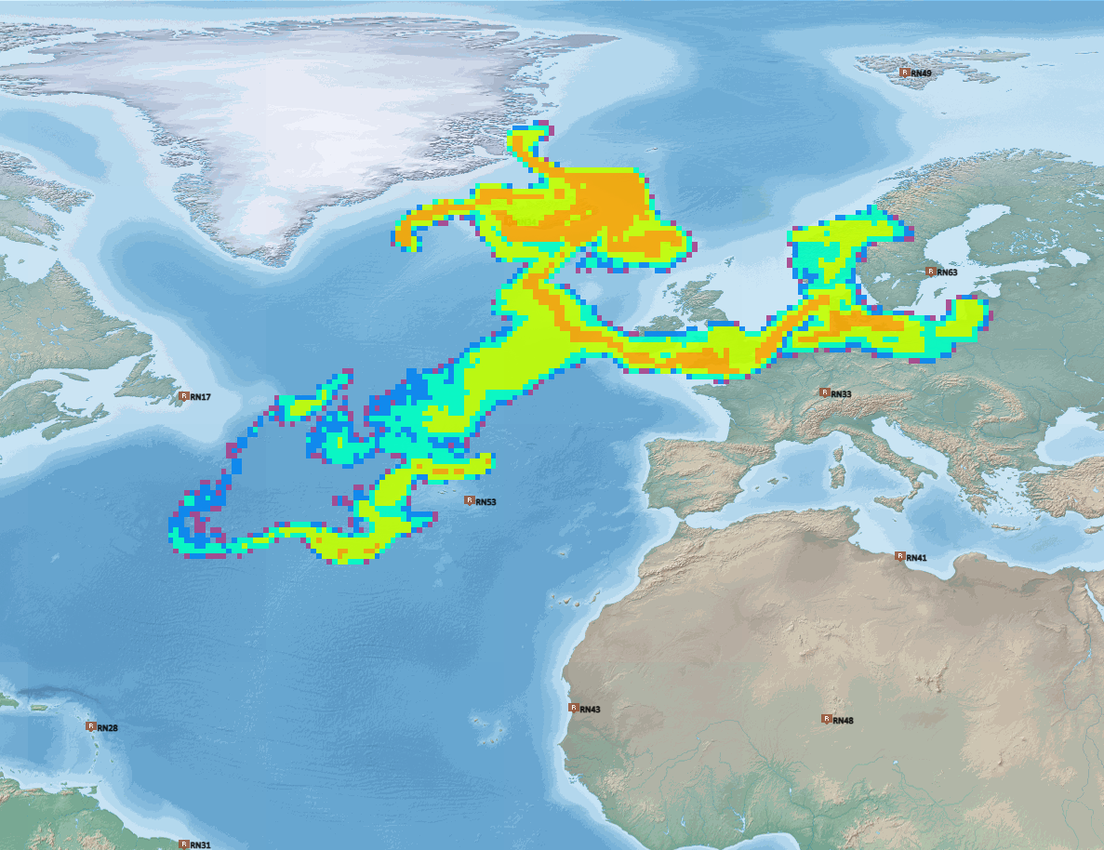
Connection Through Atmospheric Transport Modeling
As radioisotopes are transported through the atmosphere, they may pass other IMS stations, or the same IMS station multiple times
ATM backward simulation from RN63 at T – 115h
The IDC produces ATM backwards simulations corresponding to each sample measurement
Predicts particle concentration vs location and time
Current resolution is 1 hour, 0.5 x 0.5 deg
Tracing is performed for up to 14 days in the past
If the ATM simulation suggests that samples may be relate, they are joined into the same sequence
RN63
P2.1-521
Please do not use this space, a QR code will be automatically overlayed

Slide 6
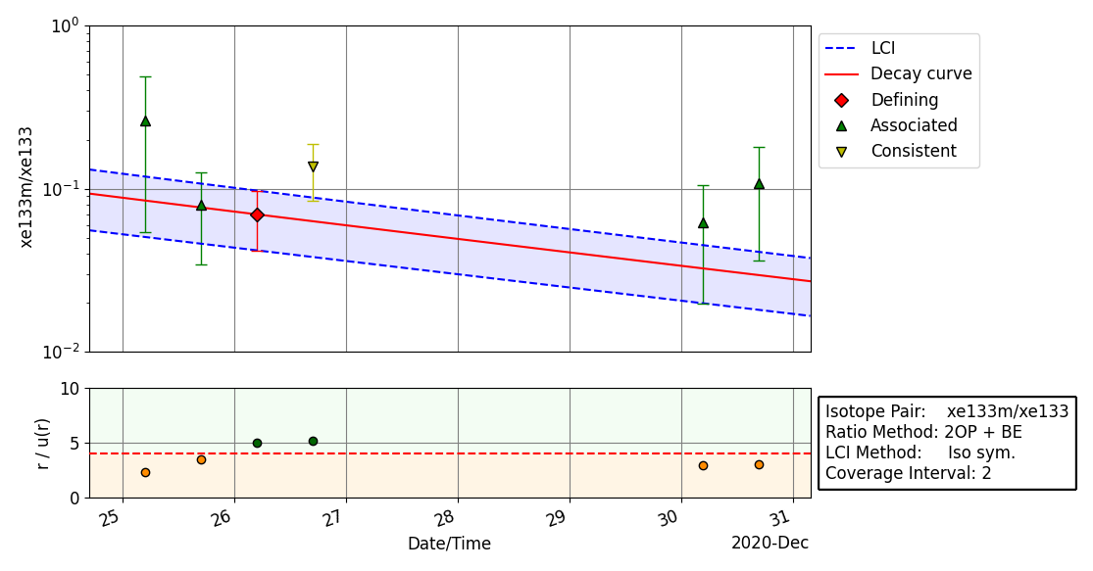
Sample association
The seed sample having the smallest uncertainties is chosen as defining
Samples are associated using a 2-sided t-test, having 5% probability of rejecting true association
Results are saved for further interactive analysis
Selected samples at station RN63
P2.1-521
Please do not use this space, a QR code will be automatically overlayed

Slide 7
Next Steps
Possible Source Region Determination from ATM simulations – see poster P{2.4-334 by Robin Schoemaker
Event Discrimination
Automatically determine source of event
Utilize data and simulations of Nuclear Power Plant releases and Nuclear Explosions
Event timing
Determine most likely release time based on event discrimination results
P2.1-521
Please do not use this space, a QR code will be automatically overlayed

