Slide 1
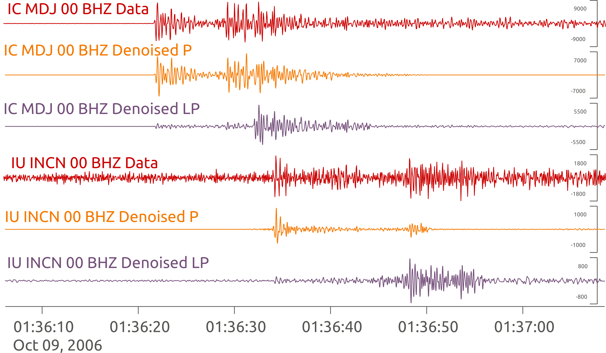
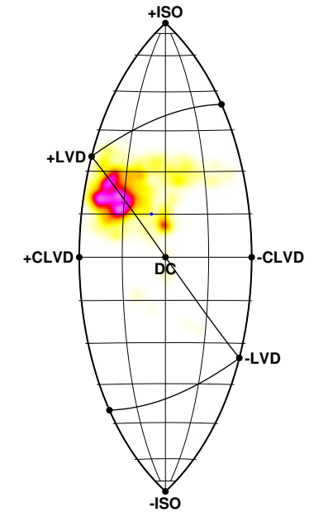
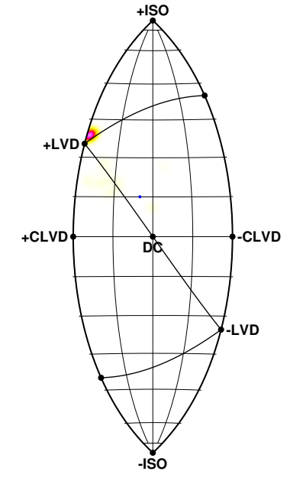
Advantages and Issues of Applying Machine Learning Based Denoising on Inversions of the Democratic People's Republic of Korea Nuclear Tests
We trained an autoencoder denoiser on a IMS dataset (several 10k seismological and hydroacustic waveforms)
We train one autoencoder for P-waves and one for long periods
Denoised data are great for detection and picking – but for what else?
MT analysis of the 2006 and 2017 DPRK test before and after denoising to check the suitability of denoised waveforms for follow up analysis
Result: great potential - but a slightly biased interpretation is to be expected at the current stage of denoising technology
Data vs denoised
MT Before
MT Denoised
Machine learning network
Andreas Steinberg, Peter Gaebler, Christoph Pilger, Gernot Hartmann, Johanna Lehr
Federal Institute for Geosciences and Natural Resources (BGR)
P2.1-222

