Slide 1
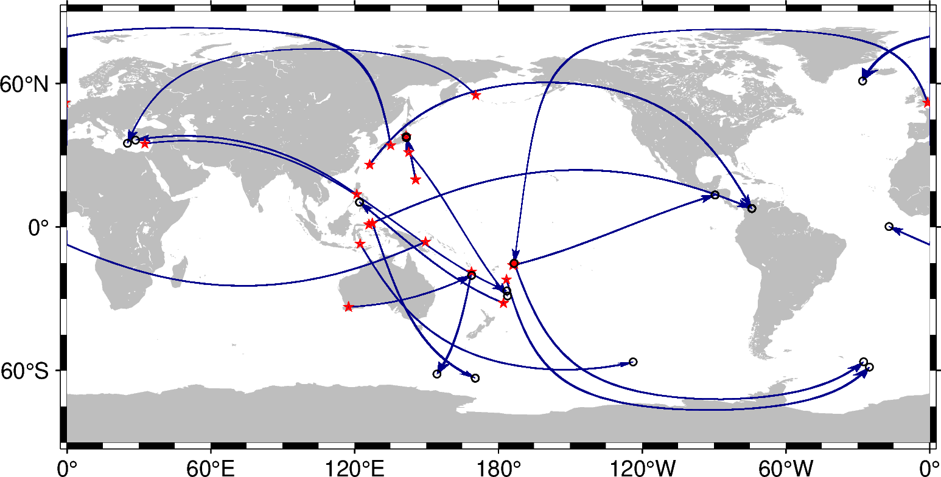
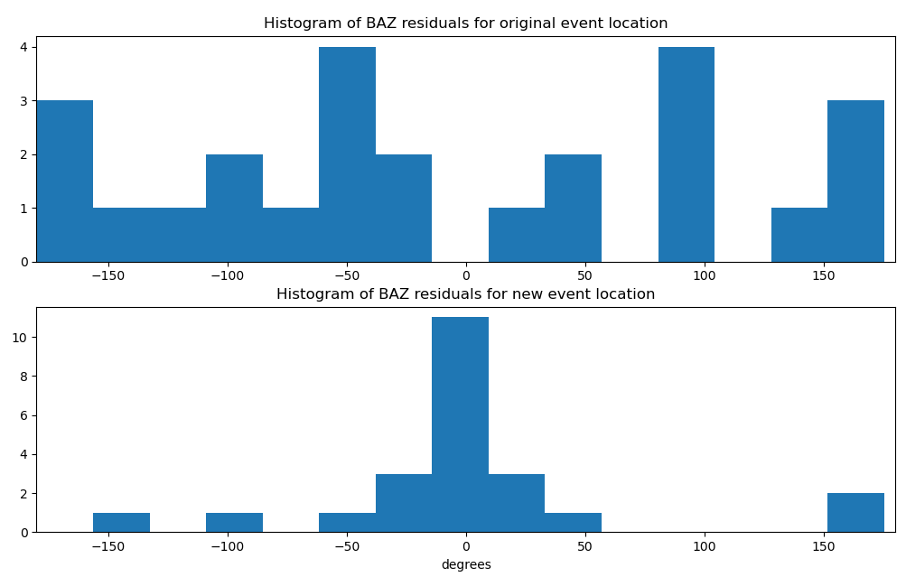
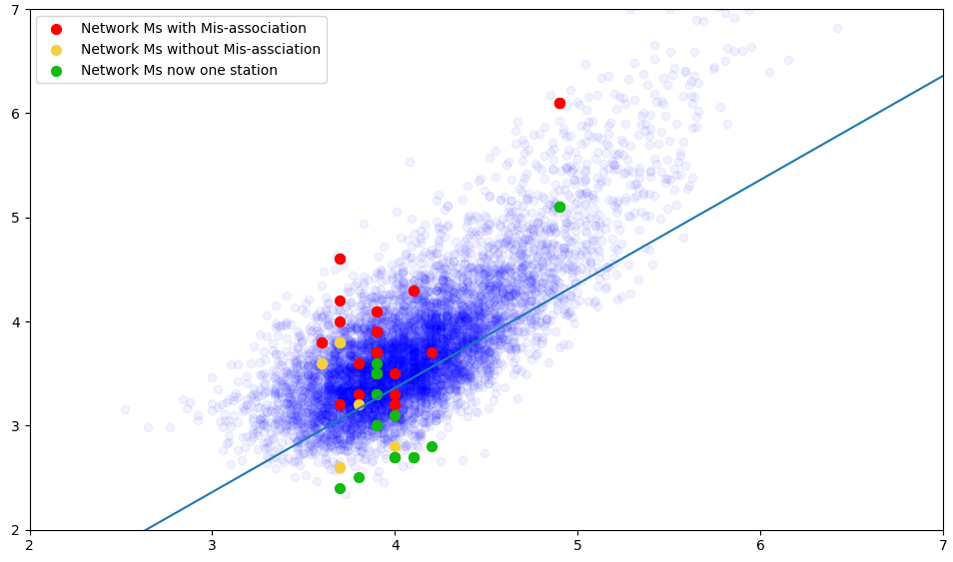
Mis-associated Surface Waves Within the Automated Processing Flow of the Reviewed Event Bulletin
John Condon, Neil Selby
AWE Blacknest
P2.1-287
There are scenarios where the International Data Centres’ automatic surface wave processing can fail due to the constraints of the dispersion test used for detection and association.
Most common scenario is the a surface wave from ∆ > 100° being mis-associated with an event much closer.
Additional constraints should improve association of surface waves in the reviewed event bulletin.
Updated event bulletins could look into the surface wave associations.
Azimuths should be used in MsConflict to determine associations.
Displacement (nm)
Frequency (Hz)
Time (s)
Corrected m_{b}:M_{s} Ratios
_{Surface wave Magnitude Ms}
The inclusion of misassociated arrivals in an event can reduce the accuracy of the network M_{s} and hence reduce reliability of event characterisation using m_{b}:M_{s}.
_{Body wave magnitude mb}

