Slide 1
Mis-associated Surface Waves Within the Automated Processing Flow of the Reviewed Event Bulletin
John Condon, Neil Selby
AWE Blacknest
Contained within the Reviewed Event Bulletin are surface waves that have been associated with the wrong event. This is caused by a distance limit in the processing flow. Examples are presented which are verified through a dispersion test plot.
A dispersion test was written in python to emulate the IDC automatic processing flow. Alongside this the Chael algorithm was implemented to test the azimuthal residual between potential events and the station making the surface wave detection.
We find 28 arrivals in 2022 that can be conclusively found to have the wrong event association, which had a drastic effect on the m_{b} : M_{s} screening criteria.
The effects of mis-associations in the reviewed event bulletin have been verified and the applicability of using the azimuth residual for association with the removal of the distance limit has been demonstrated.
Please do not use this space, a QR code will be automatically overlayed
P2.1-287

Slide 2
Overview of IDC Processing
There are scenarios where the International Data Centres’ automatic surface wave processing can fail due to the constraints of the dispersion test used for detection and association.
Most common scenario is a surface wave from ∆ > 100° being mis-associated with an event much closer.
Additional constraints should improve association of surface waves in the REB
Corrected Ms could be released as a prototype Updated Event Bulletin (UEB)
Azimuths should be used in MsConflict to determine associations.
IDC surface wave processing
Event formed from body waves
Surface wave arrival times predicted
Dispersion test performed
MsConflict
Maxpmf
The arrival time of the peak of the envelope at each frequency is path dependent.
Filtering the signal across a range of frequencies and comparing actual and expected envelope amplitude arrival time can be used for the detection of surface waves from a known location.
Expected arrival times are constructed with global 1 ° spacial resolution group velocity model.
Displacement (nm)
The inclusion of misassociated arrivals in an event can reduce the accuracy of the network M_{s} and hence reduce reliability of event characterisation using m_{b}:M_{s}.
MsConflict
Mark arrivals for events with 4 or more arrivals with “g” (initial assessment is that these are good).
2. Change “g” to “h” if the same arrival is associated with more than one event.
3. Mark all other arrivals associated with more than one event with “m” (unless already marked “g” or “h”).
4. Mark isolated arrivals (>60º with no closer arrivals for the same event) with “s”.
5. Delete arrivals marked with “s”, “m”, or “h”.
Frequency (Hz)
Please do not use this space, a QR code will be automatically overlayed
Left: Predicted dispersion within error limits (red curves), contours show envelope energy at each frequency band, with maximum envelop energy shown as red star for a swath of narrow band filters. The red box indicates the bounds in which the test is performed.
Time (s)
P2.1-287

Slide 3
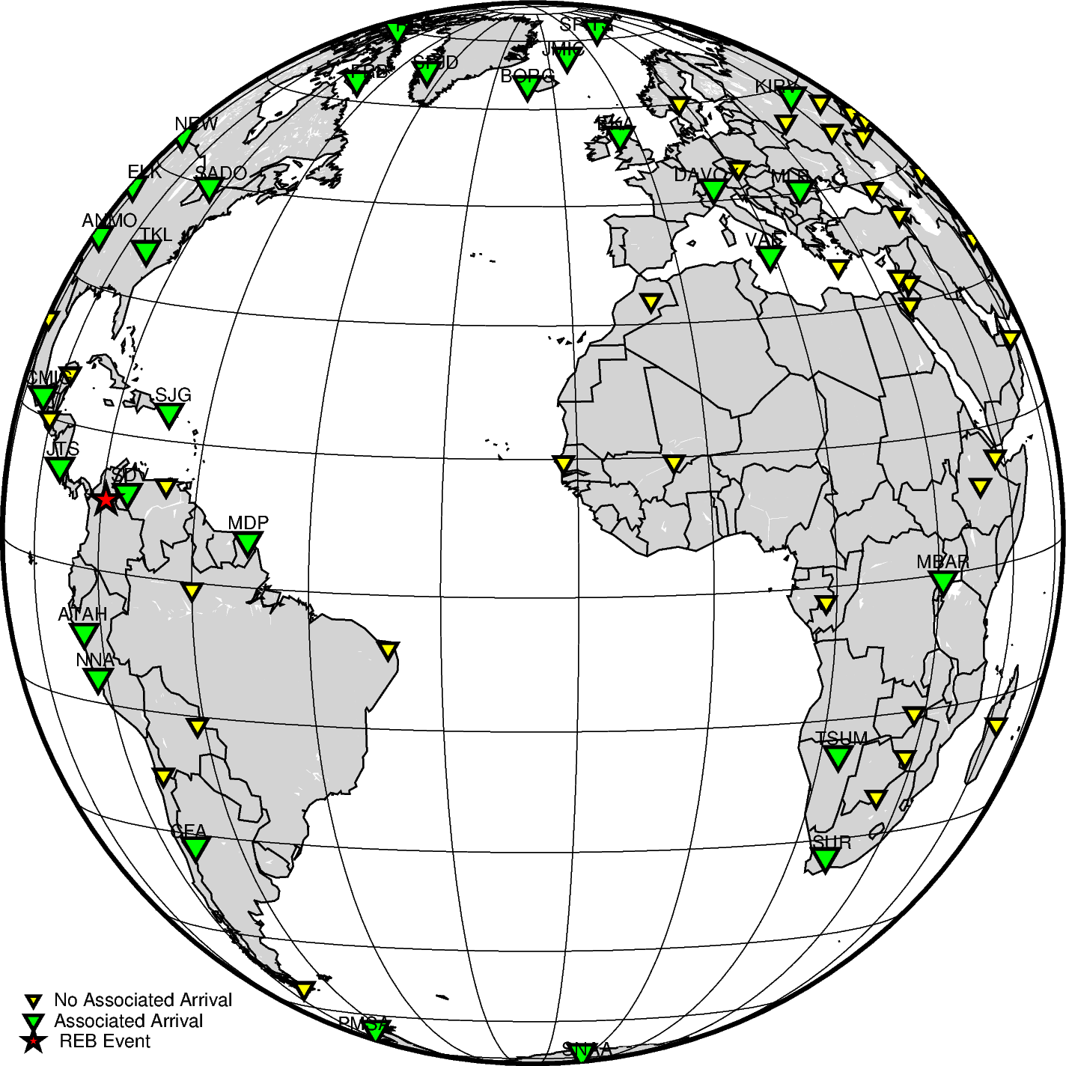
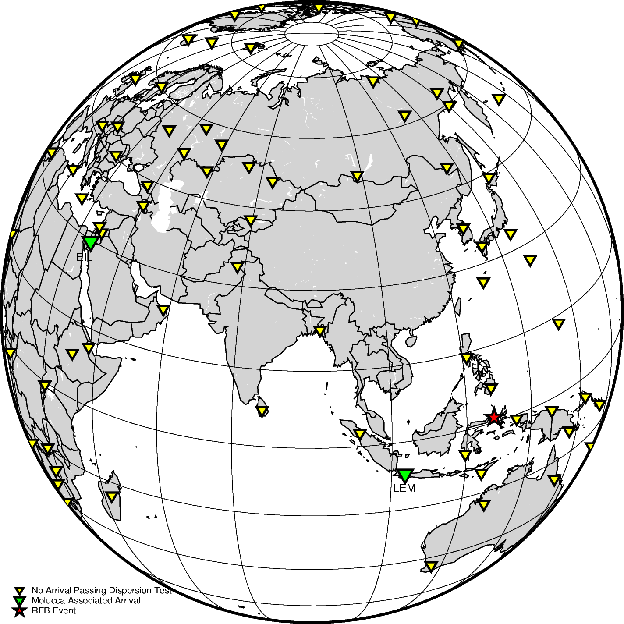
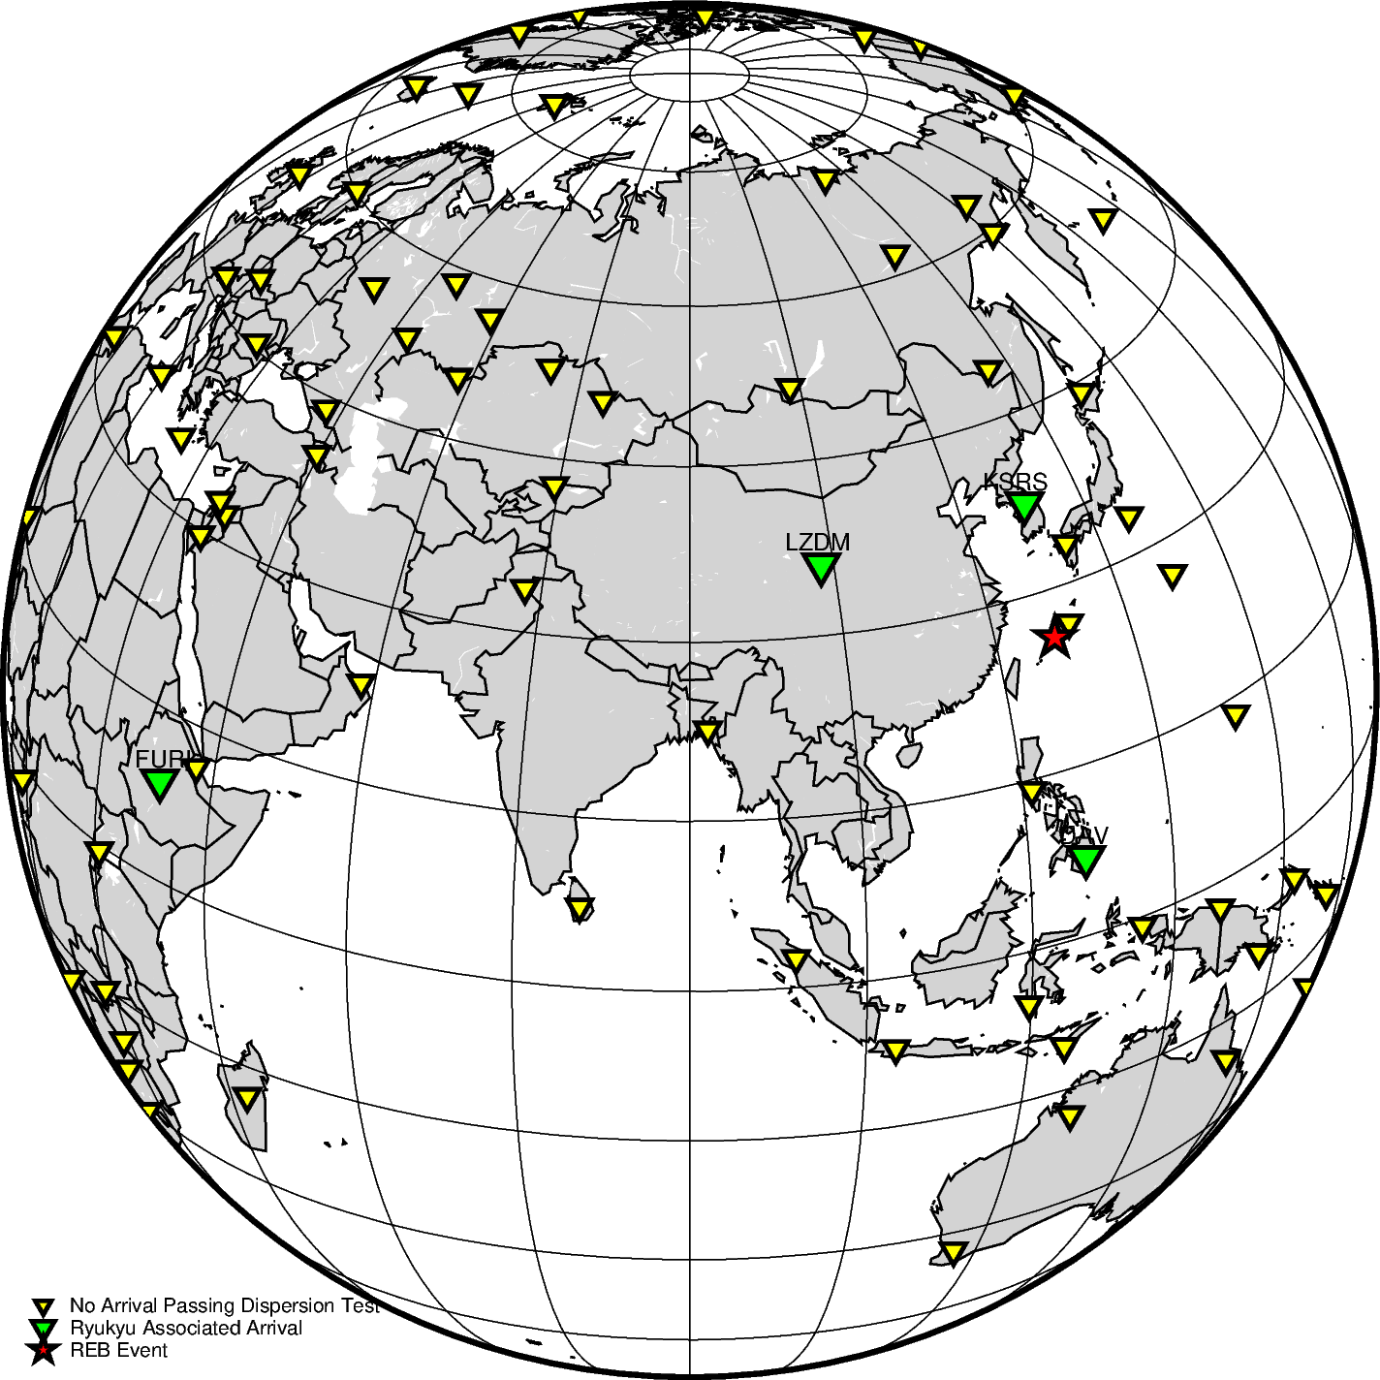
Example Mis-associations
Colombia Event:
2022/02/23
12:49:31
Molucca Sea Event:
2022/02/23
12:52:17
Ryukyu Island Event:
2022/02/23
13:01:01
An M_{s} 4.6 event occurred in Colombia on the 23rd of February 2022 at 12:49:31 at a depth of 60km.
53 associated arrivals in the REB. The closest surface wave association is at SDV (∆ = 3.75°) and the furthest association is at SUR (∆ = 98°).
Event in Molucca Sea with an M_{s} of 4.0 has two surface waves associated at LEM and EIL. Event occurred three minutes after Colombia event.
Event in Ryukyu Island with M_{s} of 3.8 has four surface wave associations. Event occurred five minutes after Colombia event.
Please do not use this space, a QR code will be automatically overlayed
P2.1-287

Slide 4
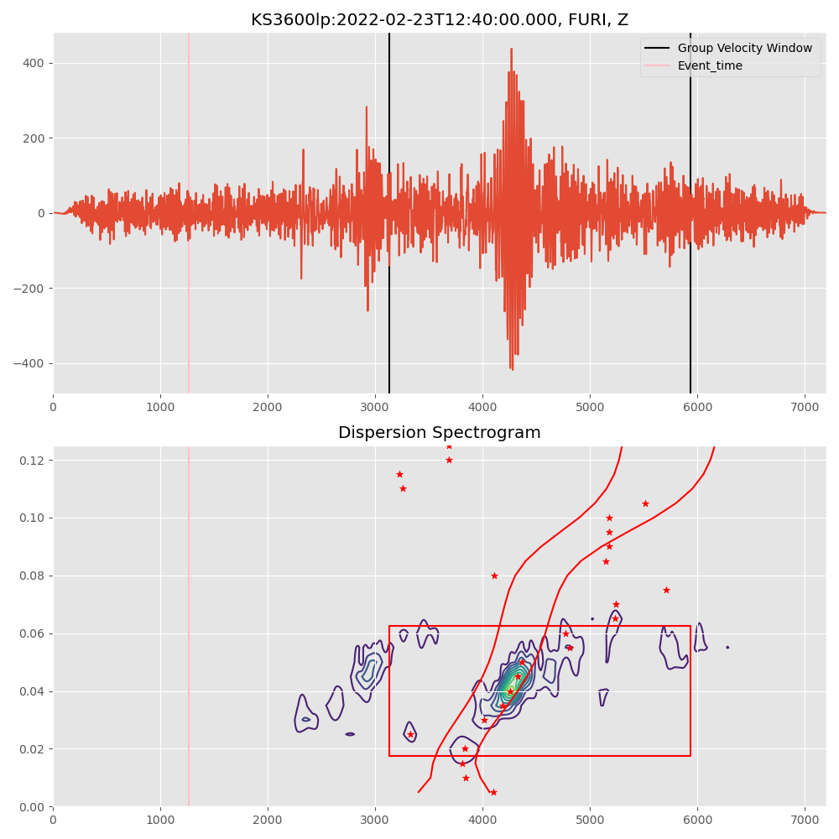
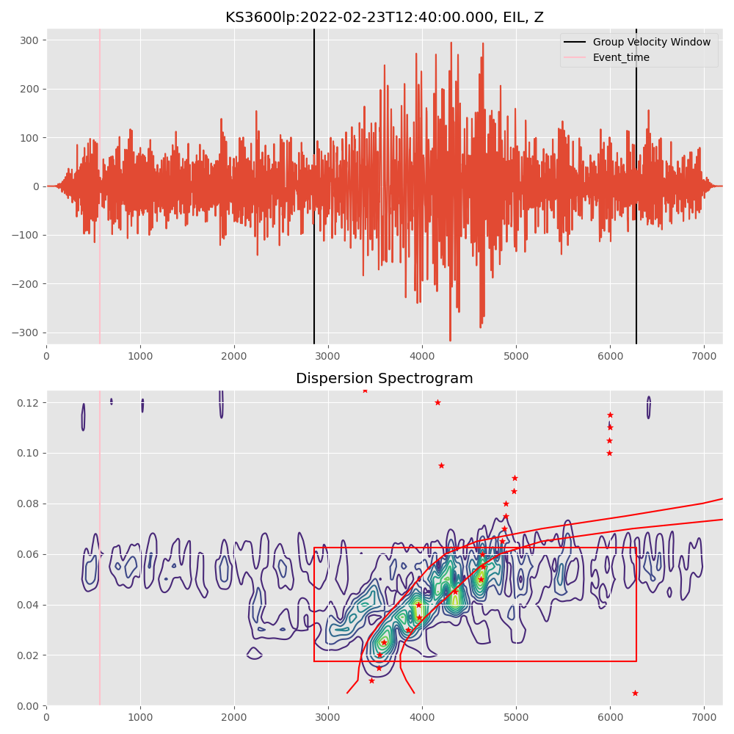
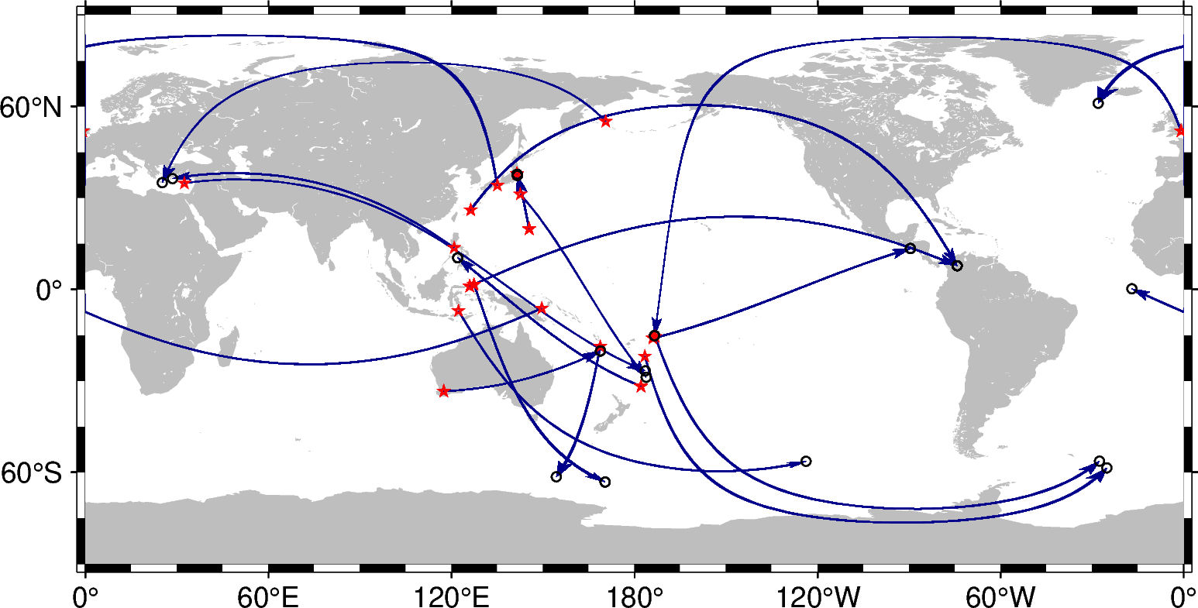
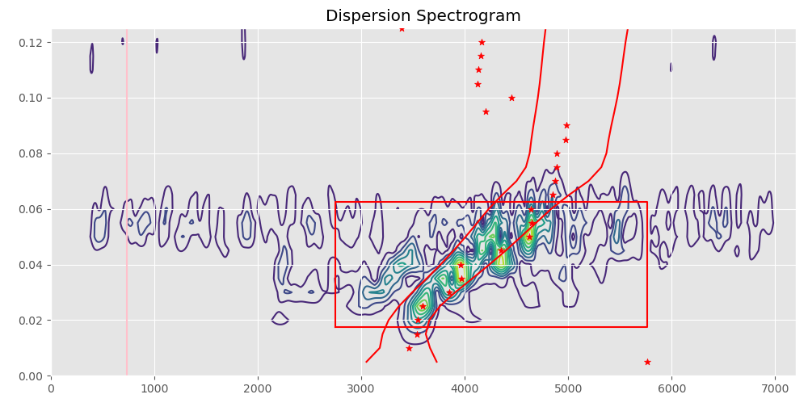
Global Mis-associations
FURI Arrival
EIL Arrival
Mis-associations Identified in 2022
Above: global map of events with mis-associated arrivals in red, and real event location in white.
Top: Long period response data. Centre: Dispersion test using the Colombia event location. Bottom: Dispersion test using the original event location.
28 different arrivals from 17 events found to be mis-associated.
Not an exhaustive list, more events than 17 with mis-associations.
Checked events with 4 or less arrivals with an arrival detected at ∆ > 90°.
Please do not use this space, a QR code will be automatically overlayed
Surface waves that are associated with lower magnitude events with a small number of surface wave detections are actually detections from the larger Colombia event from ∆ > 100° distance.
P2.1-287

Slide 5
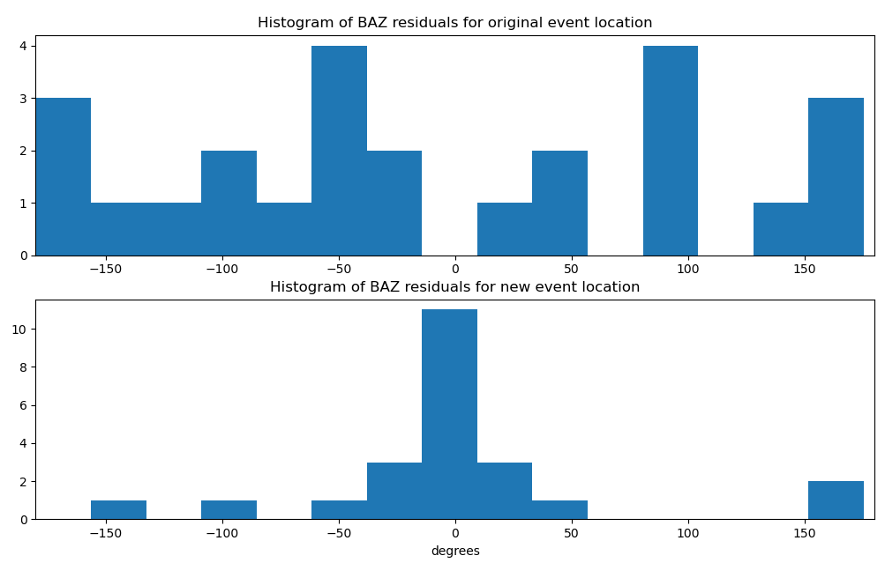
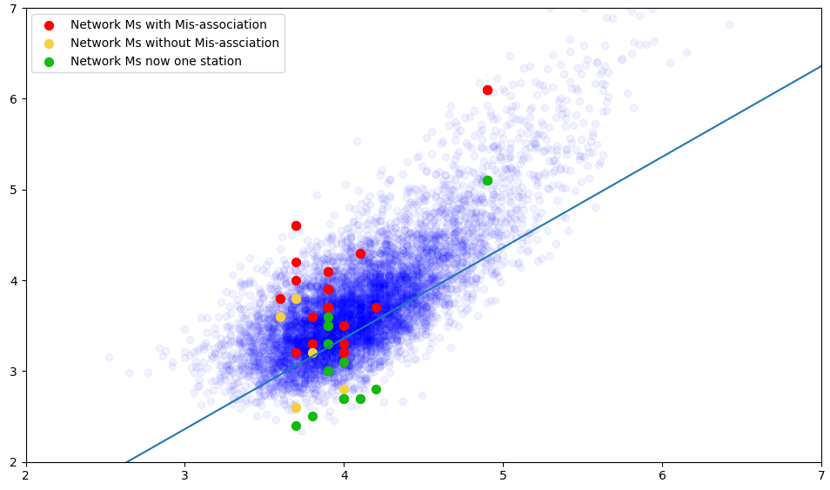
Results of Re-association
Corrected m_{b}:M_{s} Ratios
_{Surface wave Magnitude Ms}
Above: histograms of back azimuth residual comparing great circle azimuth for REB event location and the candidate new event locations.
_{Body wave magnitude mb}
Misassociations tend to come from larger events directly preceding smaller events and hence increase the network average M_{s} when associated with wrong event.
Back-azimuth residual of selected mis-associations to REB event location tends towards a uniform distribution.
Residuals to ∆ > 100° event locations centre residuals at zero with normal distribution.
Stations do not include those with orientation issues.
Please do not use this space, a QR code will be automatically overlayed
By including these mis-associations in the network M_{s} calculation, the M_{s} for the event is being over-estimated. Removing mis-associations also leaves some 12 Events with a single station M_{s} .
P2.1-287

Slide 6
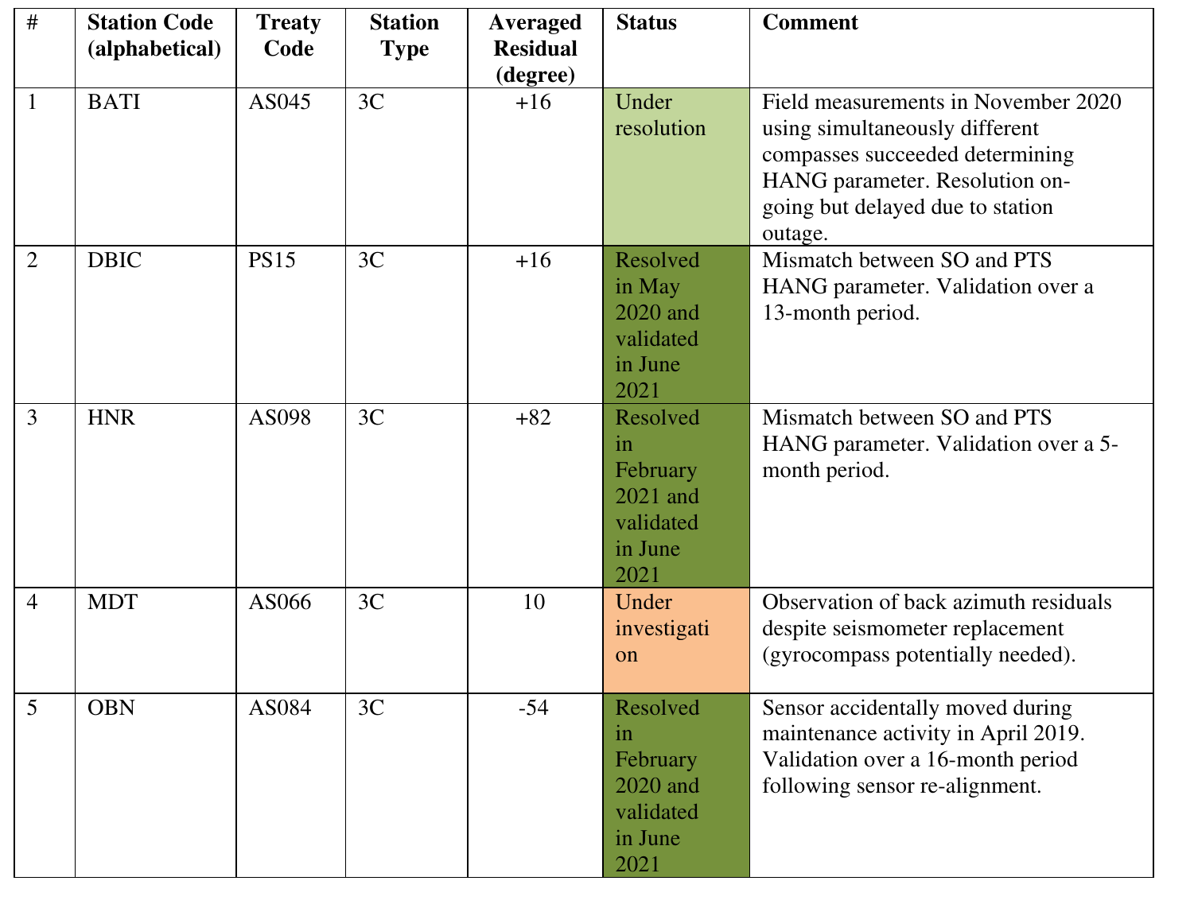
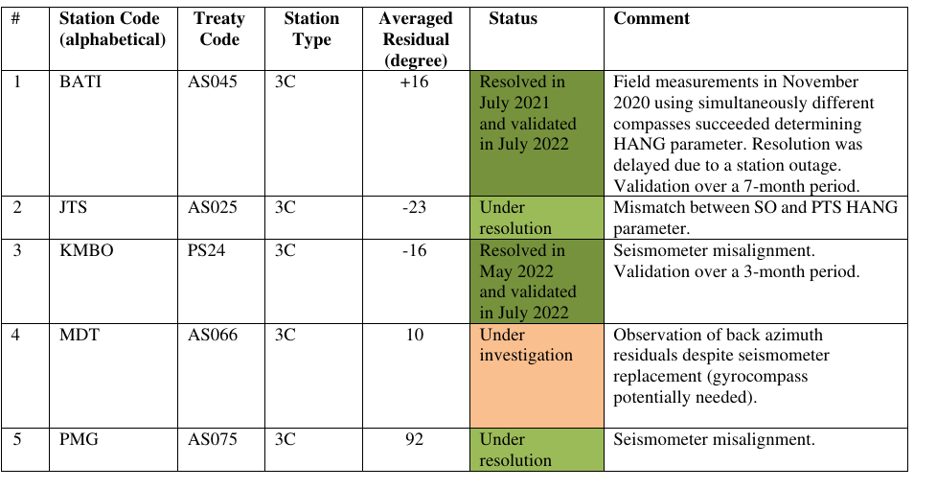
Conclusion
The REB produced by the IDC contains events in which surface wave detections, identified by Maxpmf, have been mis-associated.
So far 28 arrivals have been identified in 2022 from 17 different events, of which are mis-associated due to the 100° limit on association.
The impact of these mis-associations on the network averaged Ms has been demonstrated. This could potentially affect the reliability of event characterisation using m_{b}:M_{s}.
Continued investigation into how many different types of mis-association and how prevalent each are is required.
Recommend now that on going configuration checking is being done, test the use of azimuths to assist in association.
2021
2022
Three-component orientation issues are being fixed and as such back-azimuth residual should be used in associations.
Please do not use this space, a QR code will be automatically overlayed
P2.1-287

Slide 7
References
Stevens, J.L., Adams, D.A., and Baker, G.E., 2001. Improved surface wave detection and measurement using phase-matched filtering with a global one-degree dispersion model. Science Applications International Corp., San Diego CA.
Rezapour, M., and Pearce R.G., 1998. Bias in surface-wave magnitude Ms due to inadequate distance corrections. Bull. Seism. Soc. Am.; 88(1), 43–61.
Stevens, J.L, 2007. Automatic Surface Wave Processing Support and Documentation. CTBTO Vienna International Centre.
Ekström, G., 2006. Global Detection and Location of Seismic Sources by Using Surface Waves. Bull. Seism. Soc. Am.; 96(4A), 1201–1212.
Selby, N.D., Marshall, P.D., and Bowers, D., 2012. m_{b}:M_{s} event screening revisited. Bull. Seism. Soc. Am.; 102(1), 88-97.
Please do not use this space, a QR code will be automatically overlayed
P2.1-287

