Slide 1
A novel radioxenon event classification method based on CatBoost
Zhao Yungang,Wang Shilian,Li Qi,Zhang Xinjun,
Fan Yuanqing,Jia Huaimao,Zhang Ruiqin,Li Ruiying
Beijing Radionuclide Laboratory
Radioxenon monitoring is an important technicle for nuclear explosion monitoring,especially under ground nuclear test. The problem of discriminating radioxenon derived from an explosion or anthropogenic sources is quite interesting and remains unresolved.
In machine learning , this is a binary classification problem. The background plus explosion signals were synthesized and modeled artificially. Background data were acquired from IDC database. Eleven machine learning algorithms were applied to the dataset.
Five metrics are applied to evaluate different classifier models. Among the Eleven machine learning algorithms, CatBoost is the best method and Kneighbour is the worst method. Feature importance and SHAP value are used to interpret.
A novel radioxenon event classification method based on CatBoost is established, which is evaluated by a synthetic dataset. Compared with other ML model，CatBoost model gives the best result. The model trained by the synthetic dataset is applied to a nuclear explosion signal screening exercise.
Please do not use this space, a QR code will be automatically overlayed
P2.1-553

Slide 2
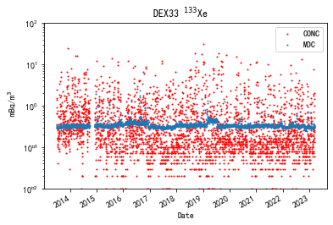
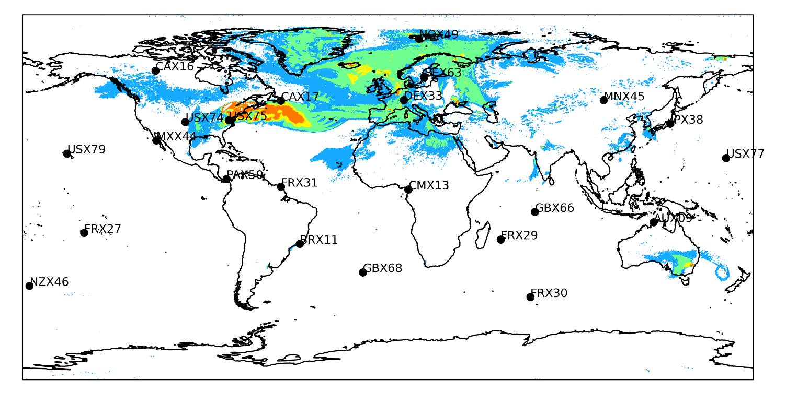
Discriminating radioxenon derived from an explosion or anthropogenic sources is remains unresolved.
^{131m}Xe,¹³³Xe,^{133m}Xe,¹³⁵Xe
Source: MIPF,NPP,NRR,etc
¹³³Xe Detected frequently
Facilities ? Nuclear Explosion?
Please do not use this space, a QR code will be automatically overlayed
P2.1-553

Slide 3
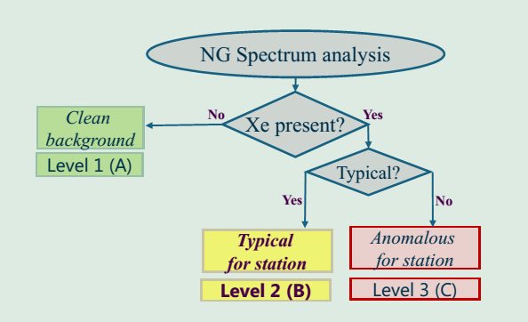
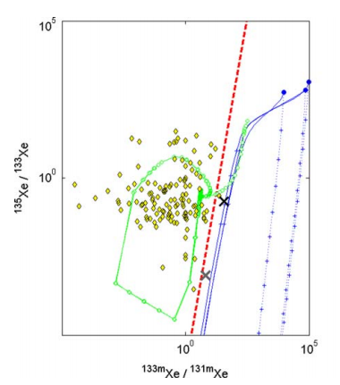
What we should discriminate is the background signal and the background plus explosion signal.
CTBTO
CTBTO: Level A,B,C,
Level C samples:400+/year
Ratio: Mainly focus on Pure explosion
MIPF have similar ratios
Background Signal?
Background Plus Explosion Signal ?
Kalinowski Plot
Please do not use this space, a QR code will be automatically overlayed
P2.1-553

Slide 4
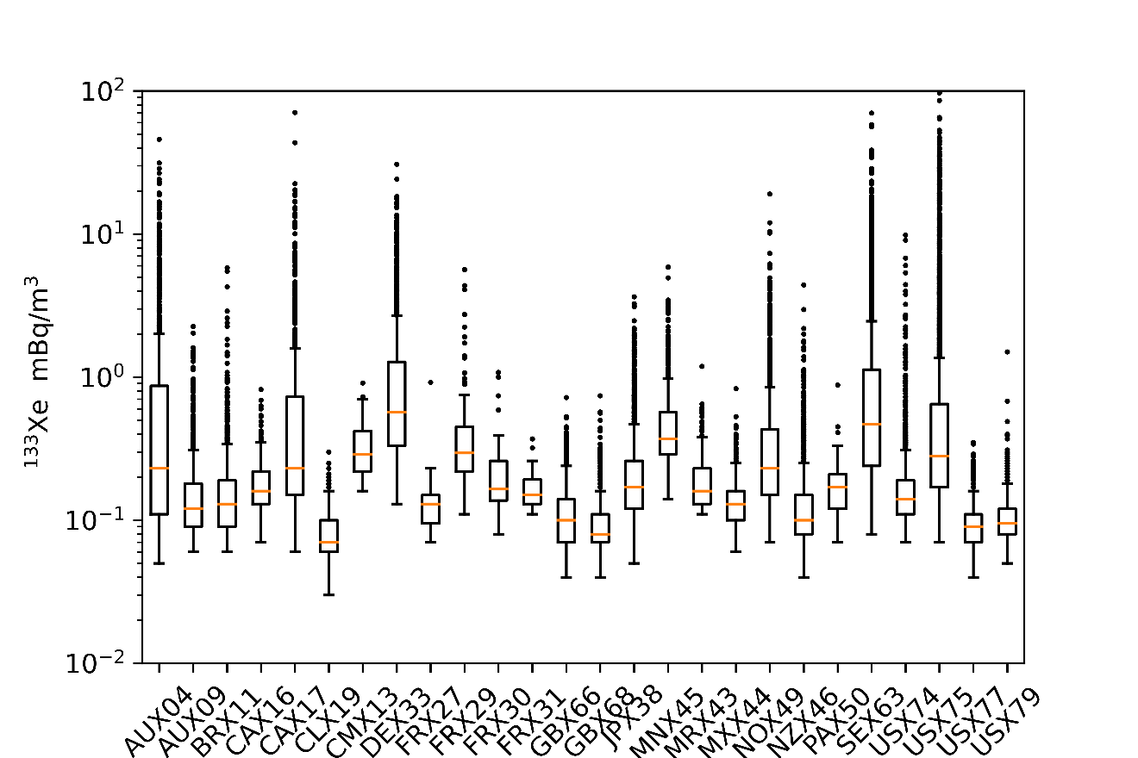
The background plus explostion dataset was producted by combine the background portion and the explosion portion.
IDC 2012-08~2023-03
Clean Para：Collection Time,Acquition Time,Volume,MDC
Before Clean:137347
After Clean:132484
Nuclear Explosion
t0: ¹³³Xe (1.1E16 Bq ), ^{133m}Xe ( 8.8E14 Bq ), ^{131m}Xe ( 2.9E12 Bq ), ¹³⁵Xe ( 6.2E16 Bq )
¹³³Xe Conc:log normal distribution
geometric mean 2 mBq/m³
minum Value:0.5mBq/m³
$$Xe_{B+E}=Xe_{B}+Xe_{E}$$
Please do not use this space, a QR code will be automatically overlayed
P2.1-553

Slide 5
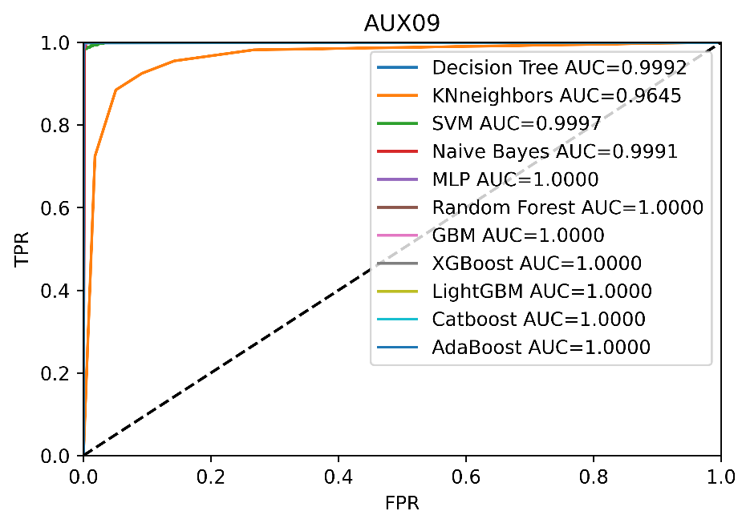
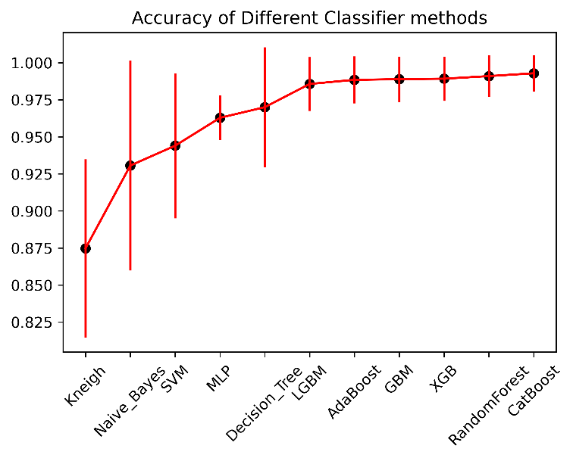
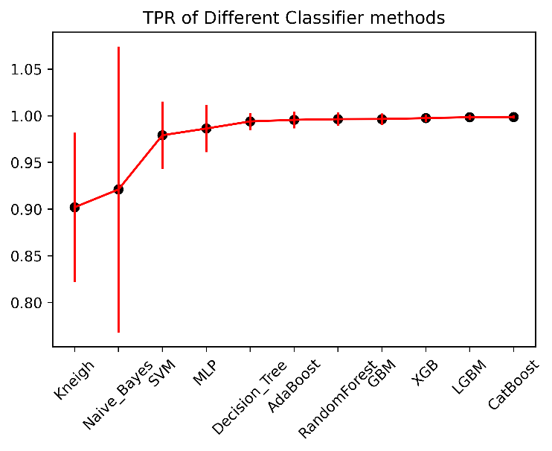
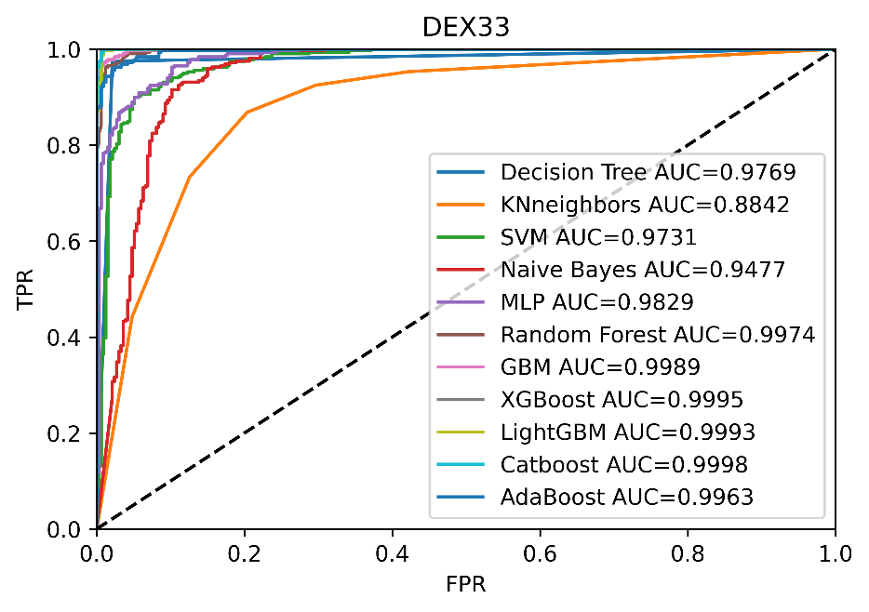
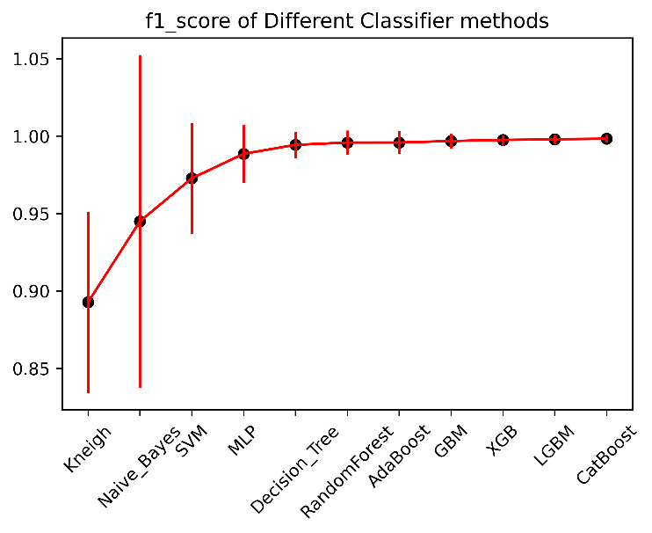
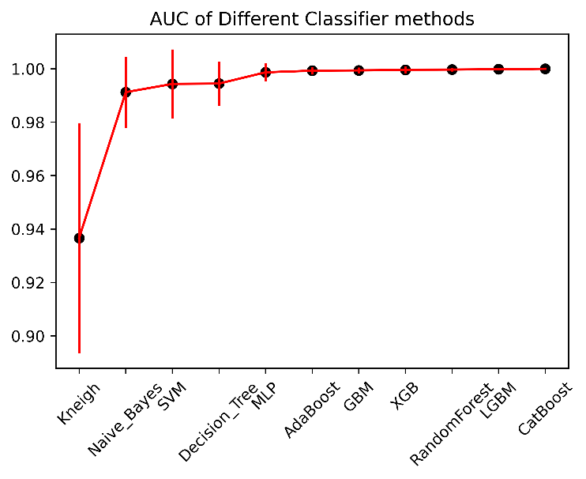
Results
Please do not use this space, a QR code will be automatically overlayed
P2.1-553

Slide 6
Conclusion
A novel radioxenon event classification method based on CatBoost is established.
The method is evaluated by a synthetic dataset.
Compared with other ML model，CatBoost model gives the best result.
Though those evaluation metrics show the method give a good result , some false negative and false positive still exist.
The model trained by the synthetic dataset is applied to the nuclear explosion signal screening open inter-comparison exercise whose scenarios are different with the synthetic dataset used for training.
Features importance and SHAP value can be used to interpret the model, but it is hard to explain why the monitoring data are classified as the background or explosion plus background.
Please do not use this space, a QR code will be automatically overlayed
P2.1-553

Slide 7
References
Trevor J. Stocki, et al. Machine learning for radioxenon event classification for the Comprehensive Nuclear-Test-Ban Treaty. Journal of Environmental Radioactivity 101 (2010) 68-74.
Frederik Postelt. Capability to detect and categorise real and hypothetical atmospheric concentrations of radioxenon for Comprehensive NuclearTest-Ban Treaty verification. Diploma Thesis (2012)University of Hamburg.
Jonathan L. Burnett, et al. The 2014 Integrated Field Exercise of the Comprehensive Nuclear-Test-Ban Treaty revisited: The case for data fusion. Journal of Environmental Radioactivity 189 (2018) 175-181.
Martin B. Kalinowski, et al. Discrimination of Nuclear Explosions against Civilian Sources Based on Atmospheric Xenon Isotopic Activity Ratios. Pure and Applied Geophysics 167 (2010) 517-539.
Matthias Zähringer, Gerald Kirchner. Nuclide ratios and source identification from high-resolution gamma-ray spectra with Bayesian decision methods. Nuclear Instruments and Methods in Physics A 594 (2008) 400-406.
C. Maurer, B. Liu, et al . 1st Nuclear Explosion Signal Screening Open Inter-Comparison Exercise 2021. RNEG/60th WGB,2023, Austria.
Please do not use this space, a QR code will be automatically overlayed
P2.1-553

