Slide 1
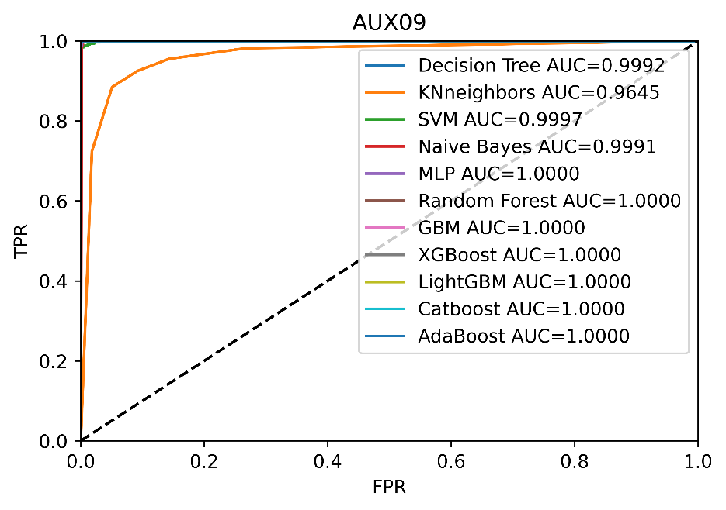
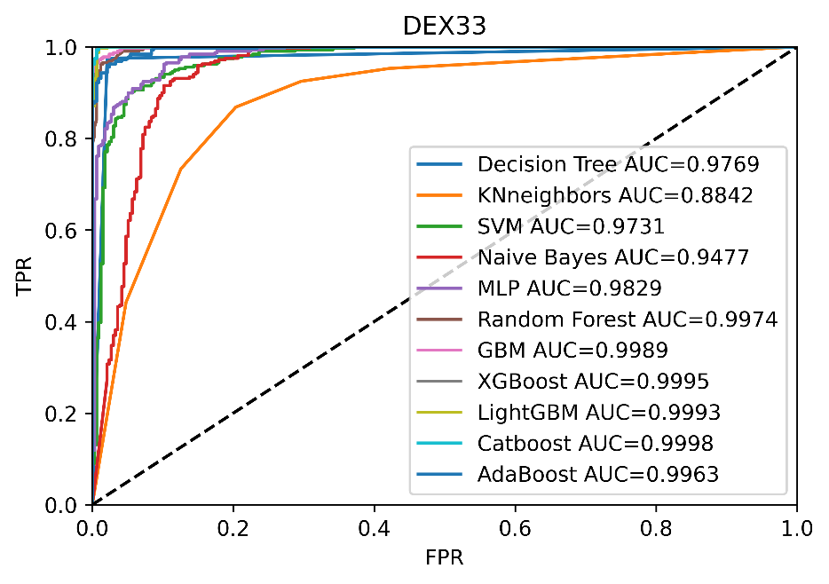
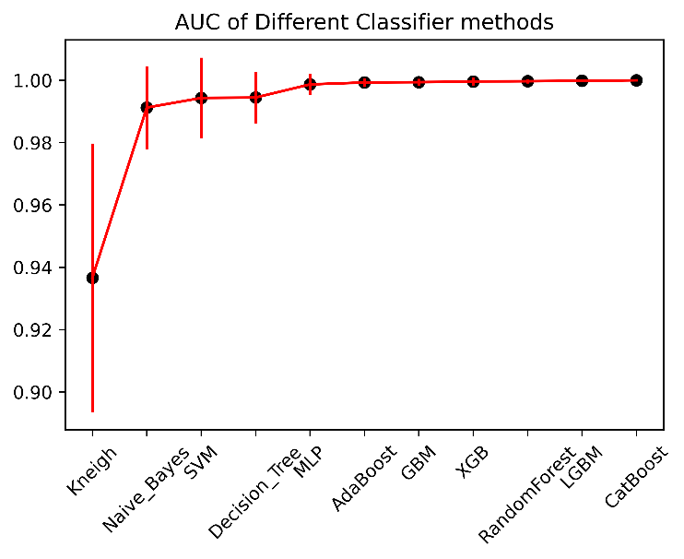
A novel radioxenon event classification method based on CatBoost
Zhao Yungang,Wang Shilian,Li Qi,Zhang Xinjun,Fan Yuanqing,
Jia Huaimao,Zhang Ruiqin,Li Ruiying
Beijing Radionuclide Laboratory
P2.1-553
The problem of discriminating radioxenon derived from an explosion or anthropogenic sources is quite interesting and remains unresolved. A novel radioxenon event classification method based on CatBoost was established.
The background plus explosion signals were synthesized and modeled artificially.
Based on the artificial monitoring data, data features were generated, such as abnormal threshold, ratios.
The dataset is divided into train data set and validation dataset. Models were trained based on different algorithms and evaluated based on the validation dataset.
Eleven machine learning algorithms were applied to the dataset, and five metrics were used to evaluated the classifier methods.
If you want to learn more about this, come see my e-poster during session 2.1 on this date or access it online on the SnT2023 Conference platform!

