Slide 1

Transportable absolute yields of underground nuclear explosions
B. G. Delbridge, W. S. Phillips, J. Kintner, J. D. Carmichael
Los Alamos National Laboratory | EES 17 (National Security Earth Science)
Demonstrates the use of a transportable method to determine the absolute explosive yields of seismically recorded underground nuclear explosions that does not require any a priori calibration, or “ground truth” measurements.
Use ratios of narrow-band envelopes of measured seismic coda waves from pairs of events to invert for model-derived yield and depth of burial.
We apply this method to the six declared North Korean nuclear tests and report new independent absolute yield and depth of burial estimates which are commensurate with previously determined source parameters.
Coda spectral ratio measurements at the DPRK test site carry the information needed for absolute yield & DOB estimation.
This Ground-based Nuclear Detonation Detection (GNDD) research was funded by the National Nuclear Security Administration, Defense Nuclear Nonproliferation Research and Development (NNSA DNN R&D). This work was performed under the auspices of the U.S. Department of Energy by Los Alamos National Laboratory. Los Alamos National Laboratory is managed by Triad National Security, LLC, under Contract 89233218CNA000001.
Please do not use this space, a QR code will be automatically overlayed
P2.1-509

Slide 2
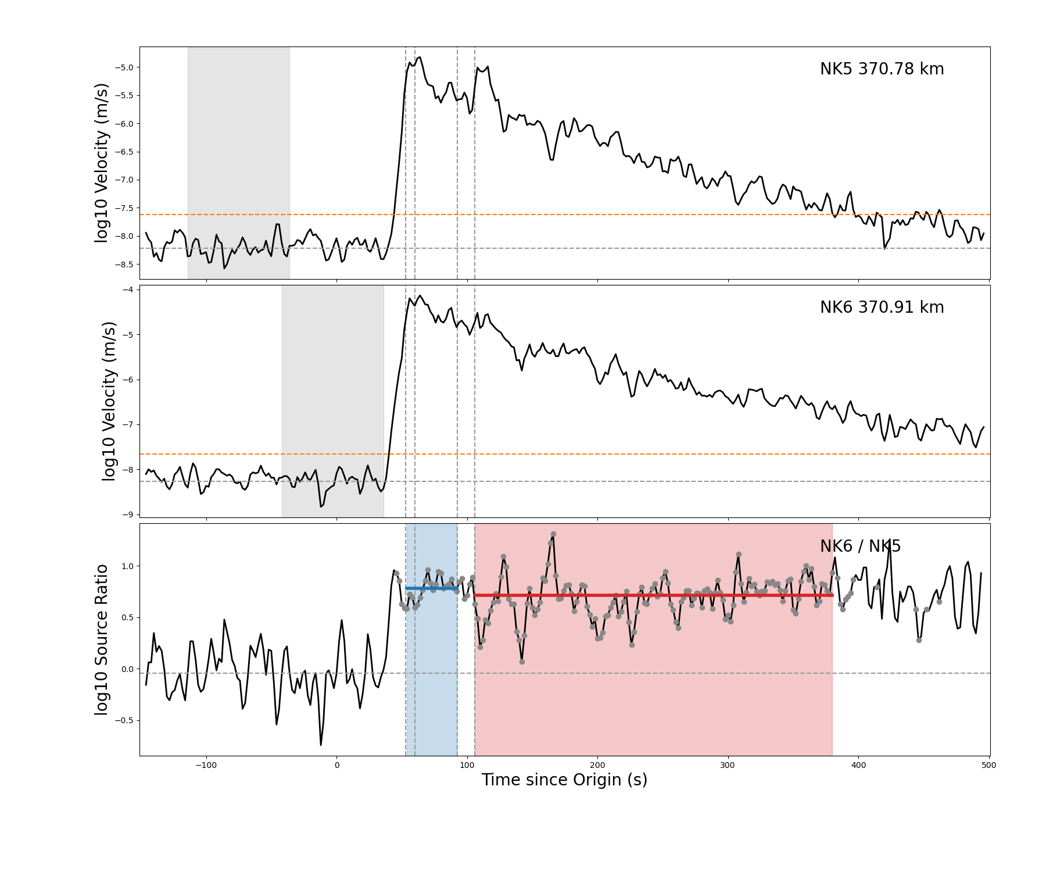
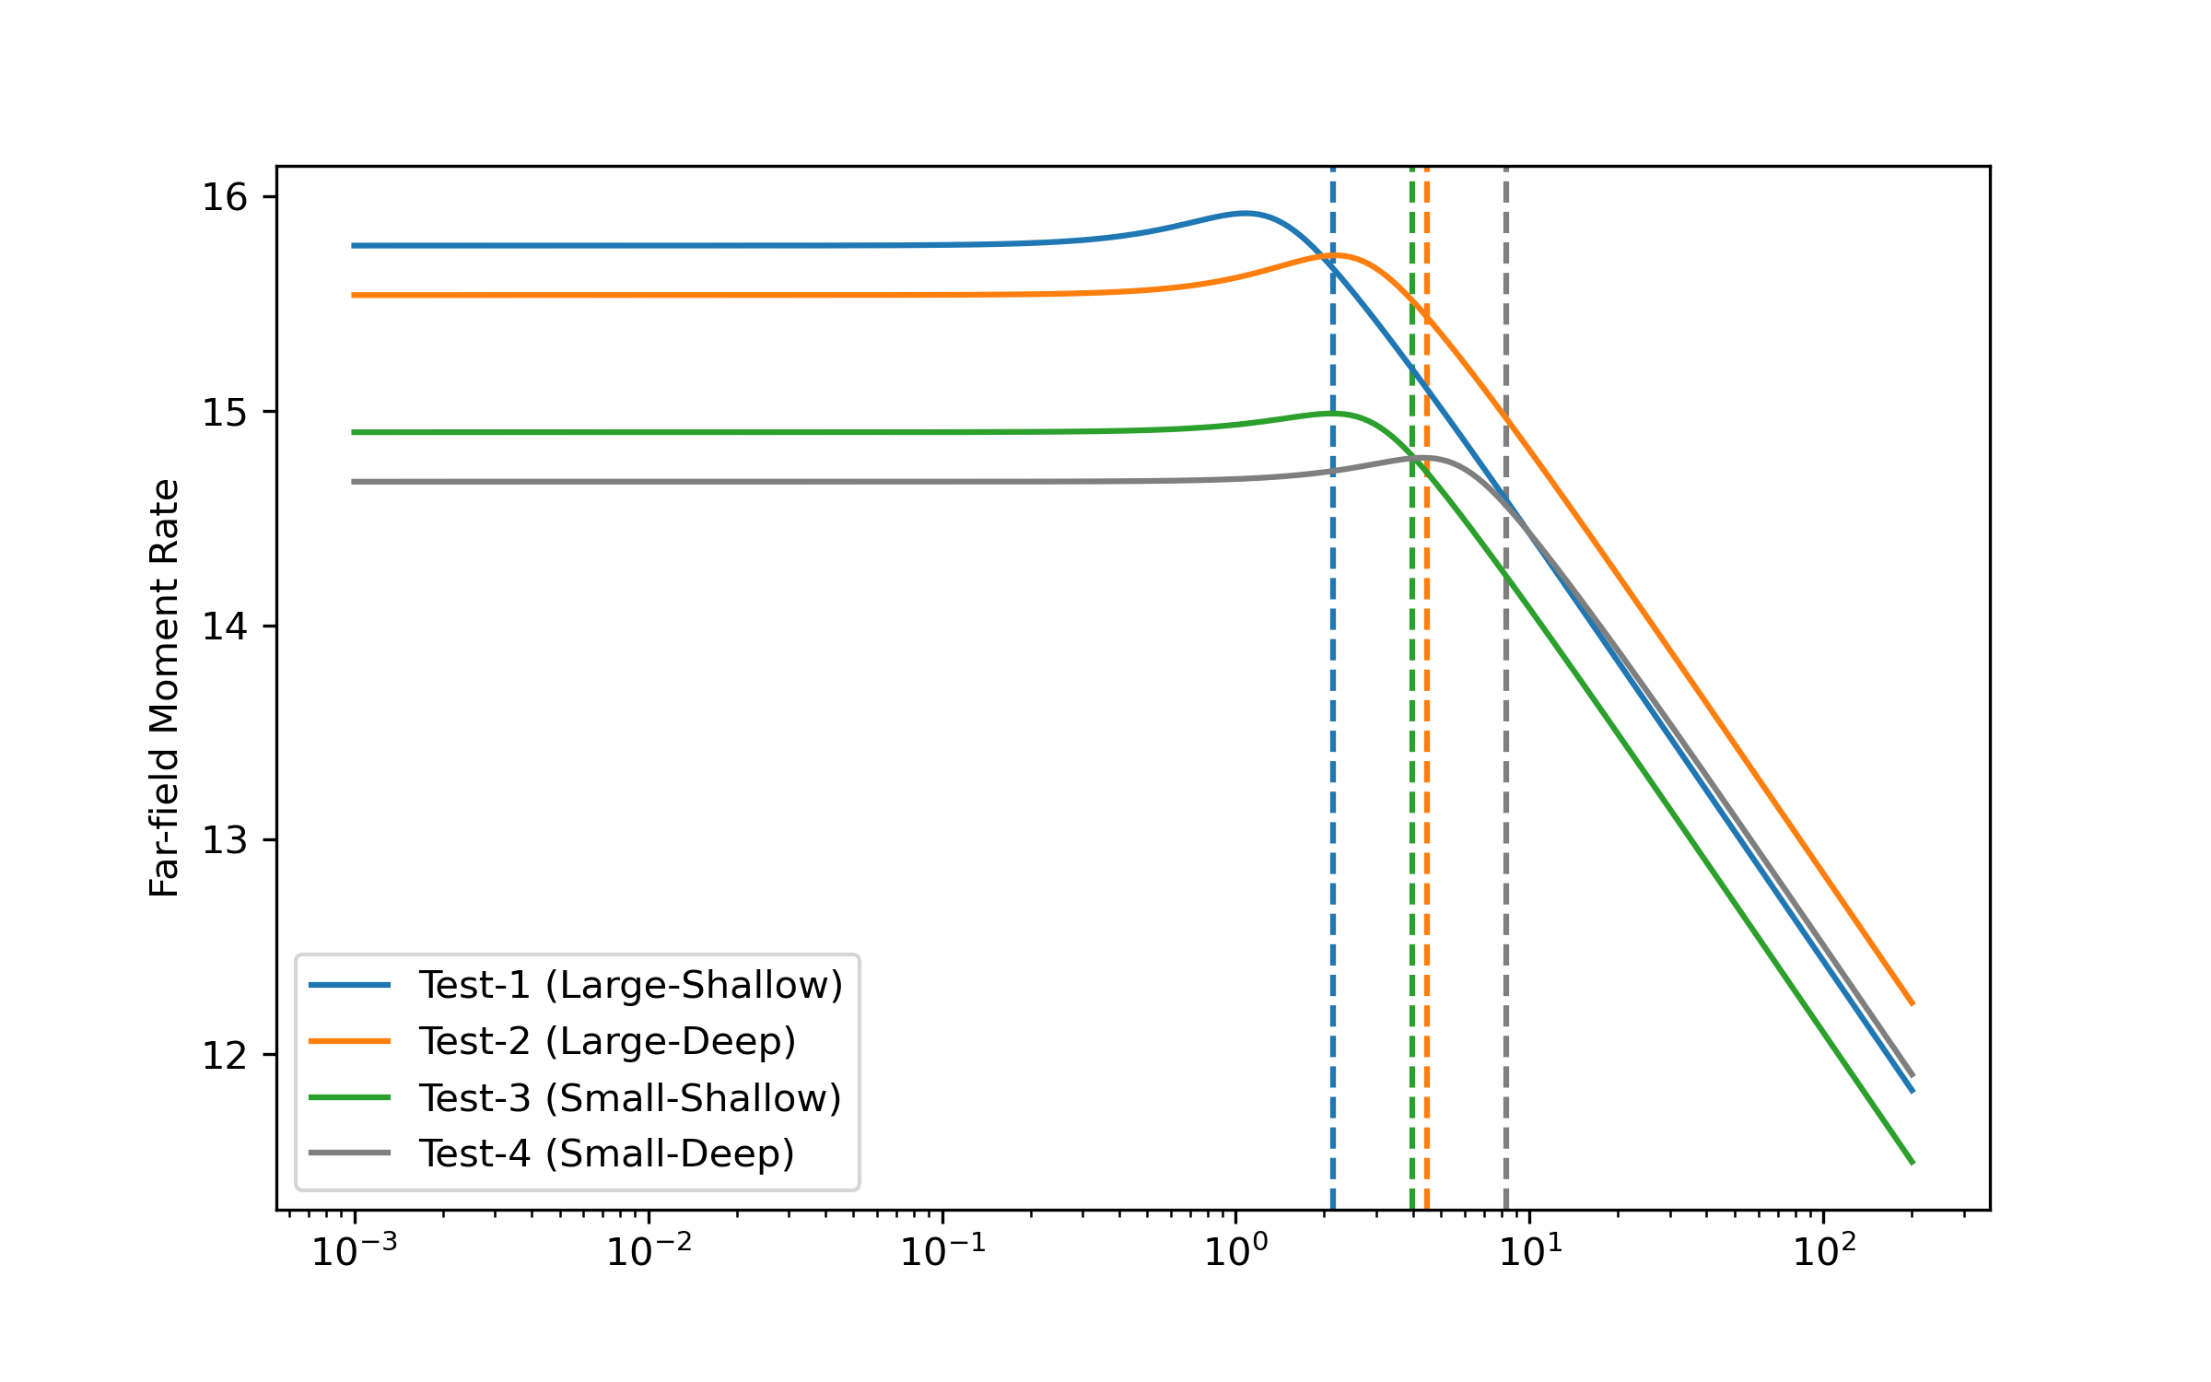
Coda Spectral Ratios for Yield Estimation
Objective: Demonstrates the use of a transportable method to determine the absolute explosive yields of seismically recorded underground nuclear explosions that does not require any a priori calibration, or “ground truth” measurements.
Approach:
Use ratios of narrow-band envelopes of measured seismic coda waves to remove path and site effects.
Use all possible pairs of seismic events to invert for absolute model-derived yield and depth of burial.
Results: We apply this method to the six declared North Korean nuclear tests and report new independent absolute yield and depth of burial estimates which are commensurate with previously determined source parameters.
Seismic Observations
Source Models
Please do not use this space, a QR code will be automatically overlayed
P2.1-509
P2.1-509

Slide 3
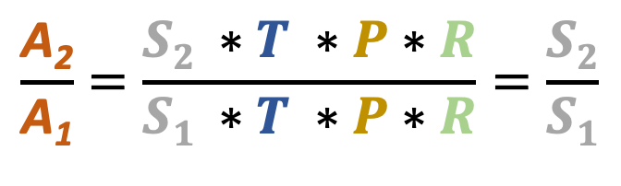
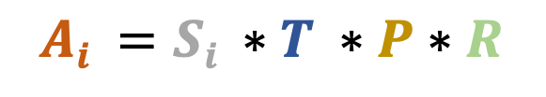
Body-wave Coda Spectral Ratios
Body-wave coda
Coda Envelope Ratios
Identical Site Response [ R ]
$$\frac{\text{A}\text{2}}{\text{A}\text{1}}=\frac{S2 ∗T ∗P∗R}{S1 ∗T ∗P∗R}=\frac{S2}{S1}$$
Event 1
[ S₁ ]
Event 2
[ S₂ ]
Taking the ratio removes path and site effects, allowing observation of the relative source ratios
Shared Path [ P ]
Shared Source Region [ T ]
Example of observed waveforms
Modeled Coda Amplitude Envelope
The stability and ‘scattered’ nature of seismic coda makes these observations ideal for seismic source analysis.
$$Ai =Si ∗T ∗P∗R$$
[ A₁ ]
Please do not use this space, a QR code will be automatically overlayed
Coda Amplitude
Envelope
P2.1-509
[ A₂ ]
P2.1-509

Slide 4
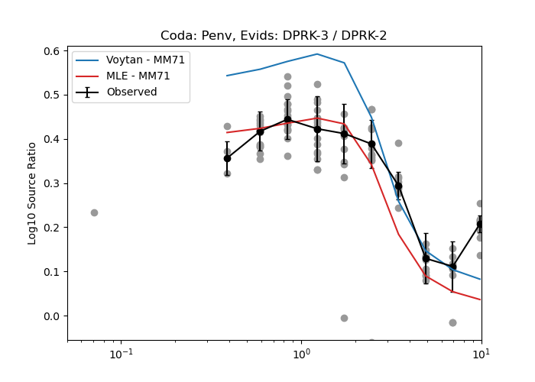
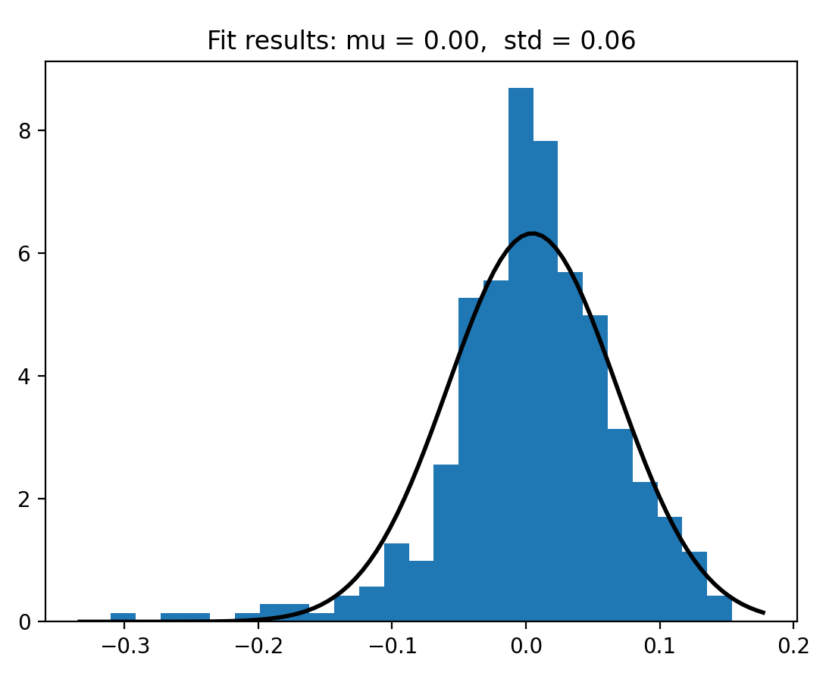
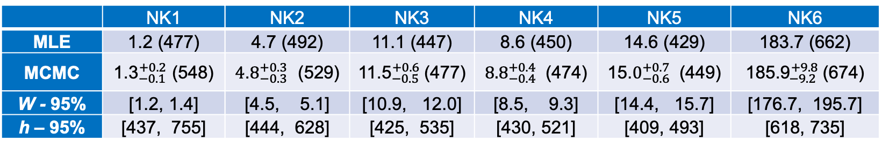
DPRK Yield and DOB Estimates
Relative relocation of DPRK announced nuclear tests, the NKTS complex, and the stations used in this study.
Histogram of model residuals and estimated normal distribution.
 | NK1 | NK2 | NK3 | NK4 | NK5 | NK6
MLE | 1.2 (477) | 4.7 (492) | 11.1 (447) | 8.6 (450) | 14.6 (429) | 183.7 (662)
MCMC | ${\text{1.3}}_{−0.1}^{+0.2}$ (548) | ${\text{4}\text{.}8}_{−0.3}^{+0.3}$ (529) | ${\text{11.5}}_{−0.5}^{+0.6}$(477) | ${\text{8.8}}_{−0.4}^{+0.4}$ (474) | ${\text{1}\text{5}\text{.}0}_{−0.6}^{+0.7}$ (449) | ${\text{185.9}}_{−9.2}^{+9.8}$(674)
W - 95% | [1.2, 1.4] | [4.5, 5.1] | [10.9, 12.0] | [8.5, 9.3] | [14.4, 15.7] | [176.7, 195.7]
h – 95% | [437, 755] | [444, 628] | [425, 535] | [430, 521] | [409, 493] | [618, 735]
Please do not use this space, a QR code will be automatically overlayed
P2.1-509
P2.1-509
Figure 8. Inverted source model ratio fits to the observed coda spectral ratios, including earthquake observations. Black
circles denote the network averaged P-coda envelope spectral ratios. The red solid curves denotes the spectral ratios predicted from MM71 models that we parameterize by the maximum likelihood yields (W) and DoBs (h) listed as “MLE” in the table below. The blue curves denote those obtain using the median of the MCMC posterior distributions for all the source parameters, listed as “MCMC” in the table below.

Slide 5
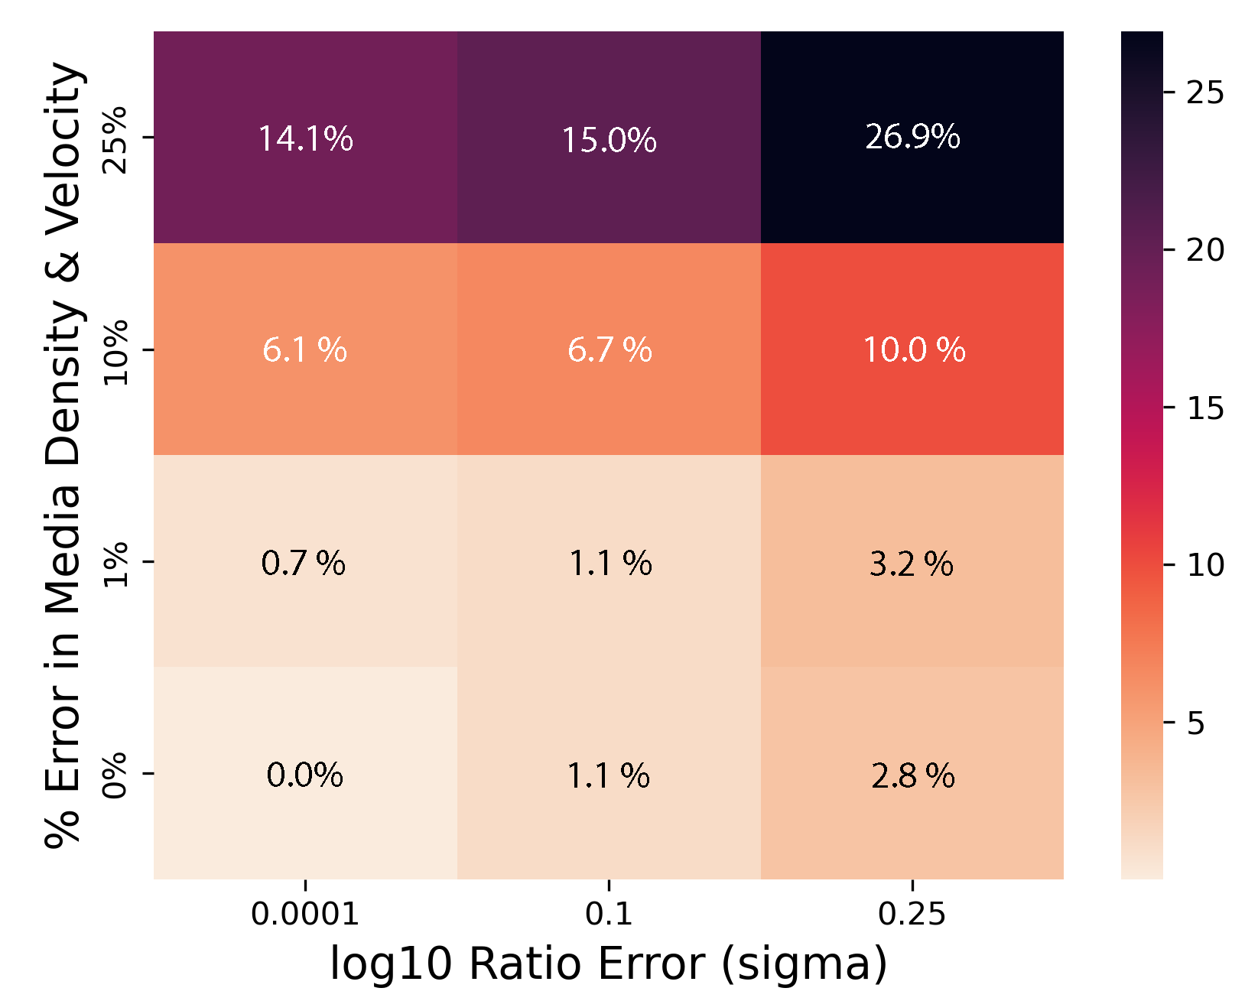
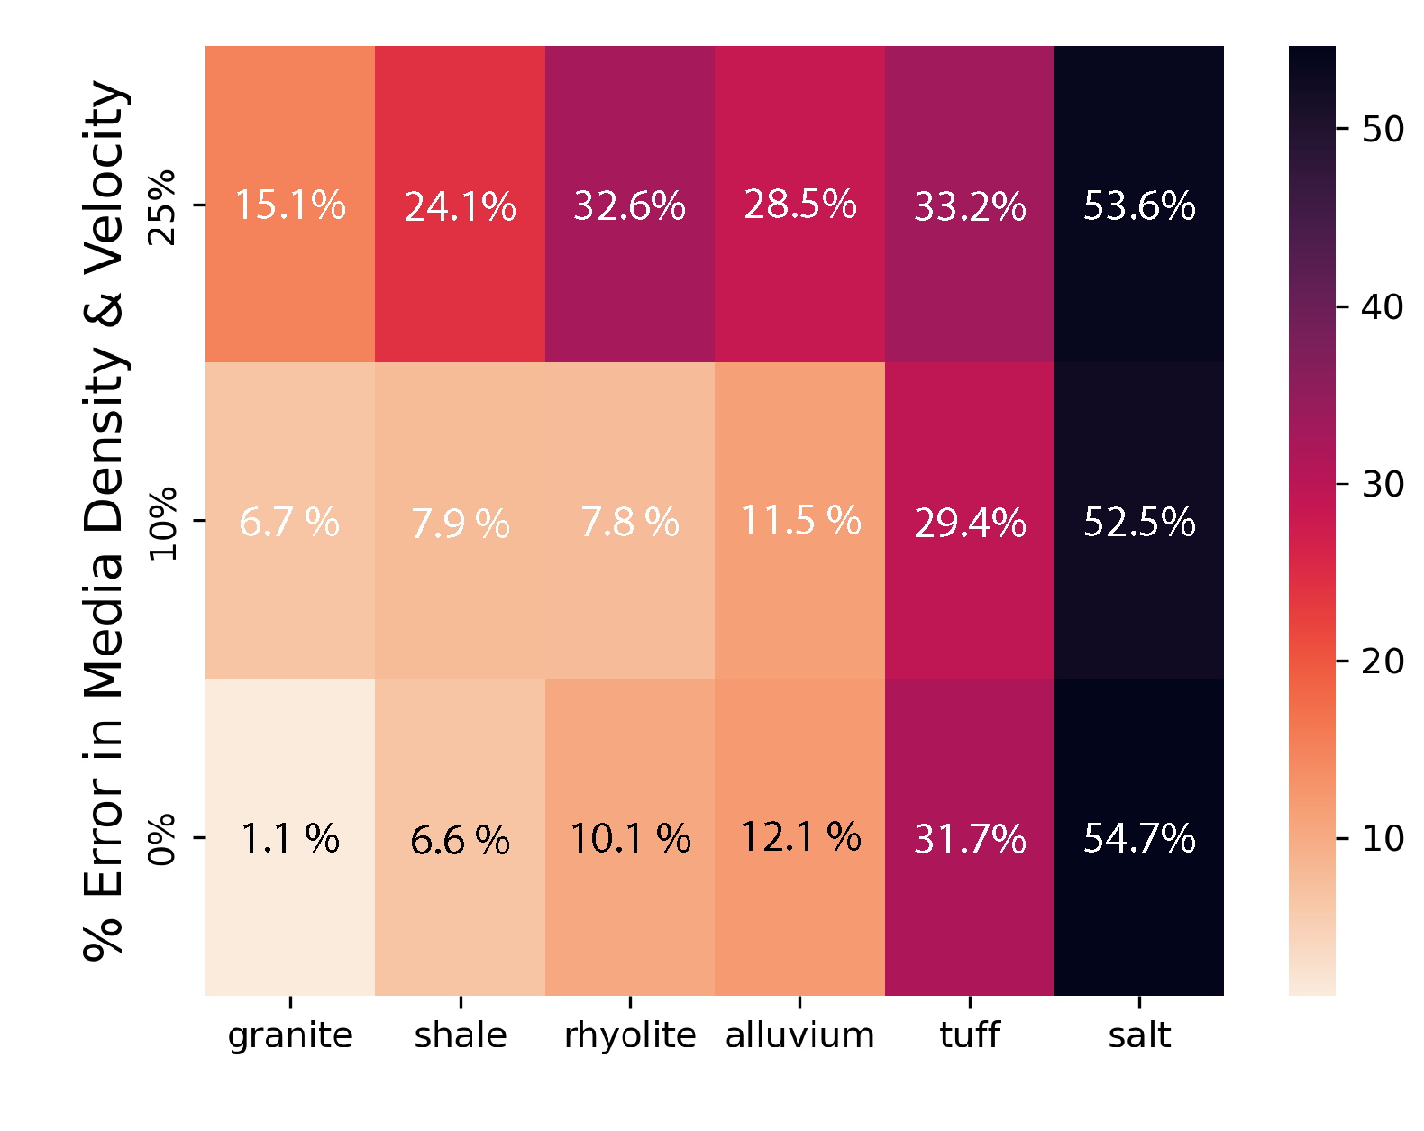
Transportable Yield Estimates
Coda spectral ratio measurements at the DPRK test site carry the information needed for absolute yield & DOB estimation.
The inversion procedure presented using the coda spectral ratios eliminates the path, and site effects, and is only weakly dependent on the near-source media properties
Please do not use this space, a QR code will be automatically overlayed
P2.1-509
Synthetic Source Type is ‘Granite’
Assumed ratio error is 2 x DPRK (~0.12)
P2.1-509

Slide 6
References
This Ground-based Nuclear Detonation Detection (GNDD) research was funded by the National Nuclear Security Administration, Defense Nuclear Nonproliferation Research and Development (NNSA DNN R&D). This work was performed under the auspices of the U.S. Department of Energy by Los Alamos National Laboratory. Los Alamos National Laboratory is managed by Triad National Security, LLC, under Contract 89233218CNA000001.
Delbridge, B. G., Carmichael, J. D., Phillips, W. S., Cleveland, K. M., Begnaud, M. L., & Gammans, C. (2023). Source characterization of the declared North Korean nuclear tests from regional distance coda wave spectral ratios. Journal of Geophysical Research: Solid Earth, 128, e2022JB024728. https://doi.org/10.1029/2022JB024728
Delbridge, B. G. , Phillips, W. S., Kintner, J., Carmichael, J. D. (2022). Transportable absolute yields of underground nuclear explosions: Application to the North Korean Nuclear Tests. LA-UR-22-26939. DOI: 10.2172/1876764 https://www.osti.gov/biblio/1876764/
Please do not use this space, a QR code will be automatically overlayed
P2.1-509
P2.1-509

