Slide 1
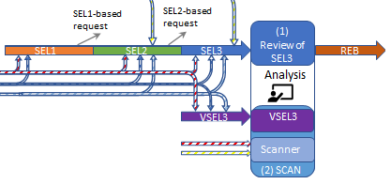
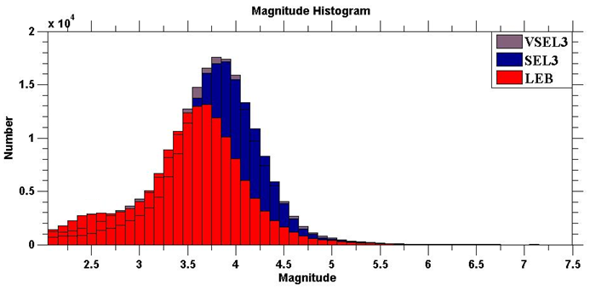
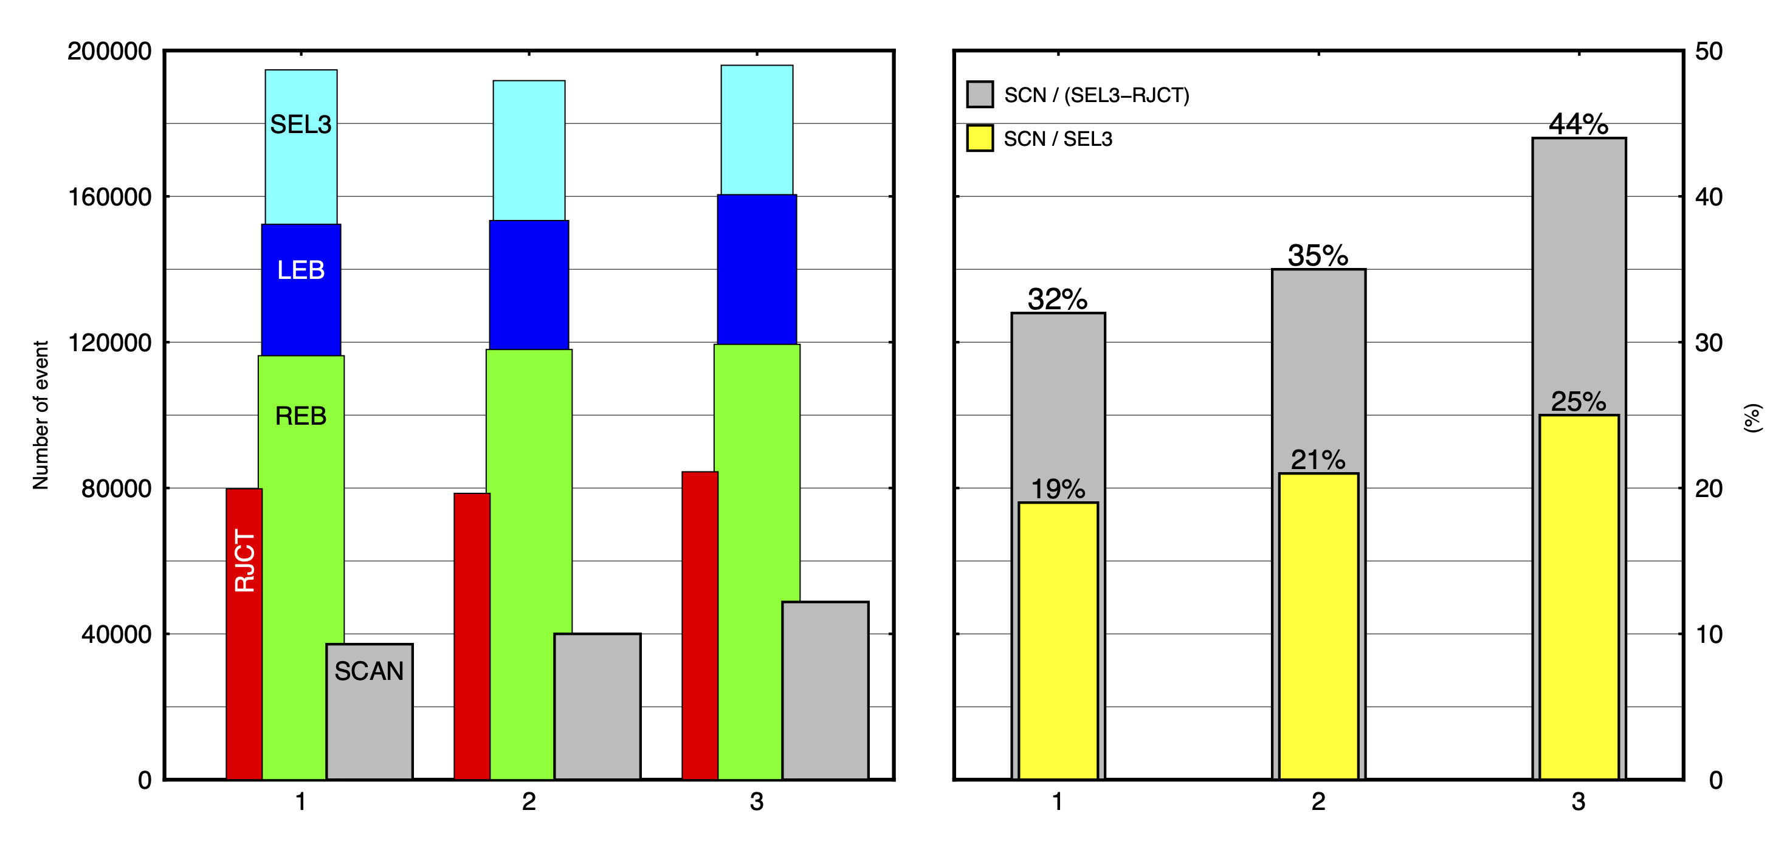
Interactive analysis perspective on the implementation of the NET-VISA in the IDC bulletin production
S. Ali, E. Qorbani, O. Ntibinyane, R. Le Bras, G. Rambolamanana
International Data Centre, CTBTO Preparatory Commission, Vienna, Austria
P2.1-575
NET-VISA is the next-generation SHI automatic event detector. It has been used operationally as a NET-VISA scanner in addition to the GA scanner since January 2018.
We used three distinct time periods and compared the different bulletins to evaluate the NET-VISA performance.
The results show about a 4.6% increase in the number of LEB events after including the NET-VISA scanner with an average of 7 events per day, and a notable increase of 17.90% in the number of scanned events.
If you want to learn more about this, come see my e-poster during session P2.1 today or access it online on the SnT2023 Conference platform!

