Slide 1
Interactive analysis perspective on the implementation of the NET-VISA in the IDC bulletin production
Sherif Ali, Ehsan Qorbani, Onkgopotse Ntibinyane, Ronan Le Bras, Gerard Rambolamanana
International Data Centre, CTBTO Preparatory Commission, Vienna, Austria
CTBTO IMS station data are being processed by automatic processing (GA), interactively analysed, and reviewed, resulting in IDC bulletins. The NET-VISA is designed to process IMS data to reduce the number of missed and false events in automatic processing.
NET-VISA has been implemented in operation as an additional event scanner tool since January 2018. In this study, we assess the effect of the NET-VISA automatic scanner on the number of events in the IDC REB and LEB bulletins.
We used three distinct time periods to evaluate the NET-VISA performance. The results show a 4.6% increase in the number of LEB events after including the NET-VISA scanner in operation, with an average of 7 events per day, and an increase of 17.90% in the number of scanned events.
A comparison between the different bulletins in distinct periods shows NET-VISA is beneficial to build more valid events, providing opportunities to improve nuclear-test-ban monitoring.
Please do not use this space, a QR code will be automatically overlayed
P2.1-575

Slide 2
Introduction
Data from the International Monitoring System (IMS) stations of the CTBTO are being processed by automatic processing, Global Association, then interactively analysed and reviewed, resulting in the International Data Centre (IDC) bulletins.
Analysts first review the Standard Events List (SEL3), produced by the Global Association (GA).
They then examine additional events brought to their attention by an auto GA scanner.
NET-VISA is the next-generation SHI automatic event detector. It has been used operationally as a NET-VISA scanner in addition to the GA scanner since January 2018.
NET-VISA also produces VSEL3 in parallel, which uses the same detections as SEL3.
Auxiliary Seismic Station
Station processing of waveform segments
SEL1-based request
SEL2-based request
Primary Seismic Station
(1) Review of SEL3
SEL1
SEL2
SEL3
REB
SEB/SSEB
Hydroacoustic Station
International Data Centre
Automatic processing of primary seismic, hydroacoustic, and infrasound stations
Analysis
Characterization and Screening
VSEL3
VSEL3
P2.1-575
Continuous waveforms
Parametric Data
VSEL3
Infrasound Stations
Scanner
Please do not use this space, a QR code will be automatically overlayed
Three steps of network processing
(2) SCAN
Time scale
seconds
1h
6h
15 min
1 hour
4 hours
6 hours
48 hours
48 hours+
Processing Stages
Continuous acquisition
Station Processing
Network processing
Analyse
Post-analysis Processing
2

Slide 3
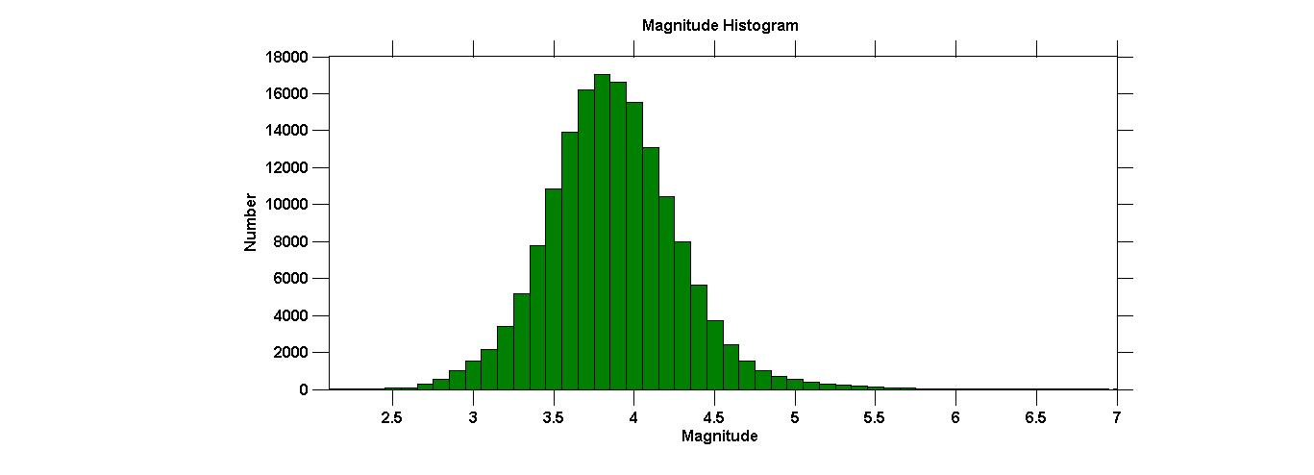
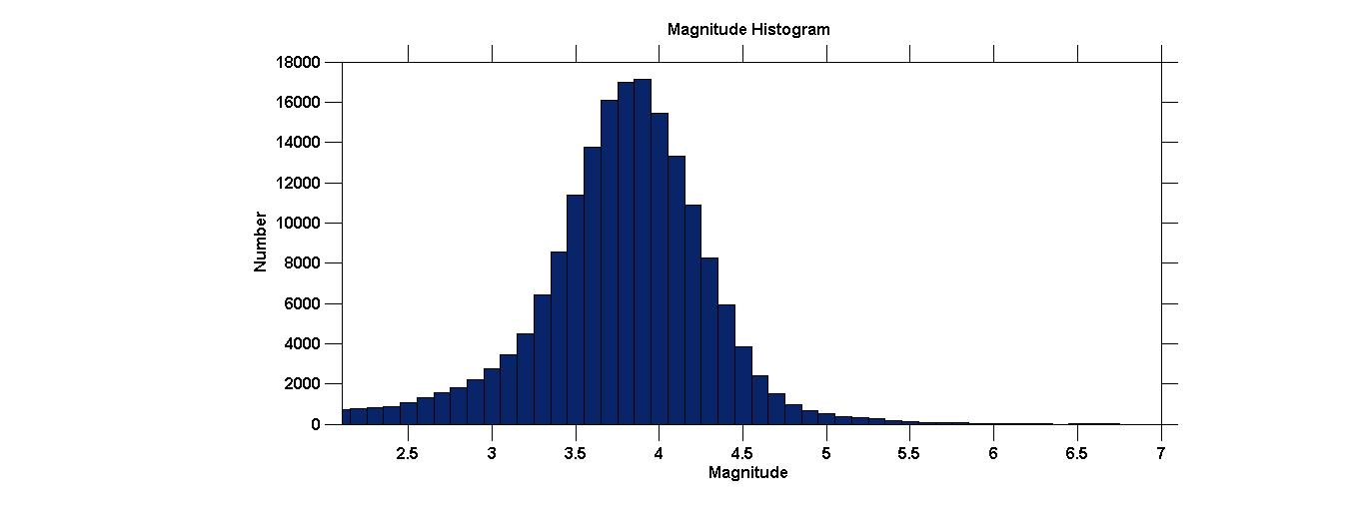
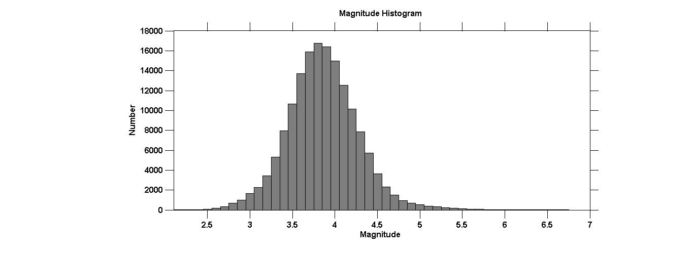
Objectives
We used three distinct time periods, each including 1200 days, two before and one after the NET-VISA scanner implementation to evaluate the NET-VISA performance as well as to exclude the effect of other possible factors, such as global seismicity and network performance.
Period 2 from 2015-2018
P2.1-575
Please do not use this space, a QR code will be automatically overlayed
Period 1 from 2012-2014
Period 3 from 2018-2021

Slide 4
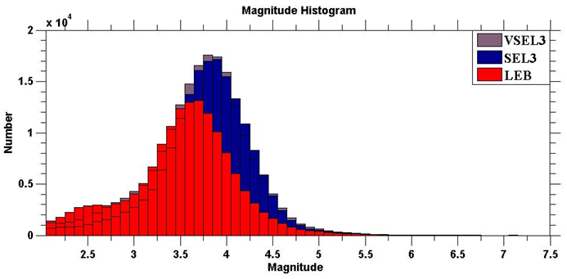
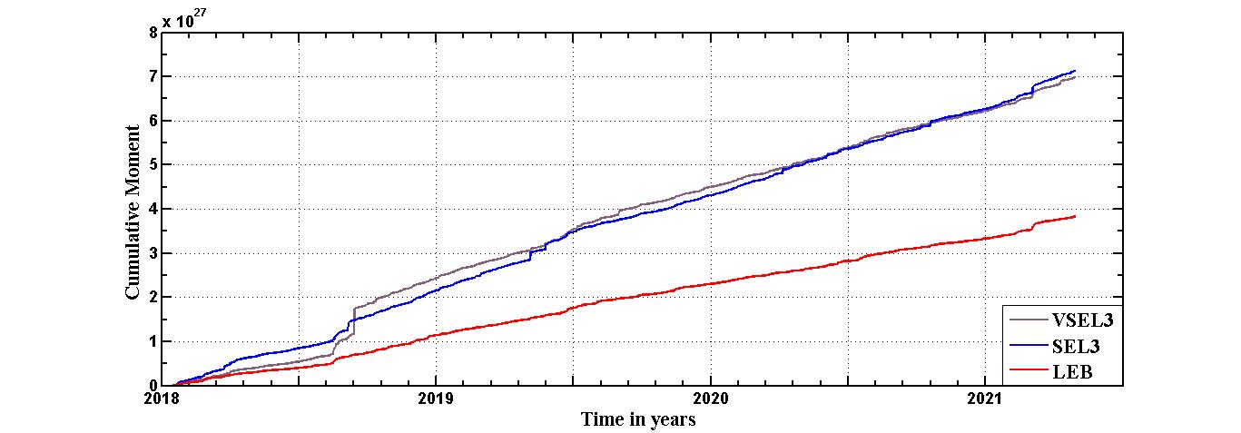
Methods/Data
The Network Processing Vertically Integrated Seismic Analysis (NET-VISA) is a Bayesian seismic monitoring system designed to process IMS data to reduce the number of missed and false events in the automatic processing. In this study, we assess the effect of the NET-VISA automatic scanner on the number of events in the IDC bulletins. In particular, the impact of the NET-VISA scanner on the number of scanned events during the interactive analysis.
Px.x-xxx
Please do not use this space, a QR code will be automatically overlayed
Number of VSEL3 events is slightly higher than SEL3 events, especially for moderate magnitude events between 3.5 and 5.
Cumulative number of events since 2018

Slide 5
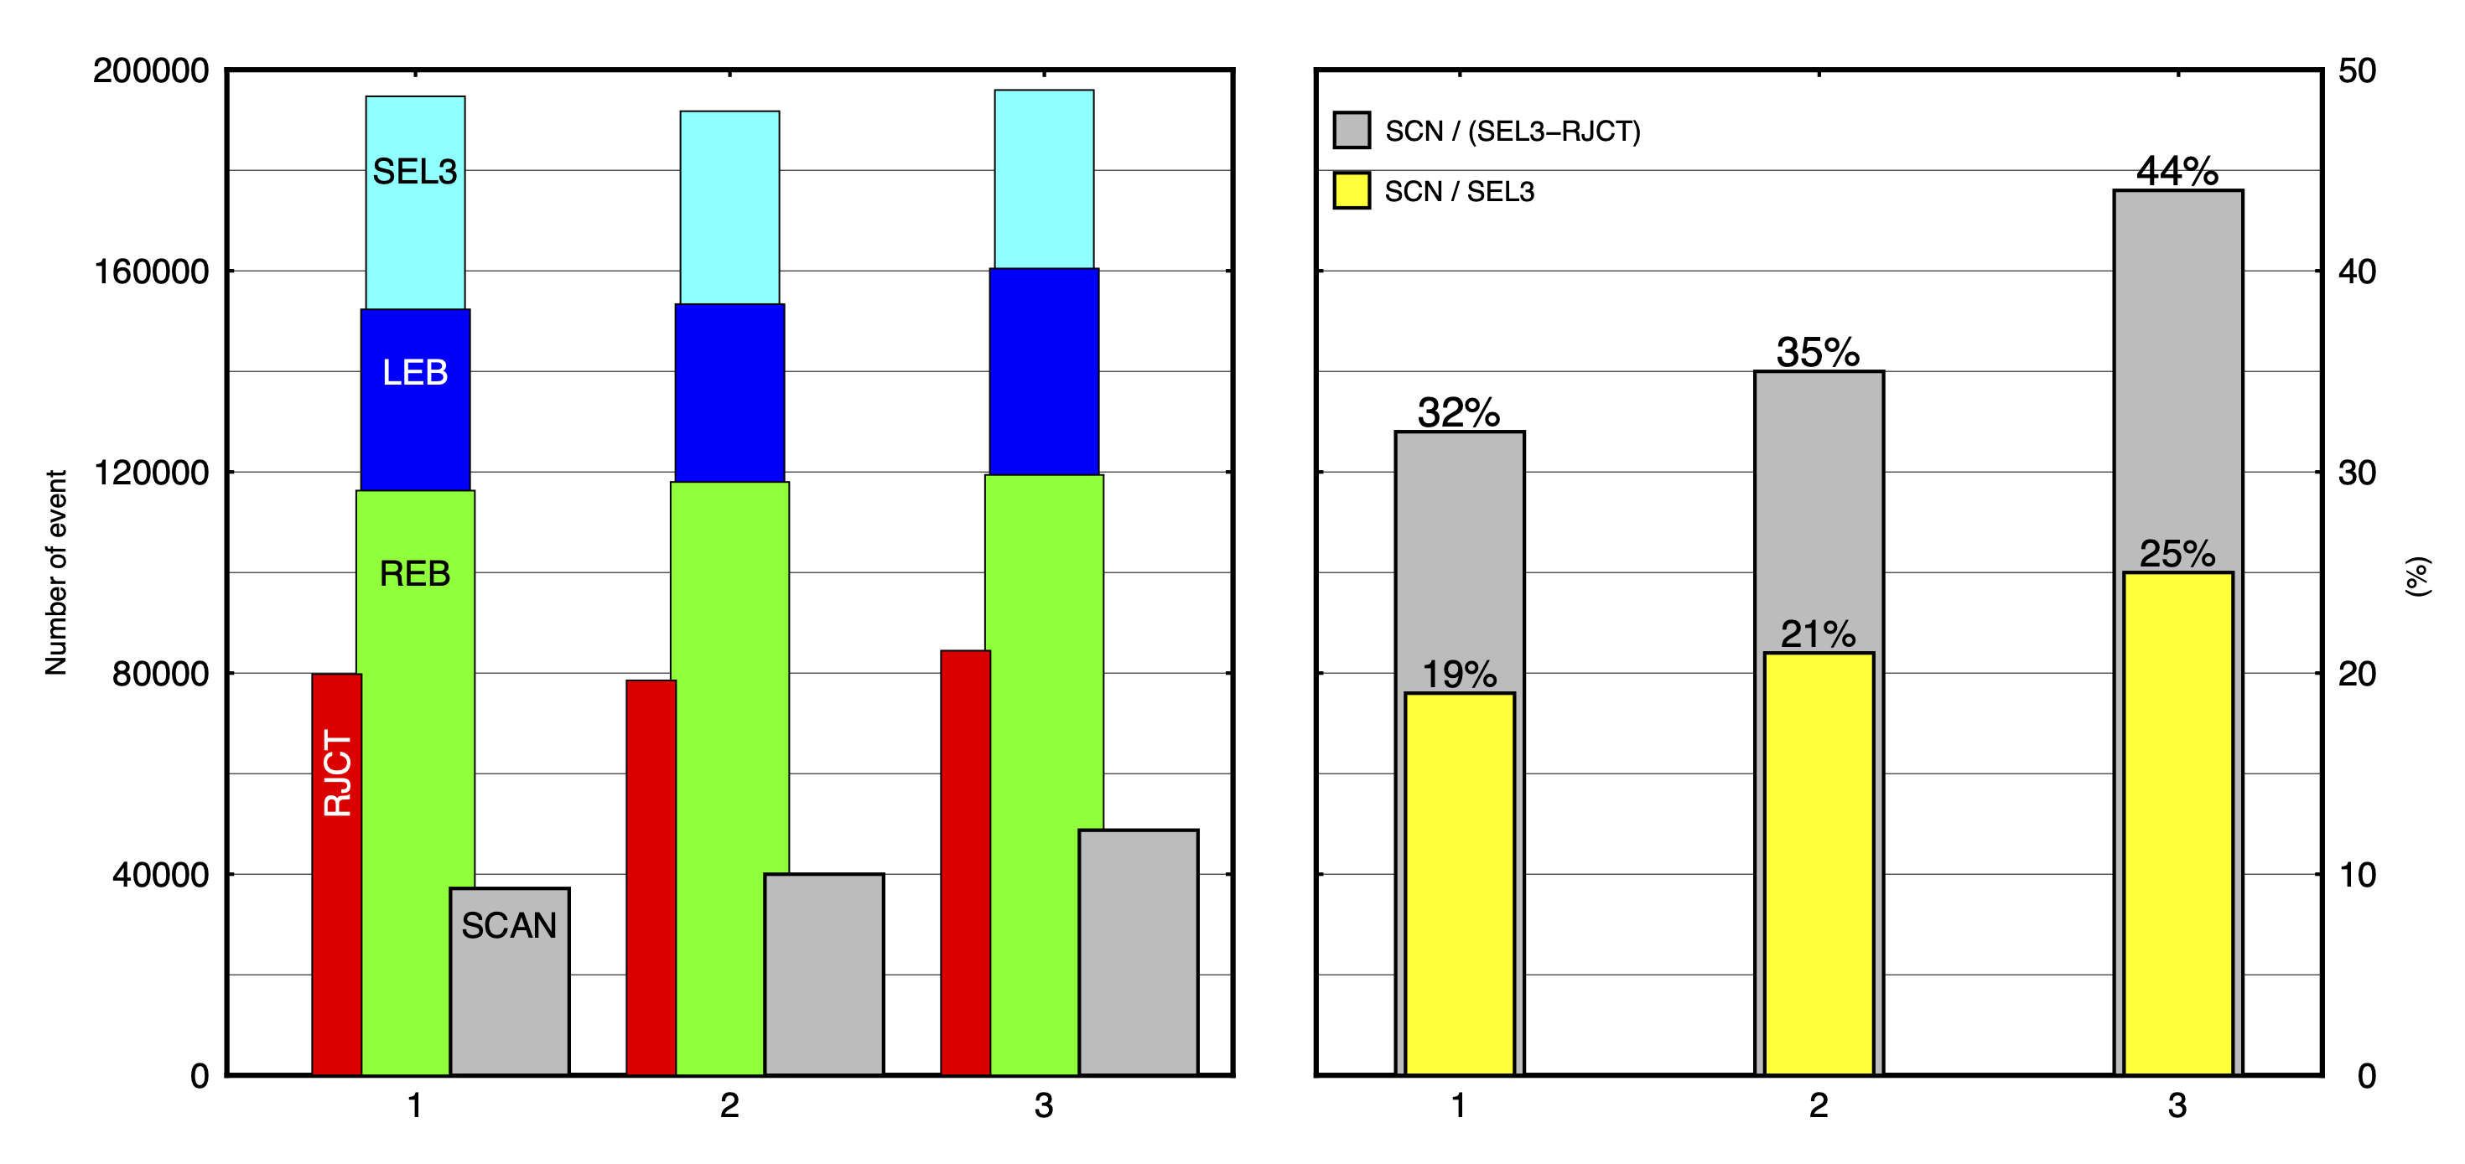
Results
Comparison of the number of events for the three assessed periods
Yearly comparison of the number of events,
2012-2021
P2.1-575
SEL3: automatically produced list of event
LEB: Late Event Bulletin
REB: Reviewed Event Bulletin
SCN: Scanned Events
RJCT: Rejected Events
Number of SEL3 from 2018 to 2021 is slightly decreasing -> Due to lower seismicity
Not the case for REB and LEB especially for Scanned events (SCN)!
We relate this to the implementation of the Net-VISA scanner in 2018
Please do not use this space, a QR code will be automatically overlayed
The increase in the scanned events in the 3rd period is notable.

Slide 6
Conclusion
Conclusion
Comparison between the different bulletins shows that the NET-VISA scanner helps to build more valid events during the interactive analysis.
The results show about a 4.6% increase in the number of LEB events after including the NET-VISA scanner in operation, with an average of 7 events per day, and a notable increase of 17.90% in the number of scanned events.
Recommendation
Swapping between GA and NET-VISA would be beneficial for the interactive analysis in order to review the SEL3 bulletin based on NET-VISA and could help to increase the number of valid events and reduce the scanning time.
P2.1-575
Please do not use this space, a QR code will be automatically overlayed

