Slide 1
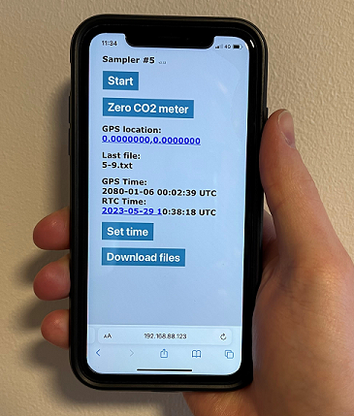
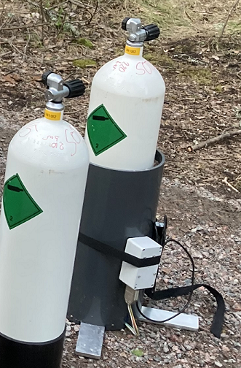
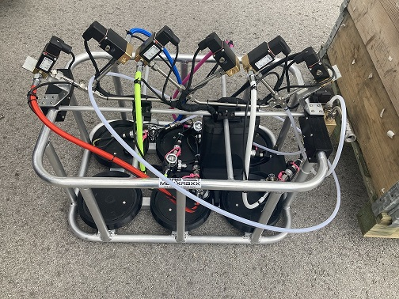
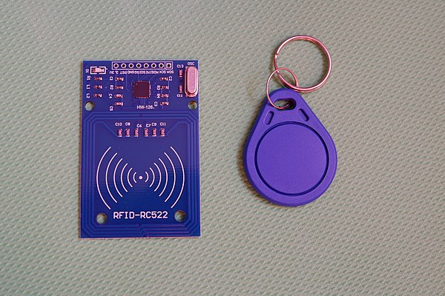
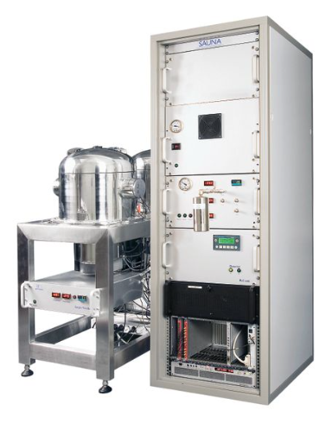
Improvements in Methods and Chain of Custody for Measurements of Soil Gas Samples
Henrik Olsson, M Aldener, K Elmgren, T Fritioff, L Karlkvist, J Kastlander, C Söderström
Swedish Defence Research Agency FOI, Sweden
P2.2-625
Wi-Fi controlled soil gas sampler
GPS
CO₂ and Rn concentration
SAUNA Field multi-sample inlet
RFID

