Slide 1

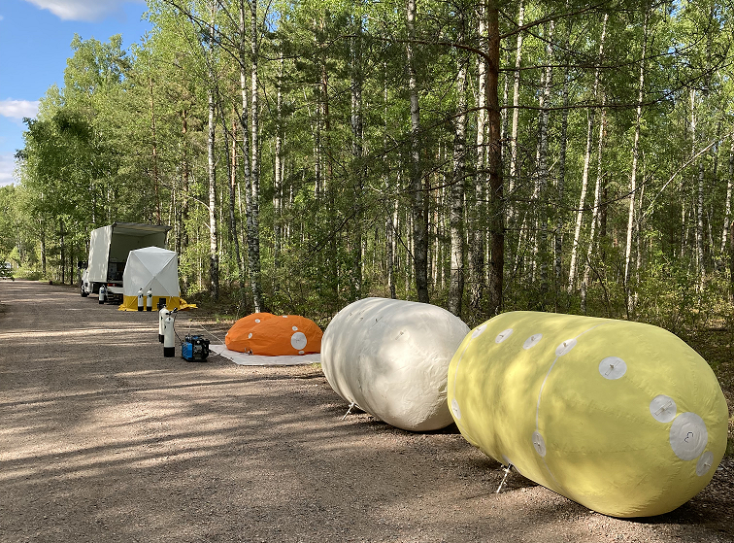
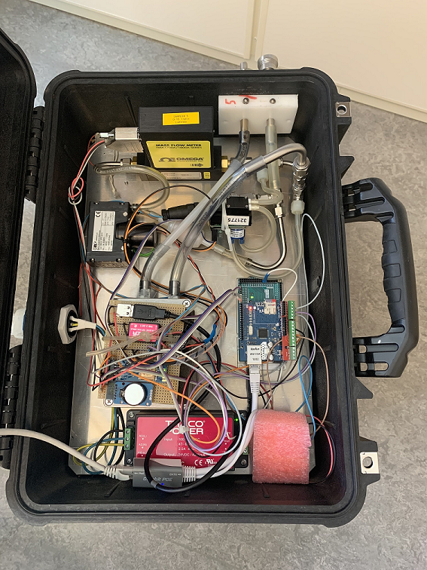
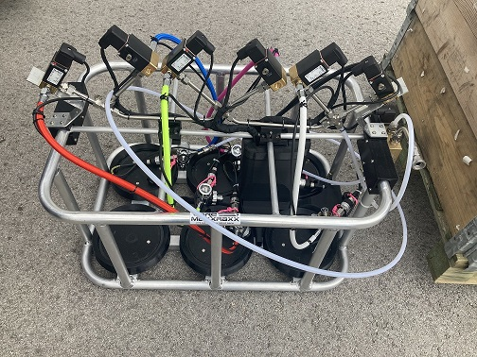
Improvements in Methods and Chain of Custody for Measurements of Soil Gas Samples
Henrik Olsson, Mattias Aldener, Klas Elmgren, Tomas Fritioff, Lindsay Karlkvist, Johan Kastlander, Catharina Söderström
Swedish Defence Research Agency FOI, Sweden
Measurement in Kvarntorp, Sweden
Soil gas sampler
Multi-sample inlet module for the SAUNA Field xenon system
Conclusions
P2.2-625

Slide 2

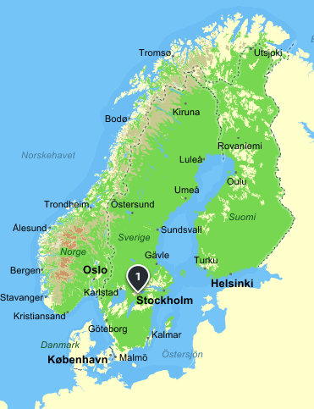
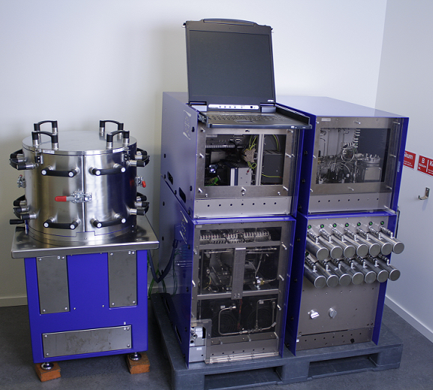
Our Motivation
An important aspect of an On-site inspection (OSI) is the measurement of soil gas samples. As with any field work, the risk of human error is not negligible, which is why there is a large motivation for simplifying operating procedures and improving the chain-of-custody for collected samples. Since 2016, we have conducted five large measurement campaigns in Kvarntorp Sweden, where soil gas was collected and the radioxenon concentration subsequently analysed with a SAUNA Field in our lab in Stockholm. During the latest campaigns, we have averaged 41 collected samples over a period of a week. The experience gained from these campaigns have led to continuous improvements in both technical equipment and routines and this work will focus on the routines used in our latest campaign in 2022.
Kvarntorp Sweden. The site has uranium rich alum shale and thus naturally occuring radioxenon in the soil gas
Picture from the measurement campaign 2022. The balloons in the foreground contain collected soil gas. The gas is then compressed and transferred to scuba bottles for easy shipping
The SAUNA Field system used for analysis of radioxenon concentration in collected soil gas
P2.2-625

Slide 3
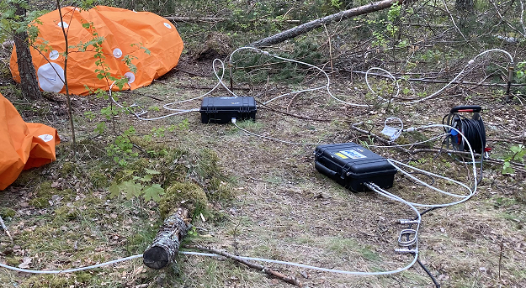
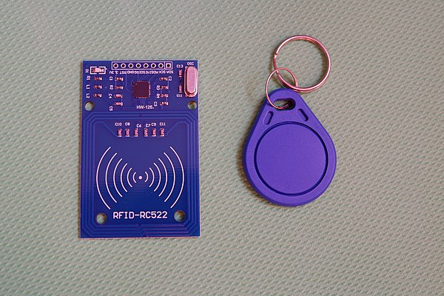

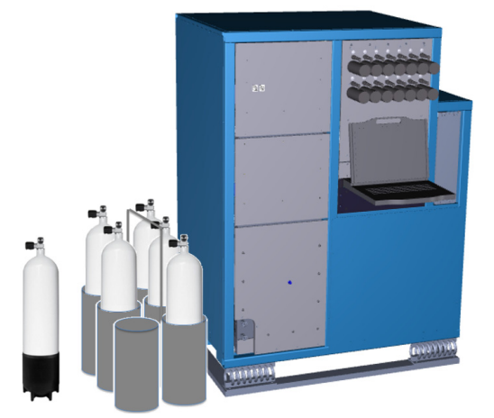


Improving Data Reliability and Traceability
Data quality and chain-of-custody
Sample data and metadata automatically fingerprinted and stored from beginning of collection to end of measurement
Traceability
Weatherproofing equipment
Process
Streamlined process improves chances of detecting short-lived radioxenon isotopes
Pen and paper is replaced with digital counterparts. Ultimately with equipment that transfers data amongst themselves
Human errors
Minimise manual text entry
Less focus on tedious work e.g. data input – more focus on the big picture
Soil gas being collected. The black suitcases are Wi-Fi controlled samplers with built in pumps. Gas from the soil is pumped and transferred to sample balloons
RFID tags are one way of minimising manual input and moving from analogue to digital protocols
P2.2-625

Slide 4
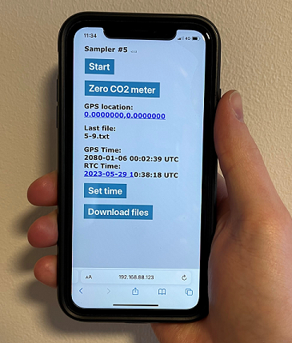
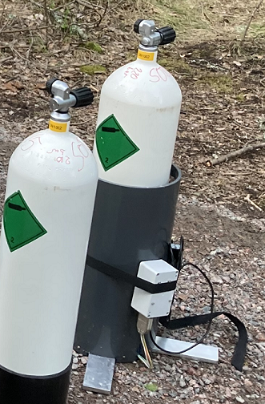
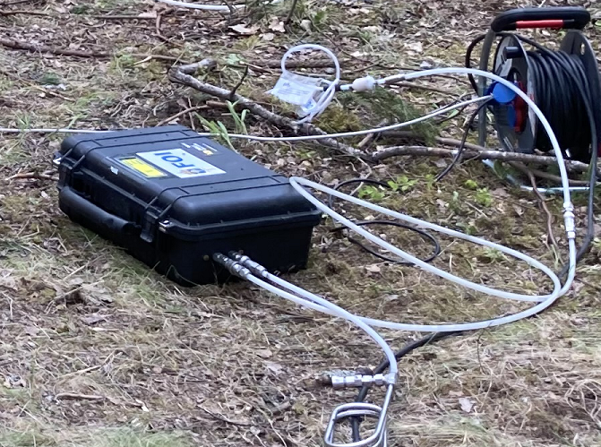
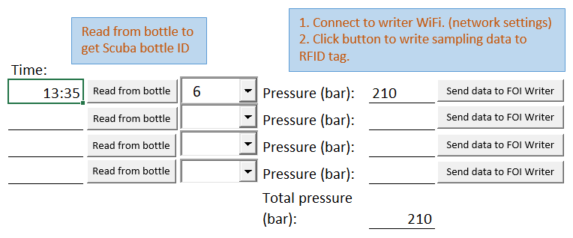
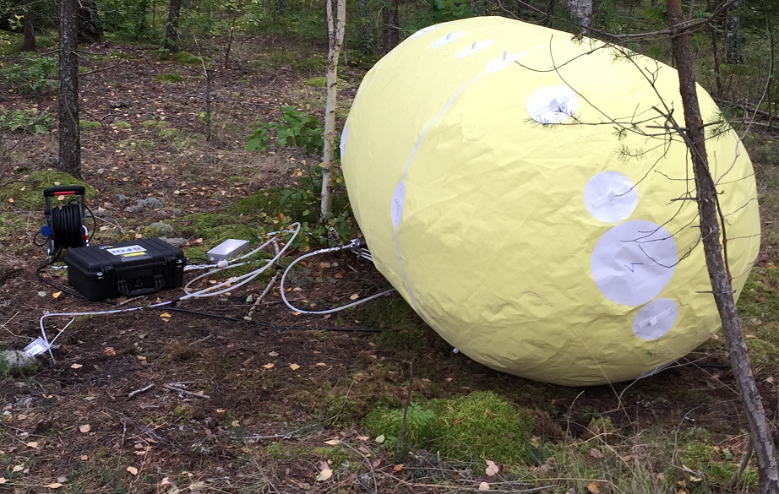
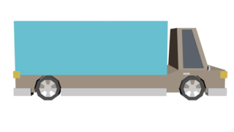
Soil Gas Sampler and RFID Writer
FOI soil gas sampler
Simple prototyping based on the Arduino platform
PID regulated pumping
GPS for time and location awareness
Recording of O₂, CO₂ and Rn concentration during sampling
Data logging to SD card
Wi-Fi and web UI for control and data download
Low power consumption, can be run on 12 V battery for over night sampling
RFID writer
Arduino powered RFID writer with Wi-Fi
Sample containers equipped with Mifare classic 1K tags
720 byte of metadata available on tag
Communicates directly with digital field protocol
Schematic view of procedure, starting with gas collection in balloons. Samples are then transferred to scuba tanks and transported to the lab in Kista and analysed with SAUNA Field
Excerpt from digital field protocol. Data from the soil gas sampler is downloaded directly into the protocol. The data can then be written to the RFID writer with a single click
P2.2-625

Slide 5
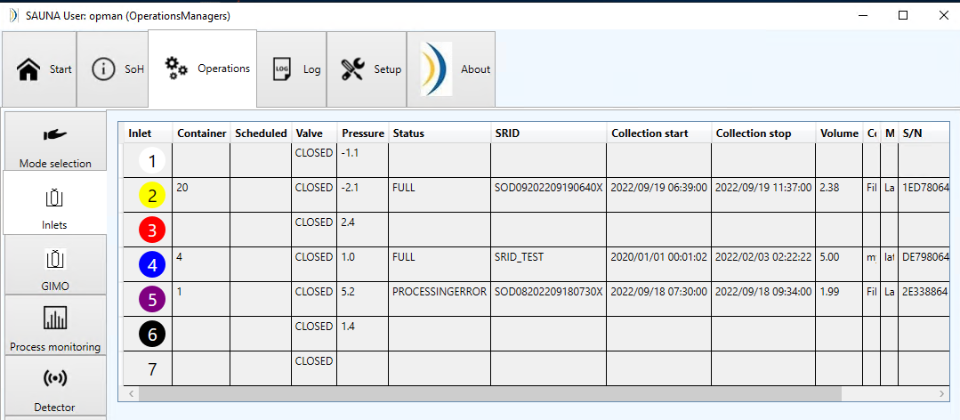
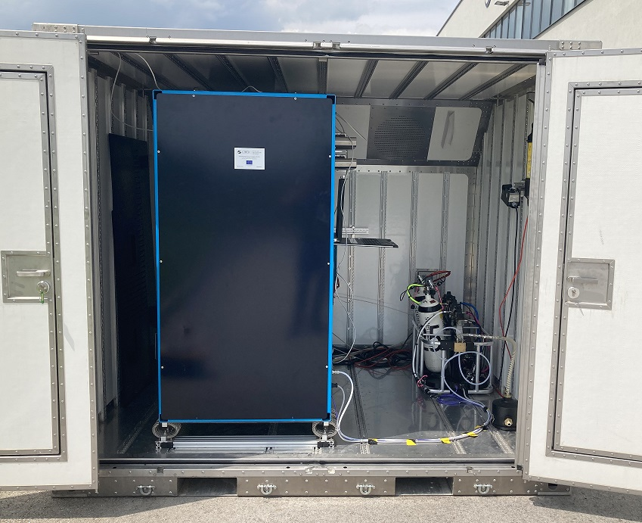
SAUNA Field with Multi-Sample Inlet
SAUNA Field multi-sample inlet
Module that connects easily to SAUNA Field for radioxenon analysis
Allows for scheduling 6 consecutive samples at once
Equipped with RFID reader
Start sample analysis with two clicks. All sample data is retrieved from RFID tag
The status of the sample is tracked and updated as it is emptied
The GUI view of the inlet status. Containers equipped with RFID appear automatically as they are added to the rack. The pressure of the containers are automatically measured and shown to the user
Close up picture of the multi-sample inlet for SAUNA Field. Six bottles can be added simultaneously. The RFID reader is hidden in the bottom piece of each position
Starting a sample equipped with RFID is as simple as selecting the sample from the drop down and pressing ”OK”. All necessary data is contained in the RFID tag. Note the colour coded inlet position which corresponds to a connection hose with the same colour
The SAUNA Field with installed multi-sample inlet module at the CTBTO TeST centre in Seibersdorf
P2.2-625

Slide 6
Concluding remarks
Conclusions
Summary
We have shown our latest procedure for soil gas sampling and subsequent radioxenon analysis
Following this procedure reduces the risk of human error and increases the confidence in the collected samples
Continuous logging of metadata (i.e. collected volume, gas composition, etc.) improves data quality and reduces the need for tedious repetitive tasks. The need for manually logging data during sample collection is eliminated
The multi-sample inlet for SAUNA Field reduces the burden on the operator by allowing six consecutive samples to be scheduled at once
Soil Gas Sampler
  Records data, GPS location and time
  Continuous measurement of O₂, CO₂ and Rn concentration during sampling
RFID writer
  Transfers sample metadata to RFID tag on the sample container
SAUNA Field equipped with a multi-sample inlet module
  Automatically reads RFID tags on samples
  Holds up to six samples
 | Mean | Median
2019 | 111 h | 115
2022 | 87 h | 84
Improvement | 22% | 27%
Future work
Using RFID tags with a stronger encryption could further improve confidence and chain-of-custody
Full automation where all devices communicate amongst themselves without the need for intermediary field protocols
Comparison of time between collection and analysis for the campaigns in 2019 and 2022. During the 2019 campaign, effort was made to visit the lab during evenings and weekends to speed up the analysis process. During the 2022 campaign, the multi-sample inlet removed the need to visit the lab outside of office hours.
P2.2-625
Notes:
Samplecontainerstatus och chain-of-custody
Develop methods and routines that minimise the risk
Sub soil gas samplers that store the sampling information automatically
Sample containers equipped with RFID tags that store sample information
A field protocol that focuses on ease of use and minimises need for user input
Equip lab analysis instruments with automatic readout from RFID tags

Slide 7
References
Sampling campaign 2016:
https://doi.org/10.1016/j.jenvrad.2018.12.006
Sampling campaign 2017:
https://doi.org/10.1016/j.jenvrad.2020.106458
A study of radioxenon in soil gas in Sweden
Aldener et al. SnT2023 contribution P2.4_637
P2.2-625

