Slide 1
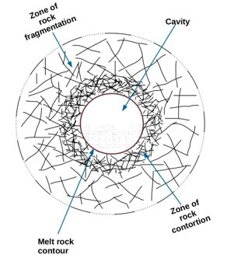
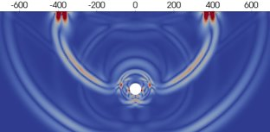
Theoretical signature of a cavern created by an Underground Nuclear Explosion in 2D exploration seismic data
Stephany Ortiz-Aguilar and Jonas D. De Basabe
Seismology Department, CICESE
P2.2-354
We investigate through numerical simulations if the caverns created by Underground Nuclear Explosions (UNE) can be detected using exploration-seismology techniques in an On-Site Inspection (OSI)
We use the Spectral Element Method (SEM) to perform the numerical simulations. We compare the results using caverns created by UNE and caverns created by other means
We show how the caverns created by UNE have a unique signature in seismic data because those associated with an UNE are surrounded by a damage zone, and the elastic waves interact with it
If you want to learn more, see my e-poster in session P2.2-354 or access it online on the SnT2023 Conference platform!

