Slide 1
Theoretical signature of a cavern created by an Underground Nuclear Explosion in 2D exploration seismic data
Stephany Ortiz-Aguilar and Jonas D. De Basabe
Seismology Department, CICESE
We investigate through numerical simulations if the caverns created by Underground Nuclear Explosions (UNE) can be detected using exploration-seismology techniques in an On-Site Inspection (OSI)
We use the Spectral Element Method (SEM) to perform the numerical simulations. We compare the results using caverns created by UNE and caverns created by other means
Our results include wavefield snapshots and seismic traces. We show how the caverns created by UNE have a unique signature in seismic data because they are surrounded by a damage zone that interacts with the wave field
Caverns created by UNE can be distinguished from naturally-occurring caverns or those created by other means. Those associated with an UNE are surrounded by a damage zone, the elastic waves interact with this zone and can be observed in the seismic data
Please do not use this space, a QR code will be automatically overlayed
P2.2-354

Slide 2
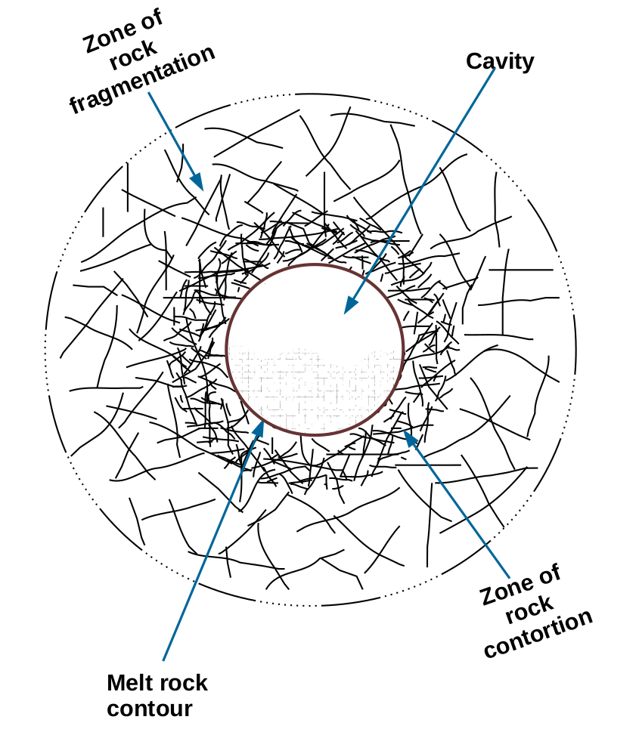
Caverns generated by an underground nuclear explosion
In On-Site Inspections (OSI), it is desirable to be able to use exploration-seismology techniques to detect caverns created by an underground nuclear explosion. However, there is scarce information about the seismic signature of this type of cavern. We performed numerical experiments of elastic wave propagation in models with caverns created by underground nuclear explosions (UNE) of 1, 20, and 100 kilotons, and obtain seismic traces in which we can observe the effect of the caverns.
Elastic properties of granite and fragmentation zone (after Boardman et al., 1964).​
Property ​ | Granite ​ | Frag. Zone​
Bulk density, g/cm³​ | 2.67 ​ | 2.54​
Porosity, % ​ | 0.9​ | 5.4​
P-wave velocity, km/s ​ | 5.52 ​ | 2.40​
S-wave velocity, km/s​ | 3.38​ | 1.50​
Please do not use this space, a QR code will be automatically overlayed
The structure of a cavern created by an UNE.
P2.2-354

Slide 3
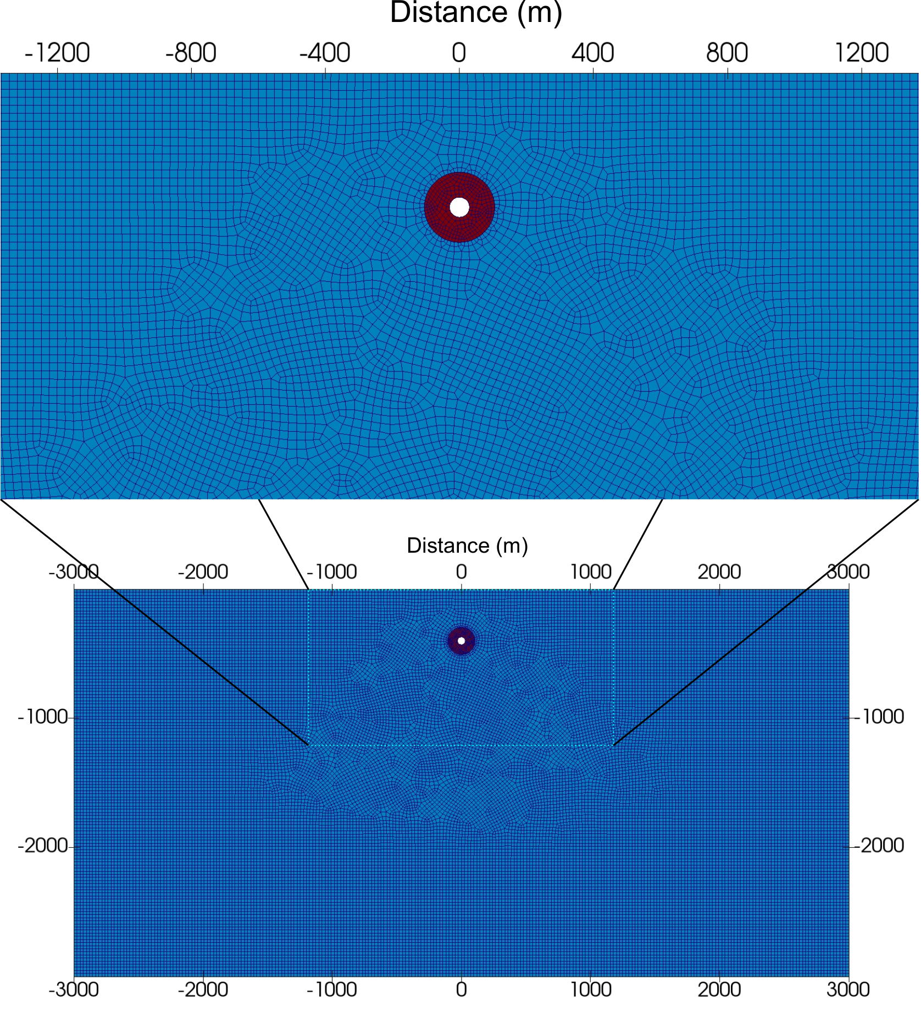
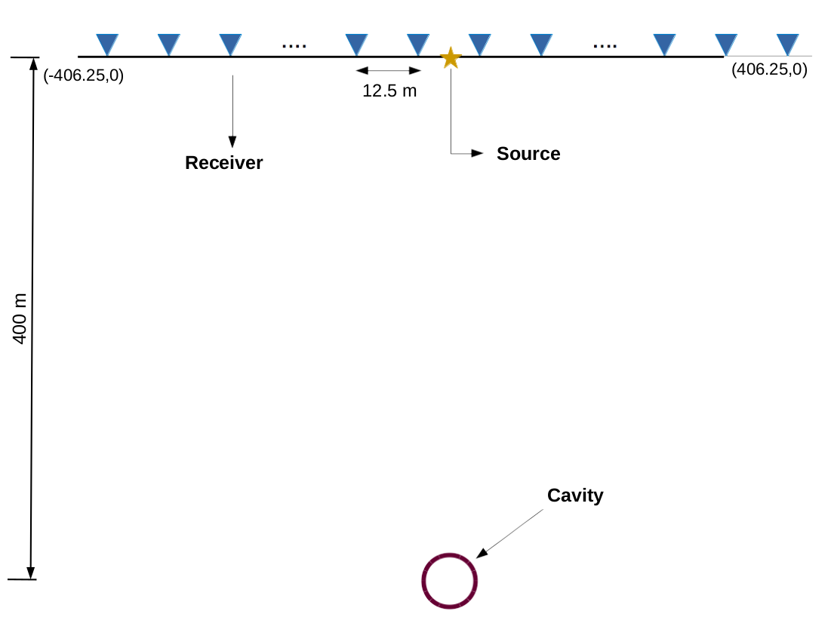
Numerical experiments
The cavern is located 400 m below the source at the surface. The size of the cavern and damage zone is proportional to the size of the explosion. For a 20 kt explosion, the radius of the cavern is 27 m, and the radius of the damage zone is 75 m. See Ortiz et al. (2020) and references therein for more detail.
Please do not use this space, a QR code will be automatically overlayed
The model is discretized with quadrilateral finite elements and we use the Spectral Element Method to simulate the wave propagation.
P2.2-354

Slide 4
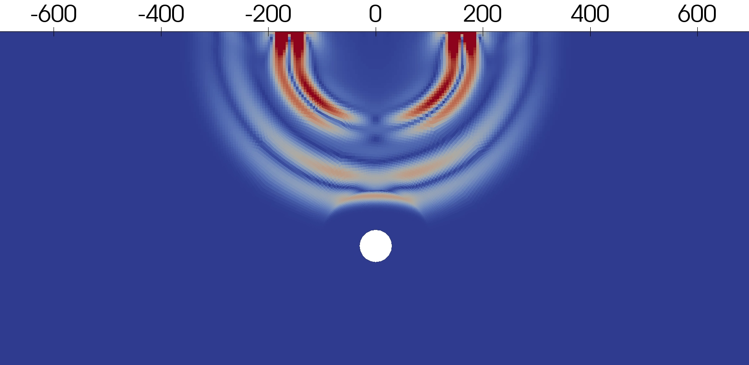
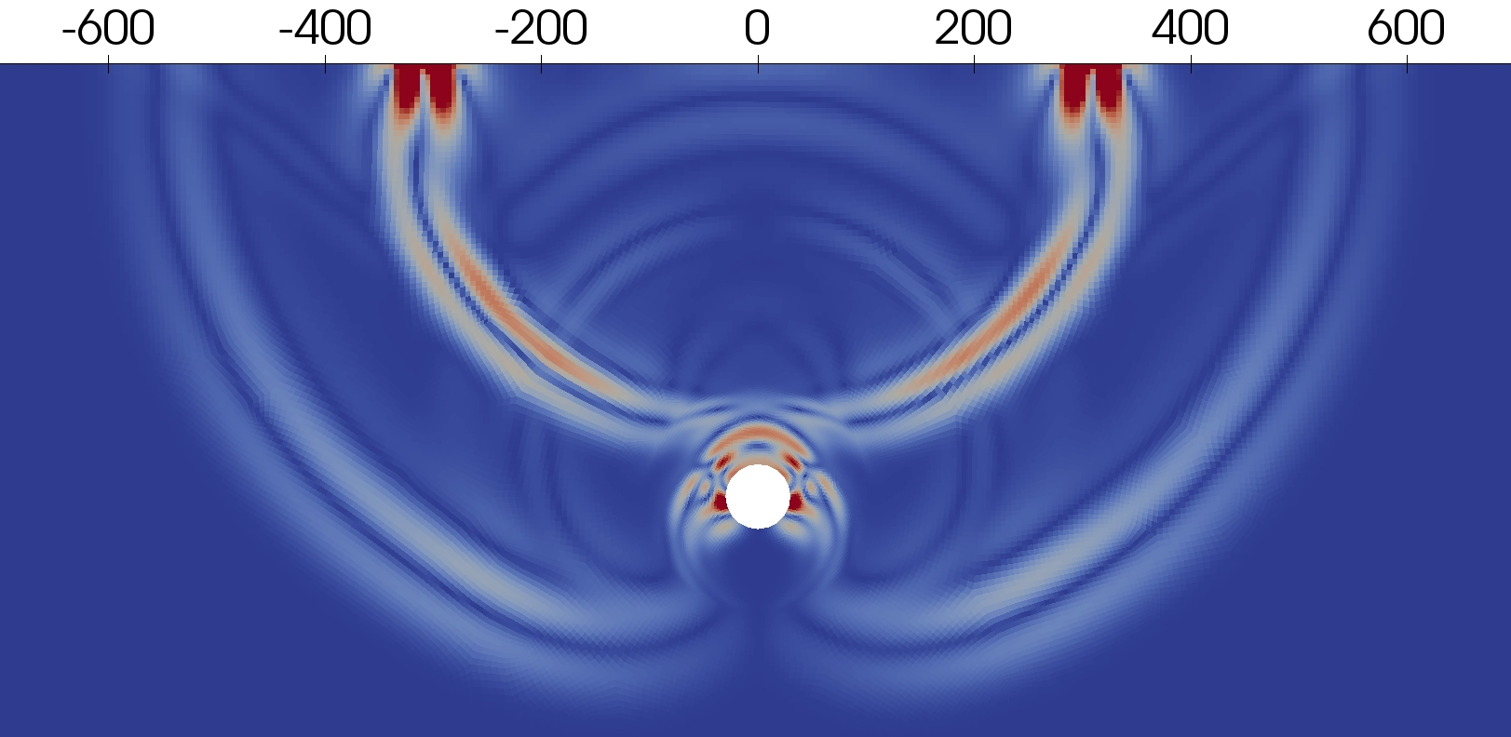
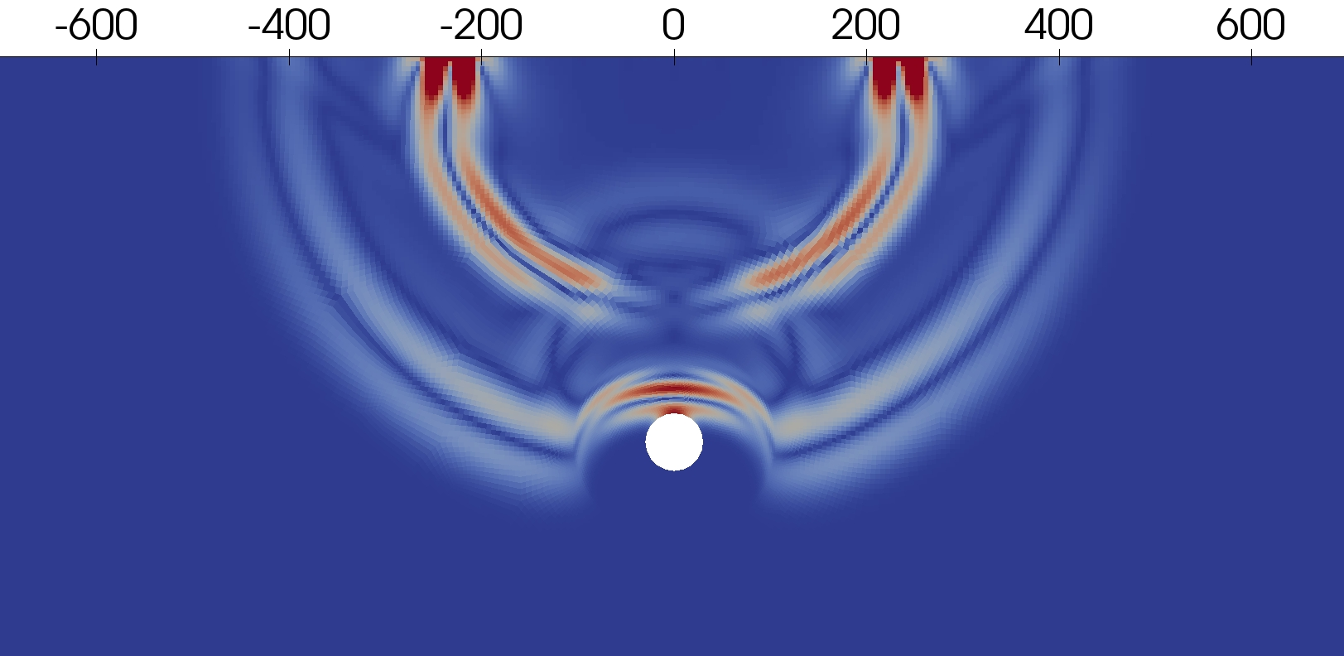
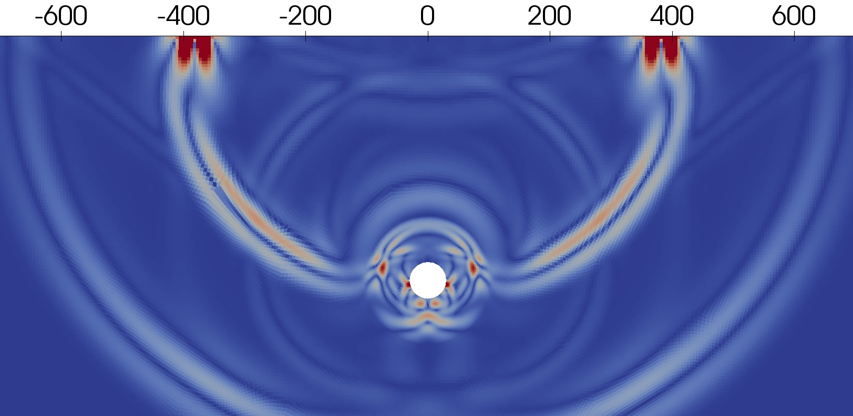
Wavefield snapshots
Propagation of the wavefield in media with a cavern from a 20 kt UNE. These snapshots show the norm of the displacement; full datasets for 1 kt, 20 kt, and 100 kt are available upon request. The wavefield interacts with the cavern and with the damage zone.
72 ms
120 ms
96 ms
144 ms
Please do not use this space, a QR code will be automatically overlayed
P2.2-354

Slide 5
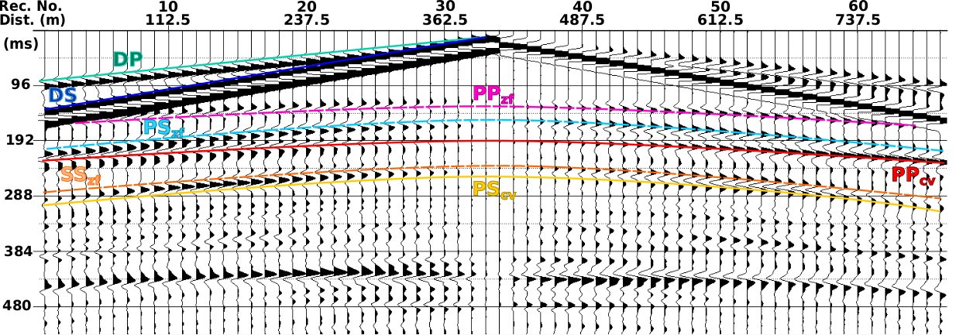
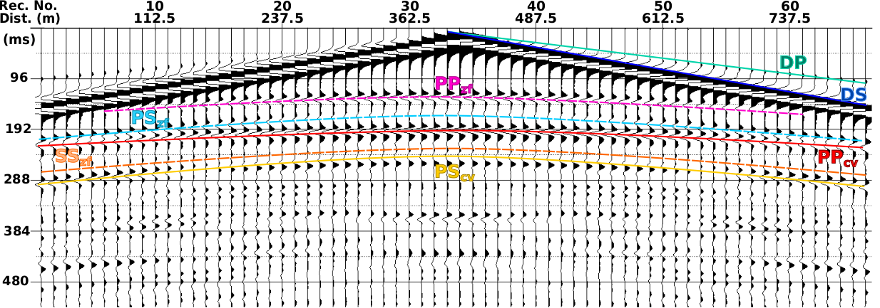
Seismic traces
U_{x}
The reflections from the damage zone are clearly visible in the seismic traces and are distinct from those of the cavern.
Nomenclature​
DP ​ | Direct P-wave ​
DS ​ | Direct S-wave​
PP ​ | Reflected P-wave ​
PS ​ | Converted S-wave ​
SP ​ | Converted P-wave ​
SS ​ | Reflected S-wave ​
PPP ​ | PP reflected as P-wave ​
PPS ​ | PP converted to S-wave ​
cv ​ | Reflected from cavern ​
zf ​ | Reflected from frag. zone ​
U_{z}
Please do not use this space, a QR code will be automatically overlayed
P2.2-354

Slide 6
Conclusions
SEM solves satisfactorily the problem of a cavern with quadrilateral elements, although the size of the structure is small compared with the half space that is discretized.
The behavior of a cavern can be distinguished from that of a cave in the seismic data. We can observe in the gathers the effect of both the fragmented zone and the cavity separately. The cavern has a particular behavior in seismic data: it acts as two concentric diffractor bodies.
Our conclusions are based on simplified models, without heterogeneities, topography, fractures, attenuation and other features that will make the data interpretation more involved.
We have performed 2D experiments with previous knowledge of the location of the caverns, whereas in an OSI the cavern is a 3D feature in an uncertain location.
Please do not use this space, a QR code will be automatically overlayed
P2.2-354

Slide 7
References
Boardman, C. R., D. D. Rabb, and R. D. McArthur, 1964, Responses of four rock mediums to contained nuclear explosions: Journal of Geophysical Research, 69, 3457–3469.
De Basabe, J. D., and M. K. Sen, 2007, Grid dispersion and stability criteria of some common finite-element methods for acoustic and elastic wave equations: Geophysics, 72, T81–T95.
De Basabe, J. D., and M. K. Sen, 2010, Stability of the high-order finite elements for acoustic or elastic wave propagation with high-order time stepping: Geophysical Journal International, 181, 577–590.
Ortiz-Aguilar, S., J. D. De Basabe, M. Gonzalez-Escobar, and V. Magar, 2020, Theoretical signature of a cavern created by an underground nuclear explosion in 2-D exploration seismic data: Geophysical Journal International, 221, 1789–1801.
Please do not use this space, a QR code will be automatically overlayed
P2.2-354

