Slide 1
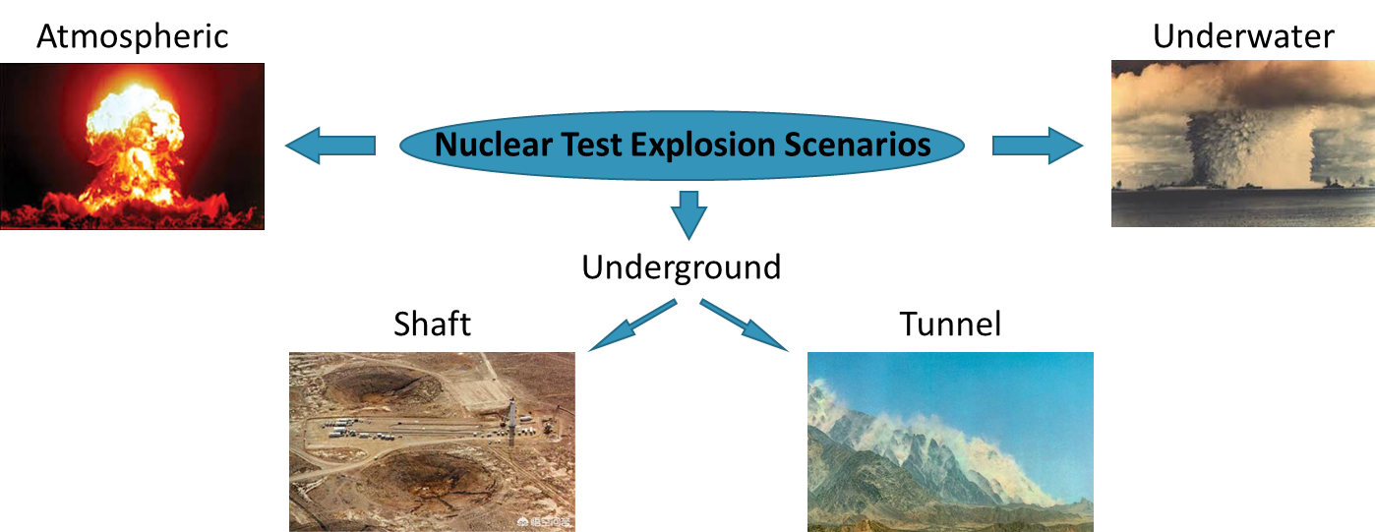
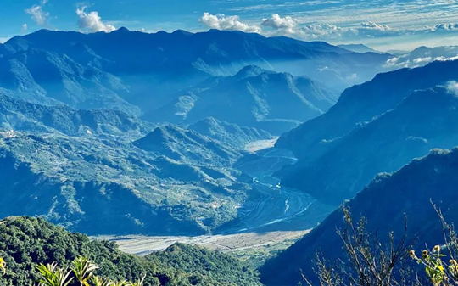
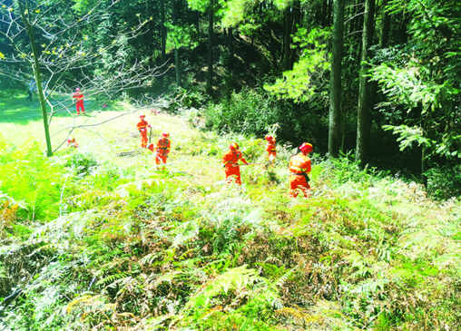
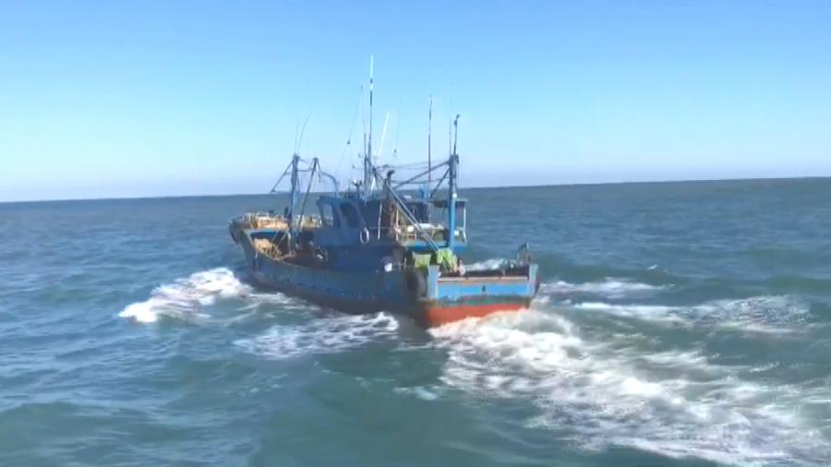
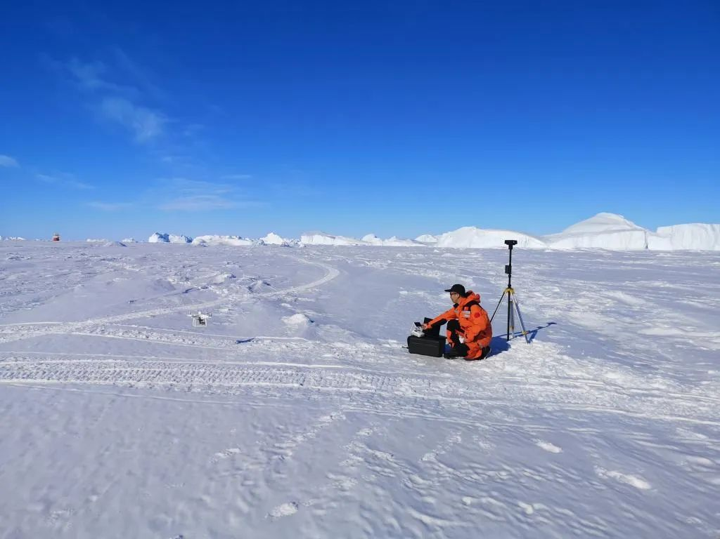
On-Site Inspection in Challenging Environments
Feihong Kuang, Gustavo Haquin Gerade
Policy Planning and Operations Section, OSI Division, the Comprehensive Nuclear-test-ban Treaty Organization (CTBTO)
P2.2-576
Nuclear Test Explosion Scenarios
Introduction
OSI Environment
Tremendous efforts have been put on the development of OSI capability since the Treaty was signed, such as OSI related field exercises, training courses, workshops and many other activities; and it achieves a lot, such as inspection technique, methodology, documentation and many other OSI capabilities.
Most of these activities and achievements are focused on moderate climate, low vegetation and gentle topography environments. If the environment changes, how the inspection team can achieve its OSI mission?
The environment in which an on-site inspection (OSI) might take place. It comprises both natural and non-natural environmental factors within the inspection area (and the base of operations) in a specific nuclear test explosion scenario which could constrain and affect OSI capabilities.
Five Key Elements of OSI Capability
How environments put effects on the conduct of an OSI. Or, in other words, what is OSI environment? How should it be characterized?
Further, what OSI capabilities are needed for a specific OSI environment?
4T + 1S | OSI Motivation | OSI Capability Elements
Target | Anomalies | Signatures and observables
Team | Inspectors | Inspectorate
Tool | Article 69 | Techniques and equipment
Tactic | Search logic | IT Methodology
Support | Operational supports | Logistics and operations support
Four Potential Challenging OSI Environments
Mountainous area
High vegetation coverage
Development of OSI Capability for Challenging OSI Environments
OSI Environment | Signatures and observables | Techniques and equipment | Inspectorate | Methodology | Logistics and operations support
Mountainous area Frigid climate High vegetation coverage | Extensive knowledge and experience Coupled into the tailored training courses | Review and test the adaptabilities of existing techniques and equipment New techniques development as needed | Tailored training | Specific deployment strategies Review of ITF/FTF | H&S plan, physical security and BOO functionality Rapid deployment support and improved logistics and operations support
High seas | 3D oceanic circulation modelling as supporting tool Marine geoscience and eco-systems impact on OSI | Review and test the adaptabilities of existing techniques and equipment On-board laboratory analysis Remotely controlled devices Techniques not in Art 69 of potential interest for ABNJ | Tailored training On-board training | Specific deployment strategies ITF/FTF for OSI in high seas | H&S and communications in high seas Survey on vessels types required Investigation of standing arrangements for port of departure/arrival
High seas
Frigid climate

