Slide 1
On-Site Inspection in Challenging Environments
Feihong Kuang, Gustavo Haquin Gerade
Policy Planning and Operations Section, OSI Division, PTS, CTBTO
From an OSI point of view, what kind of nuclear test explosion scenario should be inspected?
What is OSI environment?
Four potential challenging environments identified
Further development of OSI capabilities for a specific OSI environment
Place your QR Code here after removing this text box!
P2.2-576

Slide 2
Introduction
Tremendous efforts have been put on the development of OSI capability since the Treaty was signed, such as OSI related field exercises, training courses, workshops and many other activities; and it achieves a lot, such as inspection technique, methodology, documentation and many other OSI capabilities.
Most of these activities and achievements are focused on moderate climate, low vegetation and gentle topography environments. If the environment changes, how the inspection team can achieve its OSI mission?
How environments put effects on the conduct of an OSI. Or, in other words, what is OSI environment? How should it be characterized?
Further, what kind of OSI capabilities are needed for a specific OSI environment?
Place your QR Code here after removing this text box!
P2.2-576

Slide 3
Objectives
Treaty
CTBT-I-1
1. Each State Party undertakes not to carry out any nuclear weapon test explosion or any other nuclear explosion, and to prohibit and prevent any such nuclear explosion at any place under its jurisdiction or control.
OSI Operation Manual
CHAPTER 7: AN EVENT OTHER THAN UNDERGROUND
7.1.1 “… sets out some basic guidance on how an OSI should be conducted for an explosion other than a fully contained underground explosion…. Specific scenarios addressed here are an underwater explosion, an underwater explosion under the seafloor, and atmospheric explosions (tower, low altitude, balloon tethered or high altitude)….”
Place your QR Code here after removing this text box!
P2.2-576

Slide 4
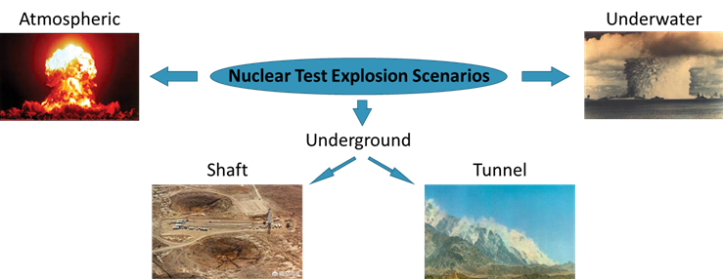
Nuclear Test Explosion Scenarios
Place your QR Code here after removing this text box!
P2.2-576

Slide 5
Key Elements to Ensure a Successful Mission
Target
Support
“4T + 1S” Principle
Team
Tactic
Place your QR Code here after removing this text box!
Tool
P2.2-576

Slide 6
Five Key Elements of OSI Capability
4T + 1S | OSI Motivation | OSI Capability Elements
Target | Anomalies | Signatures and observables
Team | Inspectors | Inspectorate
Tool | Article 69 | Techniques and equipment
Tactic | Search logic | IT Methodology
Support | Operational supports | Logistics and operations support
Place your QR Code here after removing this text box!
P2.2-576

Slide 7
OSI Environment
What is OSI environment
The environment in which an on-site inspection (OSI) might take place. It comprises both natural and non-natural environmental factors within the inspection area (and the base of operations) in a specific nuclear test explosion (NTE) scenario which could constrain and affect OSI capabilities.
Place your QR Code here after removing this text box!
P2.2-576

Slide 8
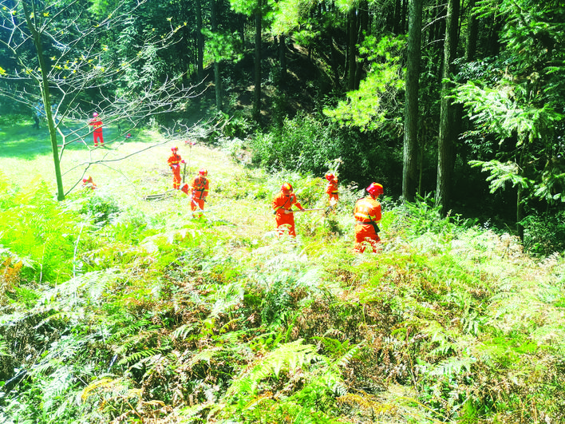
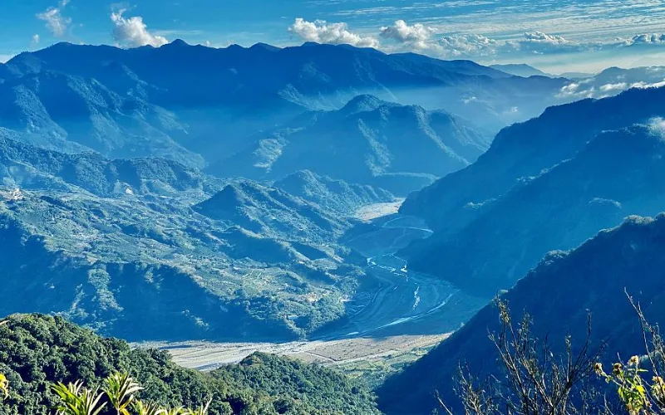
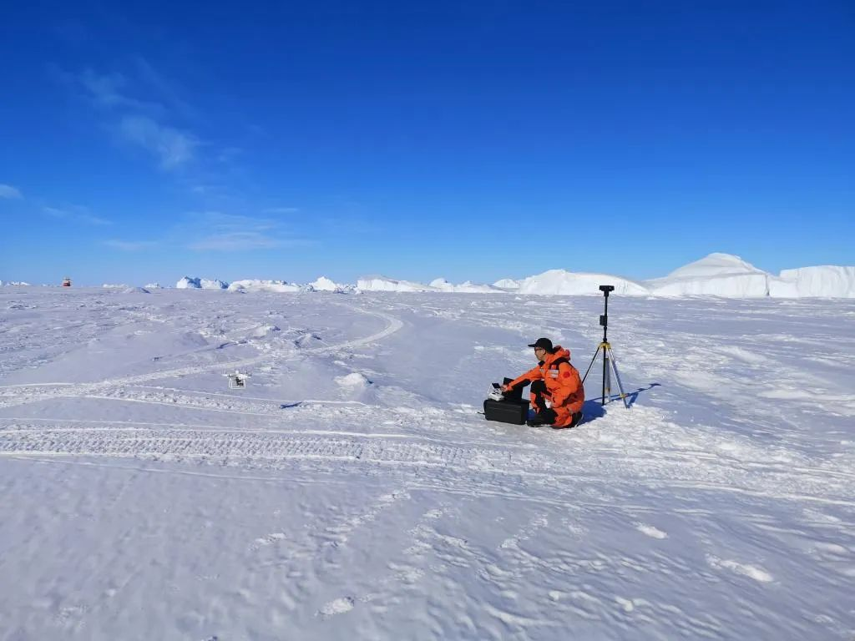
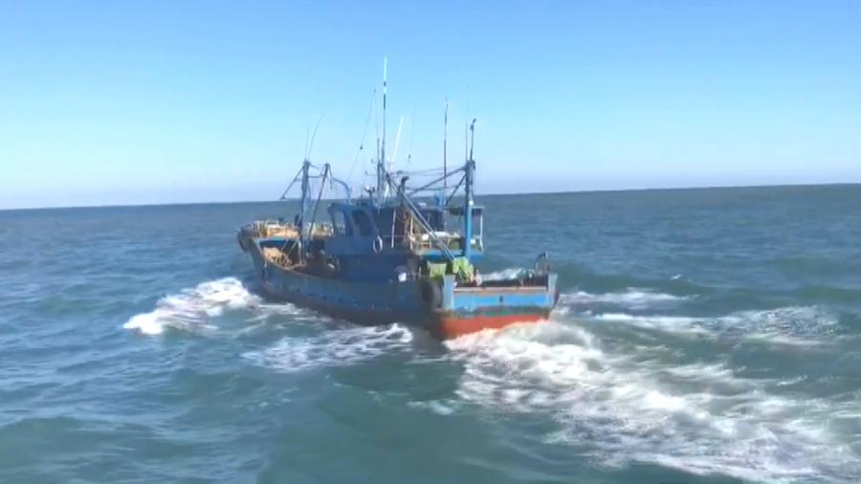
OSI in Challenging Environment
Four potential challenging environments identified
High vegetation coverage
Mountainous area
Frigid climate
High seas
Place your QR Code here after removing this text box!
P2.2-576

Slide 9
OSI Capability for Challenging OSI Environments
OSI Environment | Signatures and observables | Techniques and equipment | Inspectorate | Methodology | Logistics and operations support
Mountainous area Frigid climate High vegetation coverage | Extensive knowledge and experience Coupled into the tailored training courses | Review and test the adaptabilities of existing techniques and equipment New techniques development as needed | Tailored training | Specific deployment strategies Review of ITF/FTF | H&S plan, physical security and BOO functionality Rapid deployment support and improved logistics and operations support
Place your QR Code here after removing this text box!
P2.2-576

Slide 10
OSI Capability for Challenging OSI Environments
OSI Environment | Signatures and observables | Techniques and equipment | Inspectorate | Methodology | Logistics and operations support
High seas | 3D oceanic circulation modelling as supporting tool Marine geoscience and eco-systems impact on OSI | Review and test the adaptabilities of existing techniques and equipment On-board laboratory analysis Remotely controlled devices Techniques not in Art 69 of potential interest for ABNJ | Tailored training On-board training | Specific deployment strategies ITF/FTF for OSI in high seas | H&S and communications in high seas Survey on vessels types required Investigation of standing arrangements for port of departure/arrival
Place your QR Code here after removing this text box!
P2.2-576

Slide 11
References
Operationalization of On-Site Inspections in Different Environments, March 2021, CTBTO Technical Report, CTBT/PTS/TR/2020-2
Place your QR Code here after removing this text box!
P2.2-576

