Slide 1
Fire Detection in an On-Site Inspection Area
Ahlam R. Khekan
University of Information Technology and Communication. Iraq
ahlamr.khekan@uoitc.edu.iq
Fires can seriously threaten people’s lives and cause major economic losses.
The on-site inspection periods require inspection teams to stay at the site to conduct inspections, which necessitates the use of cameras and a monitoring system to provide site monitoring, in case of a fire.
It propose a system to predicate or to detect a fire accident in an on-site inspection area in real time using a monitoring system using a deep learning based approach.
We proposed a real-time model for fire action recognition in video based on YOLO, the accuracy obtained by methodology, its found to be 64%.
The main finding of our study is that even a small number of frames can be used to recognize actions in a video. We found that even for some cases, a single frame is sufficient for recognition of action.
Please do not use this space, a QR code will be automatically overlayed
P2.2-596

Slide 2
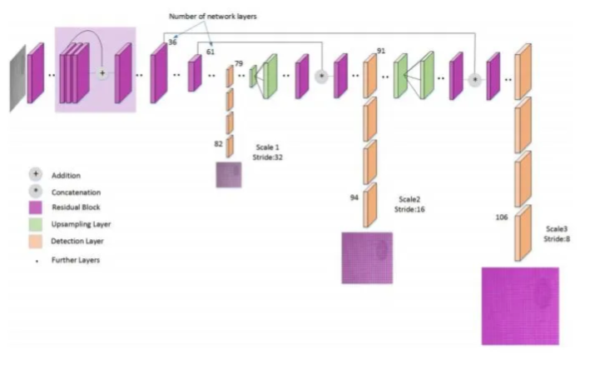
Introduction
In recent years, as fire imaging detection has become a research hotspot, imaging detection has the advantages of early detection, high accuracy, flexible system installation, and effective detection of large spaces and complex building structure fires[1]
The fire is one of the main life-threaten factors for humans, its a challenging. Recently, deep learning methods such as the You Only Look Once (YOLO) algorithm[2] have shown great potential in identifying fires automatically by learning relevant features from images. A real-time fire detection system is proposed in this poster, utilizing YOLO to detect fires in both images and video streams. The YOLO architecture comprises multiple convolutional layers for feature extraction, activation functions for non-linearity, and pooling layers. The model is trained on a set of labelled fire and non-fire images or videos to minimize the loss function using Yolo algorithms. To enable real-time fire detection, the trained yolov8 model is incorporated into a fire detection system that can process images or video streams in real-time.
YOLO Architecture
Please do not use this space, a QR code will be automatically overlayed
P2.2-596

Slide 3
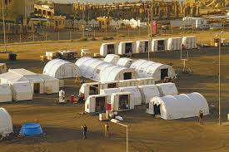
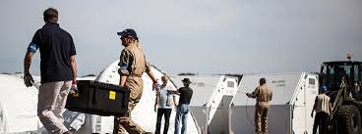
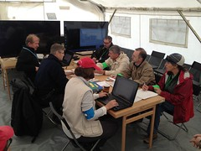
Objectives
The on-site inspection (OSI) regime is the ultimate verification measure of the Comprehensive Nuclear-Test-Ban Treaty (CTBT), comprising strong political, technical, and operational elements. It adds to the deterrence against clandestine tests and is an important measure to determine compliance. The on-site inspection periods require inspection teams to stay at the site to conduct inspections, which necessitates the use of cameras and a monitoring system to provide site monitoring, in case of a fire, the monitoring system will provide an audio alert in real-time to notify the team that there is a fire, allowing them to immediately intervene and extinguish it.
With the development of machine learning, deep learning techniques have been widely used in detection[3]. The aim of this research is to propose a system to predicate or to detect a fire accident in an on-site inspection area in real time using a monitoring system using a deep learning based approach.
In detection, Yolo-algorithm has better real-time property, higher detection accuracy and early fire detection ability, the experiments proves that this improves the fire detection accuracy rate. This paper is very practical for on-inspection area safety and monitor in real time
Please do not use this space, a QR code will be automatically overlayed
P2.2-596

Slide 4
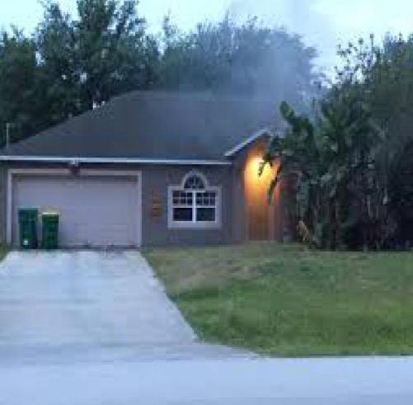
Lou, H.; Duan, X.; Guo, J.; Liu, H.; Gu, J.; Bi, L.; Chen, H. DC-YOLOv8: Small-Size Object Detection Algorithm Based on Camera Sensor. Electronics 2023, 12, 2323.
Lou, H.; Duan, X.; Guo, J.; Liu, H.; Gu, J.; Bi, L.; Chen, H. DC-YOLOv8: Small-Size Object Detection Algorithm Based on Camera Sensor. Electronics 2023, 12, 2323.
Proposed Methodology
we used a method for training and testing of the model is (YOLOv8) to fire detection, Yolo[4] is Unlike most of the previous detection algorithms, YOLO uses a completely different approach.
It applies a single neural network to the entire image, which divides the image into multiple regions and predictions are done using bounding boxes and probabilities based on each region. Since YOLO uses a single network for evaluation of the entire image, this makes it faster than most of the other algorithms like R-CNN and Fast R-CNN.
Please do not use this space, a QR code will be automatically overlayed
P2.2-596

Slide 5
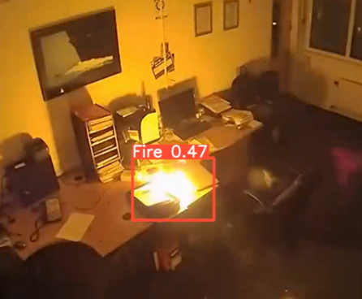
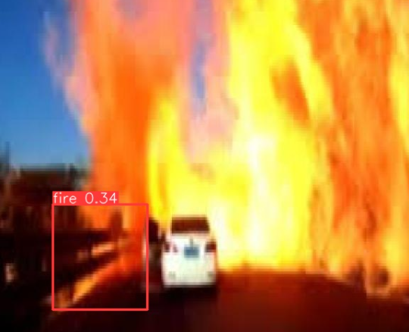
The Dataset
The dataset (image) has been used in order to test for fire and smoke detection from Roboflow [5]. It can be seen as composed by two main parts: the first images characterized by the presence of the fire and the last images which do not contain any event of interest.
Size | RESOLUTION | FRAME RATE | FRAMES | FIRE
Train | 640×640 | 70% | 597 | Yes
Validation | 640×640 | 20% | 173 | Yes
Test | 640×640 | 10% | 85 | Yes
We applied to train using Yolov8 algorithm with 597 images, Validation 137 images and tested with 85 images.
The image classifier by Yolov8, is apply with 855 images. the model is built up by Python.
In training : Speed: 2.7ms pre-process, 5.7ms inference, 4.8ms postprocess per image. For more accuracy and to reduce the average loss, we can train our model with more number of iterations.
In testing: Speed: 3.0ms pre-process, 2.8ms inference, 5.9ms postprocess per image. Hence, the accuracy is 0.64mAP
Please do not use this space, a QR code will be automatically overlayed
P2.2-596

Slide 6
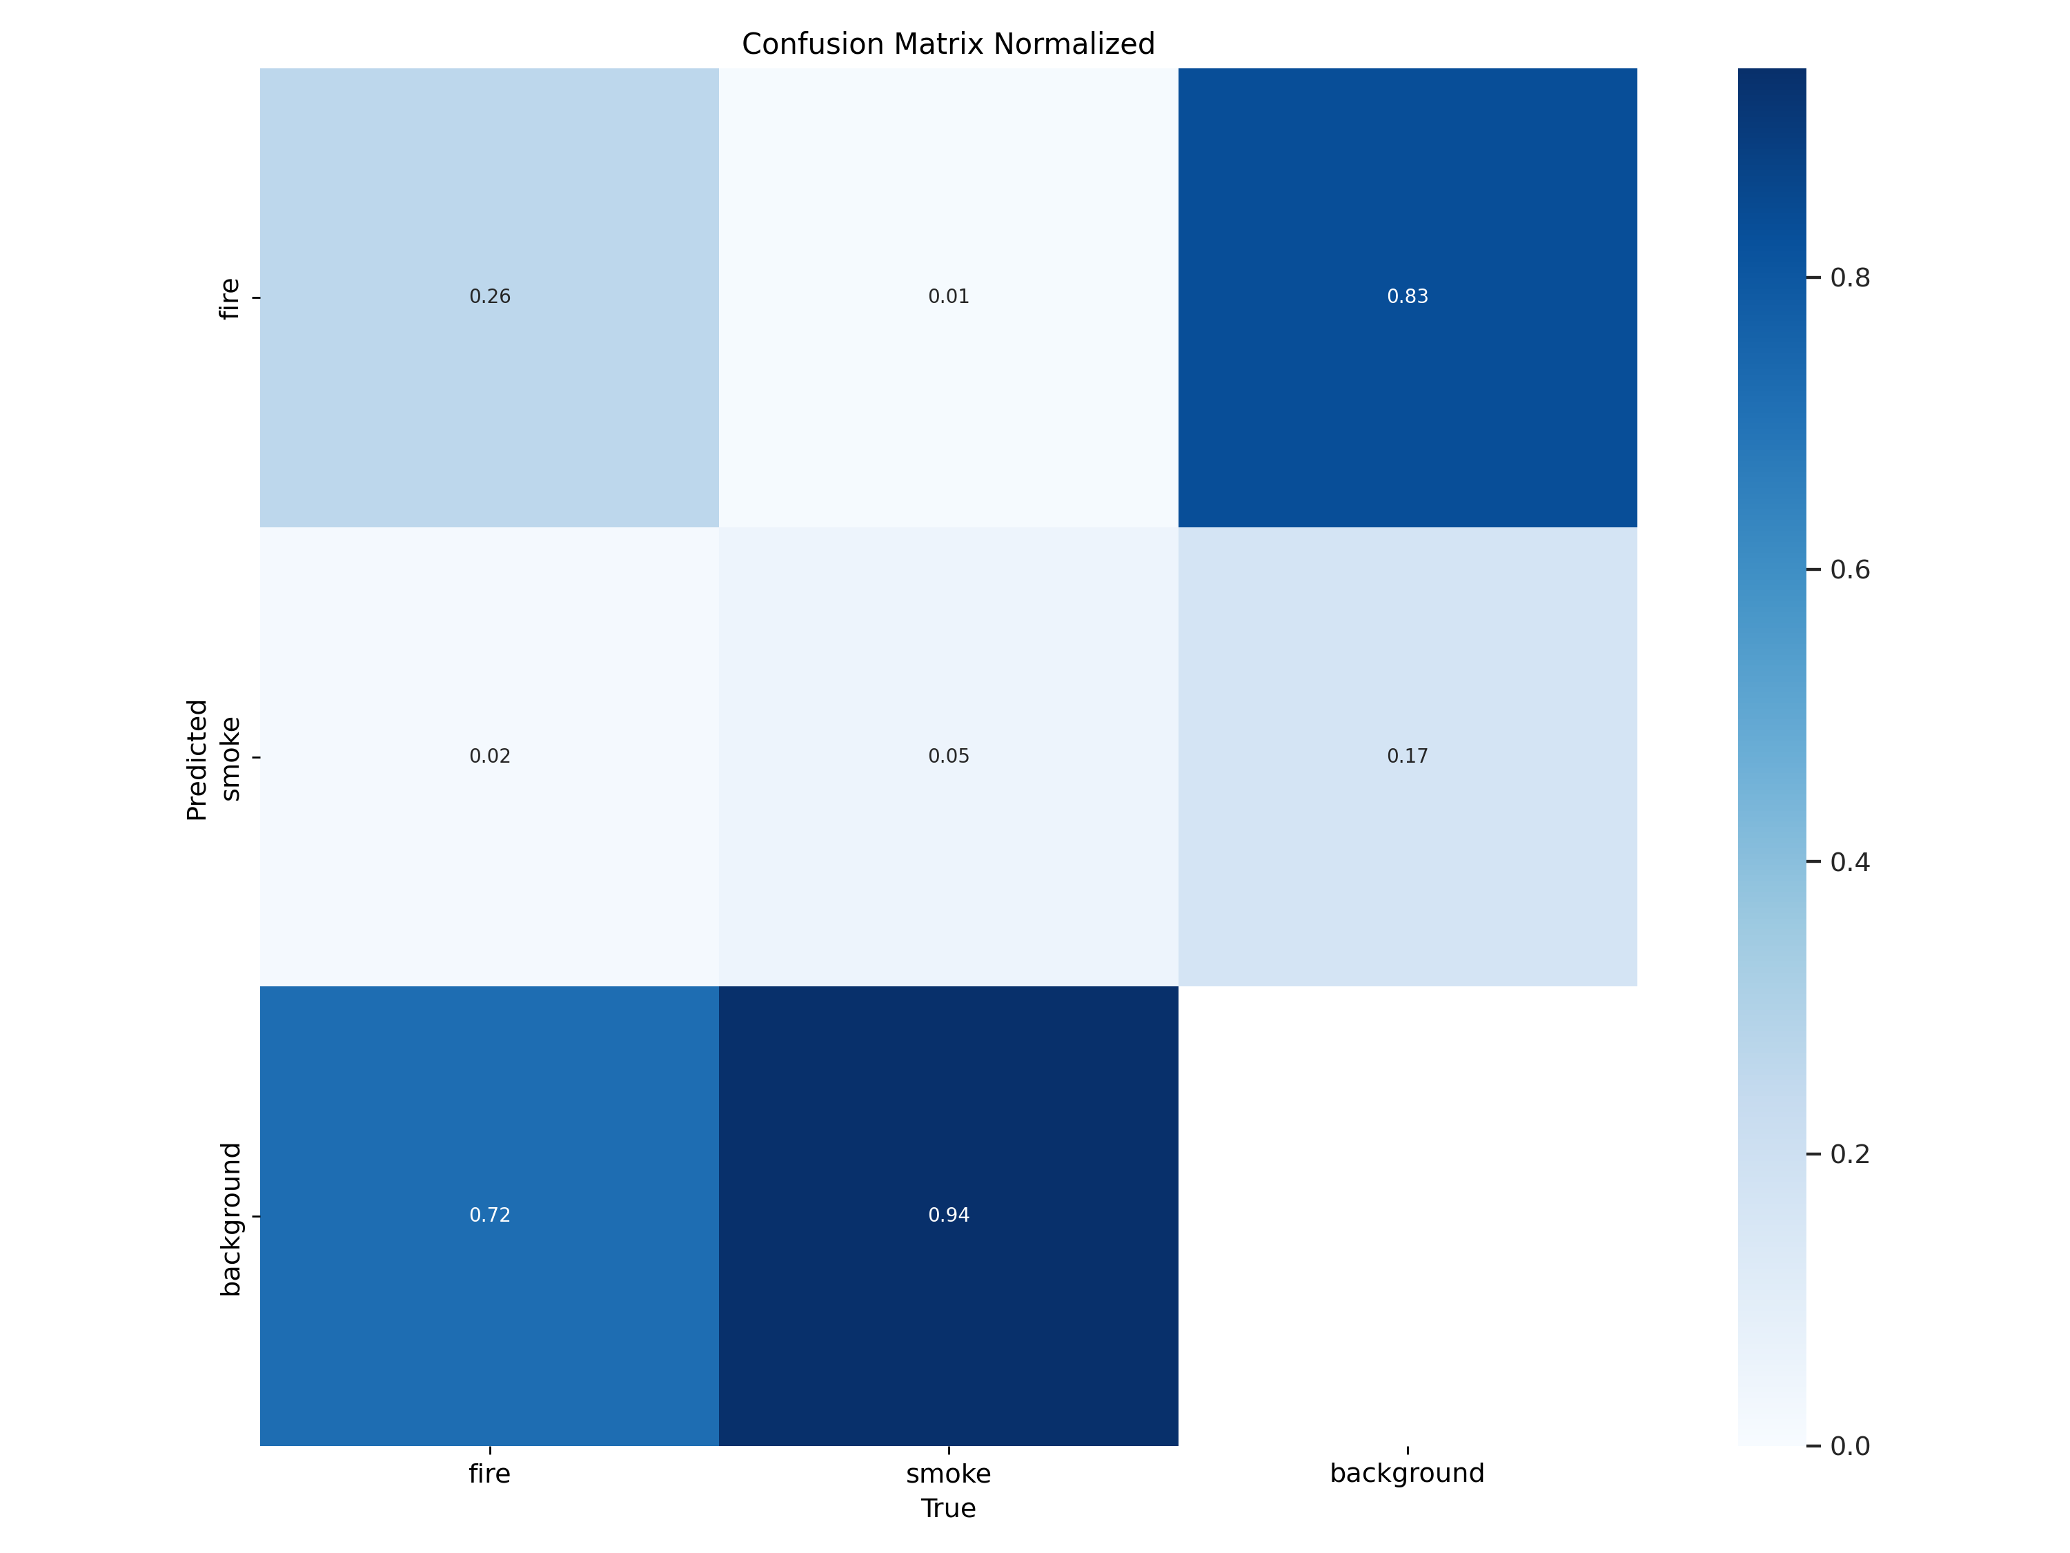
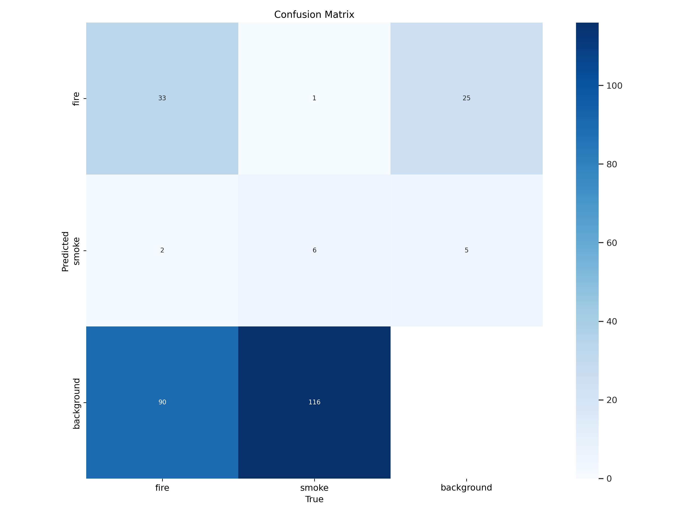
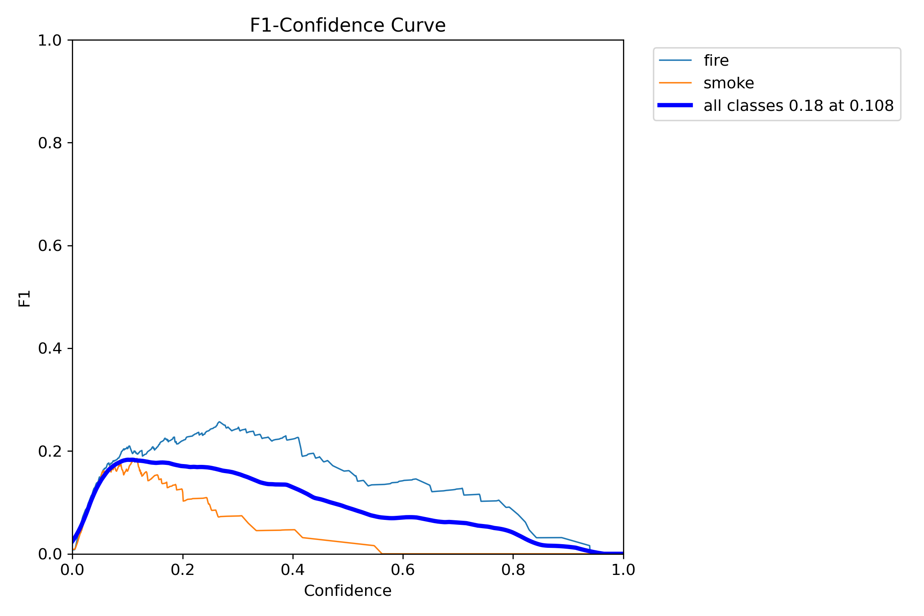
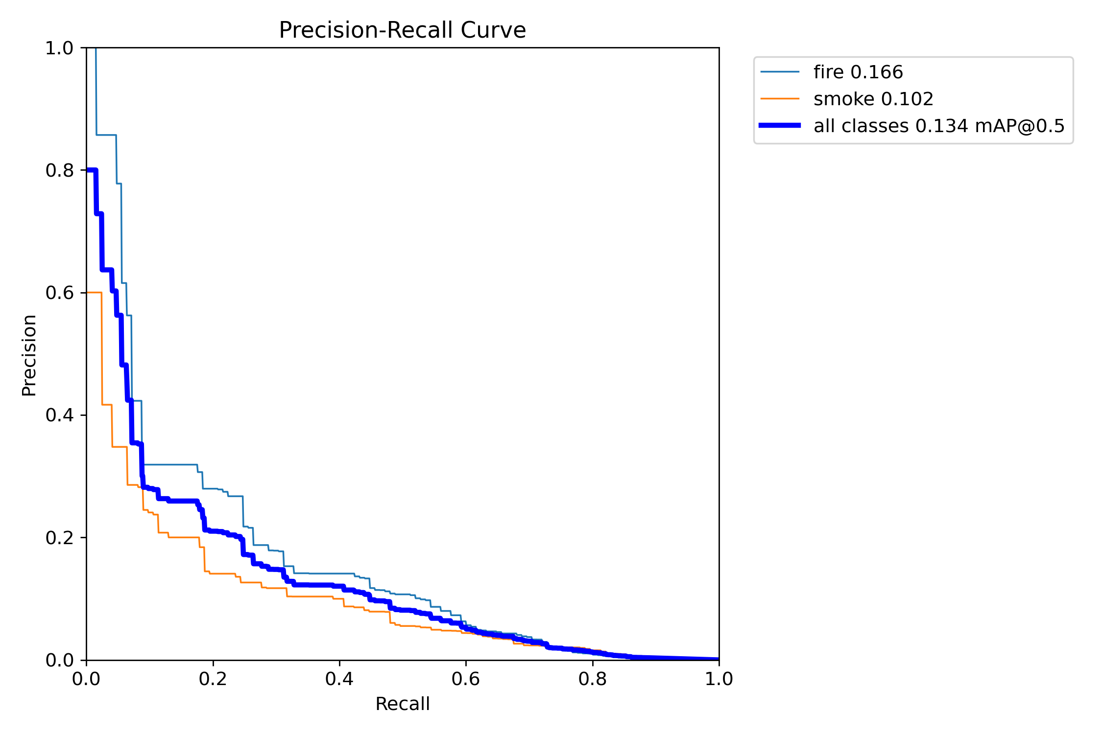
Conclusion
We proposed a real-time model for fire action recognition in video based on YOLO, the accuracy obtained by methodology, its found to be 64%.
The main finding of our study is that even a small number of frames can be used to recognize actions in a video. We found that even for some cases, a single frame is sufficient for recognition of action.
Please do not use this space, a QR code will be automatically overlayed
Confusion matrix normalization
Matrix
FI- Confidence Curve
Figure Precision- Recall Curve
P2.2-596

Slide 7
Future Work
Surveillance fire system is a very important, we will build a system to automate the task of analysing video surveillance. We will analyse the video feed in real time and identify any abnormal activates like fire or smok. There have been advancements in deep learning algorithms for deep surveillance, these advancements have shown an essential trend in deep surveillance and promise a drastic efficiency gain.
The design a model of the fire detection and alarm system should applicable, its considered to be part of the fire alarm system and are connected and controlled.
Fire control units can perform other functions, such as:
• Providing two-way firefighter communication
• Providing remote annunciator integration
• Controlling elevators, HVAC, fire doors, dampers, locks, or other fire protection features
Please do not use this space, a QR code will be automatically overlayed
P2.2-596

Slide 8
References
[1] Barmpoutis, Papaioannou, Dimitropoulos and Grammalidis, ''A Review on Early Forest Fire Detection Systems Using Optical Remote Sensing',MDPI,Sensors 2020, 20, 6442; doi:10.3390/s2022644.
[2] Redmon,Divvala ,Girshick and Farhadi,''You Only Look Once: Unified, Real-Time Object Detection ''2016 IEEE Conference on Computer Vision and Pattern Recognition (CVPR), 2016, Pages: 779-788, DOI Bookmark: 10.1109/CVPR.2016.91
[3] Zhao, C.; Feng, Y.; Liu, R.; Zheng, W. Application of Lightweight Convolution Neural Network in Cancer Diagnosis. In
Proceedings of the 2020 Conference on Artificial Intelligence and Healthcare, Taiyuan, China, 23–25 October 2020; pp. 249–253.
[4] Lou, H.; Duan, X.; Guo, J.; Liu, H.; Gu, J.; Bi, L.; Chen, H. DC-YOLOv8: Small-Size Object Detection Algorithm Based on Camera Sensor. Electronics 2023, 12, 2323.
[5]https://universe.roboflow.com
Please do not use this space, a QR code will be automatically overlayed
P2.2-596

