Slide 1
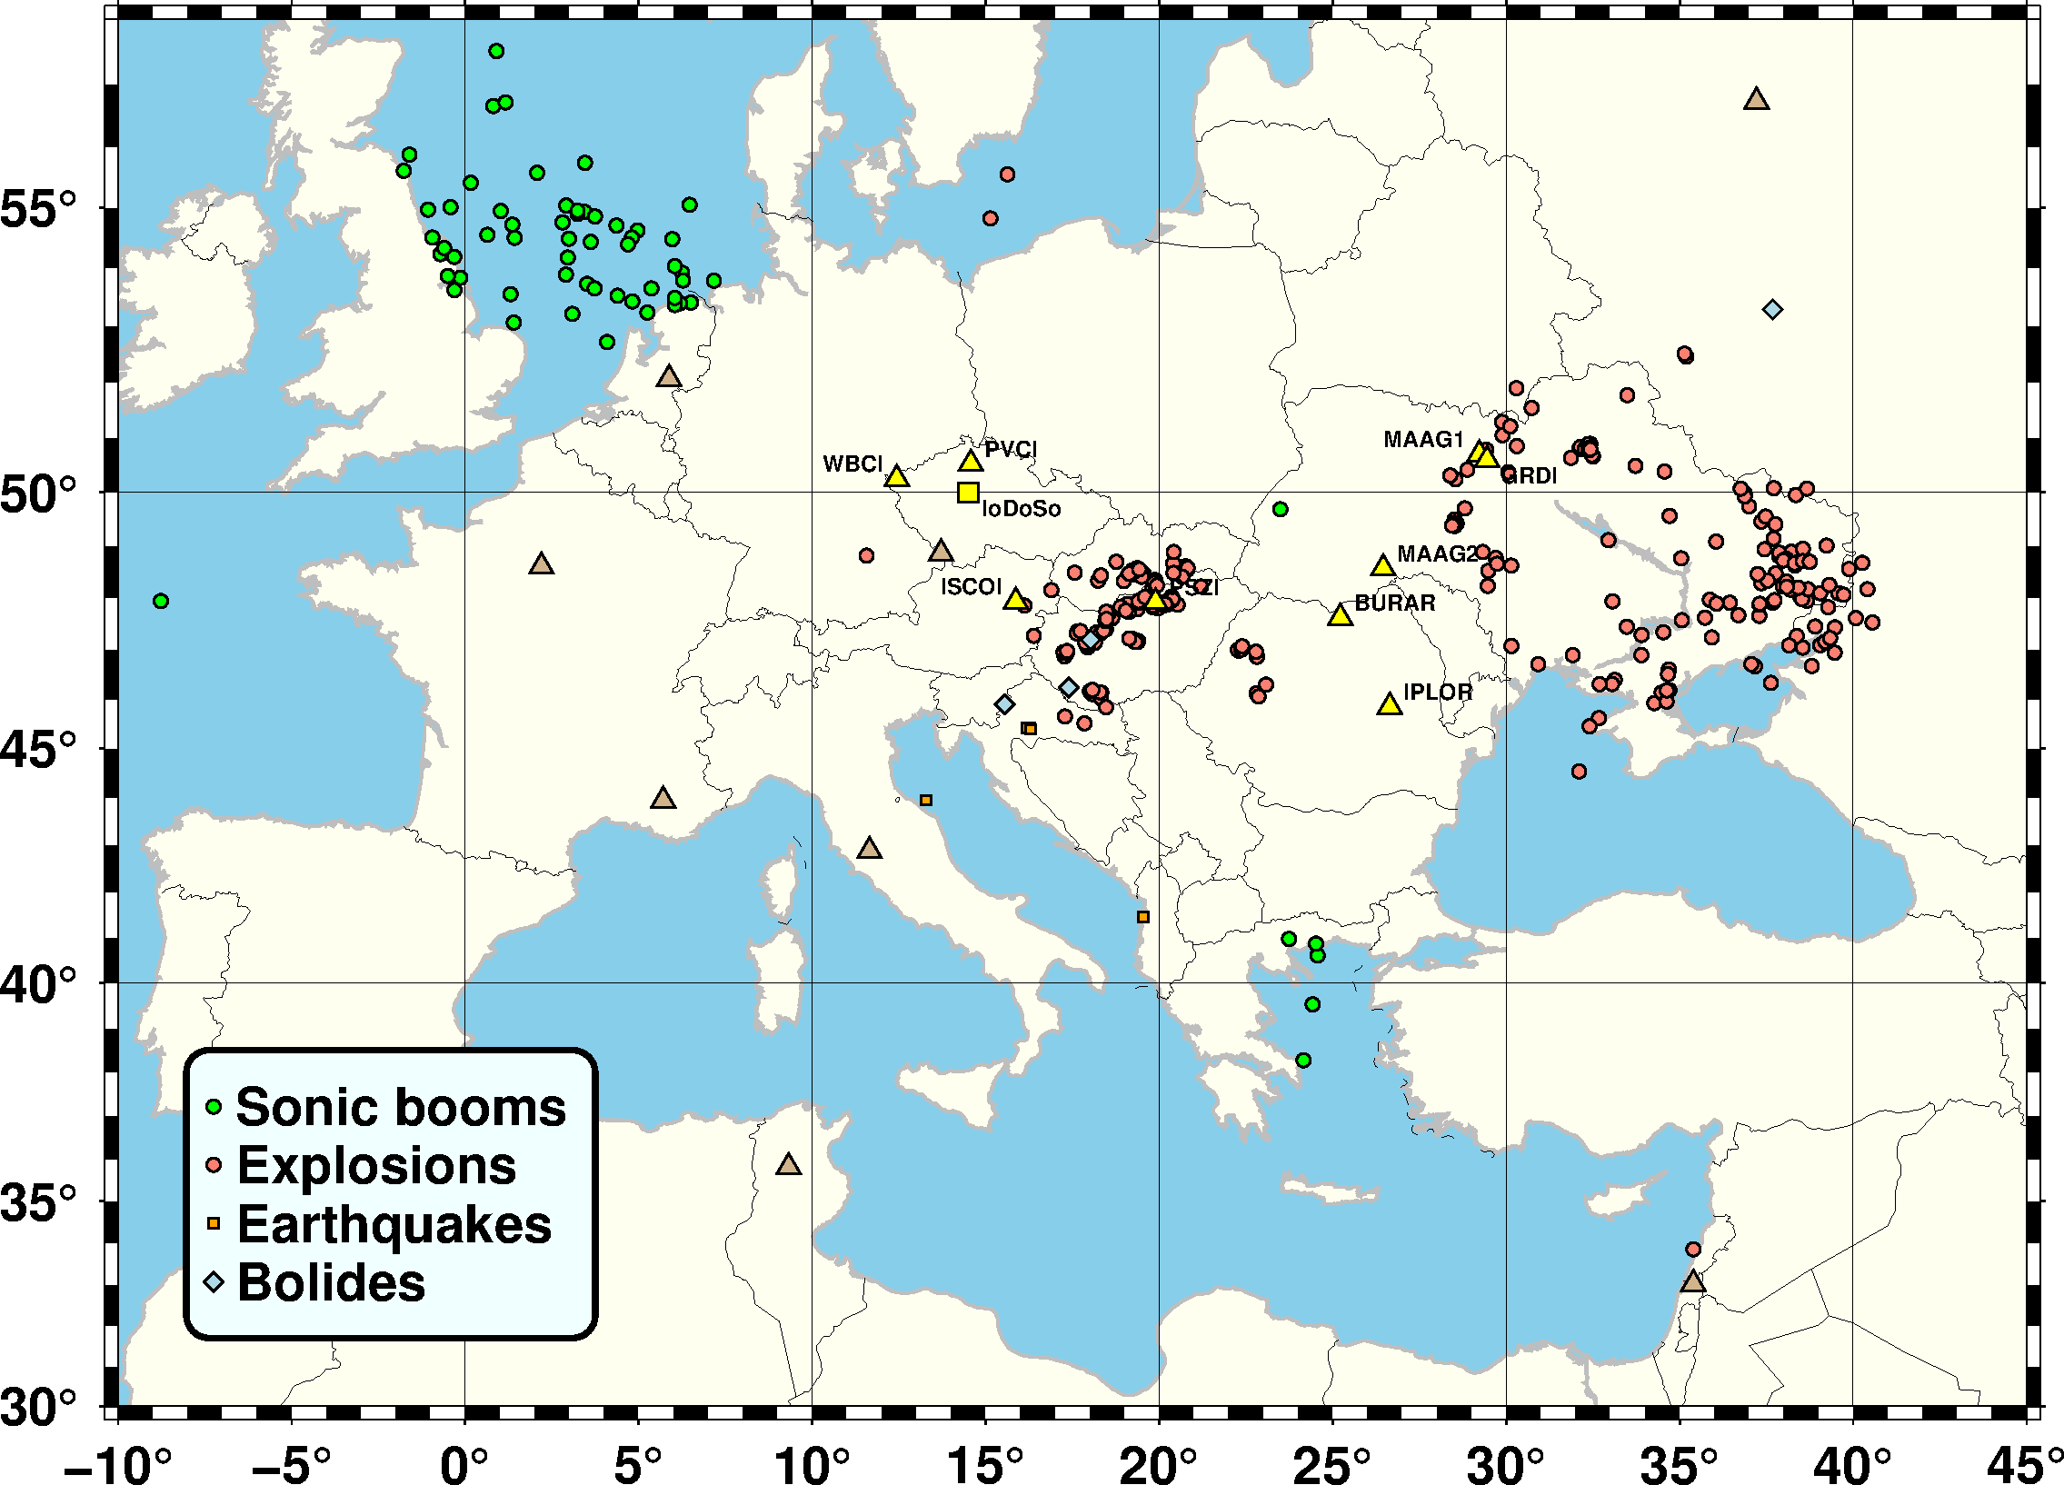
The Central and Eastern European Infrasound Network
István Bondár, Tereza Šindelářová, Daniela Ghica, Ulrike Mitterbauer, Alexander Liashchuk, Cristian Neagoe, Marcell Pásztor, Jiří Baše, Jaroslav Chum, Constantin Ionescu, Csenge Czanik, Péter Mónus, Dániel Topál, Alexis Le Pichon
P2.3-189
CEEIN bulletin 2017-2022, www.ceein.eu
We present the improved detection capabilities owing to the Central and Eastern European Infrasound Network arrays
We identify the coherent noise sources recorded at CEEIN
We show that CEEIN bears witness to the war in Ukraine

