Slide 1
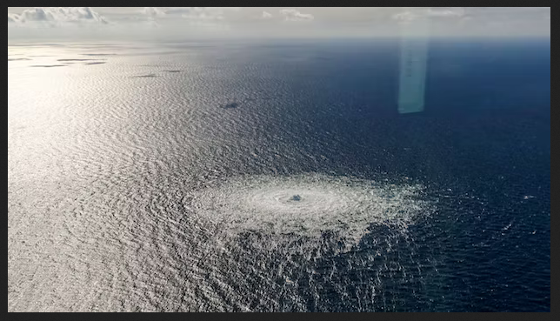
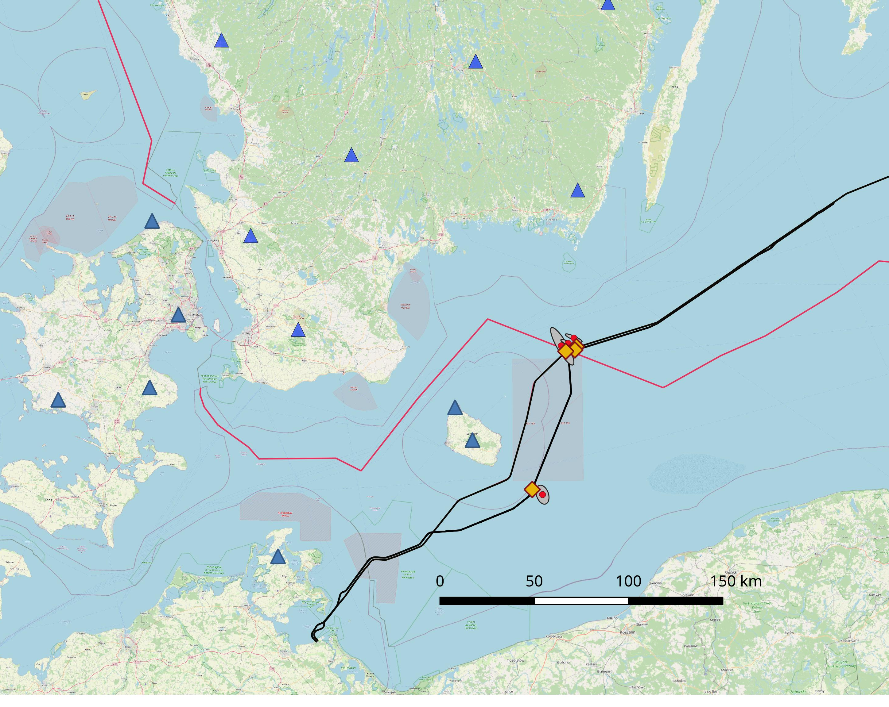
Analysis of the Nord Stream Underwater Blasts in the Baltic Sea on 26. September 2022
P2.3-571
Tine B. Larsen(1), Peter H. Voss(1), Trine Dahl-Jensen(1), Nicolai Rinds(1), Björn Lund(2), Peter Schmidt(2), Michael Roth(2), Gunnar Eggertsson(2), Andreas Köhler(3), Bettina Goertz-Allmann(3), Celso Alvizuri(3), Johannes Schweitzer(3), Volker Oye(3), Christian Weidle(4)
(1) GEUS DK, (2) Uppsala Uni. SE, (3) NORSAR NO, (4) Kiel Uni DE
NE-C
NE-B
NE-A
Event NE- A,B,C
Gas bubbles were observed in the Baltic Sea
We initially detected two events using local seismological data
The events were clearly blasts
Detailed analysis revealed that the second event contained multiple blasts
Using local and regional data gave more precise results than using REB phases
Improved insight from collaboration among neighbouring countries
Event SE
Please see my e-poster during session P2.3 on Wednesday 10:00-11:00 or access it online

