Slide 1
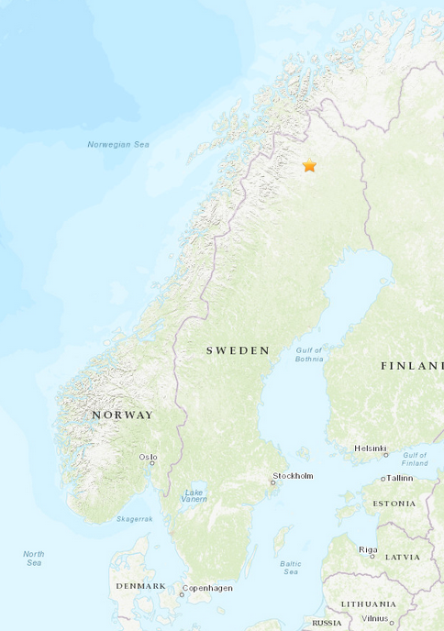
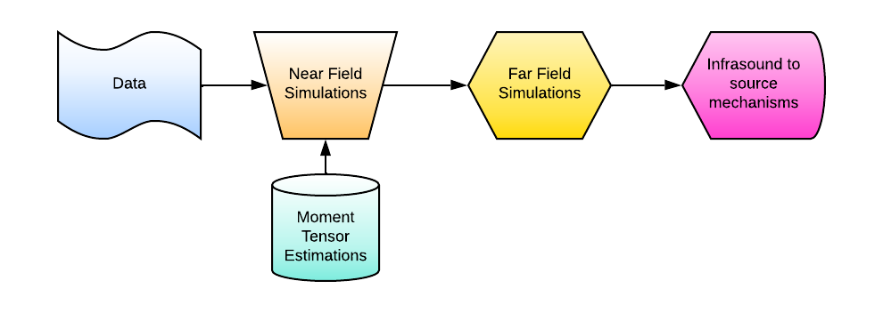
Constraining Moment-Tensor and Source Depth of a Mine Quake Using Local Infrasound Data
Antoine Turquet(1), Quentin Brissaud(1), Celso Alvizuri(1), Sven Peter Näsholm(1,2), Alexis Le Pichon(3), Johan Kero(4)
(1) NORSAR, (2) University of Oslo, (3) CEA, (4) IRF
P2.3-317
USGS
A mine-quake of mb 4.9 occurred in Kiruna, Sweden 18 May 2020 at 1:11:56.2 UTC
This event is the largest mining-induced earthquake in Scandinavia.
The seismo-acoustic data and analysed is collected both in near field and in far field.
Main motivation is to explore how much we can learn about source characteristics by adding infrasound to seismic analyses.
Notes:
The largest mining induced earthquake in Scandinavia happened in Kiruna in May 2020 having 4.9 magnitude.
The data is recorded in near and far field both infrasound and seismic sensors provides a unique dataset
We used this data to conduct near field infrasound simulations
And propagated these results to far field
The aim is to find out how much we can learn about source mechanism and characteristics adding infrasound into our seismic analyses

