Slide 1
Constraining Moment-Tensor and Source Depth of a Mine Quake Using Local Infrasound Data
Antoine Turquet(1), Quentin Brissaud(1), Celso Alvizuri(1), Sven Peter Näsholm(1,2), Alexis Le Pichon(3), Johan Kero(4)
(1) NORSAR, (2) University of Oslo, (3) CEA, (4) IRF
A shallow mine-quake of mb 4.9 occurred in Kiruna, Sweden 18 May 2020The infrasound signals are recorded in stations both in near-field (<10km) and in far field (up to 300km) creating a unique dataset.
This event is the largest mining-induced earthquake in Scandinavia and this event was the highest-magnitude minequake ever reported in Sweden.
We have analysed this unique seismo-acoustic dataset. We have conducted PMCC analysis, moment fensor analysis, transmission loss over distance, full-waveform simulations for near field and waveform simulations for far-field. We also analysed the contributions of different aspects on far-field signals.
Arrivals with dominant frequency below 2.5 Hz are visible continuously a few seconds before and after the main epicentral acoustic arrival. Full waveform simulations show in focal depths deeper than 0.5 km are unable to reproduce the arrivals at KRIS The good phase fit between data and simulations suggest that local infrasound may help to differentiate events of explosion and collapse.
Regional simulations using realistic weather models together with a realization of gravity waves match well the observed envelopes at IS37 and ARCI. Both focal depth and mechanism greatly influence the onset and overall energy distribution of the local infrasound.
Please do not use this space, a QR code will be automatically overlayed
P2.3-317

Slide 2
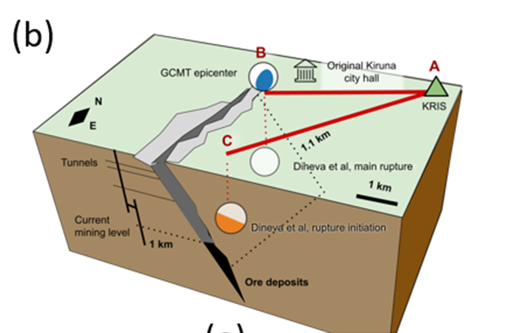
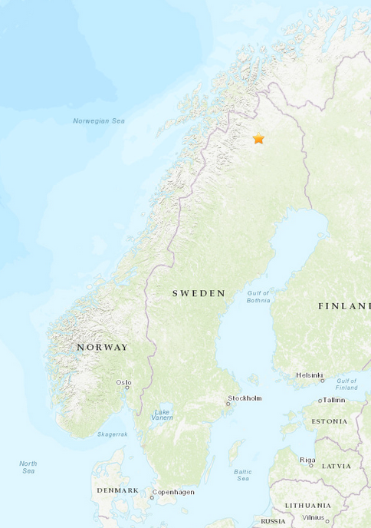
Introduction
(a) Background colors indicate the effective velocity ratio between effective
velocity in the stratosphere and at ground level.
(b) 3d representation of the mine pit
together with location of the KRIS array (label A), GCMT epicenter (label B), and locations of main source
types from Dineva et al. (2022).
155km
286km
Effective soundspeed ratio
USGS
A shallow mine-quake of mb 4.9 occurred in Kiruna, Sweden 18 May 2020 at 1:11:56.2 UTC
The mine was immediately evacuated due to aftershock risk.
This event is the largest mining-induced earthquake in Scandinavia and this event was the highest-magnitude minequake ever reported in Sweden.
The Kiruna mine, operated by Luossavaara-Kiirunavaara AB (LKAB), is the largest underground iron ore mine in the world (b).
Recent work (Dineva et al.,2022) concluded that the Kiruna minequake corresponded to a complex series of normal faulting events in the south of the mine (line AC in Fig. b) followed by less energetic collapse events in the north of the mine (line AB in Fig. b).
The event produced acoustic signals observed at three infrasound arrays at distances of 7 km (KRIS, Sweden), 155 km (IS37, Norway) and 286 km (ARCI, Norway).
The simultaneous observations of acoustic signals at both local and regional distances are unprecedented.
P2.3-317
Please do not use this space, a QR code will be automatically overlayed
Dineva, S., C. Dahnér, D. Malovichko, and L. Rudzinski (2022), Analysis of the magnitude 4.2 seismic event340 on 18 may 2020 in the Kiirunvaara mine, Sweden, in Proceedings of the Tenth Conference on Rockburst and Seismicity in Mines, Society for Mining, Metallurgy and Exploration, Englewood.
Notes:
Here we see a map showing where the epicenter is located and the effective soundspeed ratio around the epicenter. Indicating where it is more likely to have infrasound arrivals. Recently published works state that it’s a complex series of normal faulting and collapse events.

Slide 3
Objectives and Overview
Objective:
Using a unique set of local (<10km) and regional (up to 300km) infrasound observations from the same event to address our lack of understanding of seismo-acoustic coupling mechanisms.
Key findings:
– Seismo-acoustic records indicate a strong collapse at shallow depth for the 2020 Kiruna
minequake
– Seismic events corresponding to the largest seismic amplitudes do not necessarily lead to the largest infrasound amplitudes
– Focal mechanisms and depths can be retrieved from local and regional infrasound station
records
P2.3-317
Please do not use this space, a QR code will be automatically overlayed

Slide 4
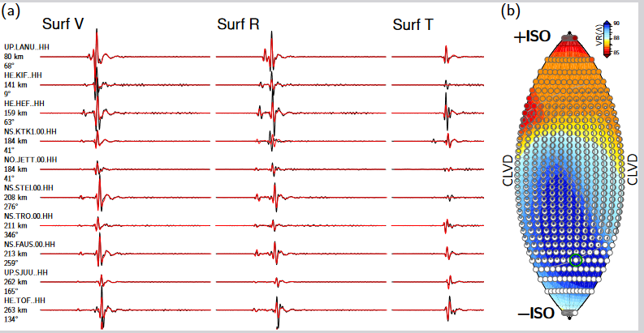
Seismic and Infrasonic Dataset
Infrasound
Analyzed infrasound arrivals at three arrays: KRIS, IS37, and ARCI.
Used Progressive Multi-Channel Correlation Method (PMCC) processing for analysis.
KRIS: Dominant frequency below 2.5 Hz visible before and after main epicentral acoustic arrival.
Arrival occurred 30 seconds after minequake origin time.
IS37 and ARCI stations show high-frequency arrivals at regional distances.
At the far field no significant energy below 1 Hz.
Moment Tensor Analysis
Used openly available broadband, 3-component stations within a 1500 km radius for source mechanism estimation.
Conducted quality check and ended up with 93 stations for analysis.
Applied bandpass filtering between 0.05 - 0.2 Hz.
Computed moment tensor using Rayleigh and Love waveforms.
Identified the mechanism that best fits the observations.
Identified negative isotropic source parameters, indicating a collapse event as the best fitting mechanism.
P2.3-317
Please do not use this space, a QR code will be automatically overlayed
Alvizuri, C., V. Silwal, L. Krischer, and C. Tape (2018), Estimation of full moment tensors, including
uncertainties, for nuclear explosions, volcanic events, and earthquakes, Journal of Geophysical Research:Solid Earth, 123 (6), 5099–5119.
Notes:
The dataset contains infrasound arrivals in 3 stations and 93 stations for seismic moment tensor analysis.
Dominant frequency is below 2.5
Infrasound arrival is 30 seconds after the seismic arrival
Pmcc shows that the in the far field energy is mainly above 1Hz
Moment tensor helped us to find the mechanism that fits the best to observations

Slide 5
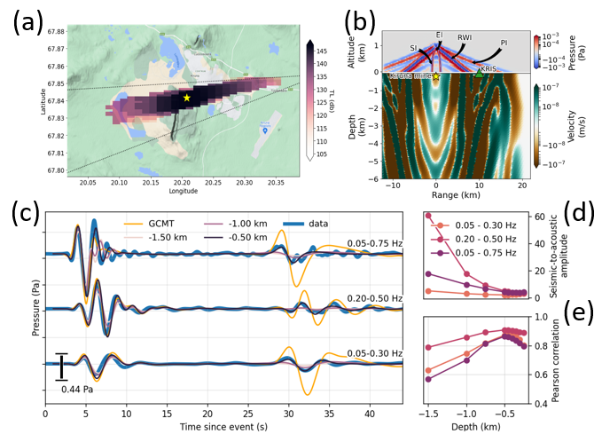
Near-field Simulations vs Data (KRIS)
We backproject the recorded signals estimate Surface Pressure Levels (SPL) around the source.
Dataset is perturbed with
origin time error ±3 s,
sound velocity cs = 330 ± 8 m/s,
backazimuth error ±5 deg.
(a) SPL location fits the GCMT epicenter
(b) Simulations from 0.2 km depth leads to 4 major phases: due to P waves (PI),
Rayleigh waves (RWI),
evanescent body waves (SI),
direct body waves (EI).
Simulations deeper than 0.5 km are unable to reproduce arrivals at KRIS (pink and purple lines in (c).
Pearson’s correlations peak for a solution around 0.5 km depth (e) and the solution has more reasonable seismic-to-acoustic amplitude ratios (d).
The good phase fit suggest that local infrasound may help to differentiate events of explosion and collapse.
P2.3-317
Please do not use this space, a QR code will be automatically overlayed
Notes:
Seismic amplitudes does not vary too much with amplitude but acoustic waves do.
Topography doesnt influence our results
Hard to capture results higher than 0.7Hz in simulations

Slide 6
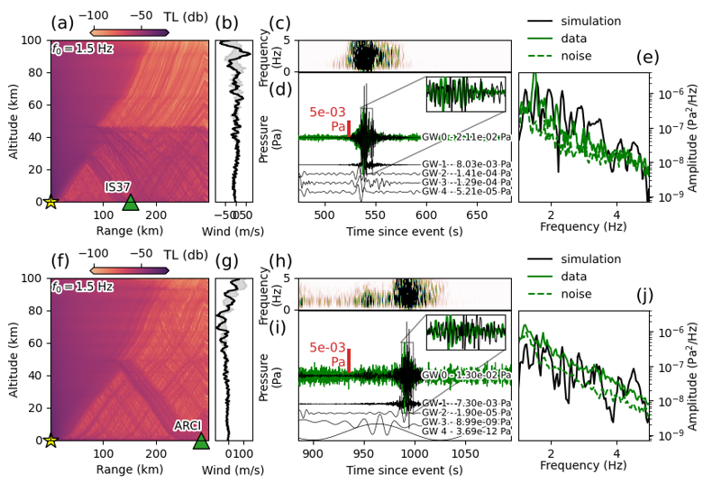
Far-field Simulations vs Data (IS37 – ARCI)
IS37
Transmission loss plots(a,f) correspond to a complex combination of waves refracted at various altitudes.
Ducting of main arrivals at IS37 occur at lower altitudes than for ARCI might be the effect of distance.
IS37’s dominant frequency peak around 1.5 Hz (e) but also produces more unrealistic frequency peaks at high frequencies.
A significant amount of energy seems to be
missing in simulated data below 1.5 Hz at ARCI (f) highlighting that atmospheric models are still limited.
Multiple Gravity Wave (GW) realizations are considered to perturb the model and the best fitting case is overlayed the data in (d,i).
ARCI
P2.3-317
Please do not use this space, a QR code will be automatically overlayed
Notes:
Galerkin full-waveform simulators such as SPECFEM-DG. The simulations ran at a frequency step ∆f = 10−2 Hz and up to 10 Hz.

Slide 7
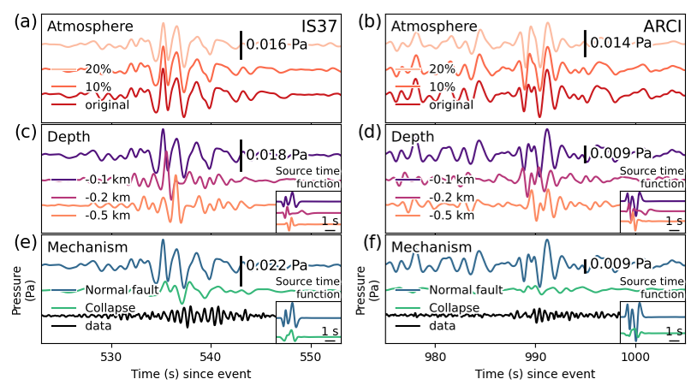
Far field Simulations vs Data (IS37 – ARCI)
First step was to generate full-waveforms for near-field. Then, we continued simulations (normal mode only) until far-field.
The source-time functions are computed as the average between synthetic waveforms simulated above the ground for three different launch angles corresponding to the waves refracting back to both IS37 (30 − 35 degrees from vertical) and ARCI (40 − 45 degrees from vertical).
The amplitude of a given gravity-wave perturbation only has a weak effect on the signal’s characteristics (a,b).
P2.3-317
Both focal depth and mechanism greatly influence the onset and overall energy distribution of the local infrasound.
Simulated signals are dominated by Hilbert transforms of the original signals suggesting effect of caustics (Waxler et al., 2015). Therefore, Hilbert transform of recorded signals may allow us to map infrasound back to a specific focal depth and mechanism.
Please do not use this space, a QR code will be automatically overlayed
Waxler, R., L. G. Evers, J. Assink, and P. Blom (2015), The stratospheric arrival pair in infrasound390
propagation, The Journal of the Acoustical Society of America, 137 (4), 1846–1856.

Slide 8
Conclusions and Perspectives
The 2020 Kiruna minequake was the largest-ever recorded mining-induced seismic event in Sweden.
For the first time ever, the signature of a shallow seismic event was detected and studied both in local and regional pressure records indicating a shallow collapse event between 1 and 0.5 km depth north of the Kiruna mine.
Our full waveform simulations capture the coupling and transfer of energy between solid earth and atmosphere, as evidenced by good agreement between observed and synthetic waveforms.
Our approach of applying seismic full moment tensors with mechanical numerical simulations suggests a practical framework to further detect and characterize seismic-acoustic sources.
Future work will include uncertainties in the source and solid-atmosphere models, including seismic source realizations, their coupling with the atmosphere and infrasound generation, the influence of earth and atmospheric models, and continued validation with observations.
P2.3-317
Please do not use this space, a QR code will be automatically overlayed

