Slide 1
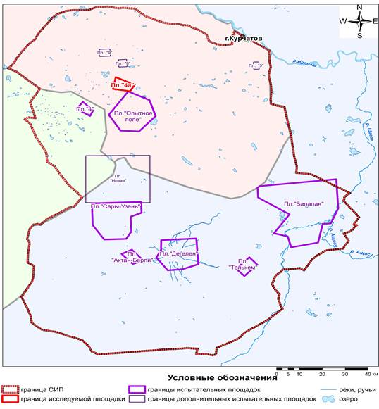
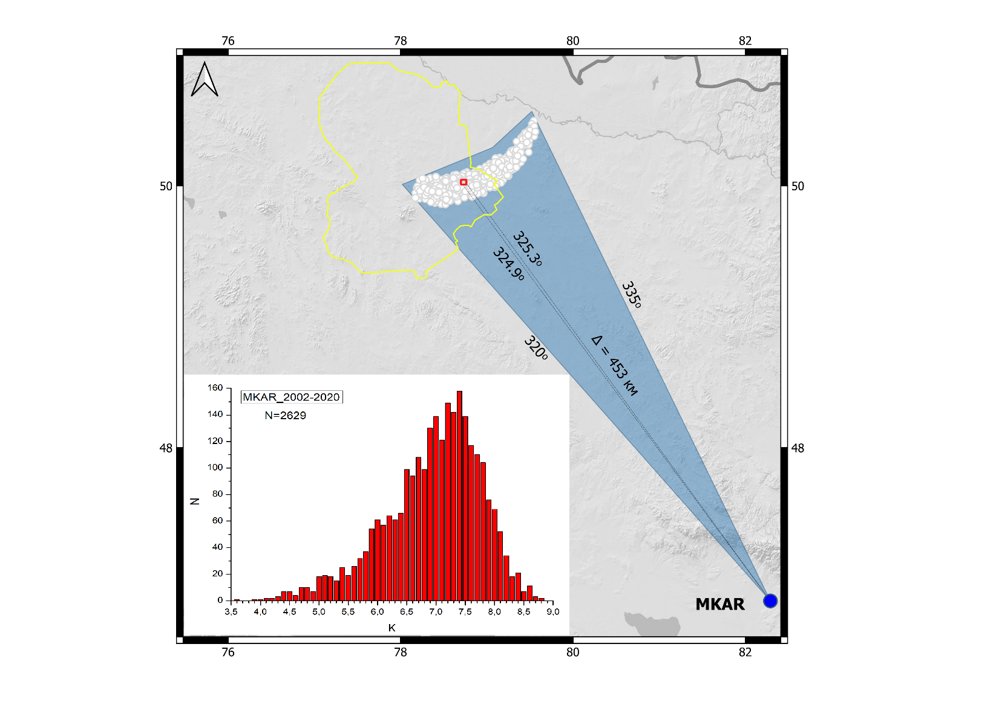
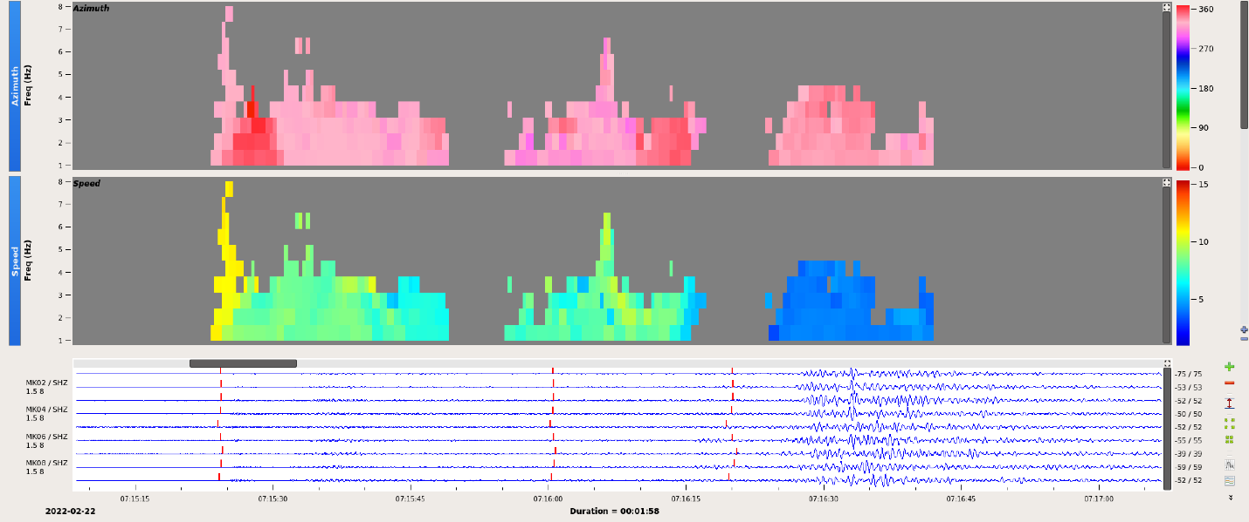
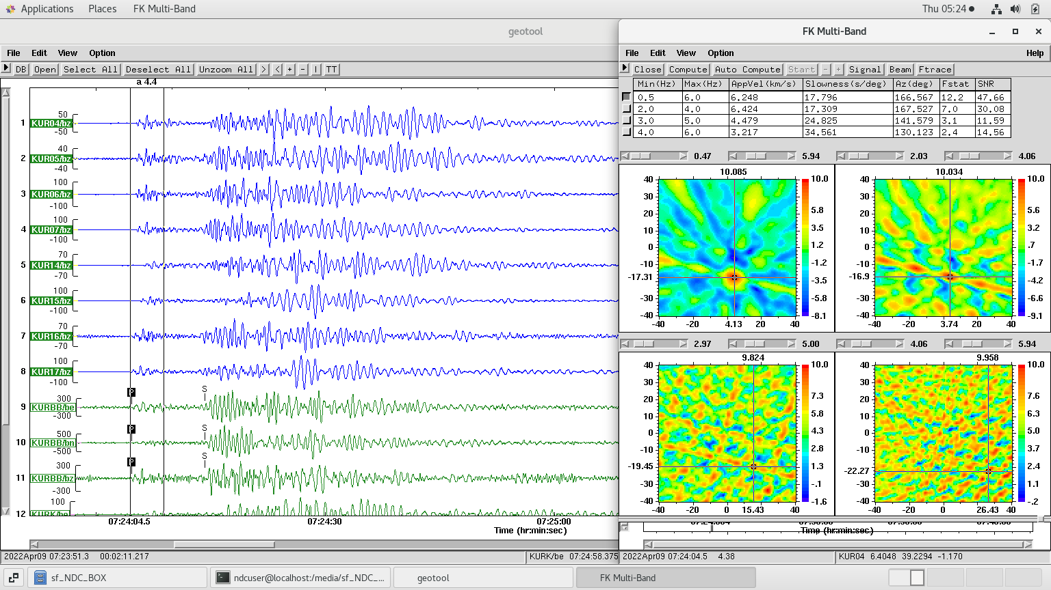
Kazakhstan IMS stations recording the quarry blast conducted on the territory of the former Semipalatinsk Test Site
Mukambayev A.S., Mikhailova N.N.
National Nuclear Center of the Republic of Kazakhstan
P2.3-166
The work describes the analysis of reasons of large scattering of quarry blast (QB) epicenter's location and elaboration of recommendations for KNDC analysts to improve the location accuracy.
There are also tectonic and induced earthquakes occurring on the STS territory. Thus, the location accuracy and correct identification of events nature play an important role in monitoring of geodynamic events at the Test Site.
For the detailed analysis, Geotool, GPMCC software included into NDC-in-a-Box package are used. The recommendations for KNDC analysts on enhancing the explosions parametrization – FK analysis using the subsystem of seismic large-aperture array Kurchatov-Cross KURK (AS058), application of azimuths only for Pn/Lg phases of Makanchi station were given.
The reliability of events relation to explosions enhances under the joint analysis of seismic and infrasound data.
STS
Sary-Uzen site
Degelen site
Balapan site

